Slide 1
SPOTS

Slide 2
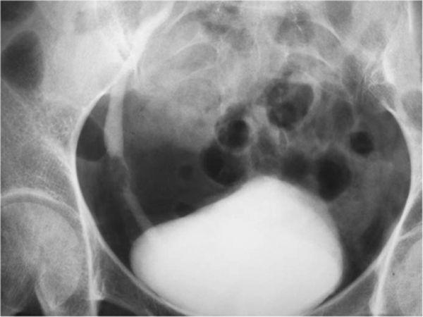
Notes:
Figure 41.7 Transitional cell tumour seen on an IVU as a filling defect in the distal ureter.

Slide 3
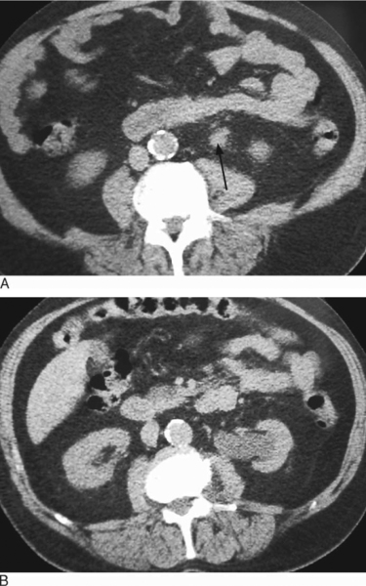
Notes:
Figure 41.8 T3 tumour of the ureter is seen as (A) an ill-defined soft tissue mass in the proximal left ureter and (B) with proximal hydronephrosis

Slide 4
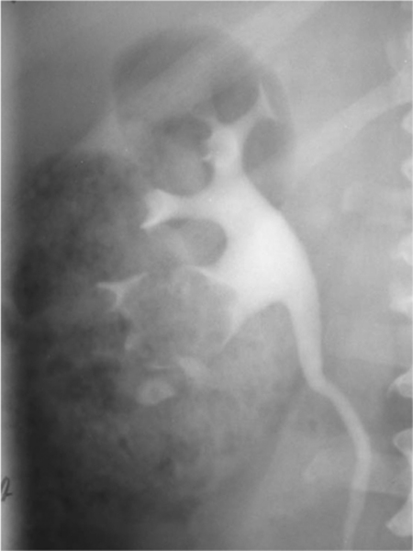
Notes:
Figure 41.9 Transitional cell tumour is seen in the kidney as a filling defect in the lower pole calyx on an IVU.

Slide 5
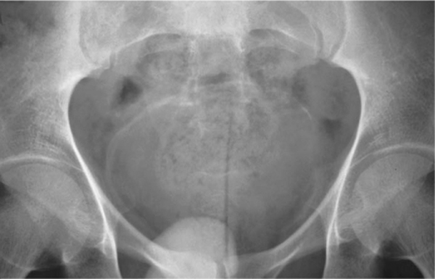
Notes:
Figure 41.10 Urinary tract schistosomiasis. The characteristic curvilinear calcification in the bladder wall is seen on the precontrast radiograph of an IVU series. Ureteric obstruction was seen following contrast injection (not shown).

Slide 6
Notes:
Figure 41.11 Ureteric endometriosis. (A) IVU demonstrates extrinsic compression in the distal left ureter with proximal ureteric dilatation. (B) CT demonstrates an abnormal soft tissue mass on the left side of the pelvis which is causing ureteric dilatation. There is a similar soft tissue mass of endometriotic tissue surrounding the sigmoid colon

Slide 7
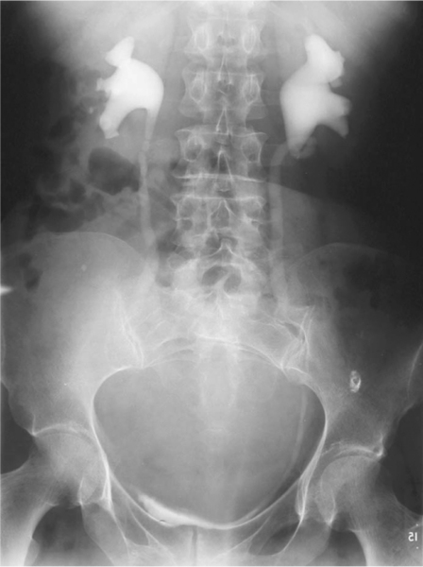
Notes:
Figure 41.13 A large ovarian mass causes pelvicalyceal and ureteric dilatation.

Slide 8
Notes:
Figure 41.14 Retroperitoneal fibrosis (periaortitis). There is a concentric soft tissue abnormality surrounding the aorta with obstruction of the right ureter. Differential diagnosis includes lymphoma and retroperitoneal metastases

Slide 9
Notes:
Figure 41.20 Bilateral staghorn calculi are seen on the control image of an IVU series.

Slide 10
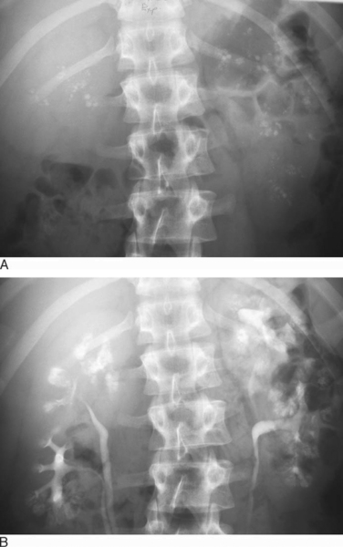
Notes:
Figure 41.21 Medullary sponge kidney. (A) Plain radiograph demonstrates multiple foci of calcification which are seen to lie in the renal medulla after injection of contrast medium (B).

Slide 11
Notes:
Figure 40.1 Renal cell carcinoma. (A) Nephrotomogram of IVU demonstrates loss of the normal lateral contour of the left kidney and calyceal splaying. (B) Ultrasound demonstrates a homogeneous mass of reduced reflectivity. (C) CT confirms the presence of an enhancing mass with a necrotic centre in keeping with a renal cell carcinoma.

Slide 12
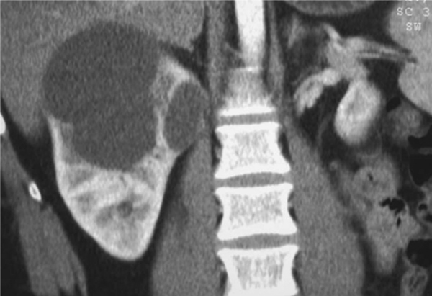
Ultrasound of kidney
Notes:
Figure 40.4 Ultrasound of a renal cyst. Ultrasound demonstrates a well-defined lesion with no internal echoes and enhanced through transmission. There are fine foci of linear calcification in the wall, making the lesion Bosniak class II.
Figure 40.5 Bosniak class II cyst. Coronal post contrast CT. This complex cyst in the right kidney was difficult to evaluate in the axial plane and best examined in this coronal section.

Slide 13
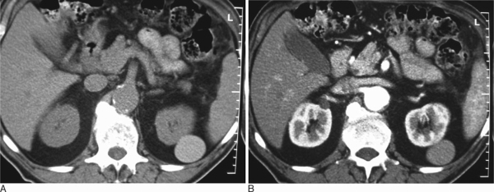
Notes:
Figure 40.6 CT of haemorrhagic renal cyst. (A) Precontrast image reveals a high-density, round, smooth mass in the left kidney. (B) Following contrast medium there is no significant change in the appearance or density of the mass.

Slide 14
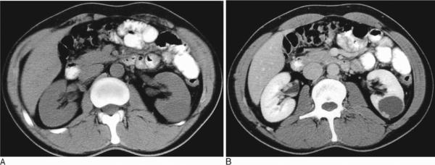
Notes:
Figure 40.7 Cystic renal cell carcinoma. (A) Precontrast image demonstrates a homogeneous low-attenuation mass in the left kidney. (B) Postcontrast image demonstrates a small peripheral nodule of enhancing tumour in the wall of the cyst (Bosniak class IV).

Slide 15
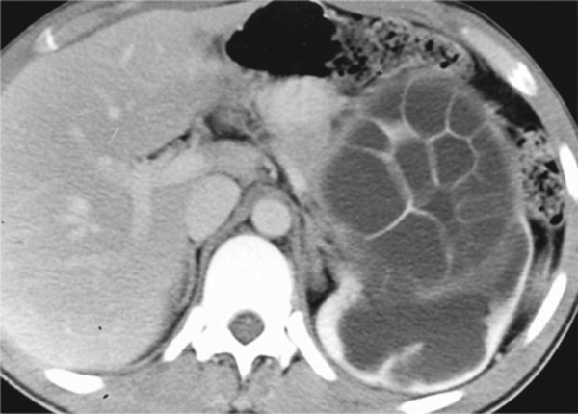
Notes:
Figure 40.8 Hydatid disease of the kidney. There is a cystic mass in the left kidney with a multiloculated internal appearance from the presence of many daughter cysts. The mass is causing marked pelvicalyceal dilatation.

Slide 16
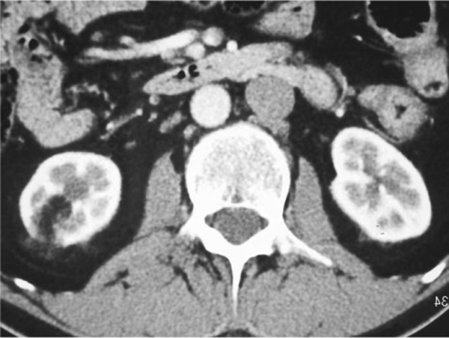
Notes:
Figure 40.10 Angiomyolipoma. Axial CT demonstrates small areas of fat within the right kidney consistent with an angiomyolipoma.

Slide 17
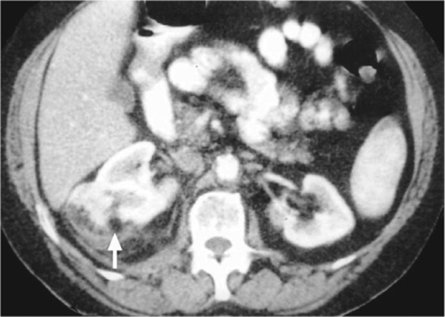
Notes:
Figure 40.11 Bleeding angiomyolipoma. CT obtained following a severe attack of abdominal pain demonstrates perirenal blood and inflammatory change surrounding the right kidney following a spontaneous bleed. There is central fat density (arrow) which suggests the presence of an angiomyolipoma.

Slide 18
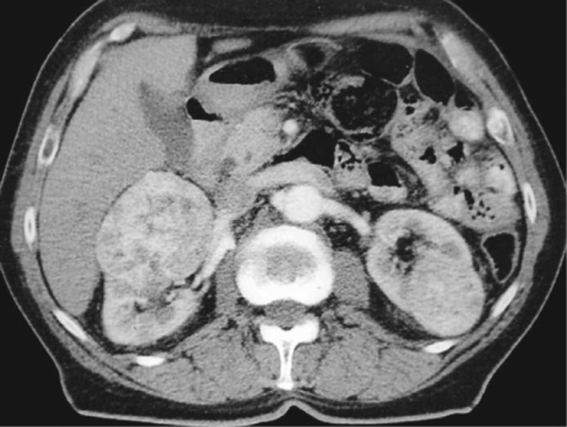
Notes:
Figure 40.12 Oncocytoma. CT demonstrates multiple well-defined enhancing masses in both kidneys which were confirmed by percutaneous biopsy to be oncocytoma. Follow-up examination at 12 months did not demonstrate any growth.

Slide 19
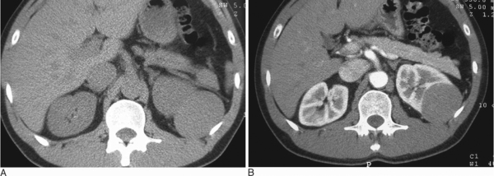
Notes:
Figure 40.15 Papillary carcinoma. Pre- (A) and post- (B) contrast CT demonstrates a large poorly enhancing homogeneous mass seen in the left kidney that has the typical appearances of a papillary tumour. These have a relatively indolent course. Care must be taken not to diagnose these well-defined and homogeneous lesions as cysts.

Slide 20
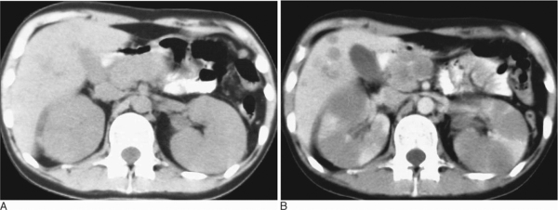
Notes:
Figure 40.16 Non-Hodgkin's lymphoma. (A) Unenhanced CT demonstrates homogeneous enlargement of both kidneys. (B) Postcontrast examination demonstrates multiple focal areas of reduced enhancement within the kidneys, consistent with lymphoma. Hepatic and pancreatic deposits of lymphoma can also be seen.

Slide 21
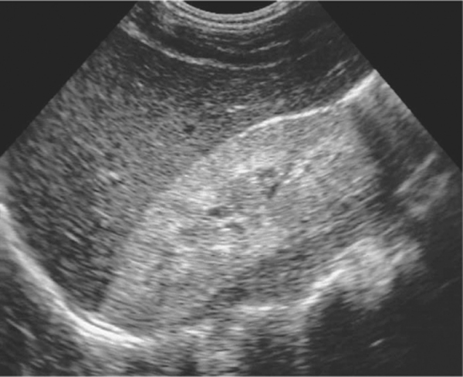
Notes:
Figure 39.1 Renal parenchymal disease. Longitudinal ultrasound images of right kidney show increased reflectivity compared to the adjacent liver.

Slide 22
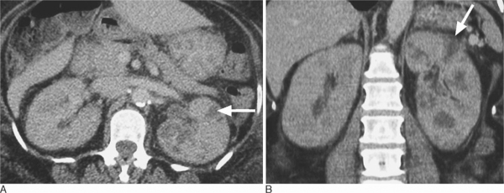
Notes:
Figure 39.4 Diffuse unilateral acute pyelonephritis. (A) Axial and (B) coronal enhanced CT shows wedge- and band-shaped areas of reduced enhancement in the left kidney (arrow). There is associated perinephric inflammatory change (long arrow).

Slide 23
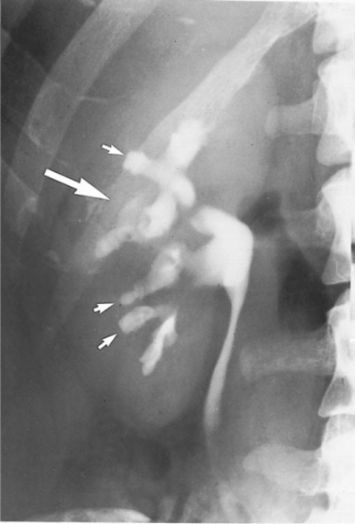
Notes:
Figure 39.5 Analgesic nephropathy. Characteristic ‘egg in a cup’ cavities (short arrows) and a ‘horn’ (long arrow). No focal cortical loss.

Slide 24
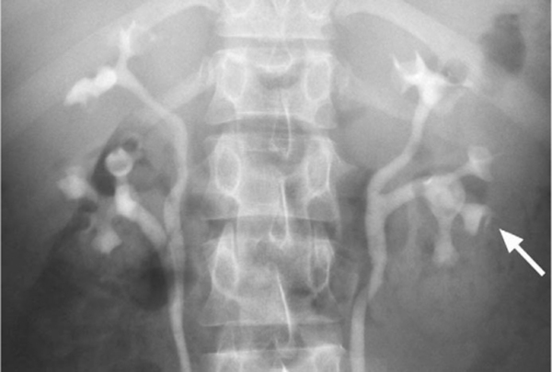
Notes:
Figure 39.6 Papillary necrosis in sickle cell trait. Minor abnormalities in many papillae (arrow). No focal cortical loss.

Slide 25
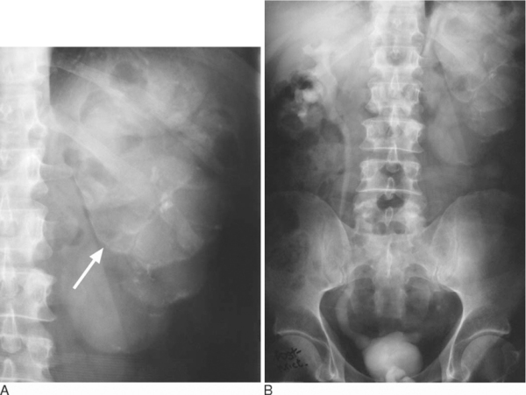
Notes:
Figure 39.7 Tuberculous autonephrectomy. (A) Control radiograph—note the typical cloudy appearance of the calcification in the kidney (arrow). (B) 15-min radiograph. No function on the left. The right ureter is dilated and the bladder small and thick walled.

Slide 26
Notes:
Figure 39.8 Diffuse left xanthogranulomatous pyelonephritis. (A) CT shows dilated calyces (arrow) with a thinned parenchyma. (B) Note the perinephric inflammatory change (white arrow) and calcification (black arrow).

Slide 27
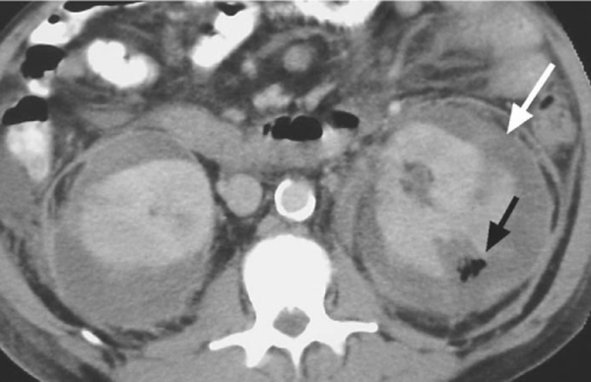
Notes:
Figure 39.9 Emphysematous pyelonephritis. CT shows gas within the renal parenchyma (black arrow) with parenchymal destruction. Note perinephric collections (white arrow).

Slide 28
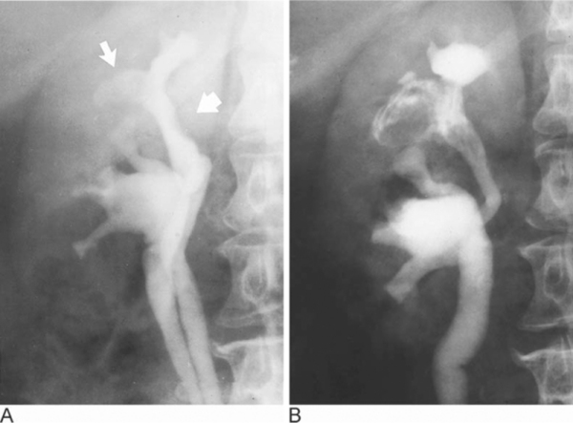
Notes:
Figure 39.10 Cholesteatoma of the kidney. Recurrent urinary tract infection for many years. (A) IVU 1975. Filling defect in upper pole calyx (arrow). Also flat defect in the infundibulum (broad arrow). The latter is consistent with leukoplakia. (B) IVU 1979. Extensive irregular filling defects with typical whorled pattern in the upper pole. At operation, solid material, which proved to be mainly keratin, was found in the upper pole.

Slide 29
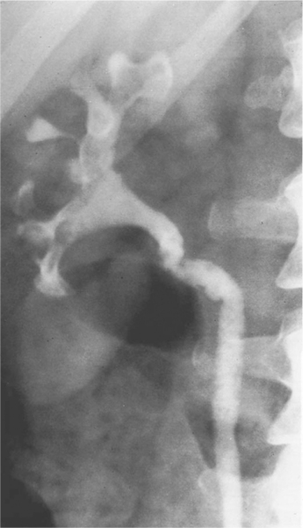
Notes:
Figure 39.11 Pyeloureteritis cystica. A staghorn calculus occupies much of the collecting system.

Slide 30
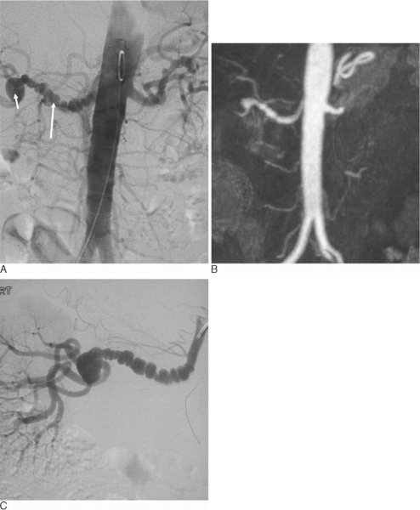
Notes:
Figure 39.12 Fibromuscular dysplasia. (A) On this AP aortogram the pigtail catheter is positioned just above the renal arteries. There is fibromuscular disease involving the distal right renal artery (arrow) with an aneurysm (short arrow). (B) MR angiography demonstrates the same findings. (C) On a selective right anterior oblique (RAO) angiogram the characteristic saccular dilatations and the web-like stenoses are more clearly evident.

Slide 31
Notes:
Figure 39.13 Takayasu's disease. (A) Axial CT demonstrates the diffuse thickening of the wall of the aorta (arrow). (B) Curved multiplanar coronal reformats demonstrate the bilateral renal artery stenosis (arrows).

Slide 32
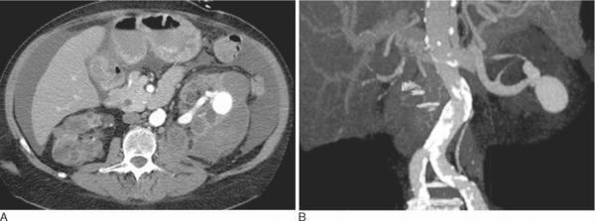
Notes:
Figure 39.18 Arteriovenous fistula. CT angiogram of a patient who developed an AV fistula following a renal biopsy. (A) Axial CT. (B) MIP of the CT angiogram.

Slide 33
Notes:
Figure 39.19 Focal infarction. (A) CT of the same patient as Fig 39.16 with focal infarction of the lower pole of the left kidney due to (B) occlusion of an accessory lower pole renal artery (arrow).

Slide 34
Duplex Doppler US. Spectra obtained from the interlobar arteries in (A) transplant kidney and (B) another transplant kidney
Notes:
Figure 39.22 Duplex Doppler US. Spectra obtained from the interlobar arteries in (A) a normal transplant kidney and (B) a transplant kidney undergoing rejection. Note the absent diastolic flow.

Slide 35
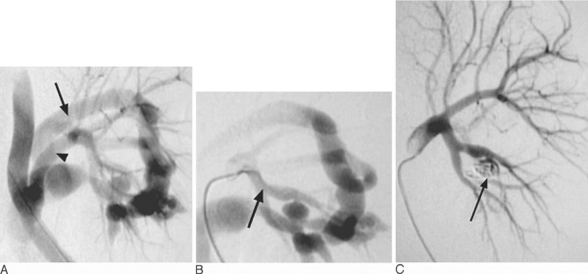
Notes:
Figure 39.24 Arteriovenous fistula in a transplant kidney following biopsy. (A) The fistula is well illustrated on the flush angiogram (artery, arrowhead; vein, arrow). (B) Selective angiogram with a catheter in the renal artery (arrow). (C) Post-embolization angiogram. Fistula occluded, no evidence of infarction.

Slide 36
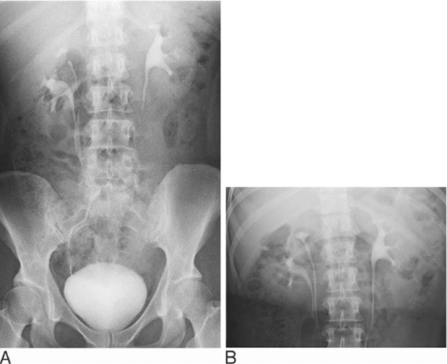
Notes:
Figure 38.2 Intravenous urogram. (A) Duplex right ureters on a 15-minute full length radiograph. (B) Designated renal area radiograph for improved visualization of duplex (right) and normal (left) collecting system.

Slide 37
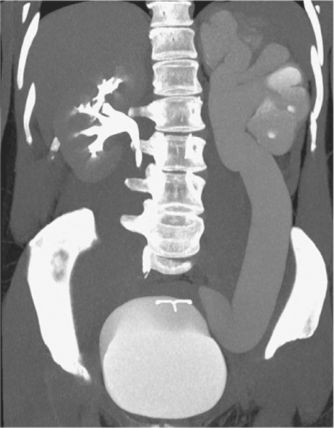
Notes:
Figure 38.13 Mega-ureter predisposes to recurrent urinary tract infections.

Slide 38
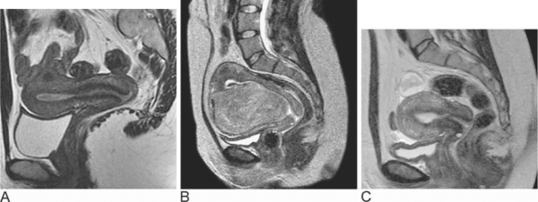
Notes:
Figure 38.16 T2-weighted fast spin-echo (FSE) images of the uterus. (A) Clear depiction of the zonal anatomy of the uterus. A small fibroid is present in the posterior fundal region. (B) Sagittal section of the uterus containing a pedunculated submucosal fibroid. (C) Sagittal section of the uterus post-uterine artery embolization following spontaneous passage of the fibroid per vaginum.

Slide 39
Notes:
Figure 11-81 Cecal volvulus. A: The dilated cecum with air-fluid level occupies the left abdomen. There is small-bowel obstruction indicated by multiple dilated loops in the right abdomen. Mesenteric vessels are congested (arrow), and (B) there is a whirled configuration of the mesenteric root (arrow).

Slide 40
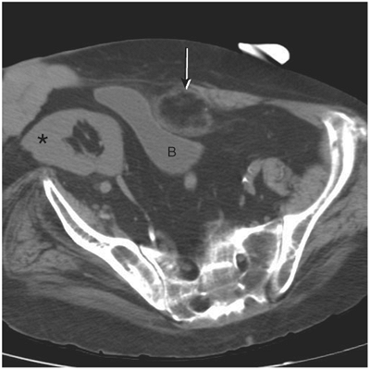
Notes:
Figure 11-80 Omental fat necrosis. A fat-density mass with a peripheral soft-tissue ring lies adjacent to the deformed bladder (B). This is larger than the typical epiploic appendicitis. There is a large postsurgical flank hernia from prior renal transplant (asterisk).

Slide 41
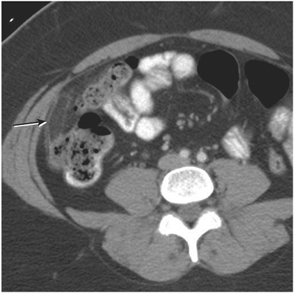
Notes:
Figure 11-79 Epiploic appendagitis. There is an oblong fat-density mass anterolateral to the ascending colon (arrow). Also present is a thin soft-tissue ring and mild inflammatory change.

