Slide 1
SPOTS

Slide 2
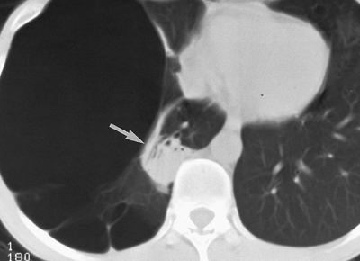
Notes:
Figure 7-204 Atelectatic pseudomass. Computed tomography demonstrates a right paraspinal mass (arrow) with central air bronchograms. A very large bulla almost completely fills the right hemithorax. The mass represented collapsed normal lung that re-expanded following resection of the bulla.

Slide 3
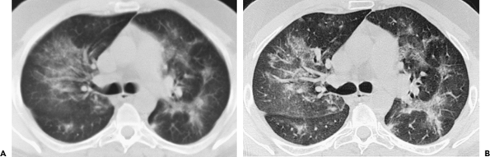
Notes:
Figure 7-154 Pneumocytitis carinii pneumonia. A, B: Conventional and high-resolution computed tomography illustrate the improved spatial resolution of the latter, which more clearly demonstrates the interstitial nature of the infectious process, including areas of ground-glass opacification.

Slide 4
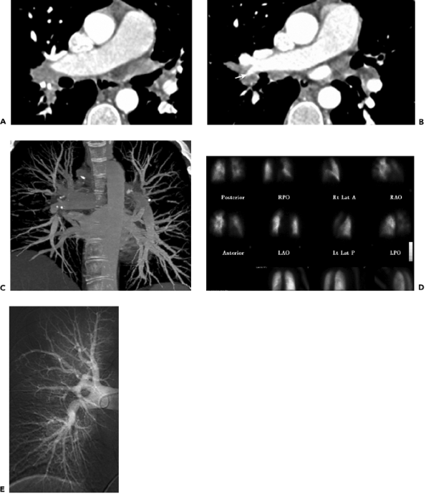
Notes:
Figure 7-146 Fibrosing mediastinitis, not pulmonary embolism. A, B: Cephalocaudal computed tomography images show intact pulmonary arteries becoming narrowed (arrow) as they extend through partially calcified hilar lymph nodes. C: Volume-rendered computed tomography with altered windowing demonstrates the narrowed arteries without emboli extending through the partially calcified enlarged hilar lymph nodes. D: Ventilation/perfusion scintigraphy, performed because patient was part of Prospective Investigation of Pulmonary Embolism Diagnosis (PIOPED) II study, was interpreted as high likelihood ratio for pulmonary emboli. E: Catheter pulmonary angiogram, performed because of discrepant interpretation between prior two diagnostic tests, corroborates absence of pulmonary emboli. The narrowing of the pulmonary arteries is better seen on the computed tomography angiogram, and the calcified lymph nodes are not visible on the subtraction catheter pulmonary angiogram.

Slide 5
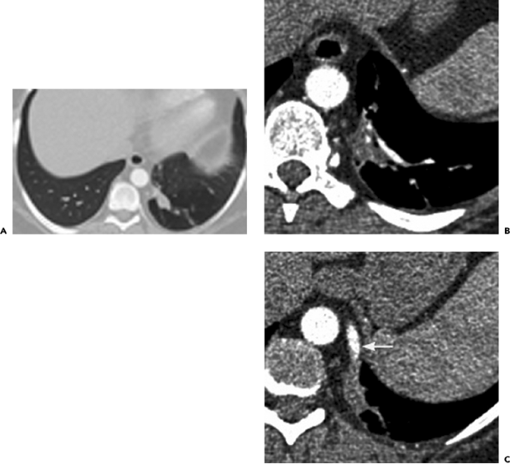
Notes:
Figure 7-108 Intralobar sequestration. A: Lung window setting computed tomography shows ovoid nodular opacity in posterior basal segment of left lower lobe, with some associated peripheral scarring and surrounding hyperinflation. B, C: Postcontrast soft tissue window setting cephalocaudal computed tomography images show a supplying vessel (arrow) from the descending aorta.

Slide 6
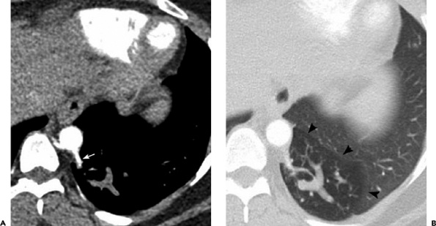
Notes:
Figure 7-107 Intralobar sequestration. A: Soft tissue window setting computed tomography shows a serpiginous opacity in the left lower lobe, supplied by a vessel (arrow) from the descending thoracic aorta. B: Lung window setting computed tomography shows region of hyperlucency (arrowheads) surrounding the opacity in posterior basal segment of the left lower lobe.

Slide 7
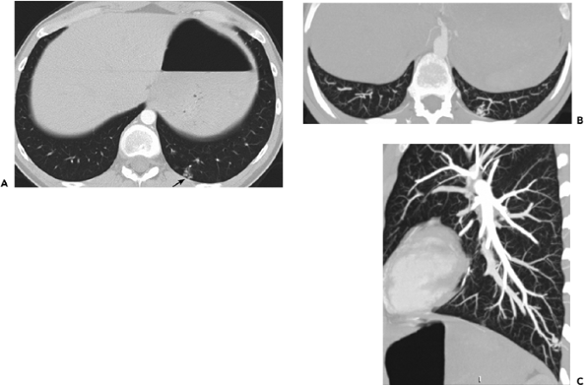
Notes:
Figure 7-106 Small peripheral pulmonary arteriovenous malformation. A: Transaxial computed tomography images shows a cluster of small nodules in posterior basal segment of the left lower lobe (arrow). B: Transaxial thin-section maximum-intensity projection computed tomography shows small vessels supplying the lesion. C: Sagittal thin-section maximum-intensity projection corroborates only very small vessels supplying the malformation, not deemed suitable for embolization, and catheter pulmonary angiography obviated.

Slide 8
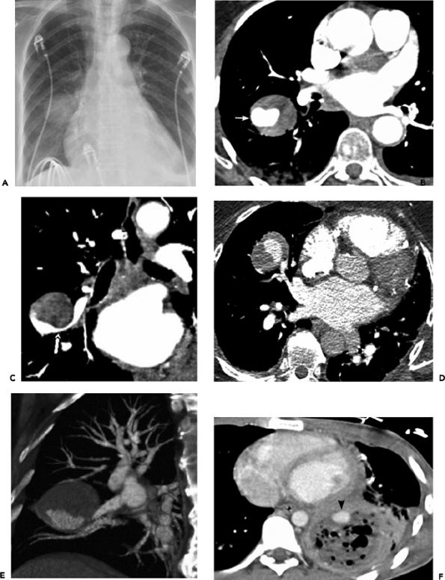
Notes:
Figure 7-102 Pulmonary artery pseudoaneurysms. A: Posteroanterior chest radiograph demonstrates a right perihilar mass in a patient who developed hemoptysis following cardiac catheterization (including Swan-Ganz catheterization). Mild cardiac enlargement and small bilateral pleural effusions are present. B, C: Transaxial and coronal reformatted computed tomography images demonstrate a pseudoaneurysm of the right pulmonary artery (arrow), surrounded by thrombus. This was successfully treated with coil embolization. D, E: In another patient, transaxial and oblique reformatted computed tomography images demonstrate a pseudoaneurysm of the middle lobe pulmonary artery, in a patient who previously had a Swan-Ganz catheter inserted during a myocardial infarction. F: In another patient, a small pseudoaneurysm of the left lower lobe pulmonary artery (arrowhead), causing hemoptysis, has developed adjacent to a left lower lobe abscess.

Slide 9
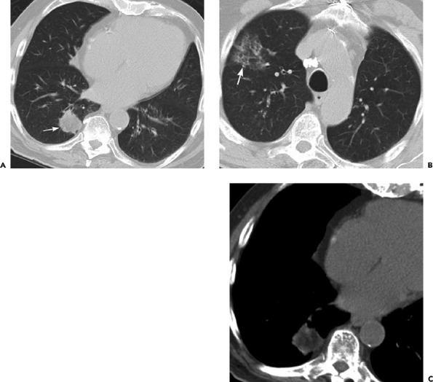
Notes:
Figure 7-99 Lipoid pneumonia. A: Computed tomography shows an irregular spiculated 3-cm mass (arrow) in posterior basal segment of the right lower lobe. B: More cephalad computed tomography image demonstrates some patchy ground glass opacity in the anterior segment of the right upper lobe (arrow). C: Soft tissue window setting computed tomography through right lower lobe mass demonstrates very low attenuation within the lesion, with multiple Hounsfield numbers in the negative range, compatible with fat. A history of chronic mineral oil use was obtained, and the lesions were unchanged on subsequent follow-up computed tomography examinations 6 and 12 months later.

Slide 10
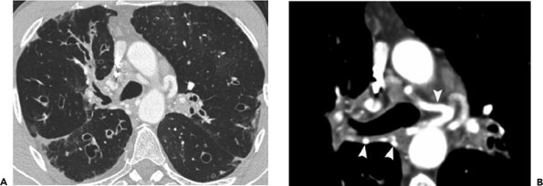
Notes:
Figure 7-87 Cystic fibrosis. A: Computed tomography with lung window setting shows panlobar varicose and cystic bronchiectasis. B: Huge bronchial artery collaterals are better demonstrated on mediastinal window setting in a 19-year-old man with marked hemoptysis.

Slide 11
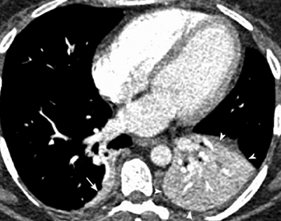
Notes:
Figure 7-74 Lower lobe atelectasis. Postcontrast computed tomography demonstrates marked enhancement of the collapsed left lower lobe (arrowheads) and posterior basal segment of the right lower lobe (arrow) in a postabdominal surgery patient suspected of having pulmonary embolism.

Slide 12
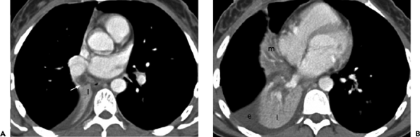
Notes:
Figure 7-73 Combined right middle and lower lobe atelectasis. A, B: Selected cephalocaudal computed tomography images demonstrate a collapsed middle (m) and right lower lobe (l). The cause is mucus plugging (arrow) in the bronchus intermedius. A small right pleural effusion (e) is seen.

Slide 13
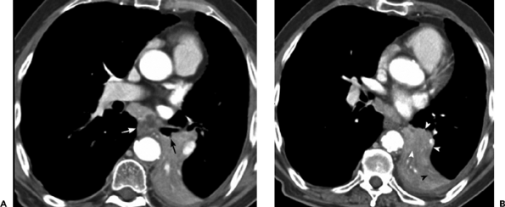
Notes:
Figure 7-72 Left lower lobe collapse. A, B: Sequential cephalocaudal computed tomography images show a central contour deforming squamous cell carcinoma (white arrowheads) completely obstructing the left lower lobe bronchus (black arrow). Tubular mucus-filled bronchi (black arrowhead) are seen distal to the tumor. Partially necrotic enlarged subcarinal nodes containing metastases (white arrow) also present. Note the volume loss in the left hemithorax.

Slide 14
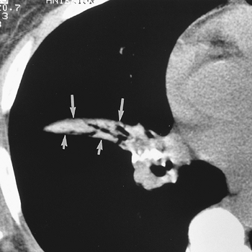
Notes:
Figure 7-71 Middle lobe collapse. Collapsed lobe seen as a wedge-shaped structure, bordered by the minor (long arrows) and major (short arrows) fissures. Air is seen in the segmented bronchi in the collapsed lobe, which was due to broncholithiasis.

Slide 15
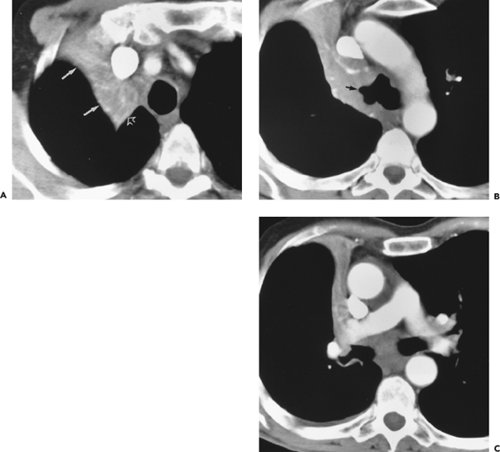
Notes:
Figure 7-70 Right upper lobe collapse. A: On computed tomography, the collapsed lobe appears as a triangular, enhancing structure, sharply marginated laterally by the minor fissure (solid arrows) and posteriorly by the major fissure (open arrow). B: On a more caudal image, the obstruction (arrow) of the lobar bronchus is demonstrated. C: Even more caudal, the collapsed lobe is flattened against the mediastinum

Slide 16
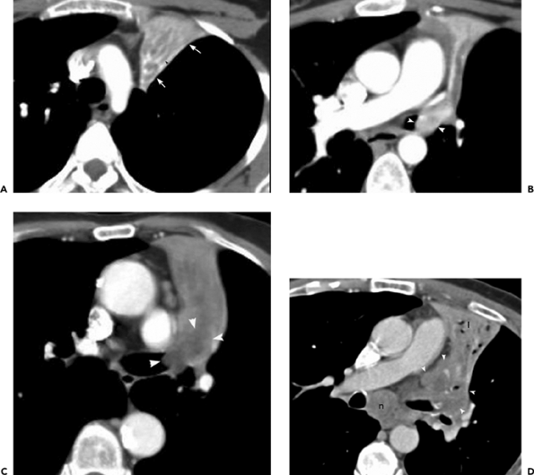
Notes:
Figure 7-68 Left upper lobe collapse. A: On a postcontrast computed tomography, the collapsed lobe appears as a triangular, enhancing structure, sharply marginated laterally by the major fissure (arrows). The relatively low attenuation tubular structures (arrowhead) in the collapsed lobe represent dilated mucus filled bronchi.B: On a more caudal image, a small enhancing mass (arrowheads) is seen occluding the left upper lobe bronchus. Bronchoscopic biopsy disclosed a well differentiated neuroendocrine carcinoma (carcinoid tumor). C: In another patient, a relatively low attenuation central tumor mass (arrowheads) is seen obstructing the left upper lobe bronchus. Bronchoscopy revealed squamous cell carcinoma. The mildly enlarged aortopulmonary window nodes (arrow) were reactive on surgical resection. D: In another patient, a large central mass (arrowheads) occludes the left upper lobe bronchus, with greater enhancement of the more distal atelectatic upper lobe (l). Marked concomitant subcarinal lymph node enlargement (n) is present. Specimens from bronchoscopy and transbronchial needle biopsy of the subcarinal mass disclosed poorly differentiated squamous cell carcinoma.

Slide 17
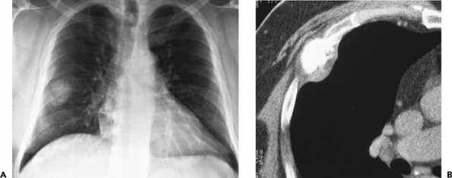
Notes:
Figure 7-23 Osteosarcoma of rib. A: Posteroanterior chest radiograph demonstrates a 2.5-cm mass projecting over the right midlung, initially presumed to represent a bronchogenic carcinoma. B: Computed tomography demonstrates a markedly calcified lesion in the right fourth anterior rib with spiculated extension into a surrounding soft tissue attenuation mass.

Slide 18
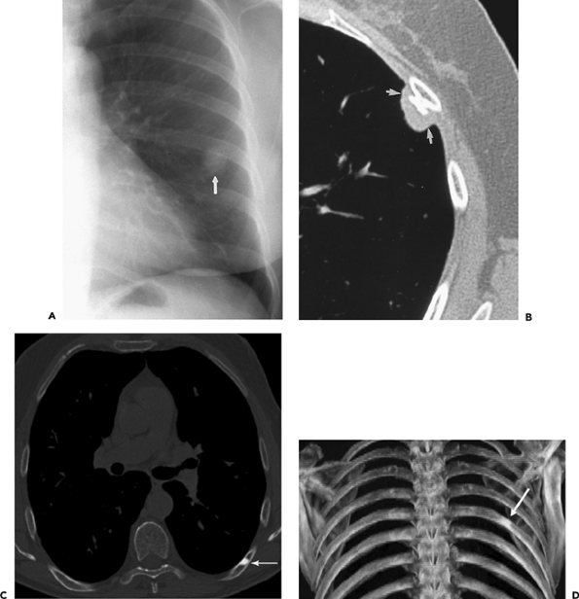
Notes:
Figure 7-21 Benign thoracic lesions. A: Posteroanterior chest radiograph demonstrates a nodular opacity projecting over the left mid lung. B: Computed tomography demonstrates a presumptive osteochondroma of the rib (arrows) accounting for the opacity. The lesion remained unchanged on 4-year radiologic follow-up. C, D: In another patient, transaxial and volume-rendered reconstruction computed tomography images with a bone window setting show a sclerotic focus, compatible with a bone island, in a left posterior rib (arrow), accounting for a vague nodular opacity seen on a previous posteroanterior chest radiograph.

Slide 19
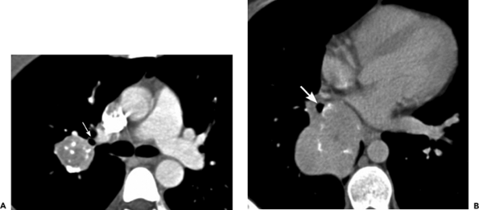
Notes:
Figure 7-18 Calcified bronchial carcinoids. A: Computed tomography shows a mainly extraluminal mass arising from apical bronchus (arrow) of the right upper lobe. B: In another patient, computed tomography demonstrates a large mainly extraluminal mass arising from the right lower lobe bronchus (arrow).

Slide 20
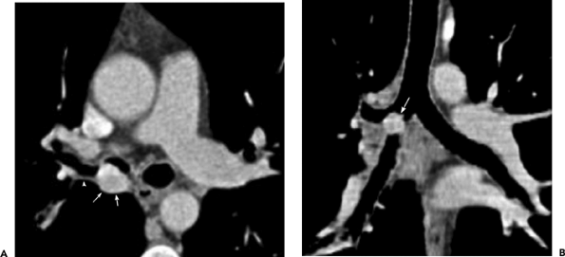
Notes:
Figure 7-17 Bronchial carcinoid. A: Postcontrast transaxial computed tomography shows a hypervascular mass (arrows) in the right main stem bronchus at the level of the right upper lobe bronchus (arrowhead). B: Coronal reformatted computed tomography demonstrates a mainly intraluminal mass (arrow). After viewing this image, the thoracic surgeon performed a successful conservative â€œplastic sleeveâ€ resection of the mass, rather than a contemplated pneumonectomy based upon his bronchoscopic observations.

Slide 21
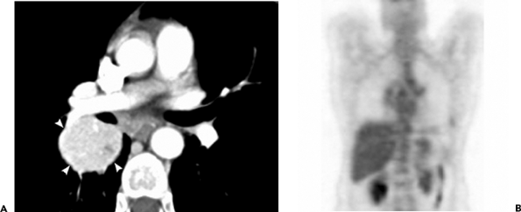
Notes:
Figure 7-15 Bronchial carcinoid. A: Postcontrast computed tomography demonstrates a relatively large, mainly extraluminal, hypervascular mass (arrowheads) arising from the bronchus intermedius. B: Positron emission tomography imaging demonstrates no increased uptake, and the mass was interpreted as a hamartoma or granuloma.

Slide 22
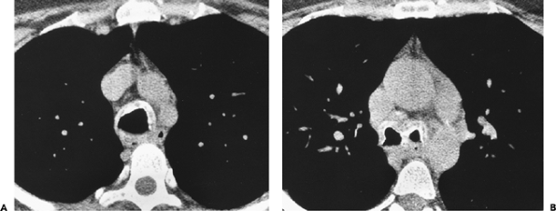
Notes:
Figure 6-172 Amyloidosis. A and B: The trachea and both main stem bronchi are thickened. Extensive calcification also is seen.

Slide 23
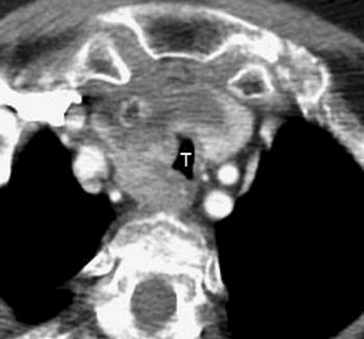
Notes:
Figure 6-167 Anaplastic thyroid carcinoma. A large mass originating from the right lobe of the thyroid gland displaces and infiltrates the trachea (T).

Slide 24
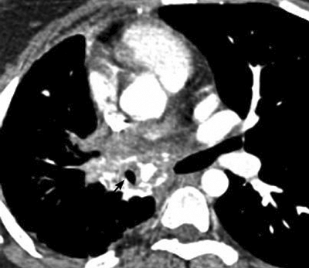
Notes:
Figure 6-92 Fibrosing mediastinitis. An infiltrating mass with coarse calcification is demonstrated, producing marked stenosis of the bronchus intermedius (arrow).

Slide 25
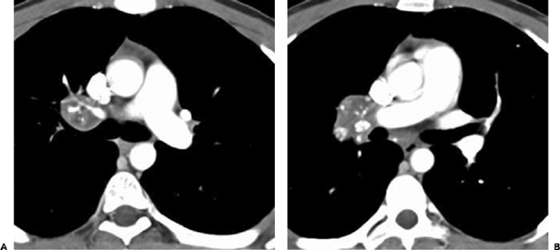
Notes:
Figure 6-91 Fibrosing mediastinitis. A and B: CT scan demonstrates a focal mass with multiple calcifications in the right hilum. Right upper lobe pulmonary artery is encased by the lesion.

Slide 26
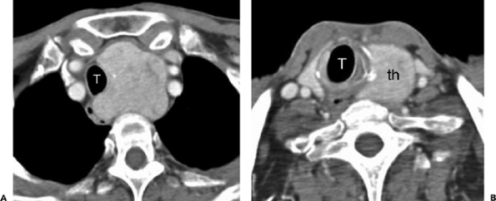
Notes:
Figure 6-85 Intrathoracic goiter. A and B: A large, intensely enhancing mass in the superior mediastinum displaces the trachea (T) and is continuous with the left lobe of the thyroid (th).

Slide 27
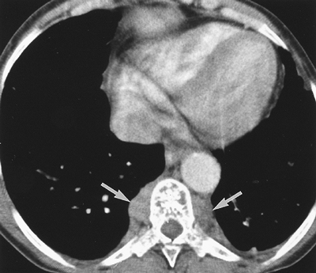
Notes:
Figure 6-69 Extramedullary hematopoiesis in a patient with sickle cell disease. Bilateral paraspinal masses (arrows) are seen. Associated bone changes of sickle cell disease also are present.

Slide 28
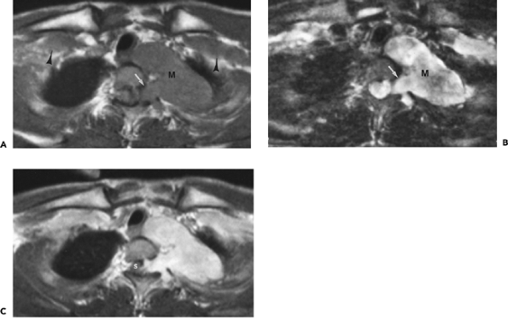
Notes:
Figure 6-64 Malignant peripheral nerve sheath tumor in patient with neurofibromatosis. A and B: On T1-weighted and T2-weighted magnetic resonance images at the lung apex, a large, left-sided, dumbbell-shaped mass (M) is seen extending into and widening the intervertebral foramen (arrow). Subpectoral neurofibromas (arrowheads) are also seen. C: There is enhancement of the mass following administration of gadolinium. S, spinal cord.

Slide 29
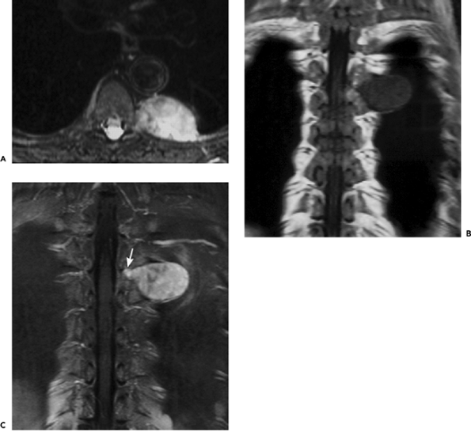
Notes:
Figure 6-63 Schwannoma. A: Axial T2-weighted magnetic resonance image with fat saturation demonstrates heterogenous high signal intensity throughout a left paraspinal mass. B: The mass has low signal intensity on the coronal T1-weighted image. C: After gadolinium administration there is marked enhancement of the lesion. A â€œtailâ€ of tumor is seen within the neuroforamen (arrow).

Slide 30
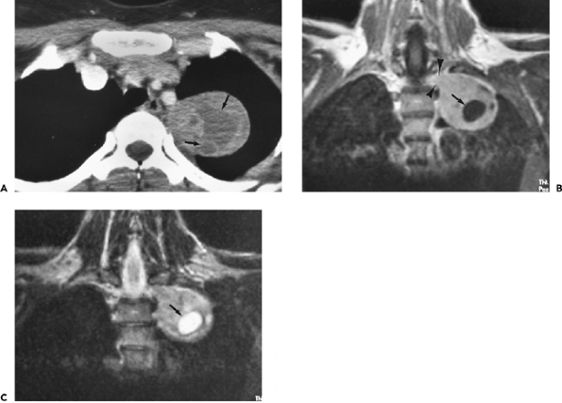
Notes:
Figure 6-62 Schwannoma. A: Computed tomography scan at the level of the superior mediastinum demonstrates a 6-cm complex mass adjacent to the left side of the thoracic spine. The mass contains multiple low-attenuation areas (arrows) secondary to cystic degeneration. B and C: On coronal T1- and T2-weighted magnetic resonance images the mass extends into the intervertebral foramen (arrowheads). A large area of cystic degeneration (arrow) is low signal intensity on the T1-weighted image and very high signal intensity on the T2-weighted image.

Slide 31
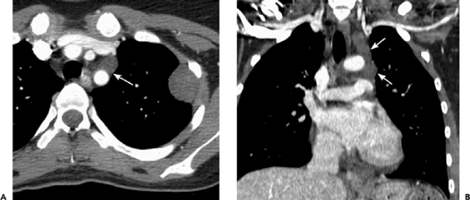
Notes:
Figure 6-60 Multiple neurofibromas in neurofibromatosis-1 (NF-1). A: A well-defined, hypodense subpleural mass is present in left upper chest wall. A small, rounded mediastinal lesion (arrow) is noted ventral to the left subclavian artery. B: Coronal reformatted computed tomography image shows the elongated morphology of the mediastinal lesion (arrows), corresponding to a left vagus nerve neurofibroma.

Slide 32
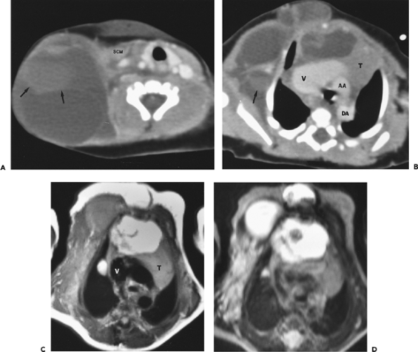
Notes:
Figure 6-58 Lymphangioma. A and B: CT scans in an infant show a large, multiloculated, low-attenuation mass arising in the right side of the neck and extending into the axilla and anterior chest wall. There also is extension into the anterior mediastinum with displacement of the thymus (T) to the left. Areas of higher attenuation (arrows) are secondary to hemorrhage. Marked dilatation of the superior vena cava (V) is seen. AA, ascending aorta; DA, descending aorta; SCM, sternocleidomastoid muscle. C: On T1-weighted magnetic resonance (MR) image at a slightly more caudal level than B, the component in the right anterior chest wall is relatively low signal intensity, whereas the mediastinal and presternal components are high signal intensity (likely from a higher lipid content). V, superior vena cava; T, thymus. D: On T2-weighted MR image, most components of the mass are very high in signal intensity.

Slide 33
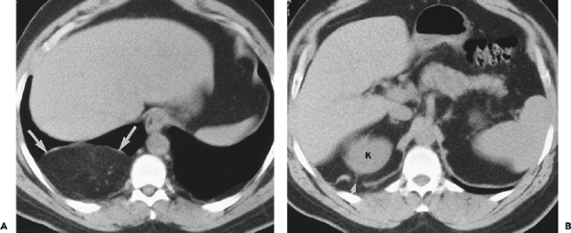
Notes:
Figure 6-55 Diaphragmatic hernia. A and B: Intraabdominal fat (large arrows) is seen extending through a defect (small arrow) in the right hemidiaphragm. K, top of right kidney.

Slide 34
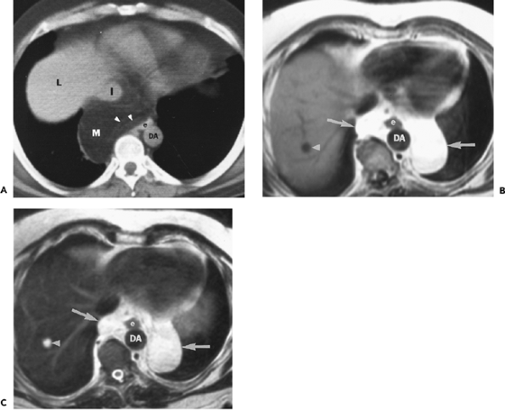
Notes:
Figure 6-54 Herniation of omentum through the esophageal hiatus. A: A large fat-attenuation mass (M) is seen in the posterior mediastinum. L, top of liver; I, inferior vena cava; DA, descending aorta; e, esophagus; arrowheads, omental vessels. B and C: On T1-weighted (B) and T2-weighted (C) magnetic resonance images in a different patient, herniated omentum also is seen. Note that the signal intensity of the mass is similar to subcutaneous fat. Arrowhead, hepatic cyst; DA, descending aorta; e, esophagus

Slide 35
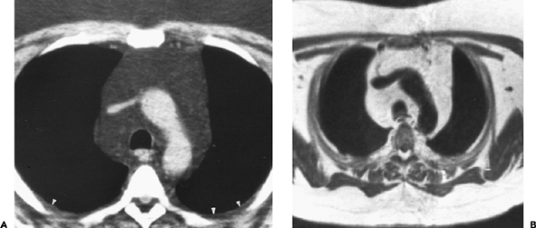
Notes:
Figure 6-50 Mediastinal lipomatosis. A: Abundant fat is seen in the anterior mediastinum and right paratracheal region; (arrowheads) extrapleural fat. B: On T1-weighted magnetic resonance image at the same level, the fat is similar in signal intensity to subcutaneous fat. On T2-weighted images the fat was similar in signal intensity to subcutaneous fat as well.

Slide 36
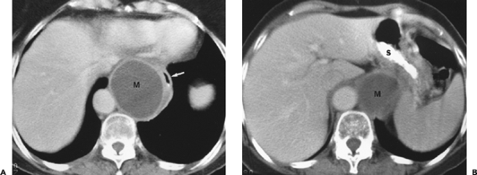
Notes:
Figure 6-47 Mediastinal pancreatic pseudocyst. A and B: In a patient with a history of chronic pancreatitis, computed tomography scans at the level of the diaphragm show a well-defined, homogeneous, low-attenuation mass (M) displacing the esophagus (arrow) and stomach (S) anterolaterally. The mass has a mildly thickened wall. Cyst aspiration disclosed fluid high in amylase.

Slide 37
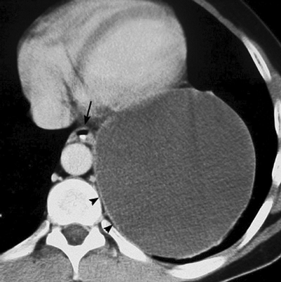
Notes:
Figure 6-41 Esophageal duplication cyst. A large cystic lesion is present in the left hemithorax. Thin, perceptible walls are seen (arrowheads). Orally administered contrast opacifies the esophageal lumen (arrow) but not the adjacent cyst

Slide 38
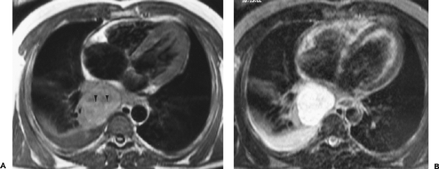
Notes:
Figure 6-40 Bronchogenic cyst. A: On T1-weighted magnetic resonance image, a fluidâ€“fluid level (arrowheads) is seen in a 6-cm mass in the azygoesophageal recess. The dependent layer is higher signal intensity than the nondependent layer, likely from layering of proteinaceous material. Adjacent atelectasis and a small right pleural effusion also are seen. B: The mass is very high signal intensity on the T2-weighted image. The fluidâ€“fluid level is barely perceptible.

Slide 39
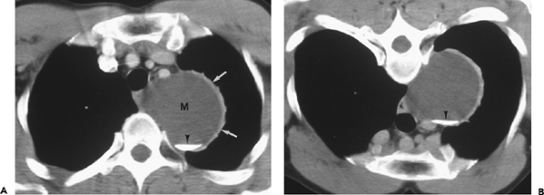
Notes:
Figure 6-37 Bronchogenic cyst with milk of calcium. A: A well-defined water-attenuation mass (M) is seen in the left superior mediastinum. The left lateral wall (arrows) is thickened from chronic inflammation and fibrosis. Arrowhead, calcium level. B: On scan obtained with patient in prone position, the calcium (arrowhead) shifts to the dependent portion of the cyst.

Slide 40
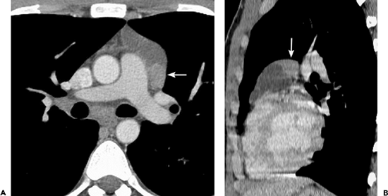
Notes:
Figure 6-31 Cystic Hodgkin lymphoma. Axial (A) and sagittal (B) reformatted images demonstrate a cystic lesion in the left lobe of the thymus. A soft tissue nodule is seen in the posterior aspect of the mass (arrows), helping distinguish this lesion from a congenital thymic cyst.

Slide 41
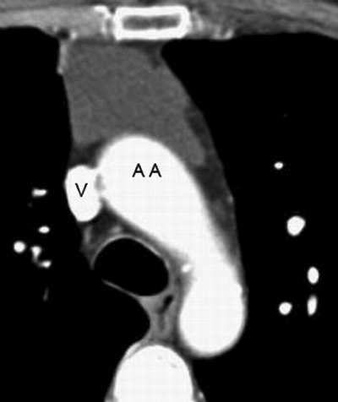
Notes:
Figure 6-28 Thymic cyst. A homogeneous, water-attenuation mass with imperceptible walls is seen in the anterior mediastinum. AA, ascending aorta; V, superior vena cava.

