Slide 1
SPOTS

Slide 2
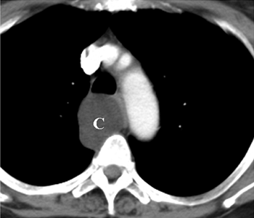
Notes:
Figure 24-17 Duplication cyst, 15-year-old girl. Contrast-enhanced computed tomography shows a homogeneous, near-water-density cyst (C) in the middle mediastinum, posterior to the trachea.

Slide 3
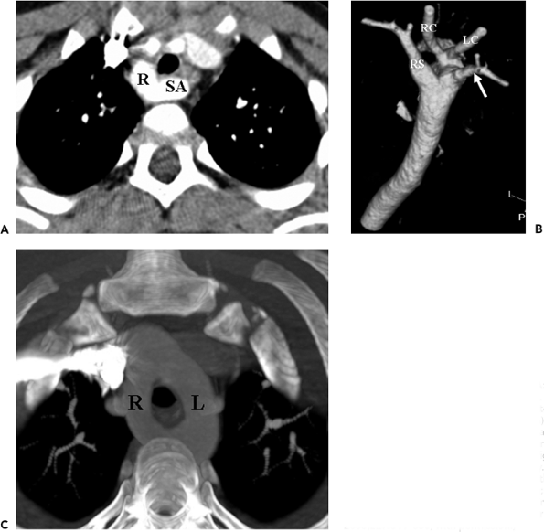
Notes:
Figure 24-20 Aortic arch anomalies. A: Right arch with an aberrant left subclavian artery, 3-year-old girl. Contrast-enhanced computed tomography (CT) scan demonstrates a right aortic arch (R) giving rise to the left subclavian artery (SA), which passes behind the trachea and esophagus to reach the left arm. B: Three-dimensional reconstruction shows the left subclavian artery (arrow) arising as the last branch off the right-sided aorta. RS, right subclavian artery; RC, right carotid artery; LC, left carotid artery. C: Double arch in an 17-year-old girl. CT shows the two limbs of the double arch encircling the trachea and esophagus. R, right arch; L, left arch.

Slide 4
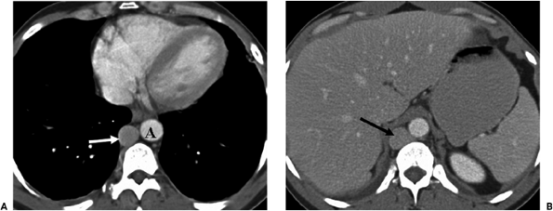
Notes:
Figure 24-21 Azygos continuation of inferior vena cava. A: Computed tomography scan at the level of the distal aorta (A) shows a markedly dilated azygos vein (arrow). B: A dilated azygos vein (arrow) is noted at the level of the liver. The inferior vena cava is absent.

Slide 5
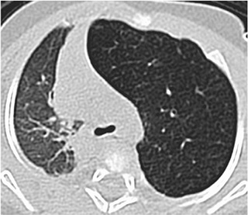
6-month-old boy
Notes:
Figure 24-22 Congenital lobar emphysema, 6-month-old boy. Computed tomography through the upper thorax shows a hyperinflated left upper lobe with attenuated vascularity.

Slide 6
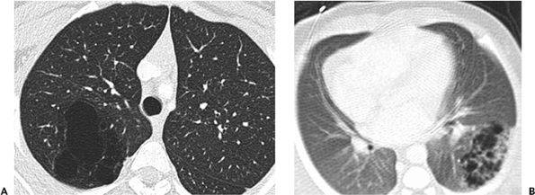
Notes:
Figure 24-23 Cystic adenomatoid malformation. A: Type I lesion, 15-year-old girl, multilocular mass in the right upper lobe containing numerous large cysts. B: Type II malformation, infant girl, a complex mass in the left lower lobe containing multiple small cysts.

Slide 7
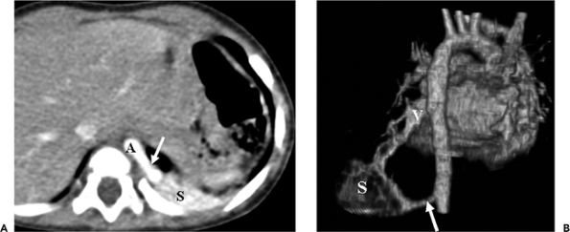
Notes:
Figure 24-25 Intralobar sequestration, 6-month-old girl with recurrent left lower lobe pneumonia. A: Computed tomography demonstrates the anomalous arterial supply (arrow) to the sequestered lung (S) arising from the thoracic aorta (A). B: Posterior three-dimensional volume-rendered image shows the anomalous arterial supply (arrow) from the descending aorta to the sequestered lung (S) and the anomalous venous drainage (V) to the left atrium.

Slide 8
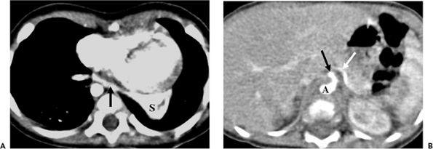
Notes:
Figure 24-26 Extralobar pulmonary sequestration, 6-month-old boy with a left paraspinal mass on chest radiographs. A: Computed tomography (CT) scan shows the anomalous vein (arrow) arising from the sequestered lung (S) and crossing the midline to the right hemithorax. B: More caudal CT image demonstrates the anomalous arterial vessel (white arrow) arising from the celiac artery (black arrow). A, aorta.

Slide 9
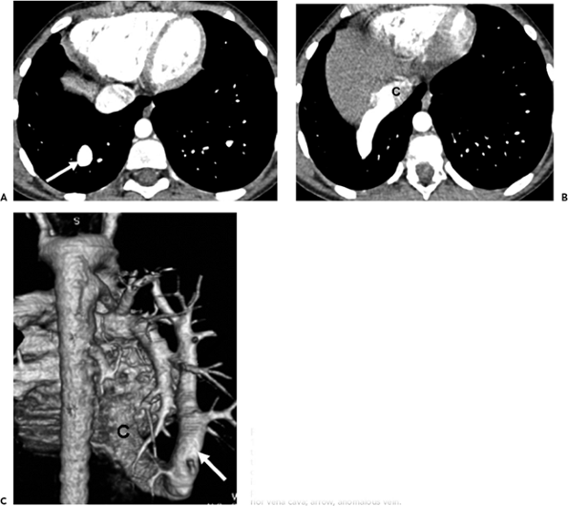
Notes:
Figure 24-27 Scimitar syndrome with partial anomalous venous return, 10-year-old girl. A: Axial computed tomography scan at the level of the ventricles shows part of the anomalous pulmonary vein (arrow). B: Several centimeters lower, the anomalous vessel enters the intrahepatic inferior vena cava (C). Note that the right hemithorax is smaller than the left and that there is mediastinal shift to the right. C: Volume-rendered three-dimensional display depicts the entire course of the anomalous vessel on one image. C, inferior vena cava; arrow, anomalous vein.

Slide 10
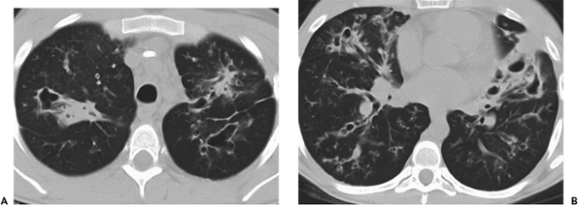
Notes:
Figure 24-29 Cystic fibrosis. A, B: High-resolution computed tomography sections at two levels demonstrate diffuse cystic bronchiectasis and peribronchial thickening

Slide 11
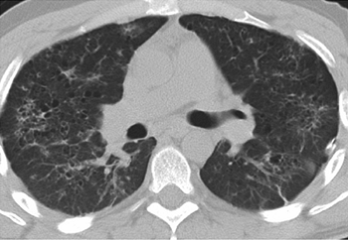
Notes:
Figure 24-32 Langerhans cell histiocytosis. High-resolution computed tomography shows multiple small air-filled, thin-walled cysts

Slide 12
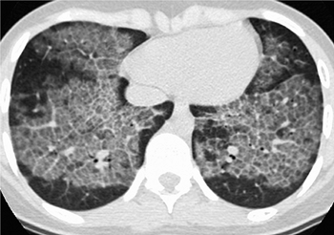
Notes:
Figure 24-33 Pulmonary alveolar proteinosis, 15-year-old girl with shortness of breath. High-resolution computed tomography through the lung bases shows extensive ground-glass opacity and interstitial thickening, creating a â€œcrazy pavingâ€ appearance

Slide 13
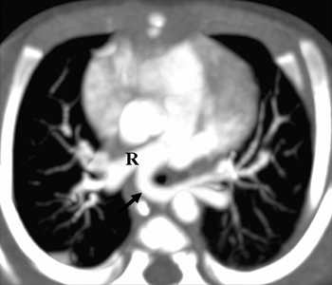
3-month-old girl
Notes:
Figure 24-37 Pulmonary sling, 3-month-old girl. Contrast-enhanced axial computed tomography image shows anomalous left pulmonary artery (arrow) arising from right pulmonary artery (R) and compressing trachea.

Slide 14
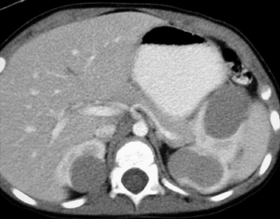
Notes:
Figure 24-43 Bilateral Wilms tumors. Computed tomography scan shows two nonenhancing low-attenuation Wilms tumors in the left kidney and one in the right kidney.

Slide 15
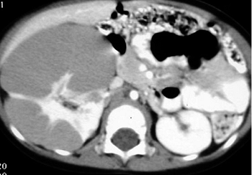
12-month-old girl
Notes:
Figure 24-44 Nephroblastomatosis, 12-month-old girl. Computed tomography demonstrates an enlarged right kidney with a rind of soft tissue in the subcapsular space compressing the enhancing renal cortex.

Slide 16
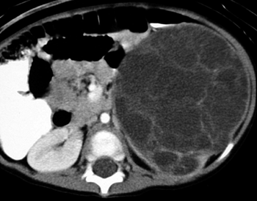
4-year-old boy
Notes:
Figure 24-48 Multilocular cystic nephroma in a 4-year-old boy. Contrast-enhanced computed tomography scan shows a low-attenuation mass containing several enhancing septations in the upper pole of the left kidney.

Slide 17
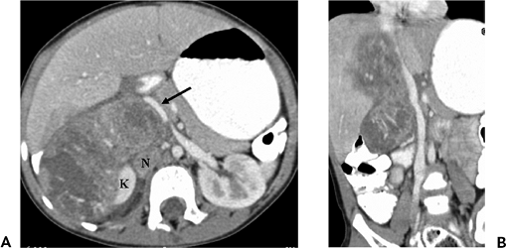
2-year-old girl
Notes:
Figure 24-51 Neuroblastoma. A: Contrast-enhanced computed tomography (CT) in a 2-year-old girl shows a suprarenal low-density mass displacing the right kidney (K) inferiorly. The inferior vena cava (arrow) is compressed and displaced anteriorly. The tumor extends to the midline and abuts but does not displace the aorta. Also noted is a small retroperitoneal lymph node (N). B: Coronal multiplanar CT shows the craniocaudal extent of the tumor.

Slide 18
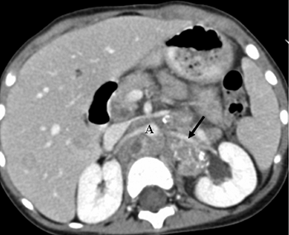
Notes:
Figure 24-53 Neuroblastoma with midline extension. Contrast-enhanced computed tomography scan demonstrates extension of tumor, with calcifications anterior to the vertebral body and with encasement of the left renal artery (arrow) and aorta (A). There is mild left hydronephrosis.

Slide 19
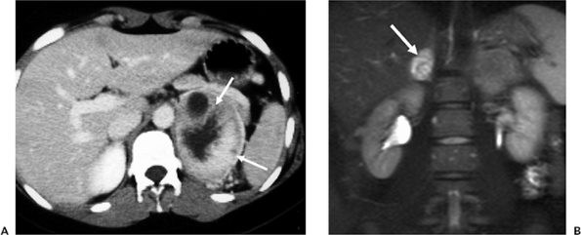
B: Fat-saturated T2-weighted magnetic resonance image in another patient
Notes:
Figure 24-56 Adrenal pheochromocytomas. A: Contrast-enhanced computed tomography scan shows a left adrenal mass (arrows) with central necrosis. The soft tissue components show moderate enhancement. B: Fat-saturated T2-weighted magnetic resonance image in another patient shows high signal intensity mass (arrow) in the right adrenal gland.

Slide 20
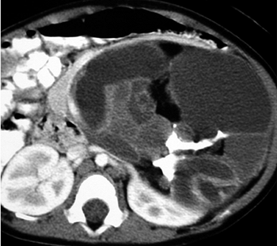
Notes:
Figure 24-57 Retroperitoneal teratoma. Contrast-enhanced computed tomography scan demonstrates a large predominantly fluid-filled mass containing areas of fat and calcification

Slide 21
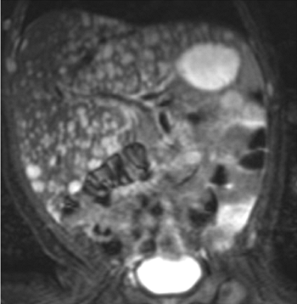
newborn girl. T2-weighted spin-echo image
Notes:
Figure 24-63 Multiple hemangioendotheliomas in a newborn girl. T2-weighted spin-echo image shows multiple lesions that are markedly hyperintense to normal liver parenchyma

Slide 22
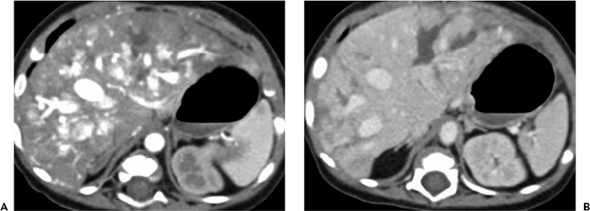
neonate. A: Arterial phase computed tomography B: PV Phase
Notes:
Figure 24-64 Diffuse hemangioendotheliomatosis in a neonate. A: Arterial phase computed tomography (CT) image obtained 12 seconds after the start of contrast administration demonstrates multiple high-attenuation lesions in the liver. B: Portal venous phase CT scan obtained 50 seconds after injection of contrast medium demonstrates nearly complete washout of the lesions.

Slide 23
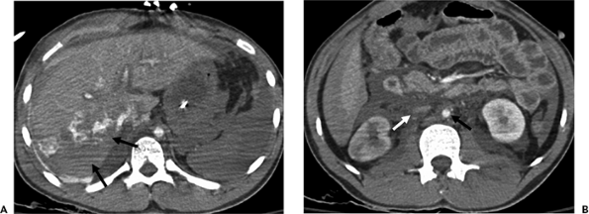
Notes:
Figure 24-73 Liver fracture with hypovolemic shock. A: Computed tomography (CT) image through the upper abdomen shows a deep parenchymal laceration extending through the right hepatic lobe, resulting in an avulsed, nonperfused posterior segment (arrows). High-attenuation extravasated contrast material representing active hemorrhage is evident at the fracture site. The decreased splenic enhancement is related to the hypotension and should not be misinterpreted as representing splenic injury. B: A more caudal CT image reveals blood in the perihepatic and perisplenic spaces, dilated small bowel loops with intensely enhancing walls, a small aorta (black arrow) and inferior vena cava (white arrow), indicating hypovolemic shock.

Slide 24
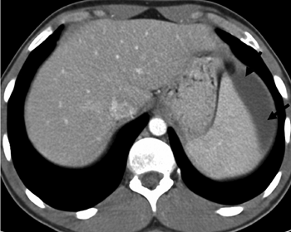
Notes:
Figure 24-74 Subcapsular splenic hematoma. A low-attenuation lenticular-shaped subcapsular hematoma (arrows) flattens the lateral splenic contour. The patient had a small splenic laceration, seen on other levels.

Slide 25
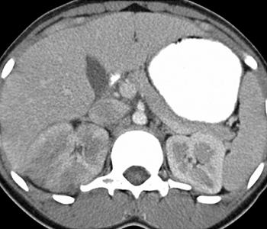
Notes:
Figure 24-77 Acute bacterial pyelonephritis, 4-year-old girl. Contrast-enhanced computed tomography shows an enlarged right kidney with several poorly enhancing areas, representing more severe areas of bacterial nephritis. Urine cultures grew Escherichia coli.

Slide 26
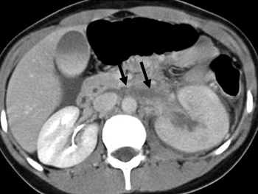
Notes:
Figure 24-78 Renal vein thrombosis in a 4-year-old boy with left flank pain. Contrast-enhanced computed tomography during the excretory phase shows an enlarged left kidney with poor excretion. Thrombus is noted in the left renal vein (arrows).

Slide 27
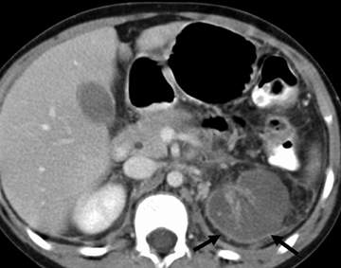
Notes:
Figure 24-79 Renal artery occlusion. Computed tomography shows an absent left nephrogram with an enhancing cortical rim (arrows).

Slide 28
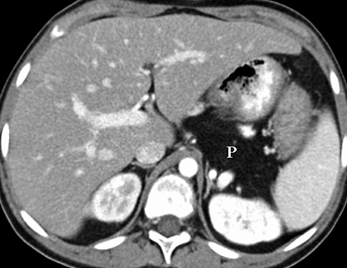
Notes:
Figure 24-80 Cystic fibrosis, 15-year-old boy. The pancreas (P) is completely replaced by fatty tissue. The liver has diminished density, also secondary to fatty replacement.

Slide 29
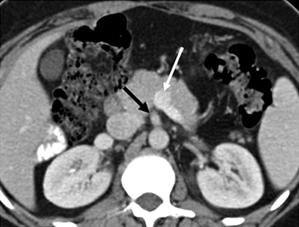
Notes:
Figure 24-83 Malrotation. Contrast-enhanced computed tomography shows reversal of the normal orientation of the superior mesenteric vessels, with the artery (black arrow) lying to the right of the vein (white arrow).

Slide 30
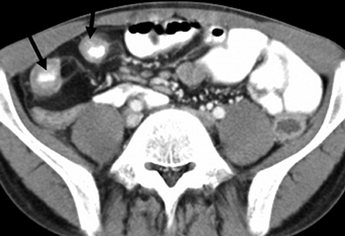
Notes:
Figure 24-84 Crohn disease. A 14-year-old boy with a palpable right lower quadrant mass. Computed tomography shows circumferential thickening of the wall of the distal ileum (arrows) and an increased amount of mesenteric fat in the right lower quadrant.

Slide 31
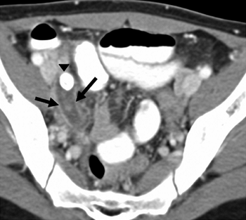
Notes:
Figure 24-85 Acute appendicitis, 7-year-old girl. Computed tomography demonstrates a dilated, fluid-filled appendix (arrows) with an enhancing wall and an appendicolith (arrowhead).

Slide 32
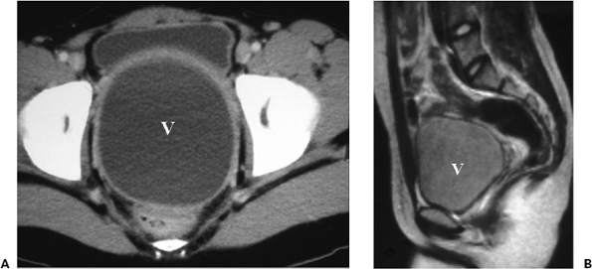
Notes:
Figure 24-89 Hydrocolpos as a result of vaginal membranes in two adolescent girls with pelvic pain. A: Computed tomography scan shows a dilated, fluid-filled vagina (V). B: Sagittal T1-weighted magnetic resonance image shows an enlarged, intermediate signal intensity vagina (V). The fluid in both patients represented blood products.

Slide 33
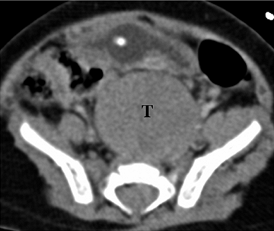
Notes:
Figure 24-94 Presacral neuroblastoma in a 2-year-old. Contrast-enhanced computed tomography shows a soft tissue tumor (T) anterior to the sacrum.

Slide 34
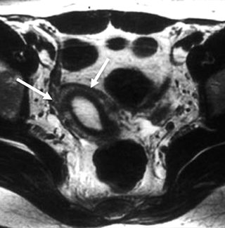
Notes:
Figure 24-95 Unicornuate uterus with a noncommunicating rudimentary horn. Axial T1-weighted image shows a single fusiform uterine cavity (arrows), which is deviated to the right. The high signal intensity focus within the right endometrial cavity represents blood.

Slide 35
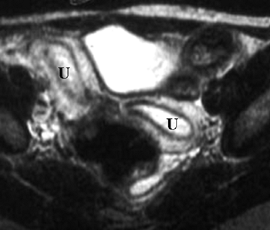
Notes:
Figure 24-96 Uterus didelphys. Axial T2-weighted magnetic resonance image demonstrates duplicated uterine horns (U) with a widened intercornual distance. Two vaginas and cervices were seen on more caudal images

Slide 36
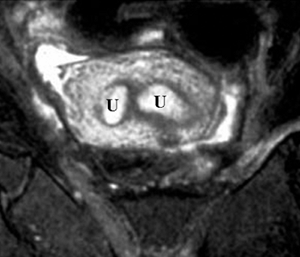
Notes:
Figure 24-97 Uterus septate, 18-year-old girl. Angled coronal T2- weighted image shows two uterine horns (U) with normal zonal anatomy. A continuous band of myometrium surrounds the horns.

Slide 37
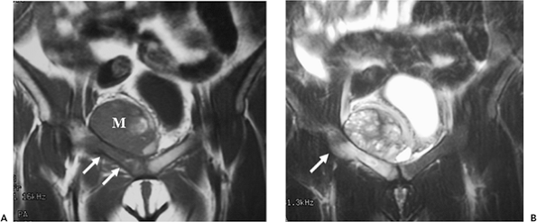
16 yr old T1 & T2W
Notes:
Figure 24-99 Ewing sarcoma, 16-year-old boy. A: Coronal T1-weighted magnetic resonance (MR) image shows low-intensity tumor in the right pubic ramus (arrows) with an associated soft tissue mass (M). B: Coronal fat-saturated T2-weighted MR image shows increased signal intensity in the intramedullary portion of the tumor and the extramedullary soft tissue component of the tumor. Tumor extension through the cortex inferiorly (arrow) is better seen on the T2-weighted image

Slide 38
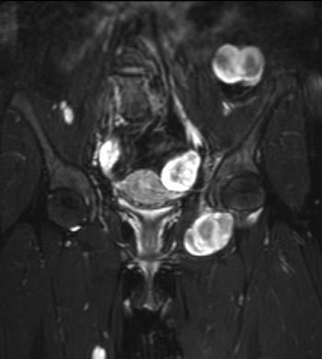
Coronal T2-weighted magnetic resonance image with fat saturation
Notes:
Figure 24-103 Plexiform neurofibromas. Coronal T2-weighted magnetic resonance image with fat saturation demonstrates the typical target appearance of benign neural tumors, with a central zone of low signal intensity and a peripheral zone of high signal intensity.

Slide 39
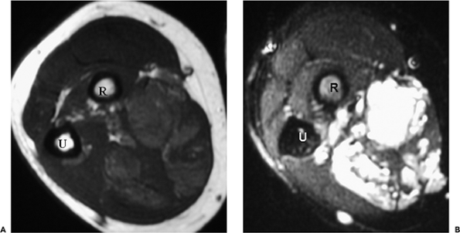
A: Axial T1-weighted B: On axial T2-weighted image with fat saturation
Notes:
Figure 24-104 Hemangioma, right forearm. A: Axial T1-weighted image demonstrates a heterogeneous mass of intermediate signal intensity replacing the posterior muscles. Low signal intensity foci represent fibrosis; foci of high signal intensity are related to fat. B: On axial T2-weighted image with fat saturation, the dilated vascular channels comprising the mass have high signal intensity. Interspersed throughout the lesion is low signal intensity fibrous tissue. The involved muscle is atrophied evidenced by the absence of mass effect given the large size of the hemangioma. Dilated vessels are also seen in the subcutaneous fat. U, ulna; R, radius.

Slide 40
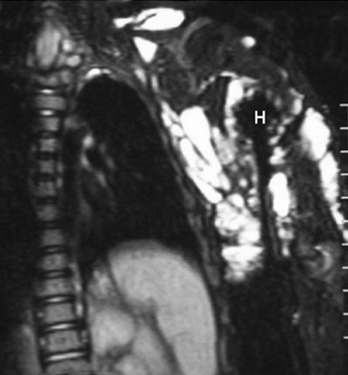
Axial T2-weighted image with fat saturation
Notes:
Figure 24-106 Cystic hygroma, 18-year-old girl. Axial T2-weighted image with fat saturation demonstrates multiple high signal intensity cysts of varying size in the subcutaneous tissues of the left upper extremity. H, humeral head.

Slide 41
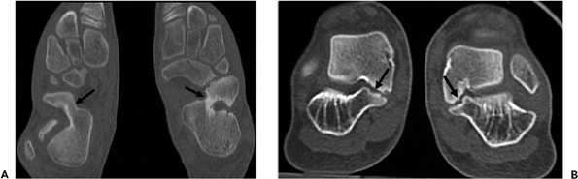
Notes:
Figure 24-110 Tarsal coalition. A: Computed tomography (CT) in a 13-year-old boy through the long axis of the hind feet shows bilateral calcaneonavicular coalitions (arrows). B: Short-axis CT image in a 14-year-old boy shows narrowing and irregularity of the cortical surfaces of the talocalcaneal joints bilaterally (arrows), indicating fibrous coalition.

