Slide 1
SPOTS

Slide 2
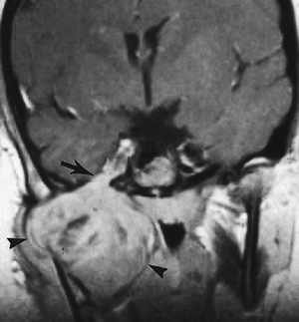
Enhanced T1-weighted coronal magnetic resonance image
Notes:
Figure 4-27 Rhabdomyosarcoma. Enhanced T1-weighted coronal magnetic resonance image demonstrates a large, enhancing soft tissue mass (arrowheads) arising in the right masticator space and enveloping the mandible. The lesion extends through the expanded foramen ovale (arrow) into Meckel's cave.

Slide 3
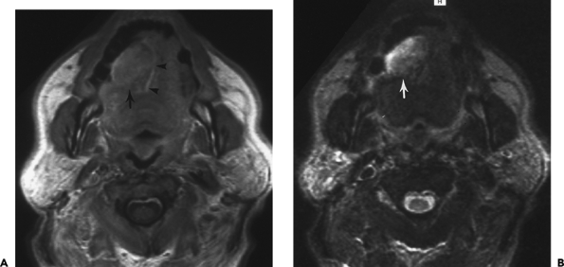
Notes:
Figure 4-28 Squamous cell carcinoma of the tongue. A right tongue mass (arrows) is revealed on transaxial magnetic resonance images. The lesion is mildly hyperintense on the enhanced T1-weighted image (A) and hyperintense on the T2-weighted image (B). The lesion displaces the midline septum of the tongue to the left (arrowheads). Anatomic asymmetry of the tongue and oral cavity is an important clue to pathology.

Slide 4
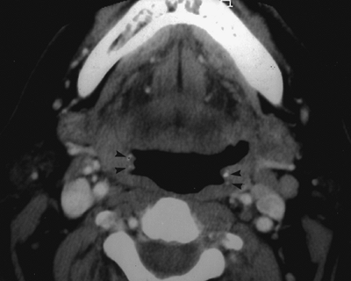
Notes:
Figure 4-29 Tonsillar calcifications. Calcifications (arrowheads) identified in the tonsils on computed tomography.

Slide 5
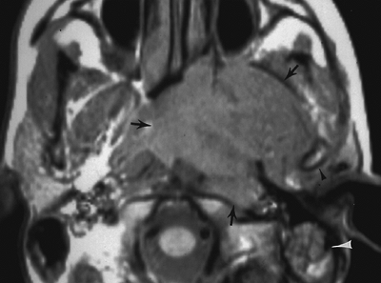
T1-weighted magnetic resonance image
Notes:
Figure 4-30 Nasopharyngeal carcinoma. T1-weighted magnetic resonance image demonstrates a large nasopharyngeal mass (arrows). The lesion invades the retropharyngeal and perivertebral spaces posteriorly and involves the anterior arch of the C-1 vertebra. The mass obliterates the fat of the left parapharyngeal space and displaces the left masticator space contents anterolaterally. The mass invades the masticator space and abuts the left mandibular condyle (black arrowhead). Anteriorly, the lesion involves the pterygoid process, left pterygopalatine fossa, and posterior nasal cavity. Note the soft tissue (white arrowhead) in the left mastoid tip resulting from eustachian tube obstruction.

Slide 6
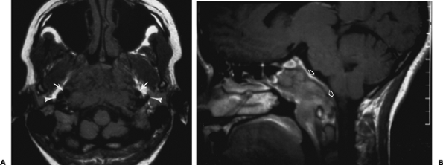
transaxial T1-weighted (A) enhanced, sagittal T1-weighted (B) MR images.
Notes:
Figure 4-31 Nasopharyngeal carcinoma. Large nasopharyngeal mass is hypointense on transaxial T1-weighted (A) and hyperintense on enhanced, sagittal T1-weighted (B) MR images. The lesion displaces the internal carotid arteries (arrows) and jugular veins (arrowheads) laterally. The mass invades the perivertebral space and the clivus (open arrows).

Slide 7
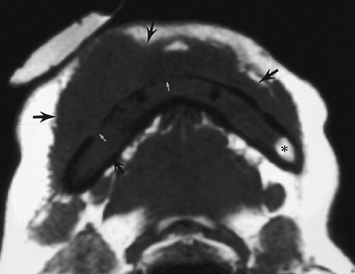
T1-weighted magnetic resonance image
Notes:
Figure 4-32 Lymphoma of the mandible. T1-weighted magnetic resonance image reveals diffuse soft tissue mass (black arrows) replacing the normal hyperintense marrow fat signal (asterisk) and extending into the extraosseus fat anterior to the mandible. Portions of the cortex are destroyed (white arrows).

Slide 8
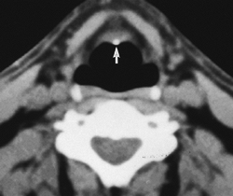
Notes:
Figure 4-40 Calcification in epiglottic cartilage, an unusual finding in this elastic cartilage (arrow).

Slide 9
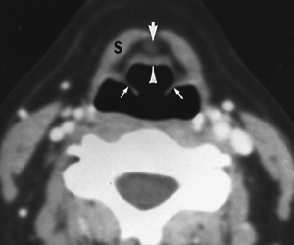
Notes:
Figure 4-41 Hyoepiglottic ligament (large arrow) is seen within the preepiglottic space; infrahyoid strap muscles (S); epiglottis (arrowhead); aryepiglottic folds (small arrows). This midline structure should not be interpreted as tumor infiltration within the preepiglottic space.

Slide 10
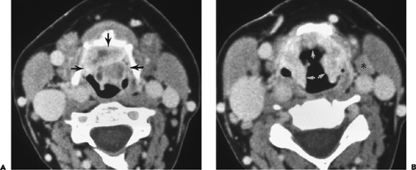
Notes:
Figure 4-46 Supraglottic squamous cell carcinoma. Enhanced computed tomography (A) demonstrates a large necrotic epiglottic mass (arrows) completely filling the preepiglottic space and compromising the airway. Image (B), more caudal to the previous slice, reveals a markedly thickened epiglottis and aryepiglottic folds (arrows) infiltrated with tumor. A metastatic lymph node is also identified (asterisk).

Slide 11
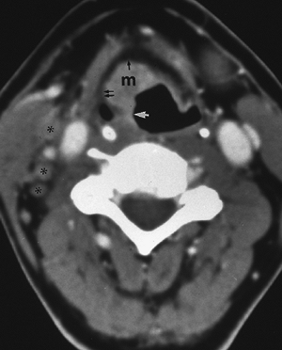
Notes:
Figure 4-47 Supraglottic carcinoma. Enhanced computed tomography demonstrates a soft tissue attenuation mass (m) arising from the epiglottis and encroaching on the preepiglottic (black arrow) and paralaryngeal (double black arrows) spaces and right aryepiglottic fold (white arrow). Metastatic lymph nodes (asterisks) are also evident

Slide 12
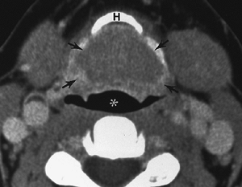
Notes:
Figure 4-48 Supraglottic carcinoma. Large, predominantly hypodense, anterior epiglottic mass (arrows) fills the pre-epiglottic space at the level of the hyoid bone (H). The airway (white asterisk) is compressed by the lesion.

Slide 13
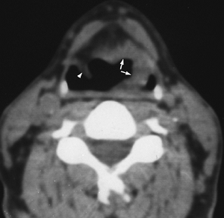
Notes:
Figure 4-49 Supraglottic carcinoma. Tumor thickens the left side of the epiglottis and extends into the paralaryngeal space and left aryepiglottic fold (arrows); normal right aryepiglottic fold (arrowhead).

Slide 14
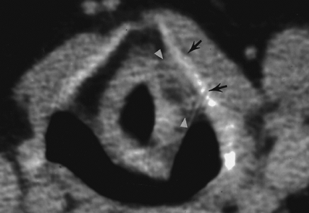
Notes:
Figure 4-50 Supraglottic carcinoma. Computed tomography scan demonstrates a soft tissue lesion filling the normally fat-containing left paralaryngeal space (arrowheads) and abutting the left thyroid lamina (arrows).

Slide 15
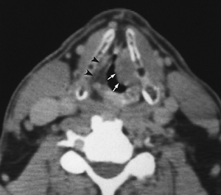
Notes:
Figure 4-51 Localized false vocal cord tumor. Carcinoma involving the left false vocal cord (white arrows) obliterates the normal low-attenuation paralaryngeal space and bulges into the airway; normal right paralaryngeal space (arrowheads).

Slide 16
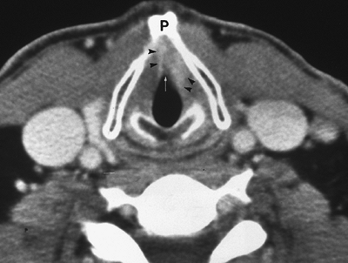
Notes:
Figure 4-52 Carcinoma of the left true vocal cord. Enhanced computed tomography in a patient with a clinically fixed left true vocal cord. An enhancing mass (arrowheads) of the anterior left true cord extends laterally into the paraglottic space to the thyroid cartilage and anteriorly to involve the anterior commissure (arrow). The anterior right true cord is also involved. The thyroid cartilage is intact and not invaded by tumor. Laryngeal prominence (P).

Slide 17
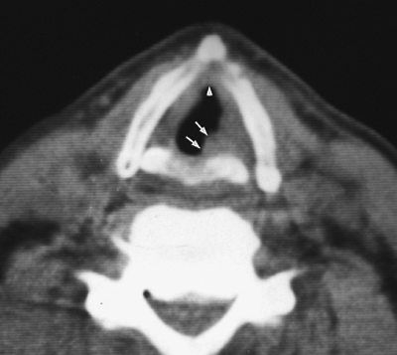
Notes:
Figure 4-53 Carcinoma of the true vocal cord with involvement of anterior and posterior commissures. Left true vocal cord tumor extends posteromedially over the arytenoid cartilage toward the posterior commissure (arrows) and anteriorly across the anterior commissure (arrowhead).

Slide 18
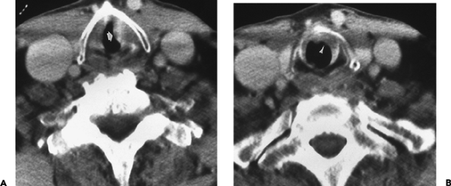
Notes:
Figure 4-54 Carcinoma of the left true vocal cord with subglottic extension. Enhanced computed tomography (CT) (A) demonstrates a smooth mass (arrow) of the left true vocal cord projecting into the airway. CT scan at the level of the cricoid (B) reveals inferior extension of the tumor (arrowhead), causing thickening of the mucosa

Slide 19
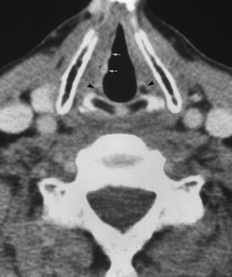
Notes:
Figure 4-55 Glottic carcinoma. Enhanced computed tomography at the level of the vocal processes of the arytenoids (arrowheads) reveals nodular irregularity of the true vocal cords (white arrows). The lesion is slightly hyperdense. Diagnosis of small lesions relies heavily on the abnormal contour of the airway caused by the mass. Interpretation also depends on detailed clinical information. Benign polyps may have an identical appearance

Slide 20
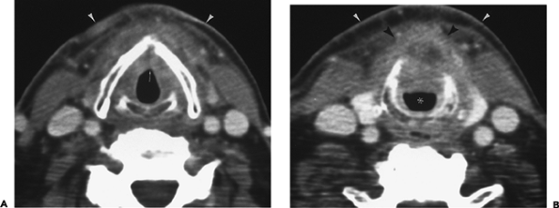
Notes:
Figure 4-56 Carcinoma of the true vocal cords with subglottic extension. Enhanced computed tomography (A) demonstrates thickening of the anterior commissure (arrow) by a mass involving both true vocal cords. B: The mass descends into the subglottic region and perforates the cricothyroid membrane and inferior thyroid cartilage to invade the soft tissues of the neck (black arrowheads). Portions of the mass are hypodense as a result of necrosis. The airway (asterisk) is markedly narrowed. Prior radiation therapy has caused skin thickening (white arrowheads).

Slide 21
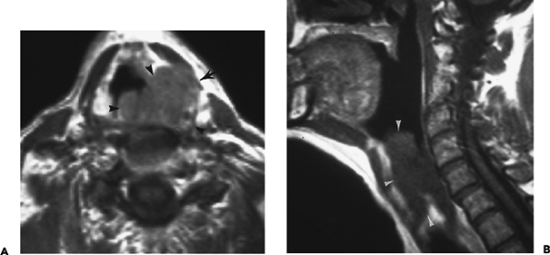
Notes:
Figure 4-57 Transglottic carcinoma. Enhanced transaxial T1-weighted magnetic resonance image (A) reveals a large supraglottic soft tissue mass (arrowheads) that invades the left paralaryngeal space, the left thyroid cartilage lamina, and paralaryngeal muscles (arrow). Sagittal T1-weighted image (B) demonstrates the full extent of tumor (arrowheads) as it infiltrates to the level of the true cords.

Slide 22
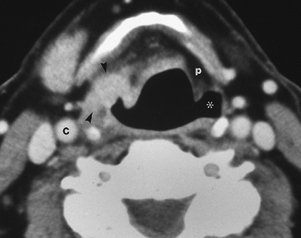
Notes:
Figure 4-58 Pyriform sinus carcinoma. Dense soft tissue mass (arrowheads) partially effacing right pyriform sinus and infiltrating paralaryngeal space on enhanced computed tomography image. The mass approaches the right carotid artery (C), but does not involve the vessel. Normal left pyriform sinus (asterisk), normal left paralaryngeal space (p).

Slide 23
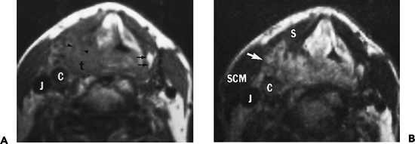
T1W & T2W
Notes:
Figure 4-59 Pyriform sinus carcinoma, with thyroid cartilage destruction and extralaryngeal extension. A: On T1-weighted magnetic resonance image, a large hypointense tumor (t) is seen in the region of the right pyriform sinus. Fat within the medullary cavity in the posterior portion of the left thyroid lamina (small arrows) is high in signal intensity, whereas the right thyroid lamina is destroyed and its medullary cavity is replaced by low-intensity tumor (arrowheads). Distinction between the tumor and strap muscles is poor. The tumor abuts the carotid artery (C) but does not involve its wall; internal jugular vein (J). B: On T2-weighted image, the extralaryngeal extension of hyperintense tumor (large arrow) and the strap muscles (S) are better delineated. Contrast between the tumor and fat within the paralaryngeal space is decreased; carotid artery (C); jugular vein (J); sternocleidomastoid muscle (SCM).

Slide 24
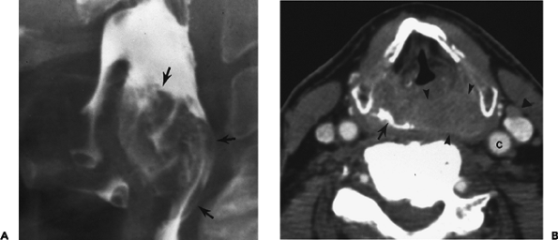
Notes:
Figure 4-60 Pyriform sinus hypopharyngeal squamous cell carcinoma. Lateral view from barium esophagram (A) demonstrates a large mucosal based hypopharyngeal mass (arrows). Enhanced computed tomography (B) reveals a large hypopharyngeal mass (small arrowheads) extending posterolaterally to abut the left carotid artery (c) and displacing the barium-filled hypopharynx to the right (arrow). A small left jugular lymph node is noted (large arrowhead).

Slide 25
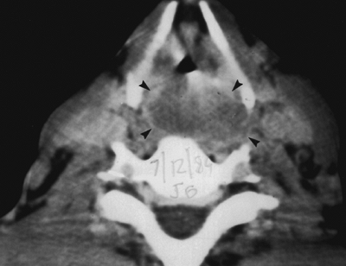
Notes:
Figure 4-61 Hypopharyngeal carcinoma. Computed tomography scan demonstrates a large hypopharyngeal carcinoma (arrowheads) that has grown posteriorly to involve the retropharyngeal space.

Slide 26
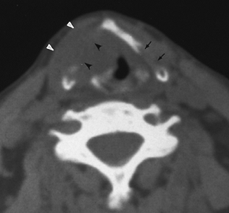
Notes:
Figure 4-62 Carcinoma of the right true vocal cord with thyroid cartilage destruction. Mass involving the right true vocal cord invades the anterior commissure and destroys the right thyroid lamina (black arrowheads), and extends into the adjacent soft tissues (white arrowheads). Cortical thinning of the posterior aspect of the left thyroid lamina (arrows) is a normal variation and should not be interpreted as cartilage destruction.

Slide 27
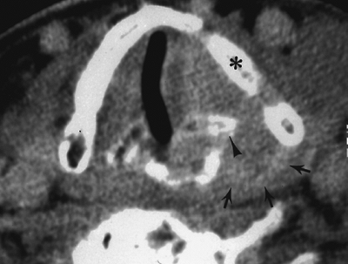
Notes:
Figure 4-63 Transglottic carcinoma, arytenoid cartilage involvement. Computed tomography scan shows a mass in the left vocal cord that extends to the thyroid cartilage (asterisk) and the left arytenoid cartilage (arrowhead). The mass escapes into the neck through the thyroarytenoid space (arrows). The left arytenoid cartilage is sclerotic compared with its companion on the right. This extensive mass also involved the supraglottic region.

Slide 28
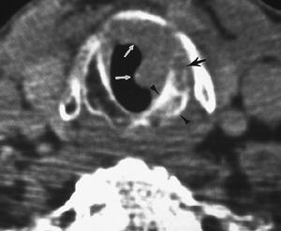
Notes:
Figure 4-64 Transglottic carcinoma with cartilage invasion. Computed tomography scan reveals a soft tissue mass (white arrows) thickening the mucosa and projecting into the airway at the level of the cricoid cartilage. This mass had spread from a glottic site and descended to the inferior margin of the cricoid cartilage. Note the cricoid sclerosis (arrowheads) and destruction, with marrow replacement by tumor (black arrow), that marked the cartilage invasion

Slide 29
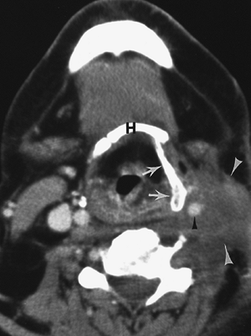
Notes:
Figure 4-65 Cervical recurrence, floor of the mouth carcinoma. A contrast-enhancing soft tissue mass (white arrowheads) is identified in the left neck at the level of the thyroid cartilage (arrows). The carotid artery (black arrowhead) is encased by the lesion. The subcutaneous fat and endolarynx are edematous because of previous radiation therapy. Note that the hyoid bone (H) and thyroid cartilage appear on the same imaging slice due to contraction of the thyrohyoid membrane

Slide 30
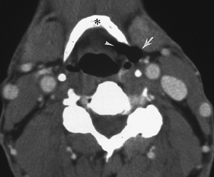
Notes:
Figure 4-66 Mixed laryngocele. Enhanced computed tomography reveals an air-filled laryngocele straddling the thyrohyoid membrane. The internal component (arrowhead) is medial to the hyoid bone (asterisk), and the external component (arrow) is lateral to the hyoid.

Slide 31
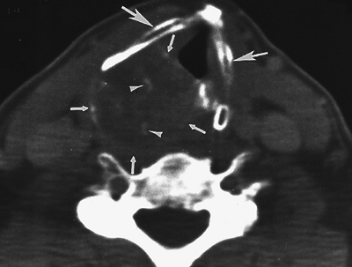
Notes:
Figure 4-67 Chondrosarcoma of the cricoid cartilage. Computed tomography demonstrates stippled calcification (arrowheads) within a large mass (small arrows) arising from the cricoid cartilage and extending into the extralaryngeal tissues. The thyroid cartilage (large arrows) is displaced anteriorly and to the left.

Slide 32
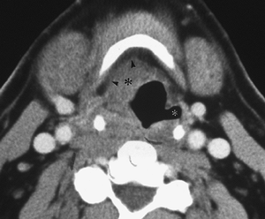
Notes:
Figure 4-68 Lymphoma of the hypopharynx. A predominately submucosal right pyriform sinus mass (black asterisk) invades the preepiglottic and right paralaryngeal spaces (arrowheads), with effacement of the right pyriform sinus. Biopsy confirmed a diffuse, large, B-cell lymphoma. Left pyriform sinus (white asterisk).

Slide 33
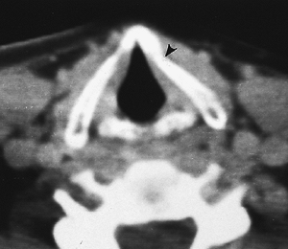
Notes:
Figure 4-70 Fracture of thyroid cartilage. A minimally depressed fracture of the left thyroid lamina (arrowhead) is seen. The adjacent strap muscles are slightly thickened secondary to hemorrhage or edema. The true vocal cords and cricoid cartilage are normal.
`

Slide 34
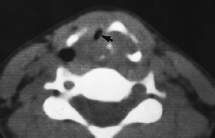
Notes:
Figure 4-71 Comminuted fracture of thyroid cartilage. Multiple fractures of the thyroid cartilage are seen, with extensive hemorrhage and edema severely compressing the airway (arrow).

Slide 35
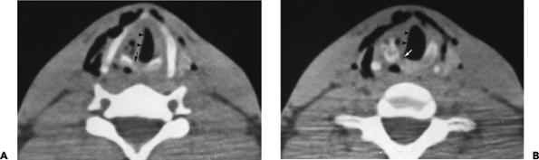
Notes:
Figure 4-72 Fracture of cricoid cartilage. A: A fracture (arrow) through the right side of the cricoid cartilage is seen. B: Edema/hemorrhage thickens the right true vocal cord and narrows the airway (arrowheads). Extensive soft tissue air is also present.

Slide 36
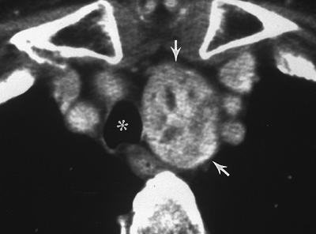
Notes:
Figure 4-74 Goiter. Enhanced computed tomography reveals an enhancing heterogeneous soft tissue mass (arrows) that originated in the thyroid gland and descended through the thoracic inlet, deviating the trachea (asterisk) to the right.

Slide 37
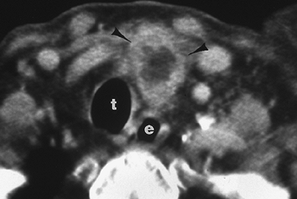
Notes:
Figure 4-75 Papillary carcinoma of the thyroid. Computed tomography reveals an enhancing thyroid mass (arrowheads) extending into the left neck. A central hypodense region is noted. A tissue plane separates tumor from trachea (t). e, esophagus.

Slide 38
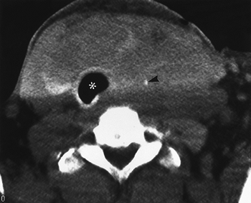
Notes:
Figure 4-76 Medullary carcinoma of the thyroid gland. A large anterior neck soft tissue neck mass replaces the entire normal thyroid gland on computed tomography. The trachea (asterisk) is displaced to the right. Small flecks of calcium (arrowhead) are deposited throughout the mass.

Slide 39
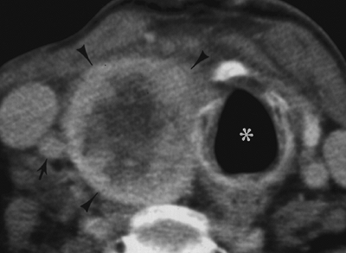
Notes:
Figure 4-77 Medullary thyroid carcinoma. Well-defined, partially enhancing, right paratracheal mass (arrowheads) is seen on the enhanced computed tomography scan. Trachea (asterisk) is displaced to the left. The lesion abuts the right common carotid artery (arrow).

Slide 40
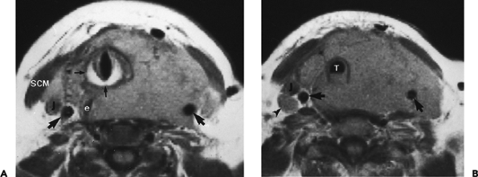
Notes:
Figure 4-78 Thyroid lymphoma. A, B: Proton density-weighted magnetic resonance images demonstrate an extensive tumor infiltrating the left and right neck. Both common carotid arteries (large arrows) are displaced posterolaterally. The left carotid is encased by tumor. The left internal jugular vein is not visualized and is most likely occluded. The posterior wall of the trachea (T) is infiltrated with tumor. The cricoid cartilage (small arrows) is well visualized because of the high signal from medullary fat; right jugular vein (J); esophagus (e); sternocleidomastoid muscle (SCM); enlarged lymph node (arrowhead).

Slide 41
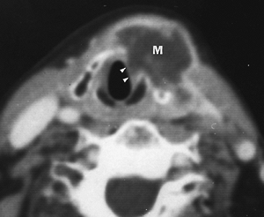
Notes:
Figure 4-79 Thyroid carcinoma. Postcontrast computed tomography image shows a large, irregular, low-density mass (M) destroying the left thyroid lamina and invading the left true vocal cord (arrowheads). More caudal images showed the mass arising from the left lobe of the thyroid.

