Slide 1
SPOTS

Slide 2
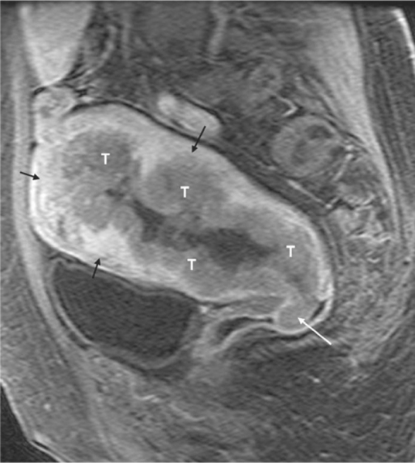
Notes:
Figure 54.17 Endometrial carcinoma, MRI. Sagittal gadolinium-enhanced T1-weighted fat-suppressed MR image shows an endometrial cancer (T) with deep myometrial invasion. Note the thin rim of normal myometrium (black arrows). The disease extends to the upper third of the vagina (white arrow).

Slide 3
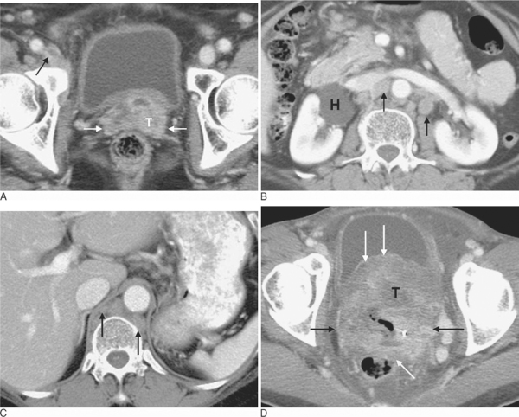
Notes:
Figure 54.19 Cervical cancer, CT. Axial CT images (A–C) show a cervical cancer (T, A) which is contiguous with the adjacent parametrial fat, indicating parametrial invasion (white arrows, A). Note the presence of a filling defect within the right external femoral vein suggesting deep venous thrombosis (black arrow, A). There is bilateral para-aortic (black arrows, B) and retrocrural lymphadenopathy (black arrows, C). Also, note the presence of right hydronephrosis (H, B). Axial CT image (D) of extensive cervical cancer (T, D) in a different patient. The tumour extends to both parametria (black arrows, D) and invades the posterior aspect of the bladder (white arrows, D) and anterior rectal wall (white arrow, D).

Slide 4
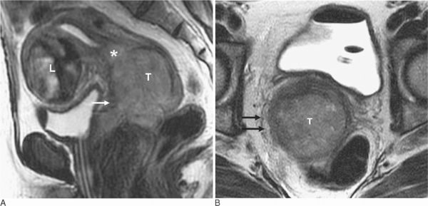
Notes:
Figure 54.20 Cervical cancer, MRI. Sagittal (A) and axial (B) T2-weighted images show a large cervix cancer (T) involving the anterior fornix of the vagina (arrow, A). The tumour invades the fibrocervical stroma on the right (arrows, B). Note the tumour extends into the lower endometrial canal (*, A). Incidentally, presence of a large uterine leiomyoma (L, A) is noted

Slide 5
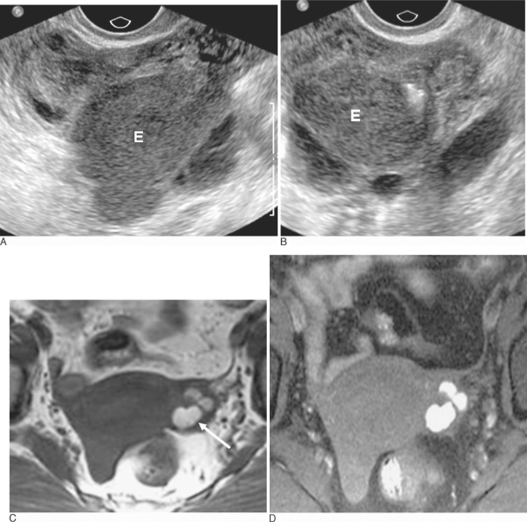
Notes:
Figure 54.21 Endometrioma. Transvaginal US in sagittal (A) and coronal (B) planes demonstrates a complex cystic mass in the left ovary consistent with endometrioma (E in A, B). Although endometriomas can appear similar to haemorrhagic cysts, the irregular contour, homogeneity of the internal echoes and persistence over an extended period favours the diagnosis of endometrioma. Axial T1-weighted (C) and T1-weighted fat-suppressed MR (D) images in a different patient show multiple high signal intensity lesions within the left ovary (arrow, C), suggesting either endometriosis or haemorrhagic cysts. Note how fat suppression increases the conspicuity of haemorrhagic lesions and helps differentiate them from dermoids. Diagnosis of endometriosis was confirmed at surgery.

Slide 6
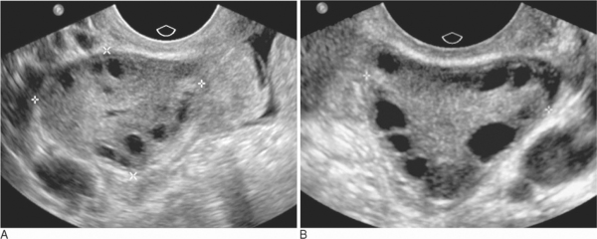
Notes:
Figure 54.22 Polycystic ovaries. Sagittal (A) and transverse (B) transvaginal ultrasound of the left ovary depicting multiple subcentimetre peripherally placed follicles in enlarged ovaries with echogenic central stroma
Polycystic ovarian disease (Stein–Leventhal syndrome)
Polycystic ovarian disease is characterized by bilaterally enlarged polycystic ovaries, secondary amenorrhoea or oligomenorrhoea and infertility. About 50% of patients are hirsute and many are obese. Many cases of female infertility secondary to failure of ovulation are due to polycystic ovarian disease. The classic appearance on ultrasound is enlarged ovaries with echogenic central stroma and greater than 10 peripherally placed cysts less than 9 mm in diameter ( Fig 54.22 ).

Slide 7
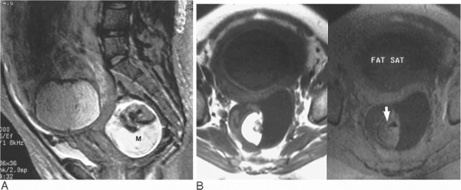
Notes:
Figure 54.25 Ovarian dermoid, intrauterine pregnancy. T2-weighted sagittal (A) and T1-weighted axial (B) MRI. The sagittal image demonstrates a fetus (F) in vertex position. Situated posterior to the uterus in the cul-de-sac is a hyperintense cystic and solid, rounded mass (M). A portion of the mass is high signal on T1-weighted image and falls in signal intensity following a fat saturation pulse (arrow B). This is consistent with fat, allowing the diagnosis of dermoids to be made with confidence.

Slide 8
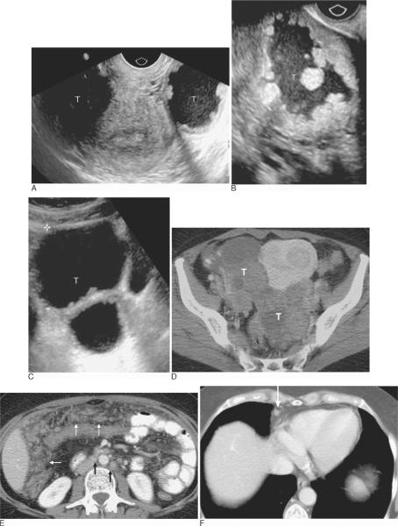
Notes:
Figure 54.27 Bilateral ovarian carcinoma. Transverse (A) transvaginal ultrasound image of the pelvis shows bilateral cystic adnexal masses (T). Sagittal images of right (B) and left (C) ovaries demonstrate cystic mass (T) with mural nodularity (B) and multiple septations (C). MDCT of a different patient shows bilateral complex solid and cystic adnexal masses (T, D), highly suggestive of ovarian carcinoma, and demonstrates the presence of omental tumour implants (white arrows, E). Note also the presence of left para-aortic, interaortocaval (black arrows, E) and superior diaphragmatic (arrow, F) lymphadenopathy.

Slide 9
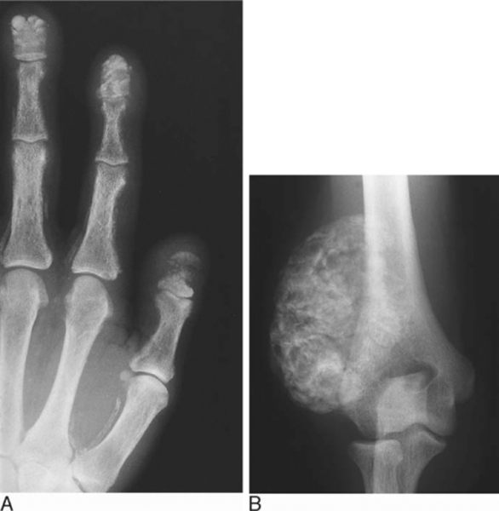
Chronic renal failure (two different cases).
Notes:
Figure 45.7 Chronic renal failure (two different cases). (A) PA hand radiograph showing the florid features of secondary hyperparathyroidism including terminal phalangeal resorption, soft tissue calcification, subperiosteal resorption, vascular calcification and osteopenia. (B) Tumoral calcinosis with heavy periarticular calcification

Slide 10
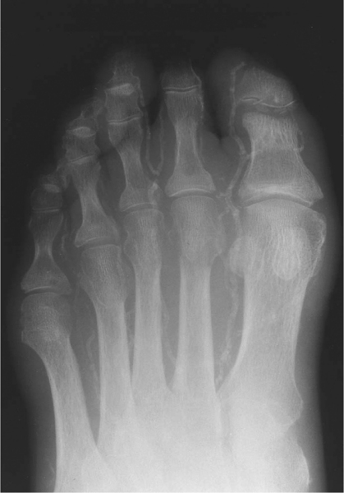

Slide 11
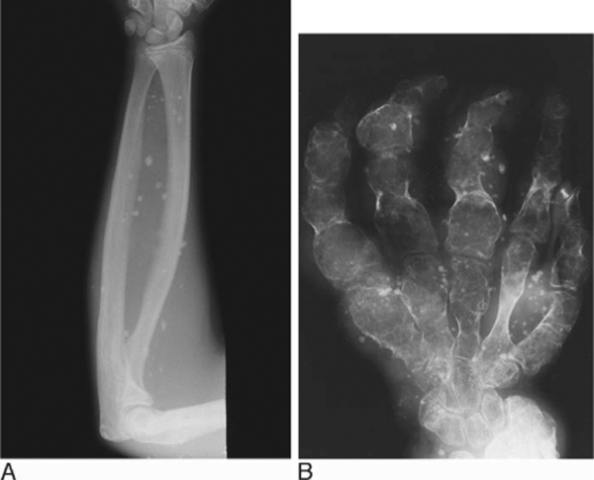
Notes:
Figure 45.8 Arterial calcification. Heavy vascular calcification in a diabetic patient. Resorption of the first and second terminal phalanges due to repeated infection.

Slide 12
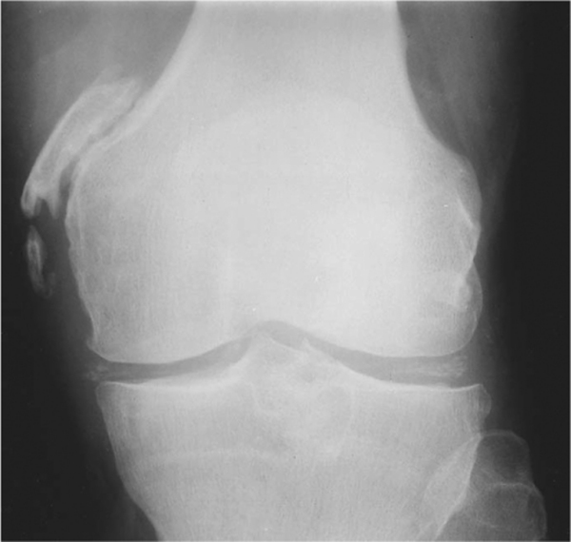
Notes:
Figure 45.12 Chondrocalcinosis of the menisci. Ossification adjacent to the medial femoral condyle indicates old medial collateral ligament injury (Pellegrini–Stieda lesion).

Slide 13
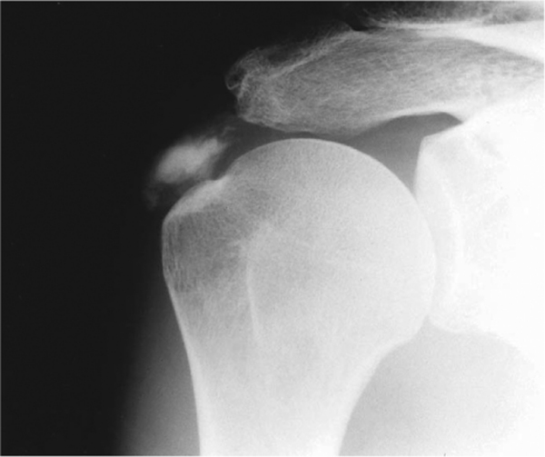
Notes:
Figure 45.13 Calcium hydroxyapatite deposition disease (HADD). Heavy calcification in the distal supraspinatus tendon.

Slide 14
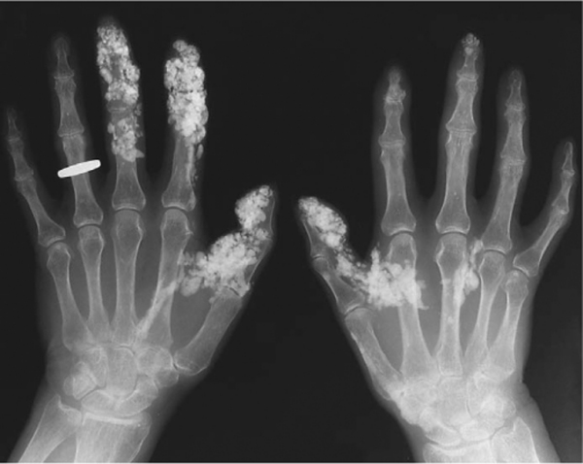
Notes:
Figure 45.14 Scleroderma. Widespread digital calcification (calcinosis circumscripta).

Slide 15
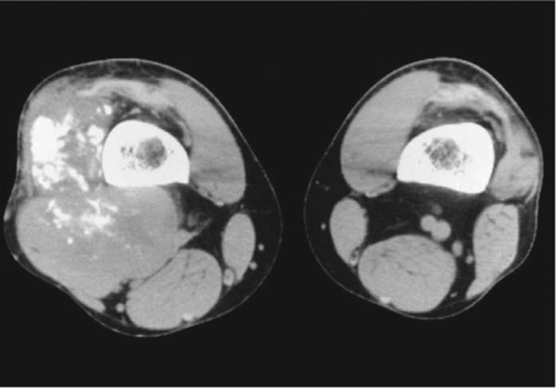
Notes:
Figure 45.15 Synovial sarcoma. Axial CT demonstrating a soft tissue mass lateral and posterior to the femur containing calcifications.

Slide 16
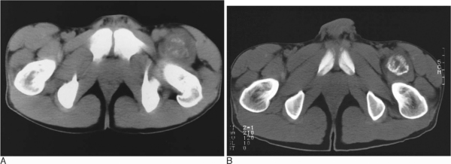
Notes:
Figure 45.17 Myositis ossificans. (A) Axial CT at presentation showing early peripheral mineralization. (B) Six weeks later there has been maturation with well-organized peripheral ossification.

Slide 17
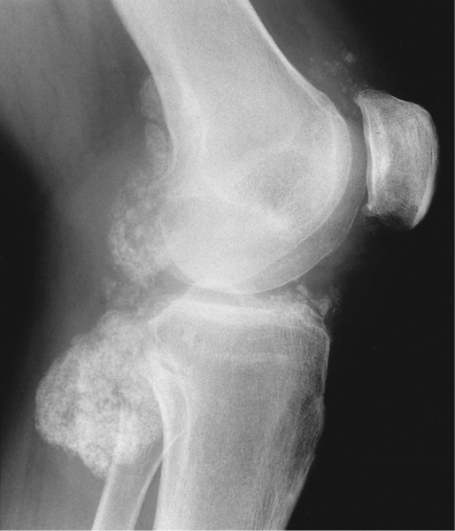
Notes:
Figure 45.23 Synovial osteochondromatosis. Lateral radiograph showing the fine cartilage calcifications of primary synovial osteochondromatosis.

Slide 18
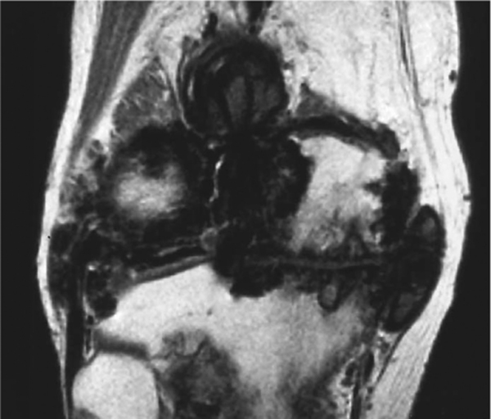
Notes:
Figure 45.24 Pigmented villonodular synovitis (PVNS). Coronal T1-weighted MR image showing dark synovial masses due to haemosiderin deposition against a background of degenerative joint disease.

Slide 19
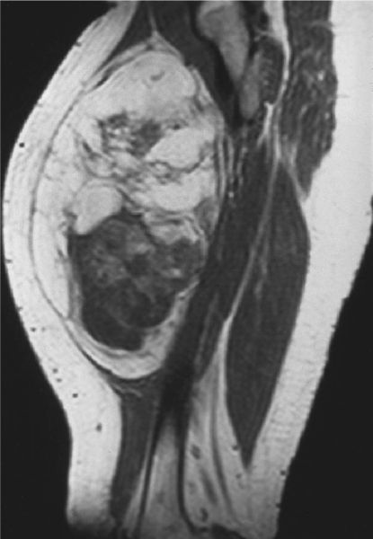
Notes:
Figure 45.25 Low-grade liposarcoma. Sagittal T1-weighted MR image of the thigh showing a heterogeneous mass. The cephalic portion is hyperintense, typical of simple lipoma, whereas the caudal component is isointense with muscle, much more suggestive of sarcoma

Slide 20
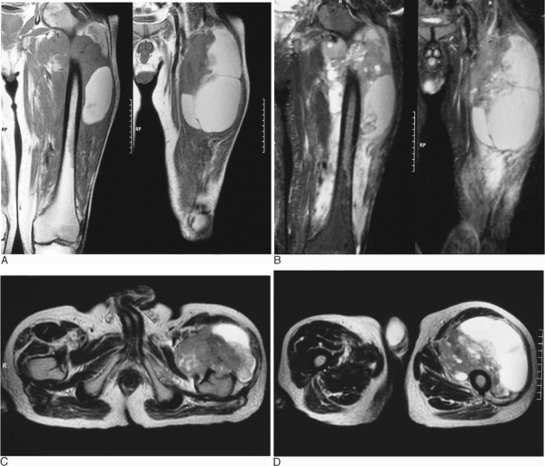
Notes:
Figure 45.28 Necrotic soft tissue sarcoma of the thigh. (A) Coronal T1-weighted images showing a large soft tissue mass with invasion of the proximal femoral diaphysis. The mass shows hyperintense areas either due to subacute haemorrhage or fat. (B) Coronal STIR images. The hyperintense areas in Figure 45.28A do not fat suppress, indicating that this represents haemorrhage and not a lipomatous tumour. (C, D) Two axial T2-weighted fast spin-echo images showing the solid and cystic/necrotic components of the tumour as well as the invasion of the anterior femur.

Slide 21
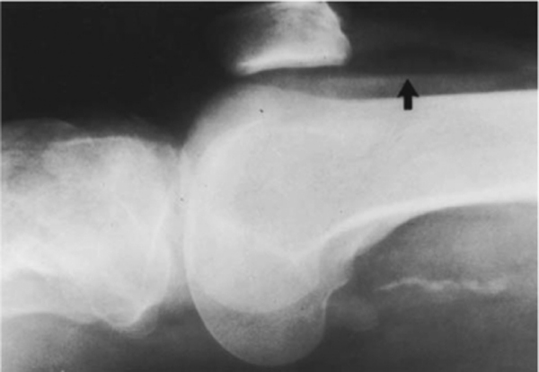
Notes:
Figure 46.1 Lipohaemarthrosis in the knee is seen as a fat–fluid level (arrow) in the suprapatellar recess on a horizontal beam lateral view. This finding is pathognomonic for an acute intra-articular fracture, usually in the tibial plateau.

Slide 22
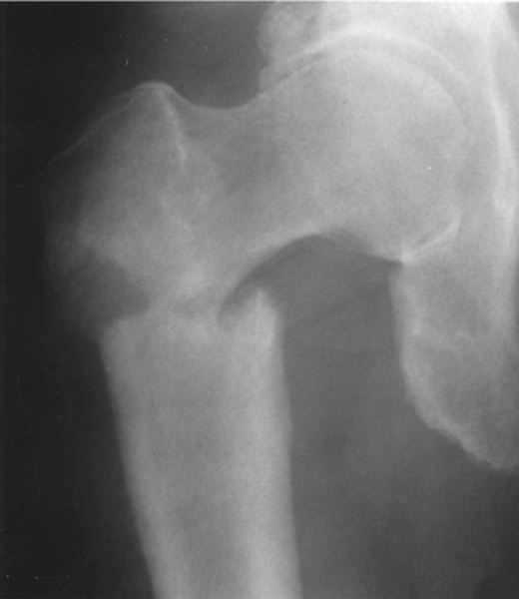
Notes:
Figure 46.2 Pathological ‘banana fracture’. A transverse subtrochanteric fracture of the right femur with varus angulation is demonstrated. A transverse fracture in a long bone, particularly in the subtrochanteric region of the femur, is almost always due to an underlying abnormality. In this case, there is a metastatic lesion in the lateral cortex which led to the fracture.

Slide 23
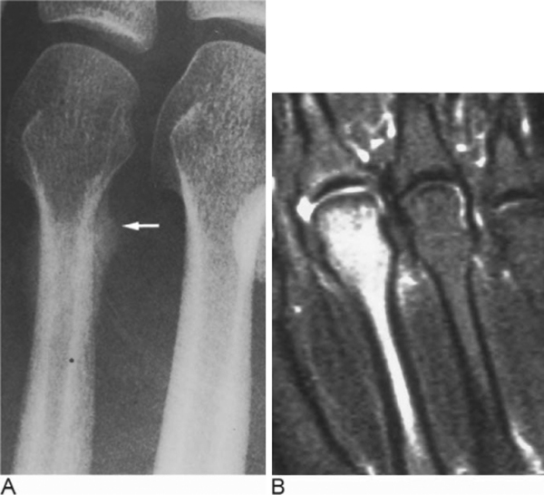

Slide 24
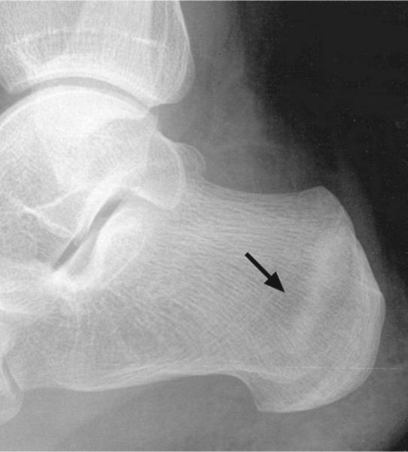
Notes:
Figure 46.3 Calcaneal stress fracture. A lateral view of the calcaneus in a young male runner who complained of heel pain for one month. Note linear sclerosis in tuberosity (arrow) of a stress fracture.

Slide 25
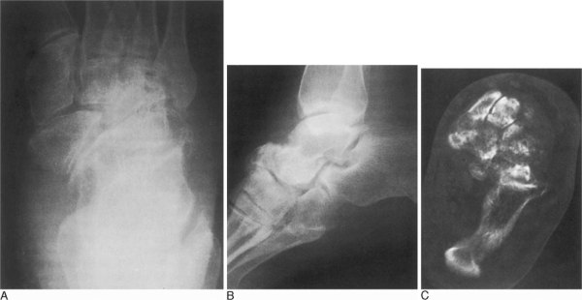
Notes:
Figure 46.4 Neuropathic changes in the foot and ankle. AP (A) and lateral (B) views of the foot in a diabetic demonstrate destructive changes in the midfoot, with multiple fracture fragments. Note the sclerosis and deformity of the navicular, cuboid and lateral cuneiform. The more distal foot demonstrates normal mineralization; because of the lack of sensation, disuse osteopenia is not usually seen. Axial CT in the same patient (C) demonstrates these findings

Slide 26
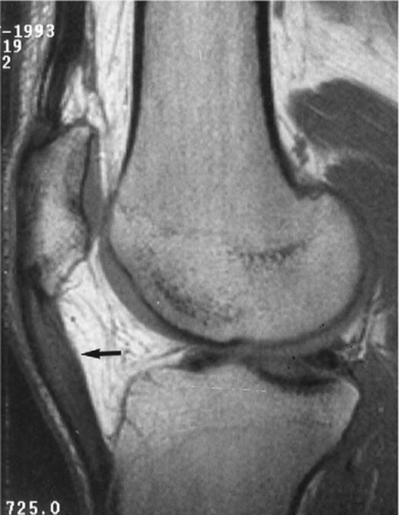
Notes:
Figure 46.5 MRI appearance of tendinitis. Sagittal T1-weighted image of the knee in a professional basketball player demonstrates abnormal signal and increased size in the patellar tendon, consistent with severe tendinitis (arrow). The tendon is normally devoid of signal.

Slide 27
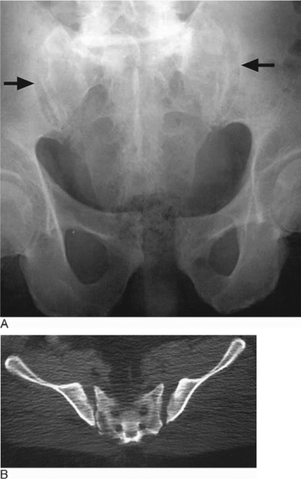
Notes:
Figure 46.10 Open book injury of the pelvis. An AP radiograph of the pelvis (A) demonstrates widening of the sacroiliac joints (arrows) and diastasis of the symphysis pubis. CT of a different patient (B) shows the widening of the sacroiliac joints and the external angulation of the iliac wings.

Slide 28
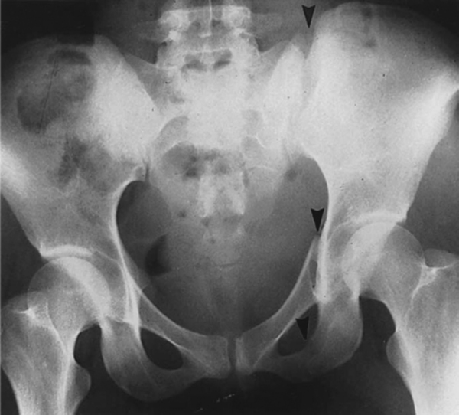
Notes:
Figure 46.11 A Malgaigne fracture. Note fractures in the left superior and inferior pubic rami, and in the posterior portion of the left iliac wing adjacent to the sacroiliac joint (arrowheads). There is superior displacement of the left hemipelvis, including the hip.

Slide 29
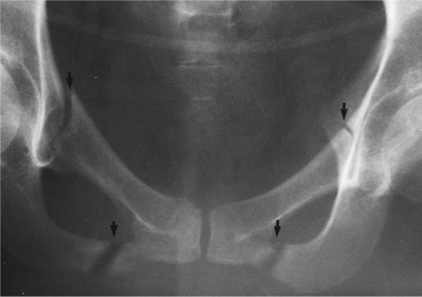
Notes:
Figure 46.13 Straddle injury. There are slightly displaced fractures of the superior and inferior pubic rami bilaterally (arrows), due to a direct blow to the perineum. Such injuries are frequently associated with trauma to the urinary bladder or urethra.

Slide 30
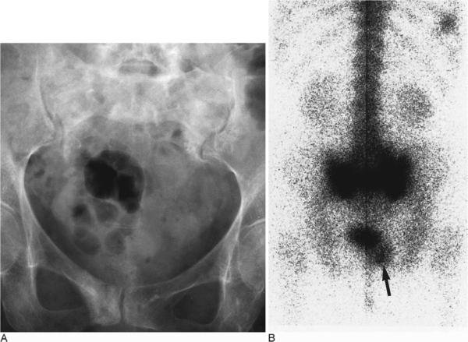
Notes:
Figure 46.16 Insufficiency fracture of the sacrum. An AP radiograph (A) demonstrates sclerosis in the sacral ala paralleling the sacroiliac joints bilaterally. No distinct fracture line is evident. There was also a focus of sclerosis in the right pubis. Spot image from a bone scintigram (B) demonstrates the classic ‘H’ pattern of increased tracer uptake in the sacrum seen in insufficiency fracture. A fracture of the right pubis is also noted (arrow).

Slide 31
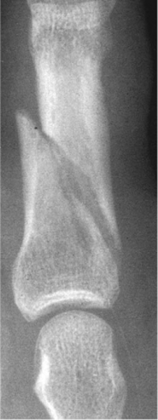
Notes:
Figure 46.18 An oblique fracture of the proximal phalanx of the fourth digit. There is minimal override of the fracture fragments.

Slide 32
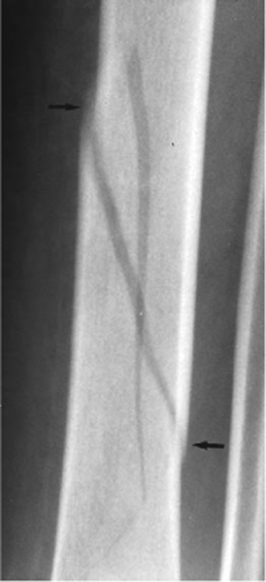
Notes:
Figure 46.19 Spiral fracture. AP projection of the leg demonstrates a spiral fracture of the tibia. Note the sharp ends of the fracture fragments (arrows), which may cause significant soft tissue injury.

Slide 33
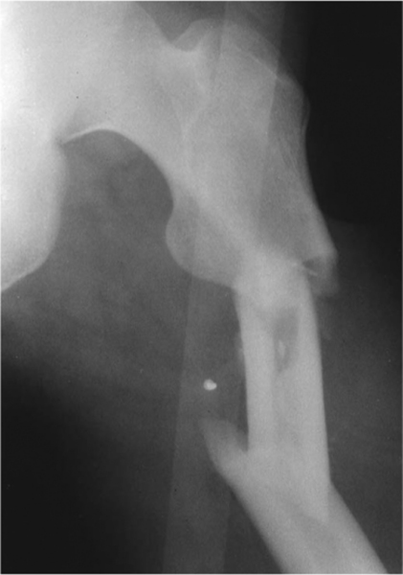
Notes:
Figure 46.20 Segmental fracture. AP view of the left hip demonstrates a three-part fracture of the proximal femoral shaft, due to massive trauma in a motor vehicle accident.

Slide 34
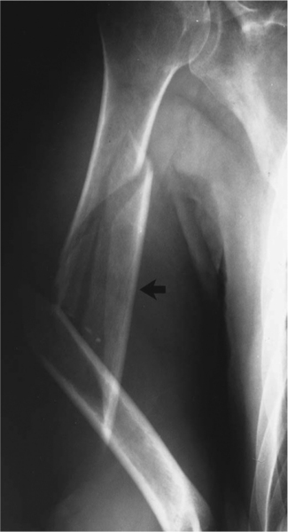
Notes:
Figure 46.21 A comminuted fracture of the midshaft of the right humerus demonstrates a large medial butterfly fragment (large arrow). There is marked lateral angulation at the fracture line between the major fracture fragments.

Slide 35
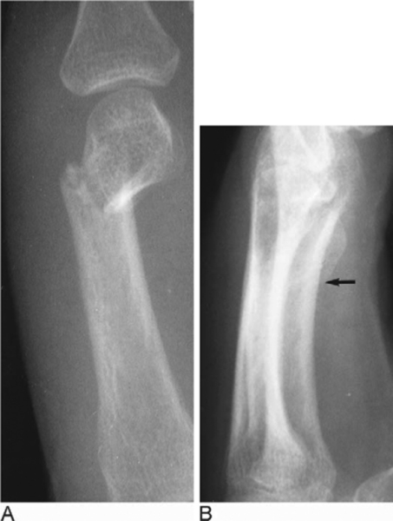
Notes:
Figure 46.23 Angulation of fracture fragments. AP (A) and lateral (B) views of a ‘boxer's fracture’ of the distal fifth metacarpal demonstrates typical radial and volar angulation of the distal fragment (arrow).

Slide 36
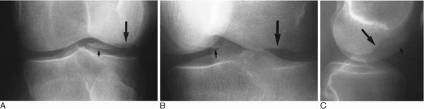
Notes:
Figure 46.27 Osteochondral fracture. AP (A) oblique (B) and lateral (C) views of the knee demonstrate a curvilinear defect in the lateral femoral condyle (arrow) representing an osteochondral injury and the displaced fragment (small arrow) located in the knee joint. Such injuries involve subchondral bone and the overlying cartilage, and are often the result of impaction forces.
An osteochondral fracture is a disruption of articular cartilage and the underlying subchondral bone, usually seen as a curvilinear zone of abnormality at the articular end of a bone

Slide 37
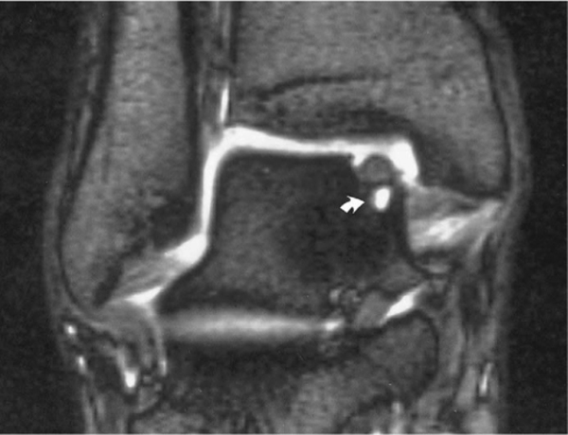
Notes:
Figure 46.28 MRI of an osteochondral fracture. Coronal T2-weighted image of an ankle demonstrates high signal fluid between a fracture fragment in the talar dome and the native talus (arrow). Fluid can track between the fragment and the talus only if the overlying cartilage is disrupted.

Slide 38
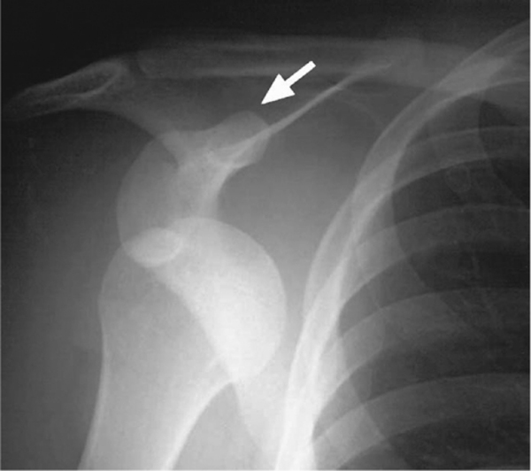
Notes:
Figure 46.31 Anterior (subcoracoid) shoulder dislocation. AP radiograph demonstrates the humeral head located inferomedial to the glenoid, beneath the coracoid process (arrow). This appearance is pathognomonic of anterior dislocation

Slide 39
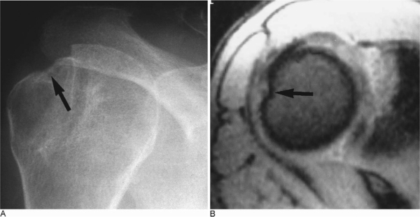
Notes:
Figure 46.32 Hill–Sachs deformity of the humerus. Internal rotation view of the shoulder (A) shows a notch in the posterolateral aspect of the humeral head (arrow). (B) Axial T2-weighted MRI from another patient who previously suffered an anterior shoulder dislocation demonstrates a Hill–Sachs defect (arrow). The Hill–Sachs defect is seen as a notch in the posterolateral humeral head above or at the level of the coracoid process.

Slide 40
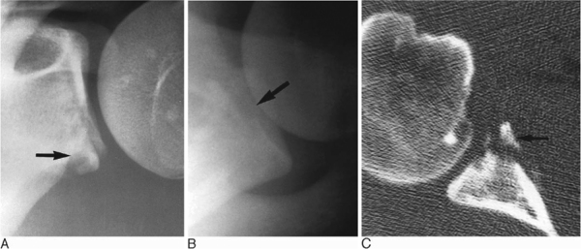
Notes:
Figure 46.33 Bankhart injury of the inferior glenoid rim. AP (A) and axillary (B) radiographs in a patient who suffered an anterior shoulder dislocation show an irregularity in the inferior bony glenoid, consistent with a Bankhart fracture (arrow). The shoulder has been reduced. Axial CT (C) from the same patient shows the relationship of the fragment (arrow) to the glenoid.

Slide 41
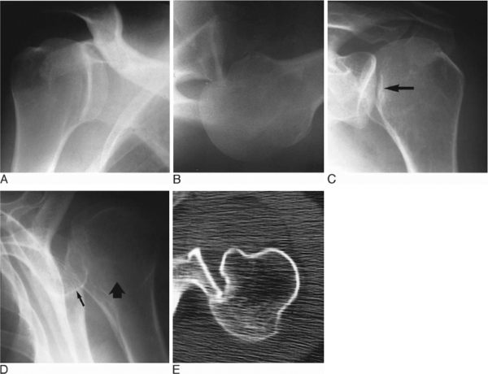
Notes:
Figure 46.34 Posterior shoulder dislocation in a 46-year-old man who was assaulted. Grashey view of the right shoulder demonstrates overlap between the humeral head and the glenoid fossa without significant craniocaudal displacement. Axillary view from a different patient (B) shows impaction of the humeral head on the posterior rim of the glenoid; this leads to (C) the ‘trough sign’ seen on an AP radiograph (arrow). Trans-scapular radiograph from a third patient shows posterior dislocation of the humeral head (large arrow) relative to the glenoid (small arrow). CT (E) from the patient in (D) shows impaction of the anterior humeral head on the posterior glenoid.

