Slide 1
SPOTS

Slide 2
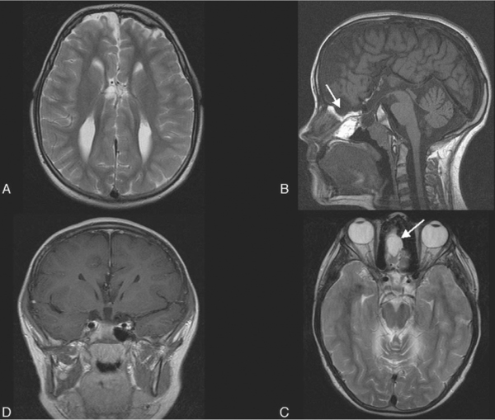
Notes:
Figure 70.13 Callosal agenesis. (A) Axial T2-weighted MRI shows separated ventricles with parallel orientation. The superior part of the third ventricle is just seen. (B) Sagittal T1-weighted MRI through the midline confirms callosal agenesis. There is no cingulate sulcus and the vertically oriented cerebral sulci extend right down to the third ventricle. This finding is associated with other midline anomalies such as a fronto-ethmoidal cephalocele (arrow), seen also on the axial T2-weighted MRI (arrow, C). (D) The optic chiasm is absent.

Slide 3
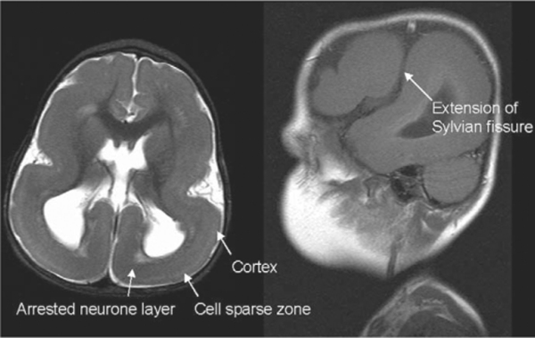
Notes:
Figure 70.15 Classical with lissencephaly. This child was ‘floppy’ at birth and then had developmental delay, seizures, and strabismus. MRI shows a smooth gyral pattern which is slightly more developed frontally in keeping with classical lissencephaly (LIS1 mutation). The cerebral cortex is generally thin and there is a band of arrested neurones deep to the ‘cell sparse zone’. The Sylvian fissures are vertically oriented and extend into a vertical cleft.

Slide 4
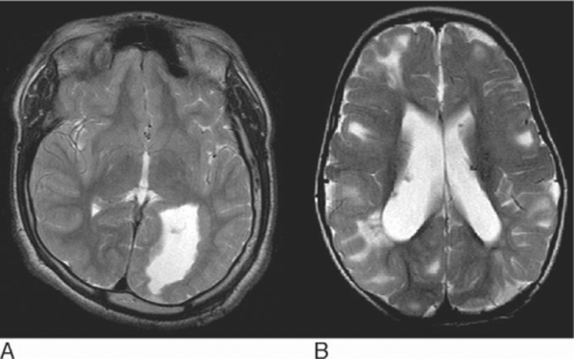
Notes:
Figure 70.16 Subependymal grey matter heterotopia (A) and subependymal hamartomas of tuberous sclerosis (B). (A) Multiple subependymal continuous ‘nodules’ running along the ventricular margin with signal intensity isointense to grey matter. (B) Scattered nodules which project into the ventricles and with variable signal intensity. Some are markedly hypointense in keeping with calcification. Note also the multiple regions of cortical and subcortical white matter abnormality with slight mass effect in keeping with cortical tubers.

Slide 5
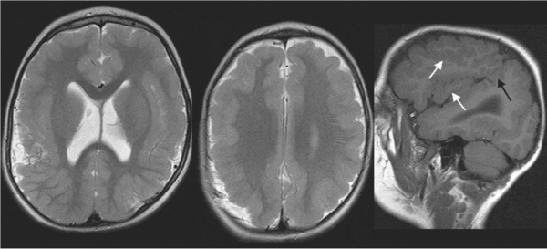
Notes:
Figure 70.17 Extensive bilateral cerebral hemisphere polymicrogyria. Virtually no normal cortex is seen. At first glance the cortex appears thickened but closer inspection reveals an overconvoluted gyral pattern and a ‘lumpy bumpy’ grey–white matter interface (including regions marked by white arrows). The Sylvian fissure is abnormally oriented with a parietal cleft that extends posteriorly (black arrow).

Slide 6
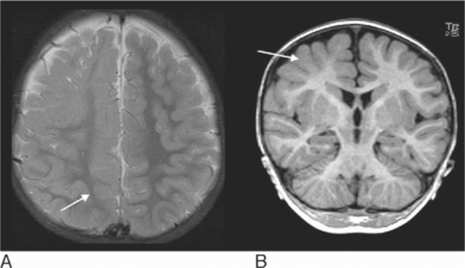
Notes:
Figure 70.18 Child with focal seizures and right fronto-parietal lobe cortical dysplasia. (A) Axial T2-weighted MRI shows blurring of the right frontal grey–white matter junction and more extensive associated white matter signal hyperintensity involving most of the hemisphere, including the parietal lobe at this level (arrow). (B) Coronal T1 SPGR image (part of the volumetric dataset) also shows grey–white matter junction signal abnormality (arrow) and more subtle white matter change.

Slide 7
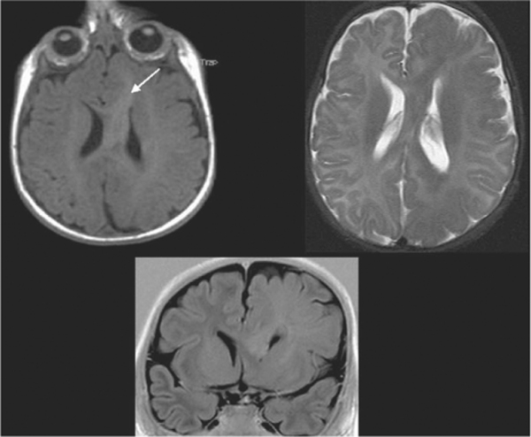
Notes:
Figure 70.19 Hemimegalencephaly with overgrowth and enlargement of the left cerebral hemisphere. There is thickening of the cortex with broad, thickened gyri, underdeveloped sulci, and extensive white matter signal abnormality. Note the typical appearance of the frontal horn and genu of the corpus callosum, which is straight and points anteriorly (arrow).

Slide 8
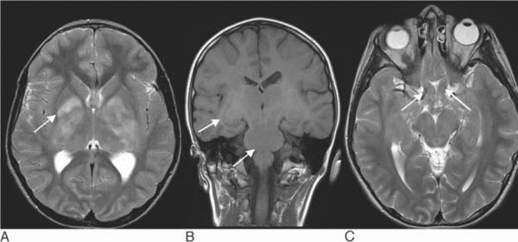
Notes:
Figure 70.20 Child with neurofibromatosis type 1 (NF1). (A,B) There are very characteristic lesions within the lentiform nuclei, brainstem, and midbrain, the so-called ‘hamartomatous’ lesions or ‘unidentified bright objects’ of NF1 (arrows). They are hyperintense on T2-weighted imaging, with minimal mass effect. Basal ganglia lesions may demonstrate some T1 shortening, as in this case, or are hypointense on T1-weighted imaging. (C) There are also bilateral optic nerve gliomas extending into the optic chiasm (arrows).

Slide 9
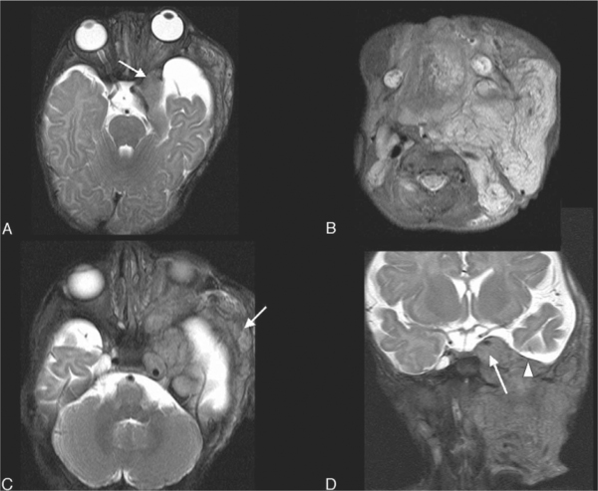
Notes:
Figure 70.21 Infant with neurofibromatosis type 1. The diagnosis was made from these images. (A) There is sphenoid wing dysplasia causing expansion of the middle cranial fossa (arrow) and absence of the lateral orbital wall, which causes the ‘bare orbit’ sign (arrow) on AP plain radiographs. (B) There is an associated extensive plexiform neurofibroma involving the deep and superficial fascial spaces of the neck, tongue, and orbit. (C,D) This is almost indistinguishable on imaging from multiple cranial nerve fibromas involving the left cavernous sinus (arrows) and middle cranial fossa. Note the neurofibroma has extended through the foramen ovale and is elevating the dura, seen as a black line (arrowhead).

Slide 10
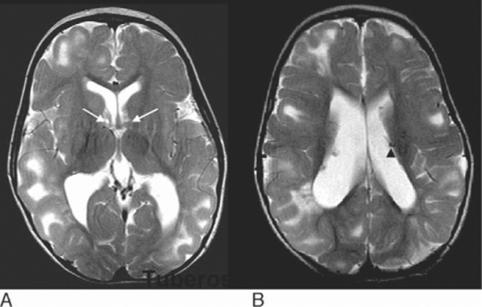
Notes:
Figure 70.22 Intracranial manifestations of tuberous sclerosis. (A) Multiple tubers involving the cortex and subcortical white matter. Bilateral lesions are seen at the foramina of Monro, in keeping with giant cell astrocytomas (arrows). (B) Subependymal nodules project into the ventricles, some of which are markedly hypointense, in keeping with calcification (arrowhead).

Slide 11
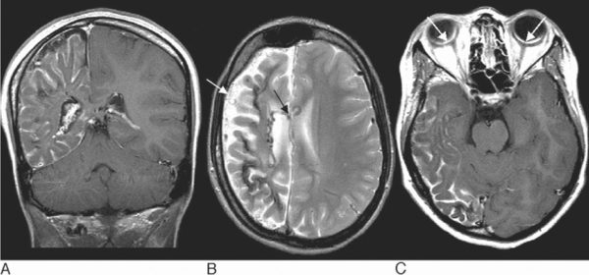
Notes:
Figure 70.23 Sturge–Weber syndrome. (A) Coronal T1 post-contrast image shows an enhancing pial angioma overlying the right cerebral hemisphere which is atrophic. The right choroid plexus is enlarged. Foci of signal hypointensity within the gyri and adjacent white matter are due to calcification. (B) Axial T2-weighted image shows in addition prominent superficial cortical veins and ependymal veins (arrows). (C) Axial post-contrast T1-weighted image shows bilateral choroidal angiomas (arrows) in addition to the pial angioma

Slide 12
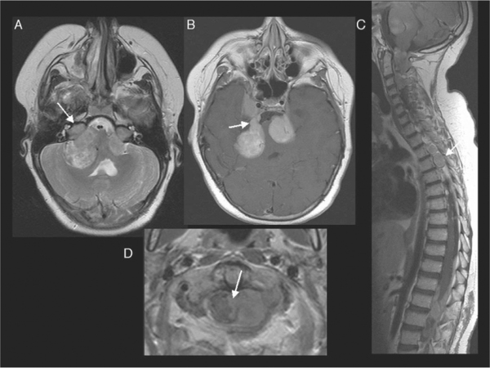
Notes:
Figure 70.24 Neurofibromatosis type 2 (NF2). (A) Bilateral cerebellopontine angle masses extending into the internal auditory meati and causing expansion (arrow) in a child with NF2 and bilateral acoustic neuromas. (B) Trigeminal schwannomas extending into the cavernous sinus on the right. The arrow indicates the cisternal segment of the right trigeminal nerve. (C) Sagittal T1-weighted images show expansion of the neural exit foramina by enhancing nerve or nerve sheath tumours (arrow). (D) Axial image shows a mainly dural mass extending out through the neural foramen with a small intradural component (arrow).

Slide 13
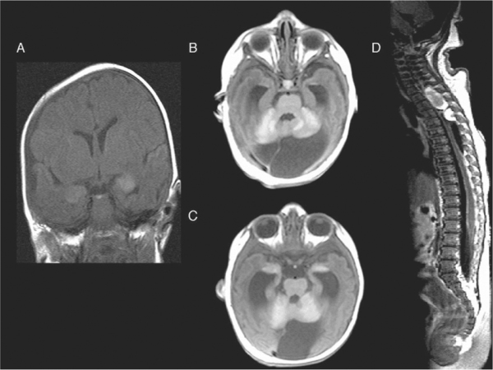
Notes:
Figure 70.25 Child with giant pigmented naevus and neurocutaneous melanosis. (A) Initial coronal T1-weighted MRI shows the typical regions of T1 shortening within the amygdalae of the mesial temporal lobes. (B,C) Axial T1-weighted MRI obtained 2 years later shows hydrocephalus in addition to the regions of melanin deposition within the mesial temporal lobes and cerebellum. These do not show any enhancement. There is a posterior fossa arachnoid cyst, a described association. (D) Within the spine there is diffuse pial enhancement over the spinal cord in addition to focal haemorrhagic and partly enhancing extramedullary lesions, indicating malignant melanoma, which was subsequently confirmed histologically

Slide 14
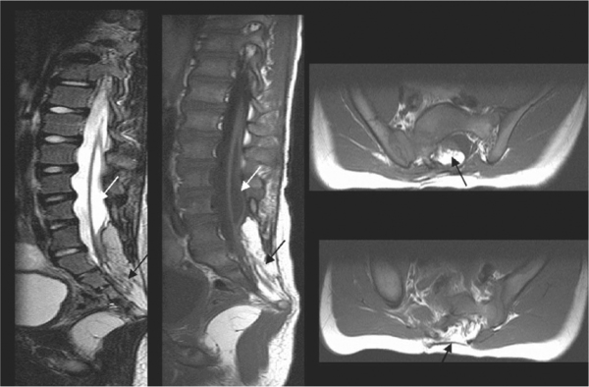
Notes:
Figure 70.27 Closed spinal dysraphism. The spinal cord is too low and the neural placode terminates at the lumbosacral junction in a lipomyelocele (black arrows). There is an associated spinal cord syringomyelic cavity (white arrows). The posterior elements are deficient and everted.

Slide 15
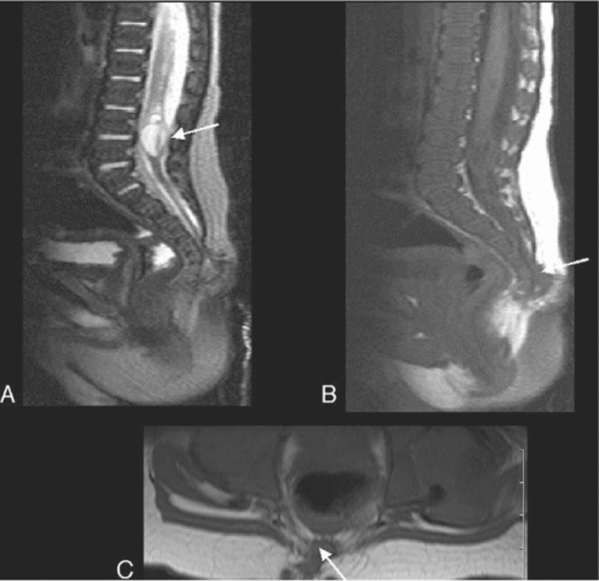
Notes:
Figure 70.28 Dorsal dermal sinus. (A) The termination of the spinal cord is very low and there is a syringomyelic cavity with internal septations. In addition there is a more focal cyst within the conus confirmed at surgical untethering to be a dermoid cyst (arrow). (B,C) There is an associated dermal sinus track (arrows).

Slide 16
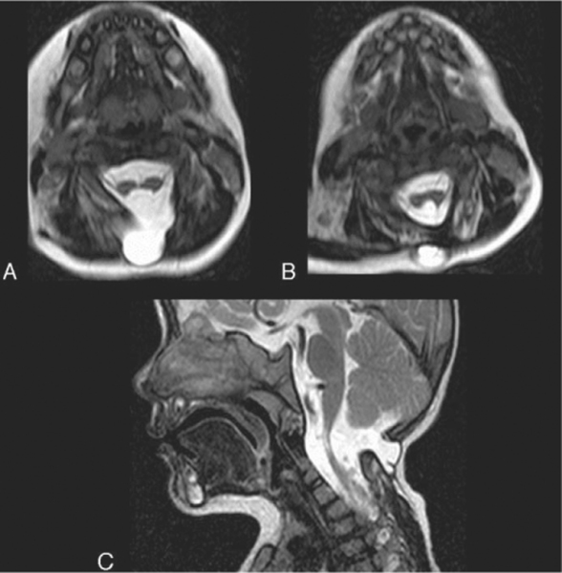
Notes:
Figure 70.29 Cervical spinal cord diastematomyelia type II with associated craniocervical meningocele. (A) Sagittal T2-weighted MRI appears to show signal abnormality and thinning of the spinal cord, and is the clue to the diastematomyelia seen on the axial images. (B,C) Axial T2-weighted MRI shows that the cord has split into two hemicords. The apparent signal abnormality is in fact normal cerebrospinal fluid interspersed between the two hemicords. These re-unite inferiorly. The meningocele is seen herniating through a bony defect in the vertebral posterior elements.

Slide 17
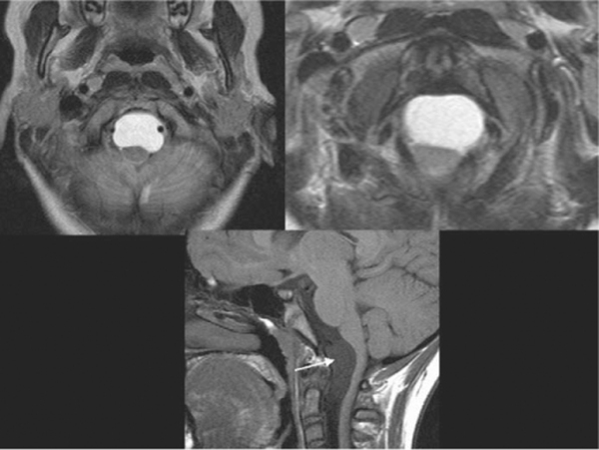
Notes:
Figure 70.30 Neurenteric cyst ventral to the medulla and upper cervical spinal cord, displacing them posteriorly, and with the vertebral arteries displaced around it. The cyst is hyperintense on the T2-weighted images and there is also some mild T1 shortening (arrow).

Slide 18
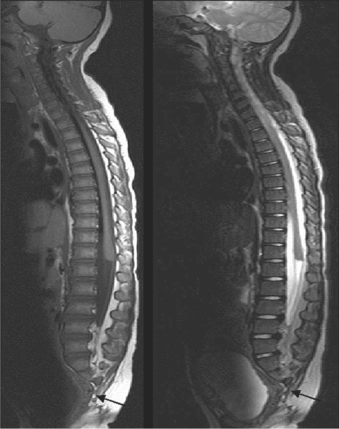
Notes:
Figure 70.31 Caudal regression syndrome. The spinal cord is truncated with a typical blunt edge seen at the inferior margin of T12. The thecal sac terminates at the superior margin of L4. The sacrum distal to S2 is agenetic (arrows).

Slide 19
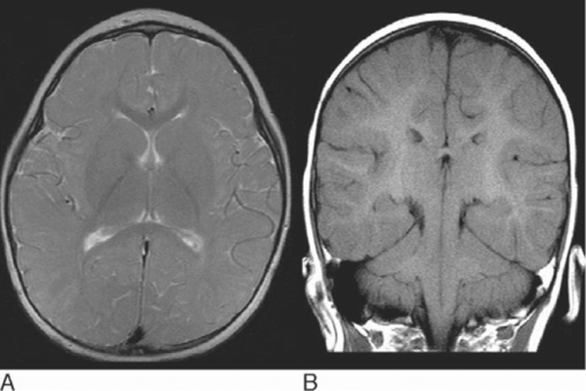
Notes:
Figure 70.32 Pelizaeus Merzbacher disease in a 2 year old child with nystagmus and developmental delay. (A) Axial T2-weighted image shows dark regions of myelination in the posterior limbs of the internal capsules, splenium, and genu of the corpus callosum, and within the parieto-occipital lobe white matter. The rest of the cerebral hemispheres are not myelinated (the white matter is too bright). This pattern is severely delayed and equivalent approximately to an age of 6 months. (B) Paradoxically coronal T1-weighted MRI shows much more advanced myelination which appears virtually complete, with T1 shortening extending right out into the subcortical white matter.

Slide 20
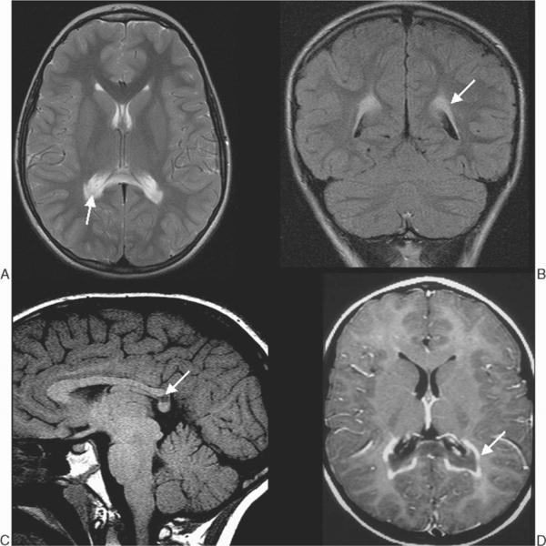
Notes:
Figure 70.33 Adrenoleuko-dystrophy. MRI of a 6 year old boy with increasing gait disturbance and impaired vision demonstrates peritrigonal and splenial signal abnormality (increased signal on T2-weighted images and low signal on T1-weighted images), and (A,B,C, arrows) marginal enhancement at the leading edges where there is active inflammation, typical of adrenoleukodystrophy (D, arrow).

Slide 21
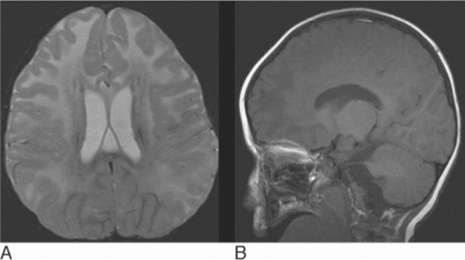
Notes:
Figure 70.34 Child with Alexander's disease. Head circumference charts showed the child had macrocephaly. (A) Axial T2-weighted MRI shows extensive bilateral symmetrical deep and subcortical white matter signal hyperintensity with a frontal predominance and mild swelling. (B) Sagittal T1-weighted MRI shows corresponding low signal in the affected areas without evidence of cavitation but in keeping with oedema.

Slide 22
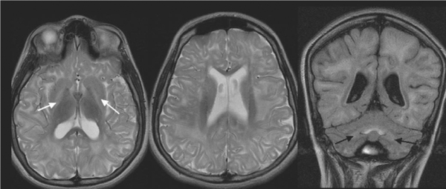
Notes:
Figure 70.35 l-2 hydroxyglutaricaciduria axial T2-weighted MRI. Coronal FLAIR and show extensive white matter signal hyperintensity involving mainly deep and subcortical white matter but with relative sparing of the periventricular white matter, and bilateral pallidal involvement. The dentate nuclei are also abnormal.

Slide 23
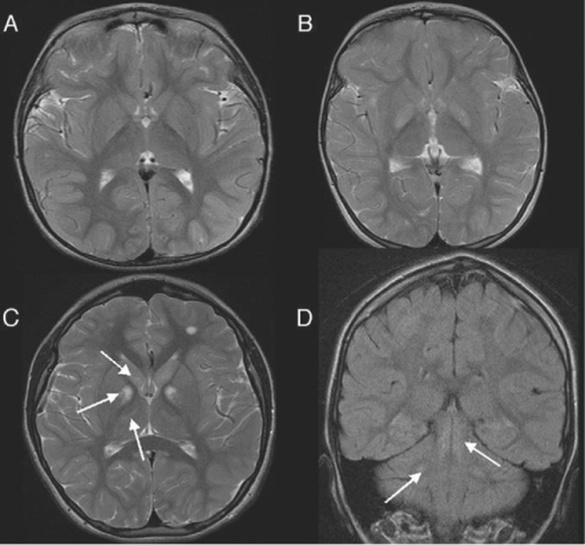
Notes:
Figure 70.36 Examples of signal abnormality affecting both globus pallidi. (A) Kernicterus. (B) Methylmalonicacidaemia. (C) Kearns–Sayer syndrome. This child also has hyperintense signal in both caudate nuclei and thalami, left frontal white matter and (D) Dorsal midbrain and cerebellar dentate nuclei (arrows).

Slide 24
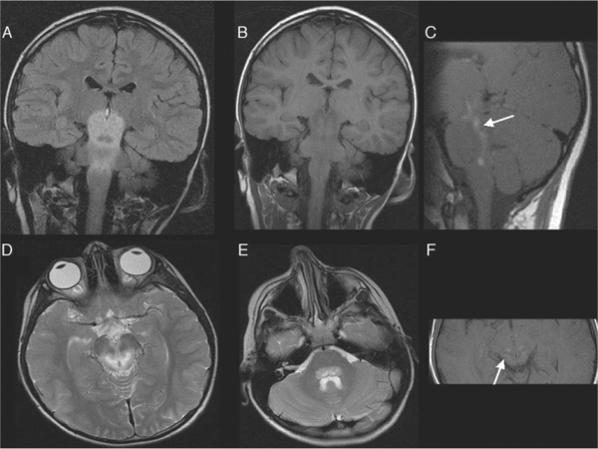
Notes:
Figure 70.37 Leigh's disease. There is bilateral symmetrical signal hyperintensity on the coronal FLAIR (A) and axial T2 images (D), (E) matched by hypointensity on the coronal T1-weighted MRI (B) affecting the midbrain, pons, and medulla. Symmetrical contrast enhancement (C), (F) indicates breakdown of the blood–brain barrier in keeping with active disease.

Slide 25
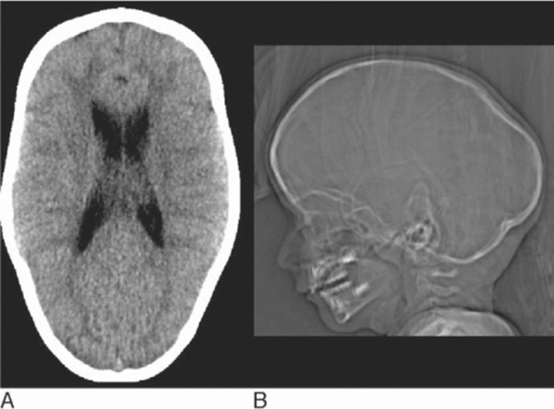
Notes:
Figure 70.38 Sagittal synostosis. (A) Brain CT and (B) lateral scout view showing the typical ‘boat-shaped’ skull or scaphocephaly of sagittal synostosis

Slide 26
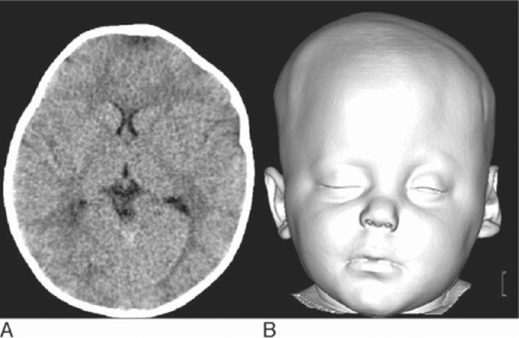
Notes:
Figure 70.39 Unicoronal synostosis. (A) Axial CT and (B) 3D surface-shaded reformat show the asymmetrical head shape of left frontal plagiocephaly due to unicoronal craniosynostosis, with bossing seen on the right side.

Slide 27
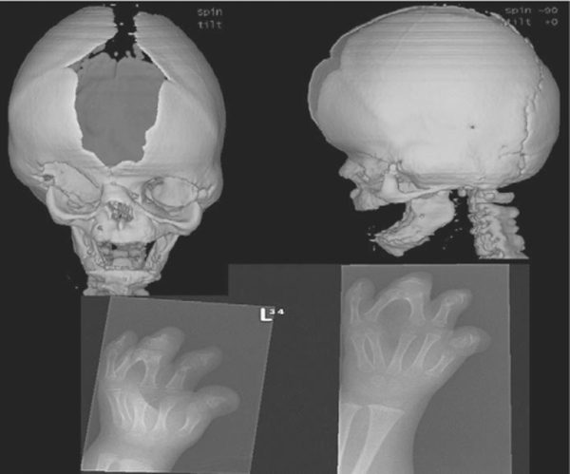
Notes:
Figure 70.40 Apert's syndrome. (A,B) 3D CT surface-shaded display shows the wide open defect of the sagittal suture and brachycaphaly with bicoronal synostosis typical of Apert's syndrome. The coronal sutures appear fused and are ridged. (C,D) Plain radiographs of the hands show the ‘mitten hand’ appearance with syndactyly and shortened metacarpals.

Slide 28
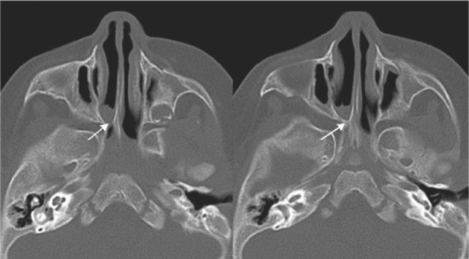
Notes:
Figure 70.41 Choanal atresia. Axial skull base CT in a child with chronic nasal discharge shows right-sided choanal atresia. There is bony narrowing of the funnel-shaped posterior right choana down to a bony bridging bar (arrows) and pooling of secretions proximally.

Slide 29
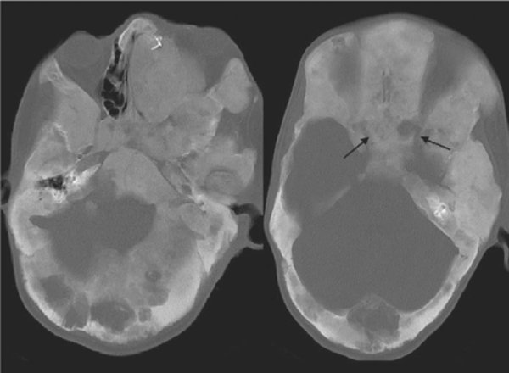
Notes:
Figure 70.42 Polyostotic fibrous dysplasia with diffuse calvarial expansion, mixed lytic lesions, and sclerosis. The optic nerve canals are markedly narrowed (arrows).

Slide 30
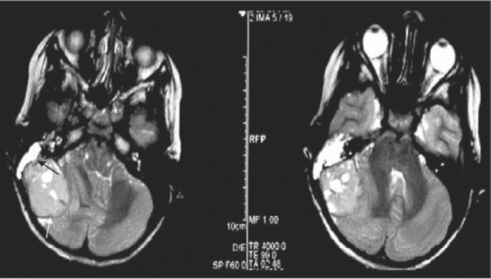
Notes:
Figure 70.43 Ewing's sarcoma. This unusual posterior fossa tumour is also hypointense on the T2-weighted images but it is extradural. The dura is seen as a hypointense layer around the tumour and it erodes the right petrous bone. There are retained mastoid secretions. This was a Ewing's sarcoma of the skull base.

Slide 31
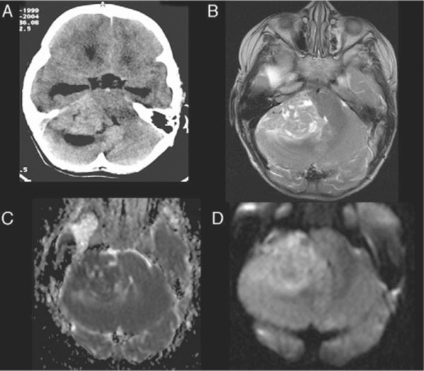
Notes:
Figure 70.44 Medulloblastoma. (A) CT and (B–D) axial T2, ADC, and diffusion MRI show a mixed solid and cystic mass within the right cerebellopontine angle encroaching on the pons and fourth ventricle and causing hydrocephalus. The solid component is hyperdense on CT, hypointense on the T2-weighted sequence, and demonstrates restricted diffusion in keeping with a cellular tumour. Despite some less typical features, such as lateral site (more usually seen in older patients and associated with the desmoplastic variant) and cystic components, on the basis of the signal characteristics this was correctly diagnosed as a medulloblastoma.

Slide 32
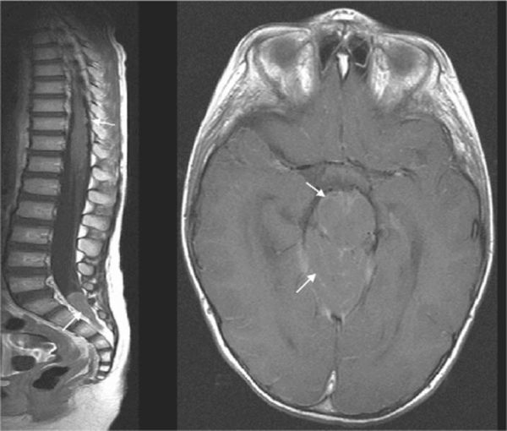
Notes:
Figure 70.45 Medulloblastoma. Same patient as in Figure 70.44 with posterior fossa medulloblastoma has evidence of disseminated metastatic disease. There is nodular enhancement over the conus medullaris and a mass within the thecal sac in addition to pial enhancement over the midbrain and cerebellar folia (arrows).

Slide 33
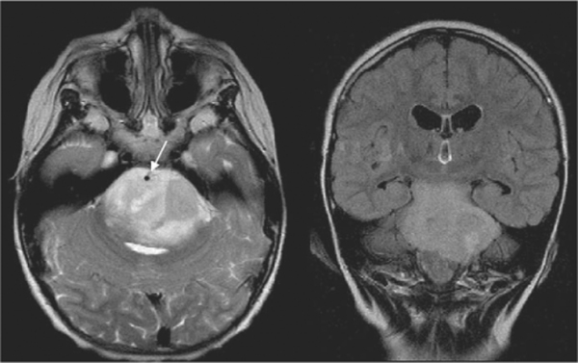
Notes:
Figure 70.48 Diffuse brainstem astrocytoma. Note the mass effect within the pons distorting the fourth ventricle and the encasement of the basilar artery (arrow).

Slide 34
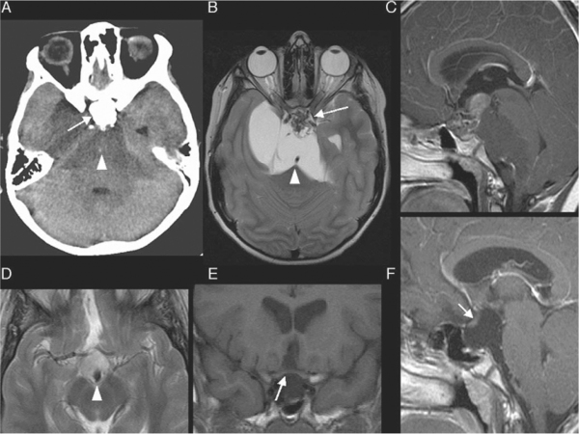
Notes:
Figure 70.49 Craniopharyngiomas in two children. (A–C) The first child has a large suprasellar, pre-pontine and middle cranial fossa tumour which is causing considerable mass effect on the brainstem and is encasing the basilar artery (arrowheads). There are solid enhancing and calcified components (arrows). The cystic components are of higher density on CT and there is T1 shortening on MRI in keeping with proteinacous contents. (D–F) The second child has a smaller suprasellar lesion, which is also calcified (arrowhead). The optic chiasm is clearly separate from the lesion and is draped over the top (E,F).

Slide 35
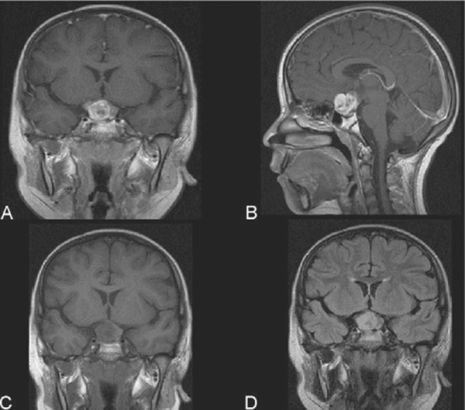
Notes:
Figure 70.50 Hypothalmic–optic pathway glioma. (A) Coronal T1-weighted, (B) sagittal, and (C) coronal enhanced T1-weighted MRI, and (D) coronal FLAIR show an optic chiasm glioma. The chiasm is not identified separately from the tumour.

Slide 36
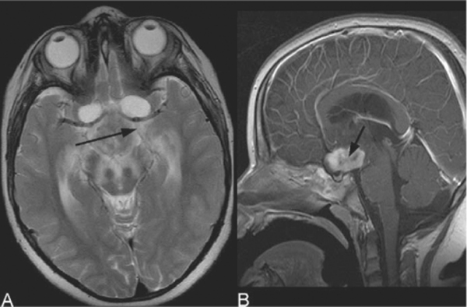
Notes:
Figure 70.51 Langerhans' cell histiocytosis. (A) Axial T2-weighted image. (B) Sagittal T1-weighted post-contrast image. Suprasellar T2 hypointense and enhancing mass (arrows) with associated oedema extending superiorly along white matter tracts in a child with multisystem Langerhans' cell histiocytosis.

Slide 37
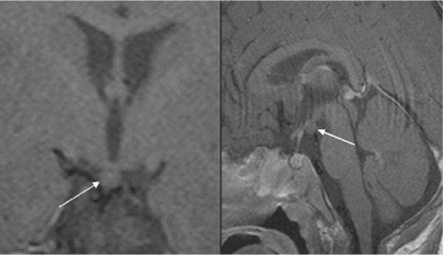
Notes:
Figure 70.52 Hypothalamic hamartoma. Coronal T1 and sagittal T1-weighted post-contrast MRI shows a nonenhancing lesion arising from the floor of the third ventricle posterior to the pituitary infundibulum and projecting inferiorly into the suprasellar cistern (arrows).

Slide 38
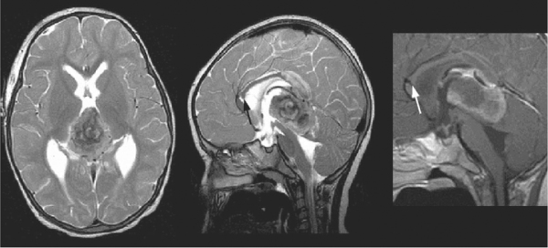
Notes:
Figure 70.53 Pineoblastoma. (A) Axial, (B) sagittal T2-weighted fast spin-echo, and (C) enhanced sagittal T1-weighted MRI in a 2 year old girl show a pineal region tumour effacing the tectal plate. The hydrocephalus is treated by a frontal extraventricular drain (track through the genu of the corpus callosum marked by the arrows). The tumour is hypointense on the T2-weighted images with rings of lower signal consistent with calcification and haemorrhagic products, and peripheral rim enhancement, and was confirmed as a pineoblastoma

Slide 39
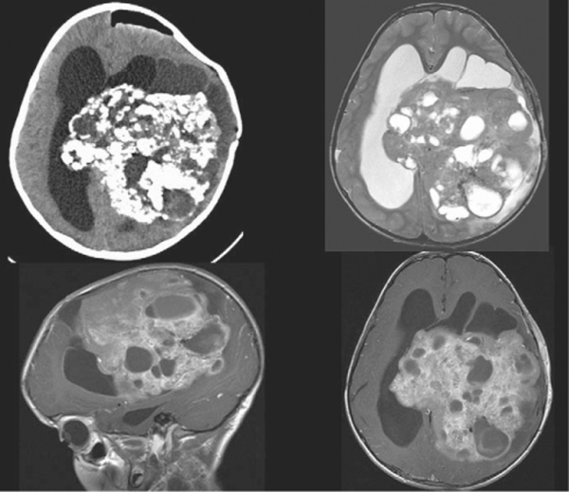
Notes:
Figure 70.54 Supratentorial grade II ependymoma. The left cerebral hemisphere tumour extends across the midline into the right ventricle. (A) CT (post partial debulking) shows it is heavily calcified and (B–D) MRI (axial T2 enhanced, sagittal T1 and axial T1-weighted MRI) show a mixed cystic and solid heterogeneously enhancing tumour. There is associated hydrocephalus

Slide 40
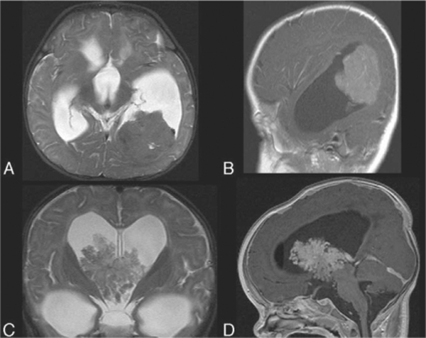
Notes:
Figure 70.55 Choroid plexus tumours. (A,B) Axial T2, enhanced sagittal T1-weighted MRI in a boy aged 6 months demonstrate a lobulated homogeneously enhancing intraventricular tumour with relative T2 hypointensity, in keeping with a highly cellular tumour closely related to the choroid plexus. The ependyma is enhancing and the interface between tumour and adjacent brain is indistinct. Histology confirmed the tumour to be a choroid plexus carcinoma and this was subsequently embolized before surgery. There is a communicating hydrocephalus which may be due to increased cerebrospinal fluid production or to proteinaceous/haemorrhagic exudate. (C,D) A different child with choroid plexus papilloma. Choroid plexus tumours although commonly seen within the trigone of the lateral ventricle may arise from anywhere within the ventricular system. This child has a frondy choroid plexus papilloma arising within the third ventricle and extending superiorly through the foramina of Monro. In this case the hydrocephalus was obstructive.

Slide 41
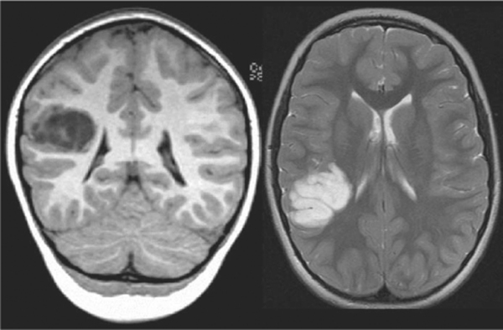
Notes:
Figure 70.56 Dysembryoplastic neuroepithelial tumour (DNT) in a child with long-standing refractory focal epilepsy referred to the epilepsy surgical programme. Several MRI examinations over 3 years had shown no change in the appearances of this right inferior parietal lobe lesion. The lesion is well-defined, cortically based, extends towards the ventricular margin, and has the typical lobulated internal architecture of DNT.

