Slide 1
DARK ROOM AND CHEMICAL PROCESSING
Dr. Pushpender singh Guide : Dr. Sagar Maheshwari Sir

Slide 2
DARKROOM
A darkroom is a place where the necessary handling and processing of film can be carried out safely and efficiently, without the hazard of producing film fog by accidental exposure to light rays.

Slide 3
DARK ROOM
Dark room is more accurately known as the “Processing Room”. It forms a very important part of radiography, such that radiography begins and ends here.
It has two sides:
wet side
Dry side
* film handling
* loading
* unloading
* Processing
Manual
automatic

Slide 4
DRY SIDE OF DARK ROOM
The shelves: For storing the films and film boxes. They should be away from tanks containing chemicals and from the entrance, preferably behind the door.
The film boxes should be set vertically, not one over the other.
Pass Box: To transfer the films
Other apparatus like-
Light proof storage bin for unexposed film
Drying devices
Film hangers of proper size

Slide 5
WET SIDE OF DARK ROOM
Processing tanks
It has ready mixed processing chemicals.
Two stirring paddles one each for developer and fixer.
Thermometer to determine temperature of the solutions.

Slide 6
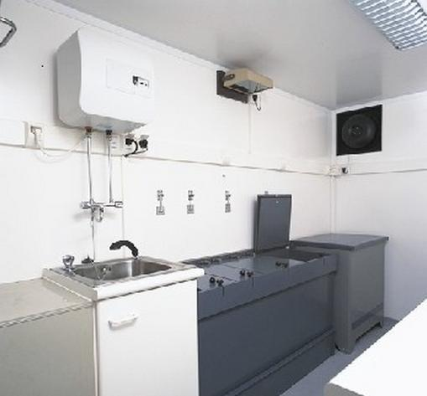
DARKROOM DESIGN

Slide 7
LOCATION
Decided during planning of the department.
Convenient placement in relation to radiographic room
No windows to make the room light proof.
Readily accessible to plumbing and electric service.

Slide 8
SIZE OF THE DARKROOM
It should be smaller than 9 msq.in area.
The ceiling should not be less than 2.7m in height and preferably not more than 3.3m

Slide 9
LEAD SHIELDING IF ADJACENT TO X-RAY ROOM
Walls b/w the darkroom and adjoining x-ray rooms should contain enough lead thickness of atleast 1.6mm(1/16 inch) of lead in the walls all the way to the ceiling.

Slide 10
ENTRANCE
Light proof, to prevent light exposure to the film.
Two way revolving door type is the ideal type in which two
cylinders are present.
The outer cylinder has two entry gates in it on opposite sides and the inner one has one gate.

Slide 11
REVOLVING DOOR- Advantage is it does not require a large floor area.

Slide 12
DOUBLE DOOR

Slide 13
MAZE or LABYRINTH TYPE- dis adv- occupies a large floor area.

Slide 14
DARK ROOM EQUIPMENT
Dark room has the following.:-
Cassette hatches
Film hangers
Light proof storage bins
Safelight
Processing tanks
Drying devices

Slide 15
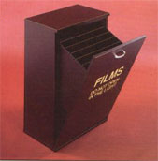
LIGHT PROOF STORAGE BINS
It is used to store
Unused films.
Vertical partitions
Subdivide the bin to
Accommodate film
Boxes of different sizes.

Slide 16
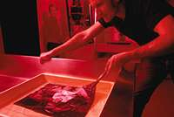
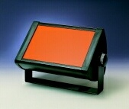
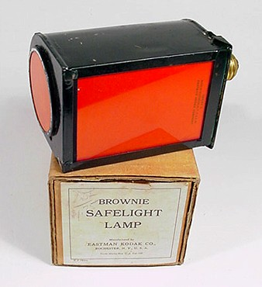
SAFELIGHT
Provides adequate illumination under processing condition but does not fog the film.

Slide 17
HOW DOES A SAFE LIGHT WORK..
When a white light is passed through colored filters , certain wavelengths(or colors )are absorbed by the filters, whilst those wavelengths which correspond to the color of the filters will be transmitted.

Slide 18
SAFELIGHT HAS THREE BASIC PARTS
Lamp housing:- This holds the bulb and filter.
Safelight filter:- This absorbs light of some colors and transmits light of others to varying degrees.
The bulb:- 25 W pearl lamp is the recommended standard.

Slide 19
SAFELIGHT FILTERS..
It consists of a gelatin dyed to the appropriate color and sandwiched between two sheets of glass for protection.

Slide 20
TYPES OF SAFE LIGHTING..
Direct safe lighting:- light from the safe lamp falls directly onto the work surface. Such illumination should be sited a minimum distance of 1.2 m (4ft) from the working surface. It is the best lighting for film loading and unloading areas.

Slide 21
INDIRECT LIGHTING..
It is intended to provide general illumination of the darkroom. The safe lamp directs the light towards ceiling, which consequently should be painted in light color in order to reflect light back into the room.

Slide 22
RED FILTER-- KODAK GBX-2 for most blue and green sensitive medical and dental x-ray films.

Slide 23
FACTS ABOUT SAFE LIGHT..
No safe light provides completely safe exposure for an indefinite period of time.
Safelight filters are designed for specific types of paper and film.
Safelight filters fade with use.
Poor safelight conditions can produce a loss in radiographic quality before actual fogging is visible

Slide 24
INTENSITY OF THE UNDESIRABLE WAVELENGTHS TRANSMITTED BY THE FILTER IS INCREASED BY..
Using too small a safelight to film distance(intensity increased due to inverse square law)
Using too high a wattage lamp inside the safe light(a 25 W pearl lamp sited a minimum of 1.2m from the film is the recommended standard)

Slide 25
HOW SAFE IS SAFE LIGHTING?
Safe lighting is not completely safe; as all films will become significantly fogged if exposed to safe light for long time.
This is because safelight filters are not perfect absorbers of the undesirable wavelengths.
So the intensity of illumination and film handling should be kept to a minimum if significant fogging is to be prevented.

Slide 26
SAFE FILM HANDLING TIME.
Safe film handling time is defined as the maximum time for which a film can be exposed to the safelights during the procedure without causing any appreciable degree of fogging.

Slide 27
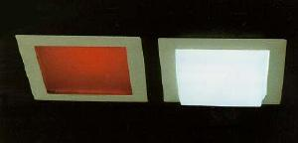
WHITE LIGHT IS USED FOR:
EQUIPMENT REPAIR AND DARKROOM CLEANING

Slide 28
Stages in production of radiograph
Exposure
Development
Wash
Fixing
Washing
Dry

Slide 29
Types of processing:
Manual
Automatic :
with replenisher
without replenisher

Slide 30
Differences between manual and automatic processing
No stop bath between developer and fixer
Hardner is placed in developer
Additional hardner is added to fixer solution
Dark room is not required
Automated processor is used in form of processing rollers hence dry to dry process.

Slide 31
MANUAL PROCESSING TANKS
The simplest type has three compartment tank
One end compartment being used for developing and the opposite one for fixing.
The middle compartment serves both to rinse and wash the films and should be supplied with running water.

Slide 32
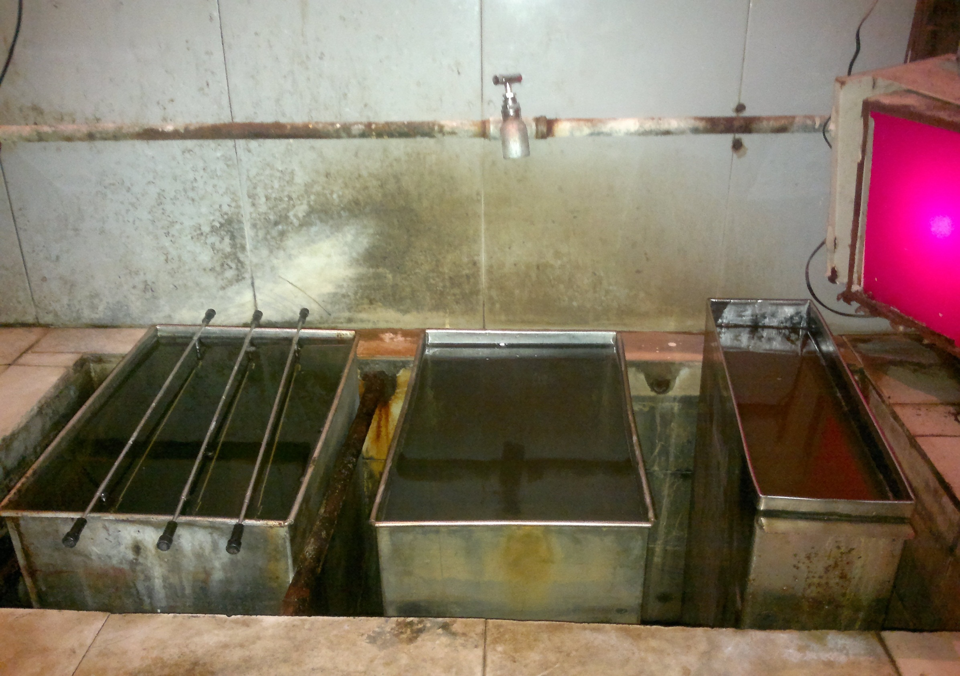

Slide 33
SIZE OF MANUAL PROCESSING TANK
3 PARTS
Development
Tank
1
Fixing tank
2
Washing tank
4
The ratio of size of tanks is 1:2:4

Slide 34
MANUAL PROCESSING TANK
It is insulated outside to prevent condensation of water and to maintain temp inside.
Thermostatically controlled warm or refrigerated water (depending on the weather) should be circulated around the processing tank to maintain optimum temp.

Slide 35
Film Base
Supports the emulsion and provides the correct degree of stiffness for handling purposes.
It is composed of either cellulose acetate or
polyester, both of which are transparent and blue- tinted.
Cellulose acetate
Dissolving cotton in acetic acid makes cellulose acetate which is then dissolved in a volatile solvent containing blue dye.
The solution of cellulose acetate is poured onto huge heated drums where it solidifies to a thickness of about 0.008 inch.

Slide 36
(2) Polyester.
The dimethyl-terebthalate (DMT)
DMT + ETYLENE GLYCOL
POLYSTER
ADV OF POLYESTER
1 increased dimensional stability
2 much stronger than acetate

Slide 37
EMULSION
Formed by silver bromide and gelatin
Silver bromide crystal.
In the early stages of emulsion manufacturing,
silver nitrate +potassium bromide
silver bromide crystals + potassium nitrate.
The potassium nitrate is then washed out and the result is a silver bromide crystal consisting of bound atoms of silver and bromide.
In medical film
- 99 % - AgBr
- 10 % - AgI
Crystal size of silver halide 1 – 1.5 microns

Slide 38
REMOVAL OF FILM FROM CARTON
Always remove the film slowly.
Rapid movement can cause a build-up of static electricity.
Careful handling will prevent many kinds of marks on the film
LOADING
The film is placed in the bottom of the cassette on the front intensifying screen.
The lid carrying the back screen is gently closed and locked by means of the back springs.
Avoid scraping or sliding the film over the edges of the cassettes or the surface of the screen.

Slide 39
HANDLING and STORAGE OF XRAY FILMS
Unexposed and unprocessed x-ray film should always be kept in a cool, dry place.
It should never be stored in basements or near steam pipes or other sources of heat.
High temperatures damage the emulsion, causing fog and lack of contrast
Ideal storage conditions prevail at temperatures of 50º to 75ºF with relative humidity of 40 to 60 percent

Slide 40
PRESSURE
Should never be subjected to extreme pressure such as wrinkling, bending, or rolling, because changes take place in the emulsion, which, upon development, appear as tree-like artefacts on the finished film.
To avoid pressure markings, packages of unexposed film should always be stored on edge; they should never be stacked one upon another.
All film should be used before its expiration date

Slide 41
PRODUCTION OF THE LATENT IMAGE
When the x-ray film emulsion is sensitized during manufacture, the SILVER BROMIDE crystals are left in a state of suspended animation awaiting the x-ray stimulus to start them on their way to becoming a radiographic image.
The potentiality for this activity exists in the tiny sensitization "specks" at the surface of the crystal
which are actually SILVER SULFIDE coumpound
When x-ray exposure occurs, the latent image is produced.

Slide 42
AgBr + silver sulphide
( sensitivity speck)
When exposure of film to light from intensifying
Screen or to direct action of x ray , energy from photon is trapped by BROMIDE ION
BROMIDE ION loose electron
Br ion + photon Br atom + electron

Slide 43
Electron trapped by silver sulphide
Which become negatively charged
Attracts Ag ion and give electrons to them
Ag ion + electron Ag atom
This process is repeated many times
Crystal in which sensitivity specks has acquired Ag atoms during exposure remain invisible and constitute LATENT IMAGE

Slide 44
CHEMICAL DEVELOPER CONTAINS
PHENIDONE
HYDROQUINONE
ACCELERATOR
BUFFER AGENT
PRESERVATIVES
RESTRAINERS
HARDENERS
SEQUESTERING AGENT
FUNGICIDE
ANTI FROTHANT

Slide 45
DEVELOPER ACTIVITY DEPENDS UPON
PH
TEMPERATURE
EVAPORATION
OXIDATION
PROCESSING BYPRODUCTS (BROMIDE)

Slide 46
DEVELOPEMENT
Process that amplifies the latent image by a factor of
millions to form a visible silver pattern .
Activator
The activator (or alkali), SODIUM CARBONATE, softens the gelatin
And provides the necessary alkaline medium so that the reducing agents can diffuse into the emulsion and attack the exposed silver bromide crystals.
Other alkalies used are SODIUM HYDROXIDE , SODIUM TETRABORATE
In general, the more alkaline the developer, the more powerful and rapid is its action.

Slide 47
DISADVANTAGE OF SODIUM CARBONATE
When a film is processed in an x-ray developer containing it and then transferred to a warm acid-fixing bath, tiny bubbles of carbon dioxide gas may form in the soft gelatin.
As the bubbles escape, they form tiny craters or pits in the emulsion, thereby breaking up the normal character of the silver image. The finished film or radiograph is blistered.
To overcome this effect, the temperature of the developer, rinse, and fixer solutions should be approximately the
same.

Slide 48
Reducers
The latent image site provides a place where the reducers accomplish the process of breaking down the silver bromide crystal to black metallic silver.
The reducing agents act as electron donors to the latent image site.
Thus the positively charged silver ions may move into the areas of the sensitivity speck and become attracted to it.
As this process continues, more silver ions are attracted and deposited as atoms of silver. The final result is the formation of black silver crystal

Slide 49
Reducing agents
ElonTM (another tradename is MetolTM) and hydroquinone.
The activity of these chemicals requires their presence in an alkaline solution.
ElonTM is unpredictable above 75ºF and hydroquinone ceases its activity below 60ºF.
The activity of the hydroquinone is slower, but it serves to build up the black tones required in the image.
Reducers are not too stable in the presence of oxygen, which they can readily absorb from the air , hence developer should always be kept covered.

Slide 50
Basic chemical reaction in development process
DEVELOPER (HYDROQUINONE) + SILVER ION
alkaline solution
OXIDISED DEVELOPER (quinone) + SILVER ATOM + HYDROGEN ION

Slide 51
WETTER
FOR CHEMICALS TO PENETRATE THROUGH GELATIN EMULSION
PHENIDONE
PRODUCES GRAY SHADES RAPIDLY ON RADIOGRAPH
HYDROQUINONE
PRODUCES BLACK SHADES SLOWLY ON RADIOGRAPH

Slide 52
ACCELERATOR
OXYGENATES THE SOLUTION TO SPEED UP DEVELOPMENT(TOO MUCH PRODUCES GRAINY IMAGE)
BUFFER
CONTROLS pH, MAINTAINS ALKALINITY.

Slide 53
RESTRAINER
If the restrainer is omitted, the reducers are hyperactive and break down the unexposed crystals, fogging the film.
If the film is left in the developer too long, the reducers will override the restrainer and chemical fog will result
POTASSIUM BROMIDE

Slide 54
HARDENER
CONTROLS EMULSION SWELLING, PROTECTS FILM FROM PROCESSING ARTEFACT
SEQUESTERING AGENT
COUNTERACTS ADVERSE EFFECTS OF METALLIC IMPURITIES, CALCIUM AND IRON
STABILISES DEVELOPING AGENTS

Slide 55
PRESERVATIVE.
SODIUM SULFITE
Sulphite removes oxygen from air dissolved in solution or at the surface of solution , before it has time to oxidise the developing agent.
Sodium sulfate works very well as a preservative because it retards oxidation of the reducing agents and prevents the formation of stains on the film.
Oxidation Products of reducing agent (which can stain the emulsion) react with sulphite to form colourless SULPHONATE.

Slide 56
RINSING PROCESS
When the film is removed from the developer, the gelatin emulsion is swollen and like a sponge, saturated with all the soluble chemicals of the developer solution.
Also, the gelatin contains the black metallic silver image and unexposed, undeveloped silver bromide crystals.
The bulk of the soluble developer chemicals should be removed from the film before it is placed in the fixing bath and these chemicals replaced by either fresh or acidified water.
Such treatment is necessary
1 to stop the reaction of development,
2 to neutralize the alkalinity of the residual developer, and
3 to remove the oxidation products of development.
There are two methods of removing these chemicals--rinsing the film in fresh water and rinsing the film in acidified water

Slide 57
ACID RINSE BATH
Acid rinse baths (dilute solution of acetic acid in water) prolong the life of the fixer and ensure maintenance of the hardening action.
An acid rinse bath eliminates the need for running water (required by a water rinse bath).
The bath immediately stops development of the emulsion and neutralizes the alkali in the developer contained in the emulsion.
Radiographs should be rinsed in the acid bath for 30 seconds but they may be left in the bath for as long as one and one-half minutes.
Do not overwork the acid rinse bath. When the activity of the solution is reduced, it will accentuate stains and streaks.

Slide 58
FIXER
FIXING AGENT
BUFFERING AGENTS
PRESERVATIVES
HARDENERS
SEQUESTERING AGENTS
SOLVENT

Slide 59
FIXER SOLUTION
The fixer has four chemical agents: an acidifier, a clearing agent, a hardener, and a preservative.
All are mixed with water, which serves as the solvent.
Acidifier
ACETIC ACID
Neutralizes any alkaline developer that may be carried over from the developing solution
The acidifying action quickly stops development and prevents formation of stains.

Slide 60
Clearing Agent
SODIUM THIOSULFATE OR AMMONIUM
THIOSULFATE
The unexposed crystals have of course, been unchanged by the developer.
Unexposed silver bromide crystals will darken on exposure to light and obscure the radiographic image.
Since the gelatin is still swollen and porous, the clearing agent dissolves out the unexposed and undeveloped silver bromide emulsion without damage to the silver image
These chemicals are commonly known as "hypo."
SODIUM OR AMMONIUM THIOSULFATE
+
SILVER BROMIDE
SILVER THIOSULFATE
(remains in solution)

Slide 61
Hardener
PLATINUM ALUM, CHROME ALUM, OR ALUMINUM
CHLORIDE
Decreases the possibility of physical injury to the gelatin emulsion.
A swollen emulsion is easily scratched or distorted during the washing and drying process.
The hardener restrains swelling of the gelatin and hardens it so that it can withstand the normal effects of processing like preventing further swelling of gelatin post fixing.

Slide 62
Preservative
SODIUM SULFITE
prevents decomposition of the clearing agent by the acid with a resultant precipitation of sulfur, as long as normal developing temperatures are maintained.
It assists in clearing the film and prevents the residual developer carried over in the film from oxidizing and discoloring the fixing bath

Slide 63
FIXER CONT..
BUFFER
-ACETATE
-CORRECTS PH
SEQUESTERING AGENT
REMOVES ALUMINIUM IONS
SOLVENT
WATER DISSOLVES OTHER COMPONENTS

Slide 64
WASHING PROCESS
Proper washing ensures the permanence of radiographs.
The object being to remove residual chemicals and silver salts from the film.
If these are not removed, the image will discolor or fade, eventually stain (brown stain of silver sulfide), and the entire film may deteriorate.
This is especially true when the radiographs are stored under conditions of high temperature and humidity.
As the fixing solution nears the exhaustion point, the concentration of silver salts becomes so high that the washing process should be more thorough at this time.

Slide 65
Normally x-ray films are washed in running water circulated so that the entire emulsion area and every portion of the wash tank receive frequent changes. In tank processing,the bar of the hanger and the top clips should always be covered by the water.

Slide 66
DEVELOPING X RAY FILM
PROCESSING SOLUTION STIRRED BEFORE PROCESSING
FILM PLACED IN SOLUTION AND AGITATED BRIEFLY TO REMOVE BUBBLES
FILM LEFT IN DEVELOPER FOR 5 MIN AT 68 º F

Slide 67
RELATION BETWEEN TEMP AND DEVELOPING
BELOW 60 º F - CHEMICALS ARE SLUGGISH CAUSING POOR DEVELOPING AND FIXING
ABOVE 75 º F -CHEMICALS WORK TOO RAPIDLY CAUSING FOGGING AND SWELLING OF EMULSION

Slide 68
FORMS OF DEVELOPING CHEMICALS
LIQUID- MORE CONVENIENT
POWDER-MAY DISSEMINATE DUST THROUGH THE ROOM

Slide 69
DEVELOPING SOLUTION MUST BE COVERED WHEN NOT IN USE TO REDUCE OXIDATION
REPLACED EVERY 3 MONTHS AS GELATIN SLUDGE AND IMPURITIES ACCUMULATE
IT FIRST TURNS YELLOW, THEN BROWN(INDICATES EXHAUSTION)

Slide 70
FILM QUICKLY REMOVED FROM DEVELOPER IN 1 MOTION AND AND PLACED IN POST DEVELOPER WATER RINSE
DRIPPING BACK OF SOLUTION IN DEVELOPER TANK SHOULD BE AVOIDED

Slide 71
CLEARING AND FIXING X RAY FILM
15 SEC
AGITATED TO AVOID STREAKING AND STAINING OF X RAY
68 F

Slide 72
FINAL WASHING
RUNNING WATER AT 68 F
ADEQUATE WASHING PREVENTS DISCOLORATION
20 TO 30 MIN

Slide 73
VENTILATION
Air condition is the preferred method.
In a small dark room exhaust fan may be used.

Slide 74
HUMIDITY
40-60%
> 60%--FILM FOG
<40% STATIC ARTIFACTS

Slide 75
TEMPERATURE
50-70 º F for film storage– to slow down the aging process of the film

Slide 76
DRYING DEVICES
Help speed up the drying of films.
Driers are available as enamel or stainless steel cabinets provided with a heating element and blower fan.
DRYING TAKES LONGER IF DEVELOPING DONES AT HIGH TEMP DUE TO SWELLING OF THE EMULSION

Slide 77
FILM FOGS
Fog is the generalized darkening of the film which is due to development of unexposed silver halides crystals that do not contain a latent image.
causes are-
Due to exposure to light.
Exposure to x-rays or other radioactive elements.

Slide 78
Chemical fog :CAUSES: Overdevelopment, development at high temperature, deteriorated/oxidized developer.
Age fog: Outdated and inadequately stored films.

Slide 79
STAINS
Discolorations appearing on a Radiograph at different stages of processing.
Brown stains- oxidized developer
Variegated color pattern- inadequate rinsing
Grayish yellow or brown- excessive fixation
Grayish white scum- incomplete washing

Slide 80
MARKS AND DEFECTS-
Crinkle marks d/t acute bending of the film.
Static marks are lightning or tree like black marks on the film, caused by static electricity d/t friction b/w the film and other objects.
Water marks caused by water droplets on the film surface which leave round dark spots of various sizes because of migration of silver particles.

Slide 81
Cassette marks are caused by foreign matter such as dust, hair, fragments of paper etc or by screen defects, which leave a corresponding white mark on the radiograph.
Air bell marks result from formation of air bubbles in the developer. A bubble prevents developer from reaching the underlying film and so leaves a small clear circular spot on the radiograph.

Slide 82
STREAKING-
Is caused by a variety of technical errors and is one of the most troublesome film defects.
It usually results from-
1)Failure to agitate the film in the developer.
2)Failure to rinse the films adequately.
3)Failure to stir the processing solutions thoroughly after replenishment.

Slide 83
THANK YOU…

