Slide 1
DMRD QUESTION PAPERS MAY 15,17,19/ 2018
DR.PAVAN KUMAR

Slide 2
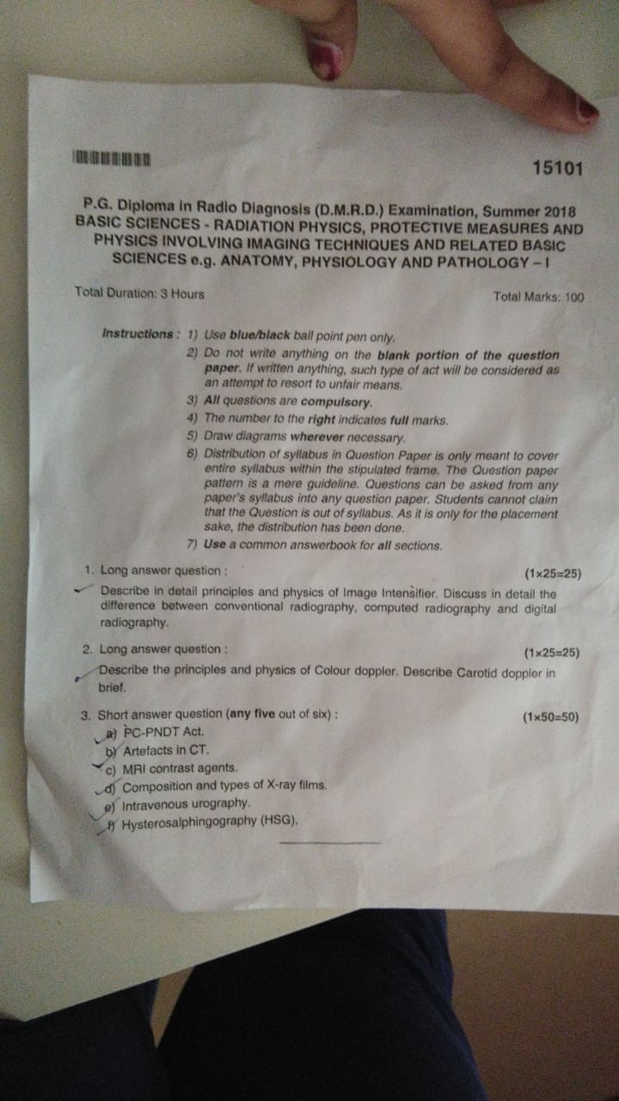

Slide 3
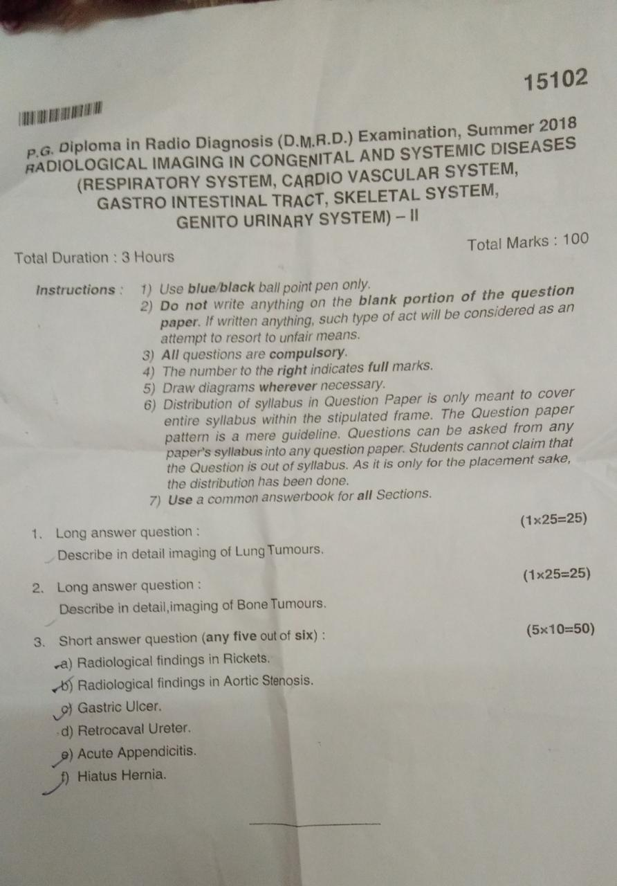

Slide 4
