Slide 1
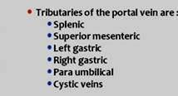
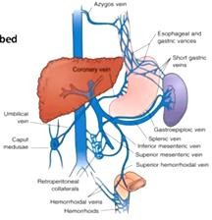
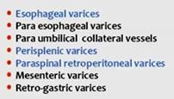
SUMMARY OF PORTAL VEIN IMAGING
SUMMARY OF PORTAL VEIN IMAGING
PV is the only vein has Tributaries & Branches.
it drains abdominal part of GIT
including Lower esophagus BUT NOT anal canal.
Formed mainly by:
SPLENIC & SUPERIOR MESENTERIC
TECHNIQUE
Spleno-portography : obsolete - inject contrast in splenic vein.
CT Triphasic
Contrast | 150 ml – Iodinated
Rate | 3 ml / sec
Arterial phase | 20 : 25 sec
Portal Phase | 25 : 30 sec
CT Portal venography : Reformate image in 2D or 3D.
ANOMALIES "rare"
Prepancreatic PV "with situs inversus"
Double PV
Agenesis of PV
Agenesis of main branches.
Porto-systemic collaterals
> 20 porto-systemic pathway are described.

Slide 2
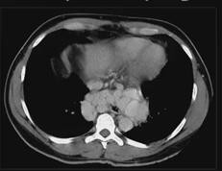
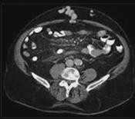
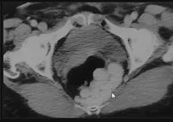
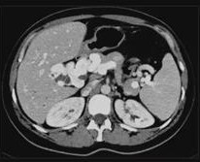
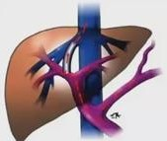
SUMMARY OF PORTAL VEIN IMAGING
Esophageal & Paraesophageal varices
Caput Medusa "Paraumblical"
Rectal
PORTAL CAVERNOMA
PV stenosis or occlusions → Multiple dilated venous channels at porta hepatis.
"worm Like" mass of veins.
SHUNTS
PV/HV | Porto-systemic | commonest
PV/HA | Arterio-Portal | Can occur
Hv/HA | A-V shunt | Rare in Liver
I ➔ Porto-Systemic shunts:
Etiology: Congenital / Cirrhosis / Traumatic / P. Hypertension
Sites :
C.P.:
Imaging: CECT → Show communication
Color Doppler "Best tool to diagnose "
Rt P.V. branch / IVC → Commonest Hepatic encephalopathy

Slide 3
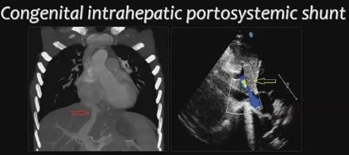
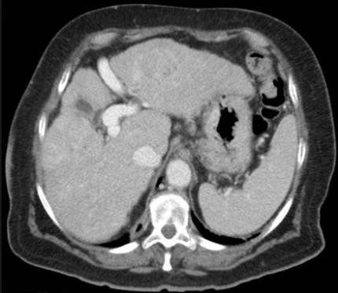
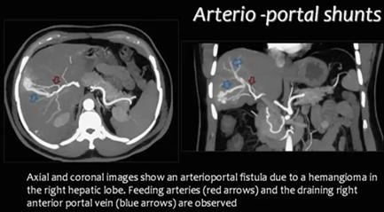
SUMMARY OF PORTAL VEIN IMAGING
PERSISTENT DUCTS VENOUSSES - Lt PV / IVC
TRANSJUGULAR INTRAHEPATIC PORTOSYSTEMIC SHUNT
TIPSS
ttt of portal Hypertension.
Indications:
Varices – Budd chiari - Refractory ascitis – Hypersplinism
(connecting Hepatic vein / Portal vein)
II ➔ Porto-Arterial shunts:
Etiology: - Congenital : rare
Traumatic : stab, bullet
Iatrogenic : common / as PTC, biopsy
Malignant : main cause
CT : → Enhanced PV at arterial phase
Porto-Arterial shunt → contrast transmit to PV at arterial phase → enhancing of Non malignant area , but Mimic HCC
To Differentiate :
US → No Focal lesion
Doppler → arterial flow in PV
MRI SPIO "Super Paramagnetic Iron Oxide " :
Deposited in HCC
Washed out in shunt

Slide 4
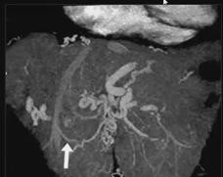
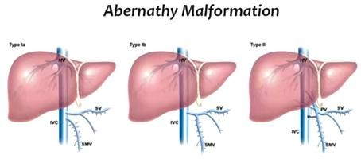
SUMMARY OF PORTAL VEIN IMAGING
III ➔ Arterio-Systemic shunts:
rare type
Communication of Hepatic Artery & Vein
Etiology: -Congenital AVM "Rendu osler disese"
-HCC -Large Hemangioma
CT →Arterial phase Early enhanced Hepatic vein.
Extra hepatic Porto–Caval shunt "Abernathy malformation" 2 Types
Congenital Porto-Systemic shunt outside the liver
 | Type 1 | Type 2
 | More in Females | Males
PV | Congenital absent PV Splenic & SMV join IVC separately | Splenic & SMV join each other forming short abnormal PV connected to IVC
 | Complete shunt portal blood to IVC
Associated | + - Polysplenia - Biliary atresia | + - Focal nodular Hyperplasia - HCC
PORTAL VENOUS ABEURYSM "Rare"
3% of all venous Aneurysms
Etiology: -Portal hypertension
Site :
"Commenst sites: Jagular, Popleteal ,Saphenous, "
-Pancreatitis -Surgery -Trauma
mostly at junction of splenic & SMV "i.e. 1st part of PV"
Main PV
Bifurcation or main branches
C.P. : - Mostly asymptomatic - Abdominal Pain
Complications: - Thrombosis - Rupture - Portal hypertension - Embolism
- Compression: on CBD or dudenoum

Slide 5
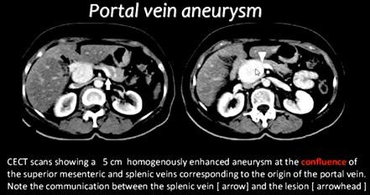
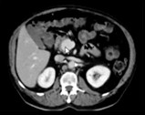
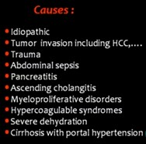
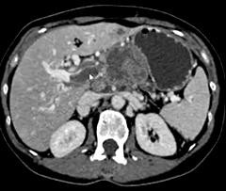
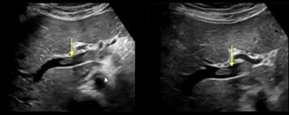
SUMMARY OF PORTAL VEIN IMAGING
Portal & Splenic vein Thrombosis
Etiology : Causes of hypercoagulopathy
-PV Rim enhanced around filling defect +/-
Portal Cavernoma
Collaterals "varices"
Shunt "arterio-portal"
*Malignant Thrombus : Enhanced / dilating PV Metabolic Active
"Best diagnosed by US"
NB. PV thrombosis → alternative arterial supply of Hepatic parenchyma → Heterogenous areas of enhancement @ arterial phase = THAD : Transient Hepatic Attenuation Difference

Slide 6
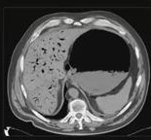
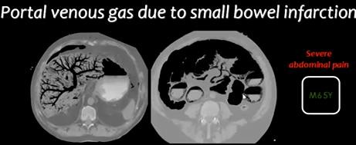
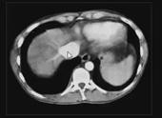
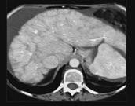
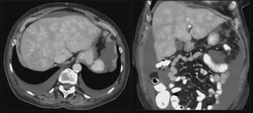
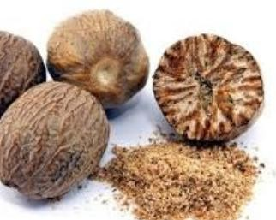
SUMMARY OF PORTAL VEIN IMAGING
GAS in Portal System "uncommon sign "
BAD SIGN = Surgical emergency / High Mortality rate
Etiology : commonest 2 causes
- Adult: Mesenteric ischemia - Infants: Necrotizing enterocolitis
➔D. D. : *Biliary gas → Central not reaching peripheral 2cm
*Portal Gas→ central & periphery up to subcapsular
Passive Hepatic Congestion or Congestive Hepatopathy
"Stasis of blood with in hepatic parenchyma"
Etiology: - Budd Chiari - Rt Heart Failure - Constrictive Pericarditis
Pathology: Congestion → impairment of drainage → Hepatomegally & dilated hepatic veins → Hypoxia / increase enzymes → Finally "Cirrhosis"
Imaging : - Early enhancement of dilated Hepatic veins & IVC "at arterial phase"
-Hepatomegally - Ascitis - Cardiomegally -Pleural / Pericardial effusions
Dilated IVC
Mottled Liver "Nutmeg"
Nutmeg= بيطلا ةزوج

Slide 7
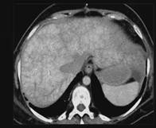
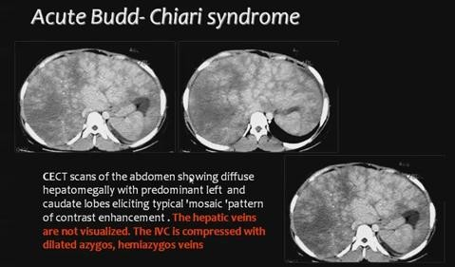
SUMMARY OF PORTAL VEIN IMAGING
Budd-Chiari Syndrome
Congested liver ← Hepatic Veins or IVC obstruction. "Acute or Chronic"
Motteled "Nutmeg" Liver
Obstructed HV & or IVC
Decreased enhancement of perophery
MRI …notice IVC obstruction
Jun 2018
Ahmad Mokhtar Abodahab Ass. Lecturer of radiology – Sohag University
Imaging of Portal Venous system - Prof Dr. Mamdouh Mahfouz (Cairo2018) https://www.youtube.com/watch?v=dwIU4USk6zM

