Slide 1
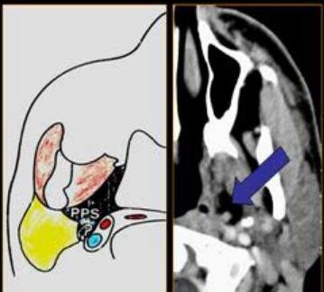
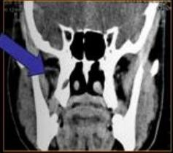
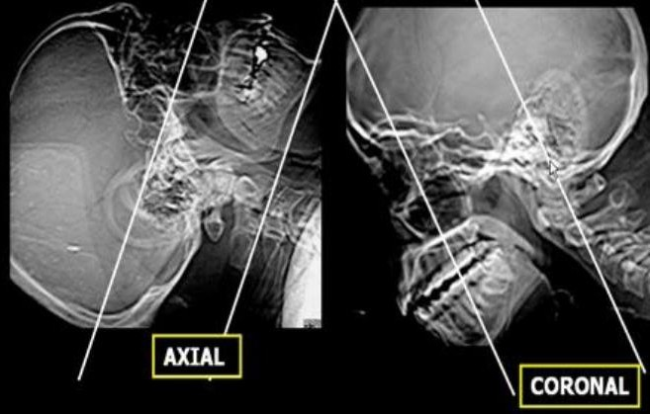
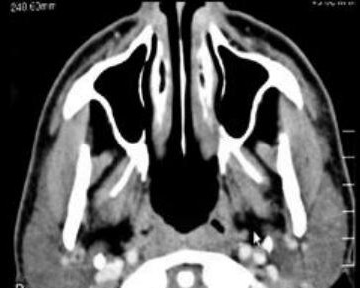
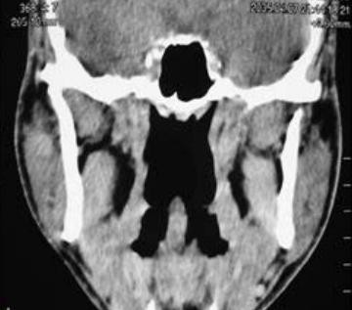
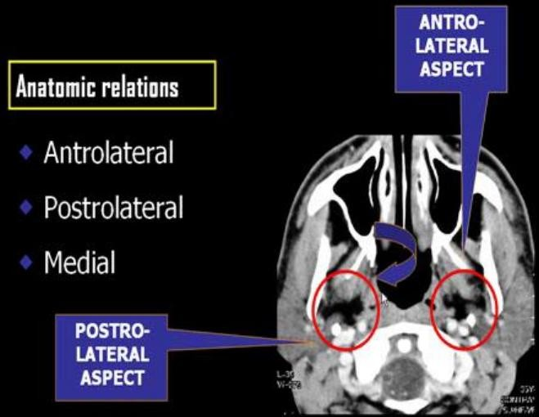

SUMMARY OF PARAPHARYNGEAL SPACES
SUMMARY OF PARAPHARYNGEAL SPACES
PARAPHARYNGEAL SPACE:
Fat filled , triangular space at lateral aspect of pharynx
It extend from
Base of Skull , down to
Oropharynx
⇨ Contents :
FAT | Arteries | Veins | Nerves
 | -Ascending pharyngeal -Internal maxillary | -Pharyngeal veins | -branches of Mandibuar N
⇨ Imagining :
CT & MRI * Axial & Coronal * 3 : 5 mm * Contrast is a must
CT is better than MRI ← better bone delineation (Calc , erosions & Hyperosteosis)
⇨ Anatomic Relations
⇨ Clinical Aspect:
-Difficult to be evaluated clinically
-Presenting Symptoms:
- Sore Throat
-Dyspahgia
-Voice change
-Post. Mandibular Mass

Slide 2
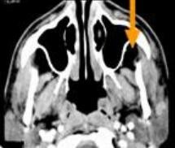
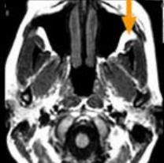
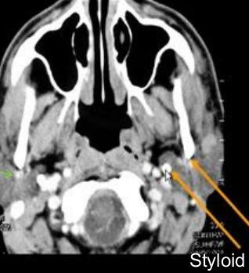
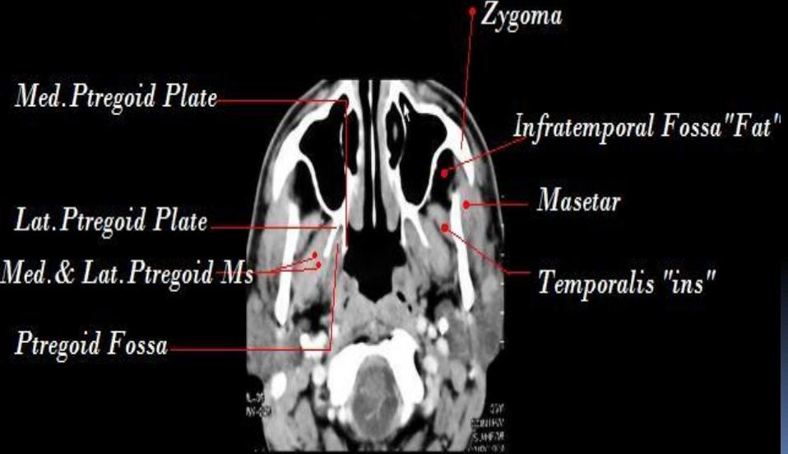
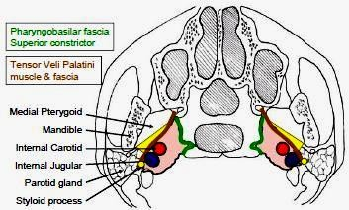
SUMMARY OF PARAPHARYNGEAL SPACES
Antero-Lateral Aspect "Infra-temporal fossa" |  | Postero-lateral Aspect
 | ☒ Masticator Space | ☒ Parotid Space
Contents | -Muscles of Mastication (masetter,temporalis, ptrygoid) -Mandibular Ramus -Mandibular N. Branch -FAT "arrow" | *Styloid Process divide it to :
 |  | Stylomandibular tunnel | Retrostyloid space
 |  | -Parotid gland "deep part" -ECA -Retromandibular v. -Facial N -Lymph n "seen if enlarged | -ICA -IJV -Cranial N 9 , 12 - Lymph n
☒ Medial Aspect "Pharyngeal Mucosal space"
⇨
(PBF) Pharyngeo-Basilar Fascia
at medial aspect of PPS
Separating Pharynx from para pharyngeal space
Tough membrane
Difficult to be infiltrated
"malignancy or sever infection"

Slide 3
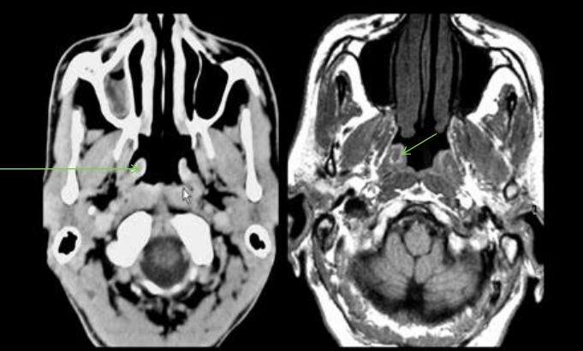
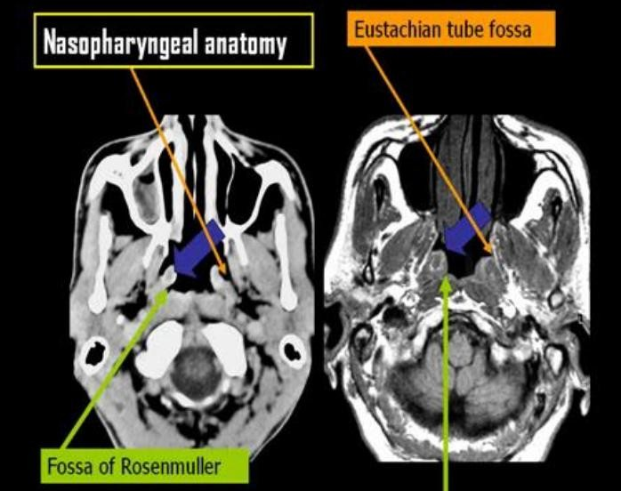
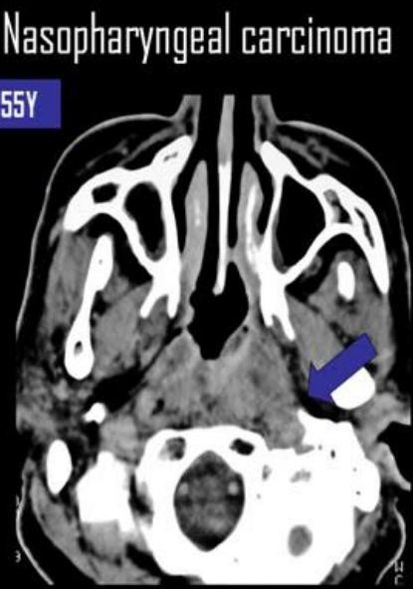
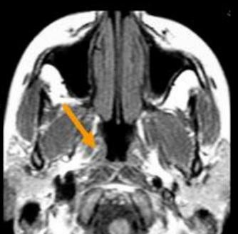
SUMMARY OF PARAPHARYNGEAL SPACES
➔Anatomy of Nasopharynx :
*T
⇨
*Th
*Ob
orus tubaris :
composed by Tensor & levator palatine Muscles in Fat plane in between them , only seen by MRI , literation of this fat line =
earliest sign of nasopharyngeal cancer
Fat Line in Torus Tubaris

Slide 4
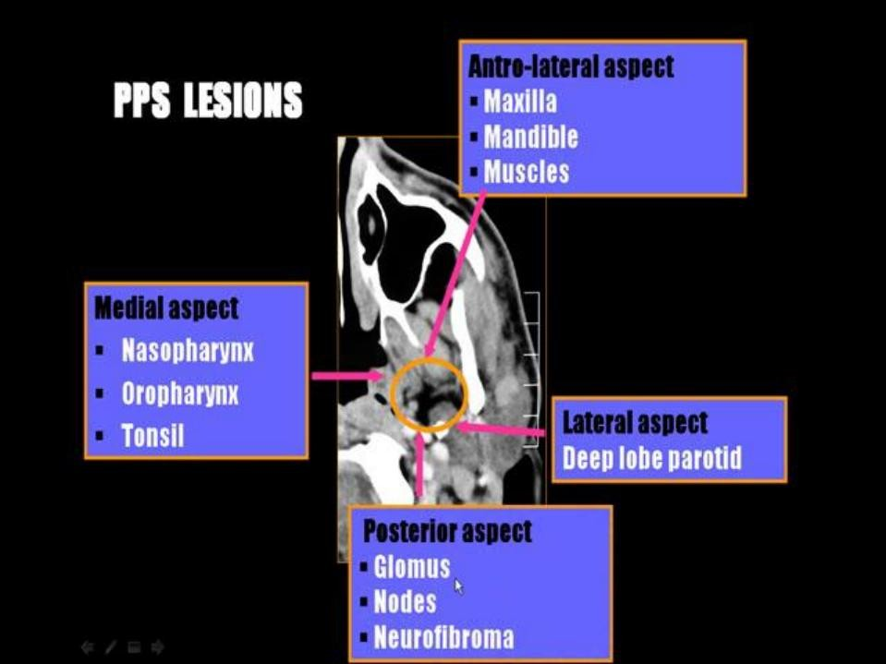
SUMMARY OF PARAPHARYNGEAL SPACES
N.B. Most Lesions arising from Parotid are Malignant

Slide 5
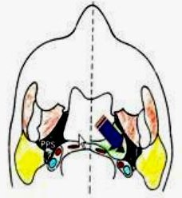
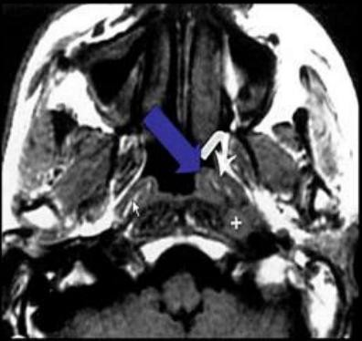
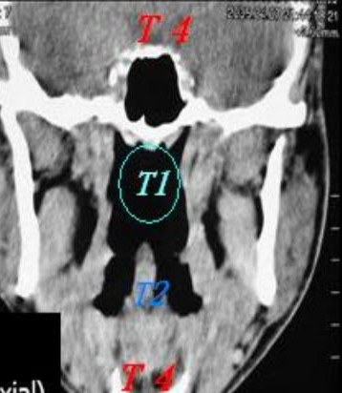
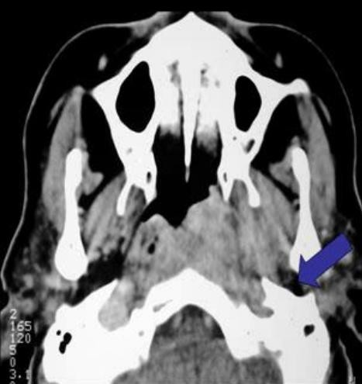
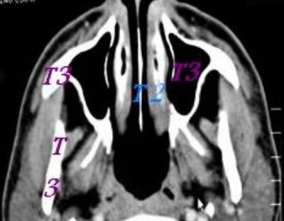
SUMMARY OF PARAPHARYNGEAL SPACES
⇨ PATHOLOGY
@ Medial Aspect of PPS: → Displacement of PPS Fat Laterally
⇨ 98 % Carcinomas :
80% Squamous cell type
Others: Adenoid , Mucoepidermoid
⇨ OTHERS
Lymphomas
Sarcomas
In Children
⇨ Rare : Angiofibroma – Melanoma – Plasmacytoma
NASOPHARYNGEAL CARCINOMA
⇨ Early Diagnosis : "Beast seen by MRI "
o Signs :
-T1 → Obliterated fat line between tensor & levator palate Ms.
Extension in PPS Fat
Obliteration of fat plane between Nasopharynx / Prevertebral ms
⇨ STAGING :
  T1 Nasopharynx confined
  T2 to Orophar. Or nasal Fossa
  T3 Bones or Sinus invasion
  T4 Intracranial/Orbit/Hypophar.
Rt intact Fat plain / Lt obliterated "early stage"
+ L.N.
Nasopharyngeal Carcinoma
parapharyngeal fat is displaced laterally

Slide 6
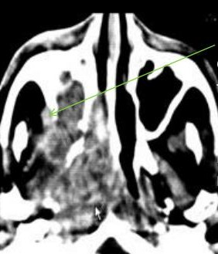
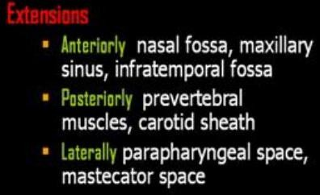
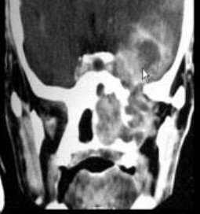
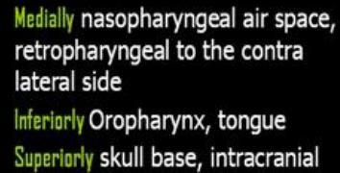
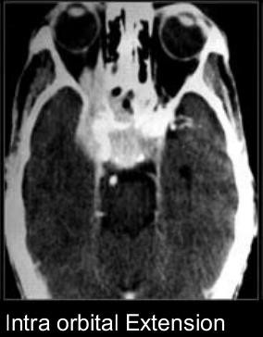
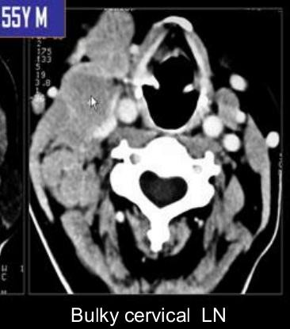
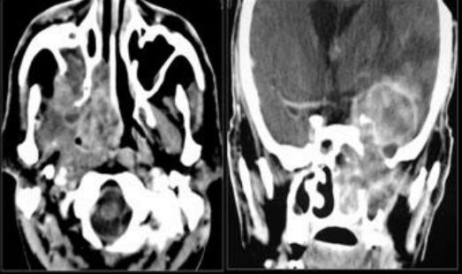
SUMMARY OF PARAPHARYNGEAL SPACES
Invading Fat Of infra temporal Fossa
"Very important note in reporting"

Slide 7
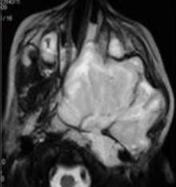
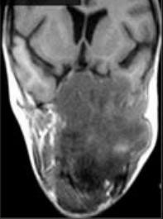
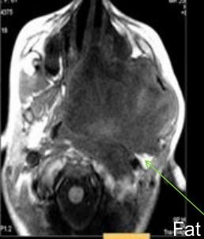
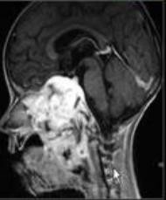
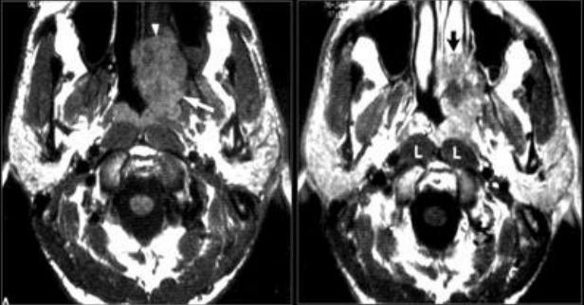
SUMMARY OF PARAPHARYNGEAL SPACES
Other Malignancies
Lymphoma 20% - Child or Adult |  | Others 10% Melanoma-Palsmacytoma- Rhabdomyosarcoma Adenoid cystic carcinoma
 | Nasopharyngeal mass in child is likely: =Lymphoma , “More with enlarged LN” =Rhabdomyosarcoma “less likely to enlarge LN , as it spread by blood stream”
⇨
Rhabdomyosarcoma
Commonest Sarcoma in Head & Neck
o 70 % < 12 y
Site: "ON TSN" Orbit >Nasophar.>Temporal bone > Sinuses> Neck
Presentation : Pain / Cranial N palsy
D.D.
  Nasophar. Carcinoma → Older age
  Angiofibroma → Boys only - Highly vascular
⇨ Adenoid cystic carcinoma
Low grade tumor → Mets very late
More suggested with presence of Muscles atrophy of the same side of
the lesion ← as it invade & thickening the supplying Nerve

Slide 8
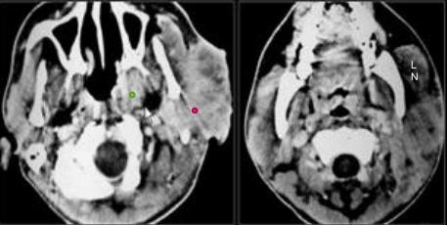
SUMMARY OF PARAPHARYNGEAL SPACES

Slide 9



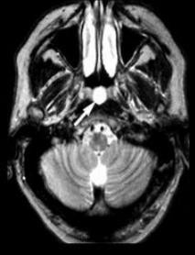
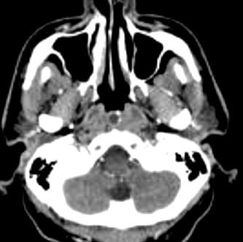


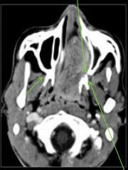
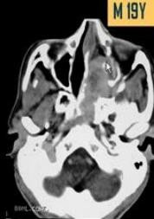
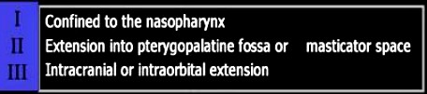
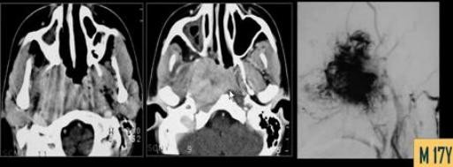

SUMMARY OF PARAPHARYNGEAL SPACES
BENIGN LESIONS OF NASOPHARYNX
⇨ Teenager BOYS ONLY
⇨ Arise near to Sphenopalatine Foramen
" Sphenopalatine foramen determined opposite to ptrego-palatine fossa"
⇨ Highly vascular → Intense enhancement
⇨ Holman-Miller sign "Classical"
= Forward displacement of Maxillary sinus posterior wall
⇨ STAGING:
*Nasopharyngeal Angiofibroma Has a characteristic extension to sphenoid sinus.

Slide 10
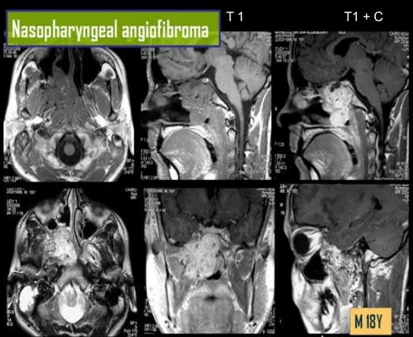
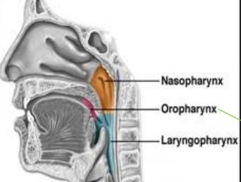
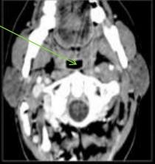
SUMMARY OF PARAPHARYNGEAL SPACES
OROPHARYNX
⇨ Pathologies : - Tonsillitis - Adenoids -Orophar. Cancer
⇨

Slide 11
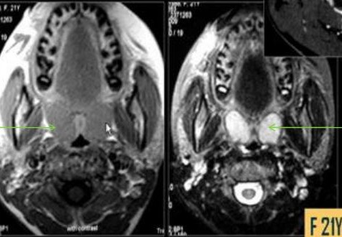
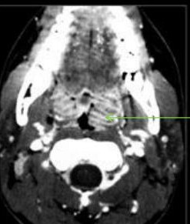
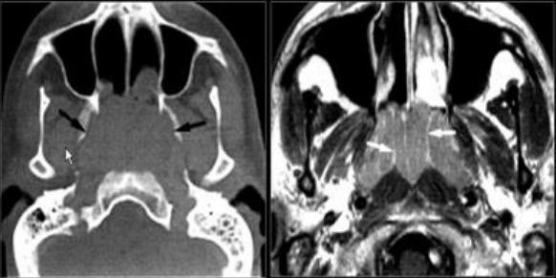
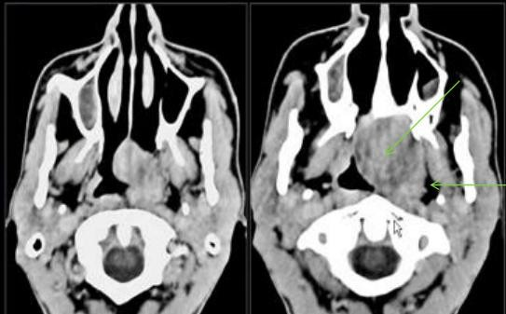
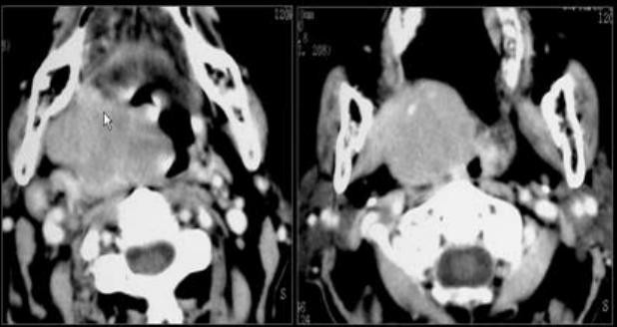
SUMMARY OF PARAPHARYNGEAL SPACES
➔ Tonsillitis
➔ Lymphoid Hyperplasia "Adenoids"
Confirmed by presence of Fat Lines with in the lesion in T1
➔ Oro-pharyngeal Carcinoma

Slide 12
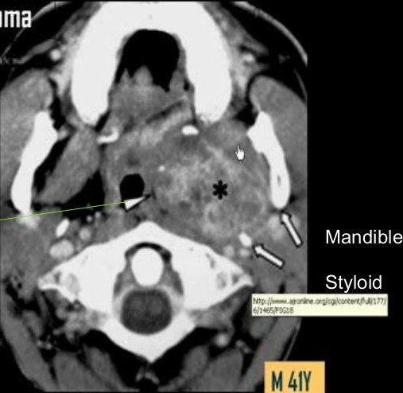
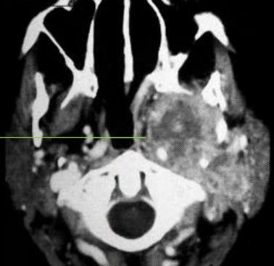






SUMMARY OF PARAPHARYNGEAL SPACES
* ttt Radiation ← Naso-pharyngeal (carcinoma) Oro-pharynfeal → ttt surgical
= Differentiation of both types mainly by site of main bulk of the lesion.
Look For Direction of Fat displacement to Assess source of
Mucoepidermoid Carcinoma
Adenoid Cystic Carcinoma
⇨ Parotid Space Masses displace styloid Process Posteriorly
⇨ Post Styloid Space Masses displace styloid Anteriorly
Deep lobe parotid T | Glomus | Cystic Neurofibroma | Neurofibroma

Slide 13




SUMMARY OF PARAPHARYNGEAL SPACES
GLOMUS
Rare / 1 : 1300000
Slow growing, , Hypervascular Tumor
Male 1 : 3 Female / 40 : 60 y
Arise from glomus bodies of IJV
4% → Mets @ Lungs, Liver, Nodes , Bones
Imaging:
  Assessed by Conventional or CT Angio NOT MR Angio
  Large at presentation 2:6 cm→ Mass in Jugular Fossa with bone destruction
  Intra & Extra cranial Extension.
  MRI → Salt & Paper appearance
Lymphadenopathy
⇨ Mets Node:
Commonest nodal disease
Enlarged>0.8cm+Cenral necrosis +fat stranding
June 2018
By
Ahmad Mokhtar Abodahab
Ass. Lecturer of Radiology - Sohag University From Lecture of Prof. Mamdouh Mahfouz

