Slide 1
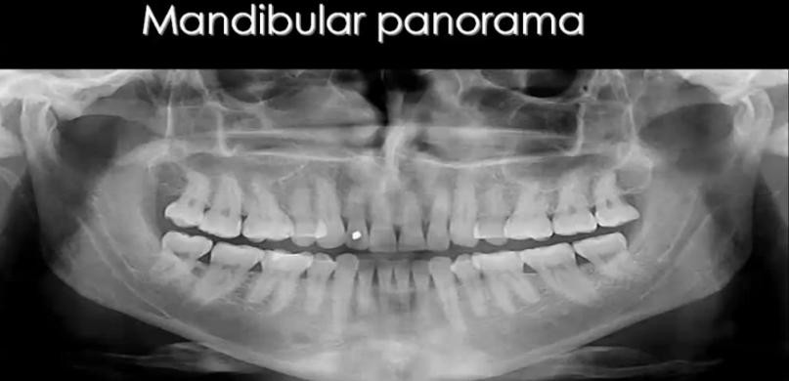
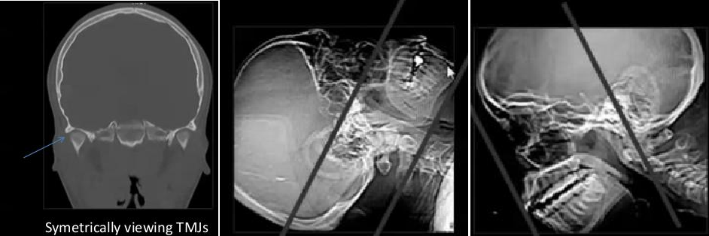
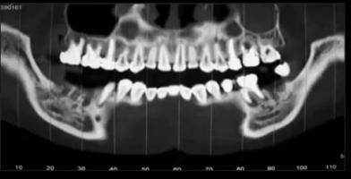
JAW IMAGING
SUMMARY OF JAW IMAGING
IMAGING MODALITY | VALUE
X – Ray | Basal
Panorama | Better evaluation of Bone & Tooth
CT | Coronal & Axial scan + CT panorama & 3D 3D only important in Trauma
MRI | Beast soft tissue differentiation Not commonly Needs in JAW
CT PROTOCOL :
- Axial & Coronal – 3 mm slice - soft & bone - Symmetrical position

Slide 2
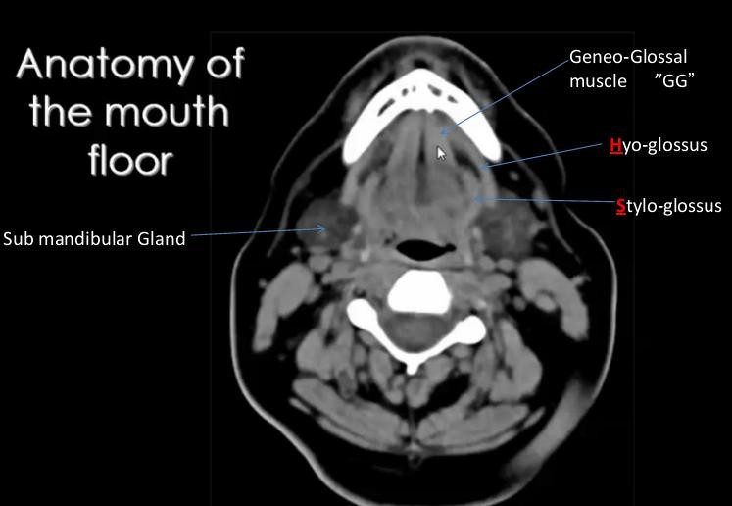
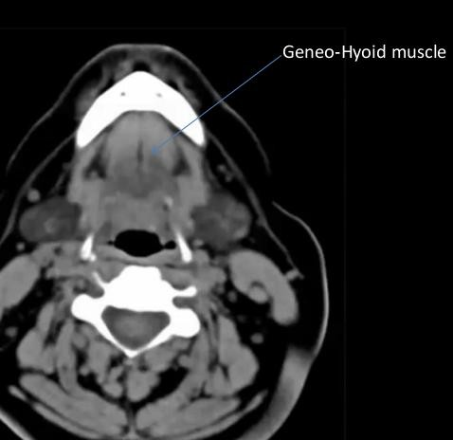
SUMMARY OF JAW IMAGING
ANATOMY
•
MANDIBULAR LESIONS
CYSTS
TUMORS
Others
MANDIBULAR LESIONS
CYSTS |  |  |  | TUMORS | OTHERS
ODONTOGENIC Related to a tooth mostly Diseased |  | NON - ODONTOGENIC Not related to tooth | Benign |  | Malignant
 |  |  | Odont. | Non
Radicular |  | Simple | = Lytic Ameloblastoma Myxoma | Osteoma
Residual |  | ABC |  | Chondromas
Dentigerous |  | Stafine | = Sclerotic Cementoma odontoma | Giant Cell
Odontogenic Keratocyst |  | Incisive | Mixed

Slide 3
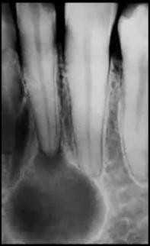
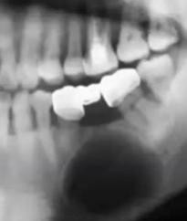
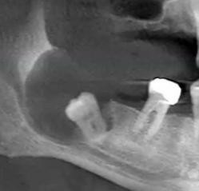
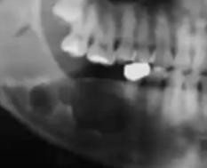
SUMMARY OF JAW IMAGING
ODONTOGENIC CYSTS Related to a tooth - mostly Diseased
 | Incidence | Age | Site | Discretion
Radicular | Commonest 65% | 30:50y | Cyst at root of caries tooth | Rounded – unilocular - <10mm
Residual |  |  | Cyst related to removed tooth
Dentigerous | Common | Young adult | Around crown of un-erupted tooth | Painless – usually 3rd molar Root mostly outside cyst
Odontogenic Keratocyst | 11% | 20 :40 th | Mostly to impacted tooth | Multilocular ,Cheesy Material - @ ramus & angle
Calcifying Odontogenic
ODONTOGENIC
Incidence
Related to a tooth - mostly Diseased
Age
Site
Discretion
Radicular | Residual | Dentigerous | Odontogenic Keratocyst

Slide 4
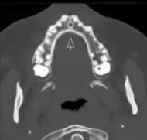
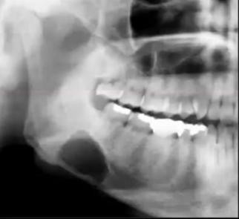
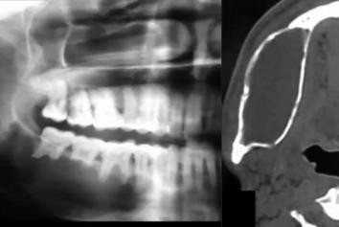
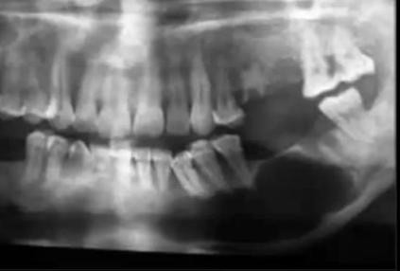
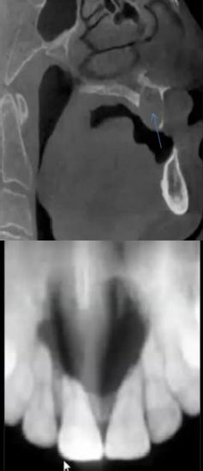
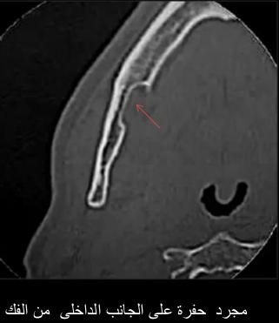
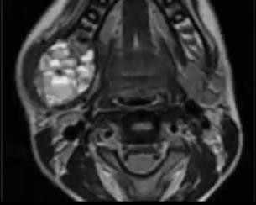
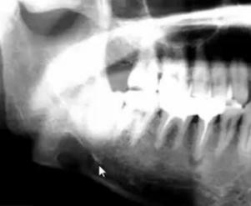
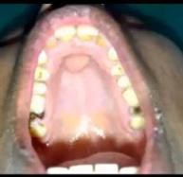
SUMMARY OF JAW IMAGING
Non ODONTOGENIC CYSTS Not Related to a tooth
Incisive | Commonest Non odont. | M>F |  | At Incisive canal Lucent cyst between incisors
Stafine |  |  |  | Not True Cyst Just Medial Bone defect
Simple | Rare |  |  | Lucent Lobulated Cyst D.D.Odontogen.Keratocyst
ABC |  |  |  | Lytic - Expansile MRI fluid-fluid levels
Incisive | Stafine | ABC | Simple Bone Cyst

Slide 5
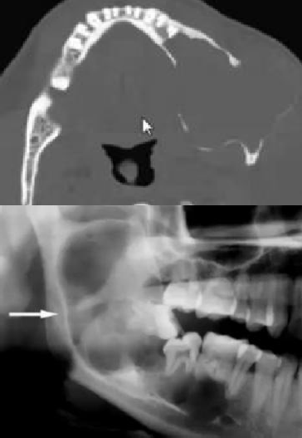
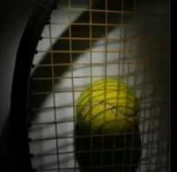
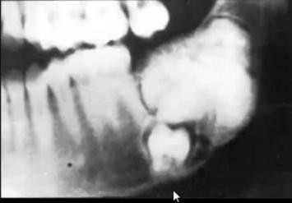
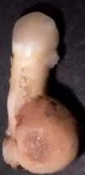
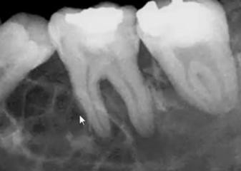
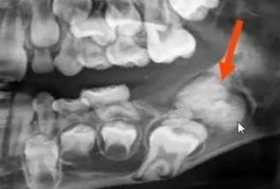
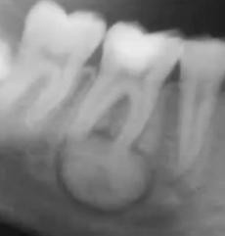
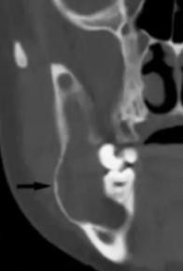
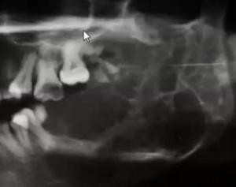
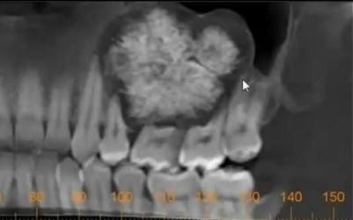
SUMMARY OF JAW IMAGING
ODONTOGENIC BENIGN TUMORS Lytic – Sclerotic - MIXED
 | Incidence | Age |  | Discretion
Ameloblastoma "Adamantinoma" | Commonest Bening tumor | 30:50y | 80 % Ramus Mandible 5 : 1 Maxilla | Hard-painless-loss teeth Unilocular-Expansile-lytic
Odontogenic Myxoma |  |  | Tenis Racket Apperance | Slow – Expansile – Lytic Multi locular septated
Odontoma |  | 2nd Decade | 50% with impacted tooth | 1:3cm - Painless Benign , may local aggressive Lucent with central calcification
Cementoma | Rare |  | Mostly 1st molar Attached to root | Well defined Opaque mass – surrounded hallow
Ameloblastoma | Odontogenic Myxoma | Odontoma | Cementoma
Adamantinoma or Odontogenic Keratocyst
Answer
Adamantinoma i.e . ” Ameloblastoma As it much more common
Expansile Lytic Cyst in Mandible …….What is your Diagnosis?
1. AVASCULAR NECROSIS

Slide 6
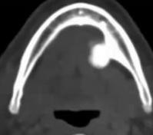
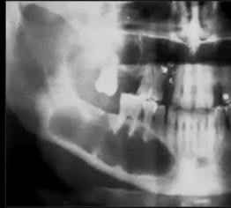
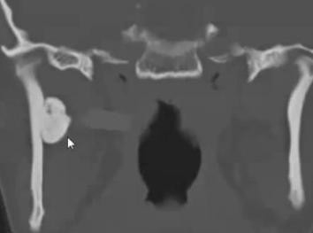
SUMMARY OF JAW IMAGING
NON ODONTOGENIC BENIGN TUMORS
 | Incidence | Age |  | Discretion
Osteoma |  |  |  | Ball of Bone
Chondromas |  |  |  | + Matrix calcification
Giant Cell |  | ₂nd _{: 3}rd Decade | D.D. Ameloblastome Odontogenic Keratocyst | Lucent Small unilocular, then enlarge multilocular
Osteoma |  | Giant Cell Granuloma

Slide 7
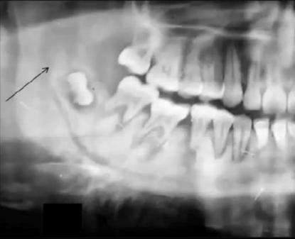
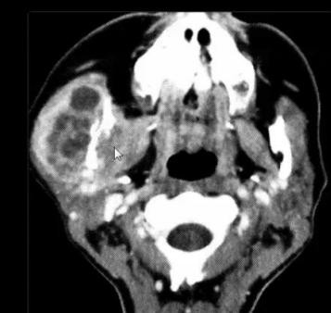
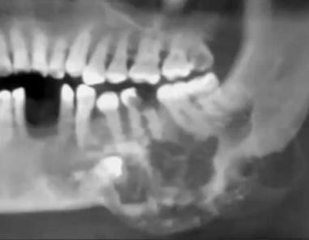
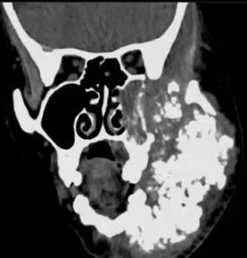
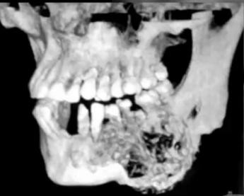
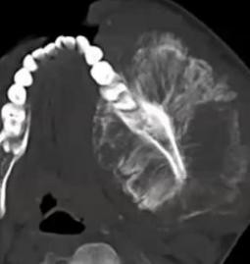
SUMMARY OF JAW IMAGING
MALIGNANT JAW TUMORS
Malignant Criteria :
Cortical destruction
Peri-osteal reaction
Extraosseous extension
Mets.
Malignant Tumors of Jaw:
Osteosarcomas
Chondrosarcomas
Malignant ameloblastoma "rare 1%"
Mets "mandible is common site of mets"
Osteosarcomas "sun rays peri-osteal reaction" | Mets

