Slide 1
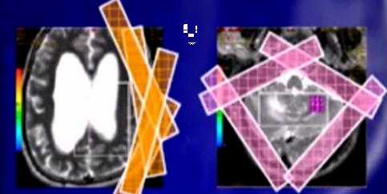
MR SPECTROSCOPY
SUMMARY OF MR SPECTROSCOPY
Source: Lecture of Dr. Ali Almoqadem
Types: 1- Single voxel : voxel = 2X2X2 "8cm3" 2- Multivoxel
⇨ VOI = Volume of Interest "area assessed by spect."
Region to be avoided: Bone – Blood – Cysts & scalp Fat
CSF & CYSTS contains Lactate → Inaccurate spectrum of lactate & Lipids
⇨ TE Echo Time: Time control parameters of spectrpscopy , which are
SNR , Signal to Noise Ratio
Spectrum Metabolites
o 2 Times are used : * Short (2000/35)
- Base line
* Long (1500/144)
Short TE → Assess : Lipids , Lactates , Myoinstoles , GLx complex
⇨ SATs Saturation Bands :
bands to kill signal from avoided regions
"Lipid , skull . eyes. Sinuses" → improve spectrum.
⇨ Water Suppression: "water peak at 4.7 ppm"
o Water conc. 100.000 > other metabolites → water signal must be suppressed to avoid it's overshadow on other metabolites.
i.e. Water concentration “curve” is very high ….. If our spectrum detect
& Map it = other metabolites will be indistinguishable beside it.

Slide 2
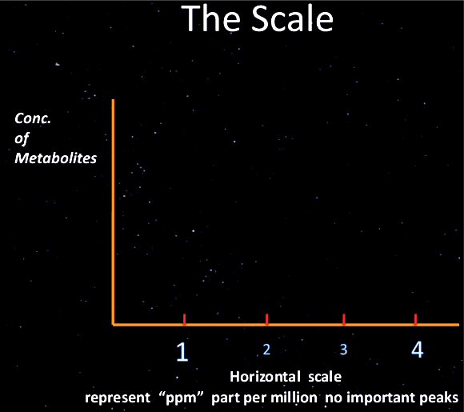
SUMMARY OF MR SPECTROSCOPY
METABOLITES & THERE SIGNIFICANCE
⇨ Some are the main “i.e. Stars “in every Curve” (Cho , Cr , NAA & MI.)
⇨ Others are seen in certain diseases.
ABC …….. When Cho > Cr & NAA = Disease
After 2 y of age → Spectrum as in Adult
AGE VARIATION
 | Neonates | Adult
NAA | Gradual increase ←Neuronal Maturation | Diminished
Cho. | High | Elevated
mi | High
Cr. |  | Increased

Slide 3
SUMMARY OF MR SPECTROSCOPY
Metabolites of MR SPECTROSCOPY
Metabolite |  |  | Locate / ppm | Phys. Significance | Diminish in | Absent in | Increased in
 | N-Acetyl Aspartate |  | 2.02 | Marker on Neuron Health seen only in neuronal tissue | Neuronal Damage | Tissue of no neurons (Mets/Meningioma) | Rare "Canavan's Dis."
 | NAA
 | Creatine |  | 3.03 3.94 | -Stable in many Dis. -Used as control -Energy Metabolism | Hypoxia Tumors |  | Trauma Hyper osmolar
 | Cr
 | Choline |  | 3.2 | - Marker of memb. Synthesis & number of cells |  |  | Active Tumor Inflammations MS Chronic Hypox.
 | Cho
 | Lactate |  | Double peak | -Product of anaerobic metabolism -Released in cell destruct | Normally absent or very low |  | Necrotic Tumor Stroke Abscess
 | Lac
 | Lipids |  | 0.9:1.2 | -May due to contamination of scalp | Normally absent |  | In aggressive disease process
 | Myoinositol |  | 3.56 | -only short TE -Astrocytes Marker | Hepatic encephalo- pathy |  | Alzheimer Demylenation Low g Glioma Gliomatosis C.
 | ml
 | Glutamate & Glutamine |  | 2.1:2.5 | -only short TE -Close to each=Glx -Regulate neurotransmitter activities |  |  | Tumefactive MS Hepatic Enceph. Sever Hypoxia
 | Glu – Gln
 | OTHERS |  | Succinate = 2.4 Acetate = 1.9 Amino Acids = 0.9 |  |  |  | Pyogenic Abcs.
 |  |  |  |  |  |  | Alanine→ Meningioma

Slide 4
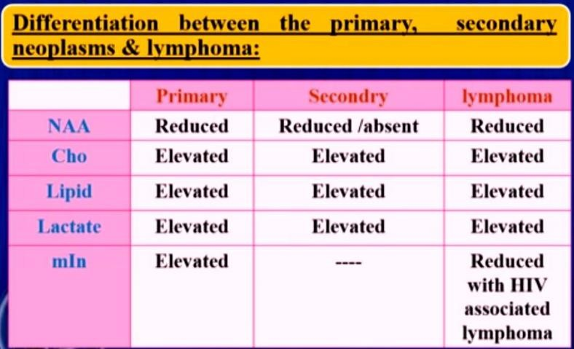
SUMMARY OF MR SPECTROSCOPY
SPECTROSCOPY & BRAIN TUMORS
- MRS is important aiding tool in diagnosis , but not alone
⇨ MRS is helpful in differentiating :
MRS helping in Grading,
. but not Grading Tumor alone
Values are slightly different from Paper to Other.
Tumor / Tumor like
Grading cerebral Glioma
TTT planning of Gliomas
Residual / Recurrent tumors
Radiation Injury

Slide 5
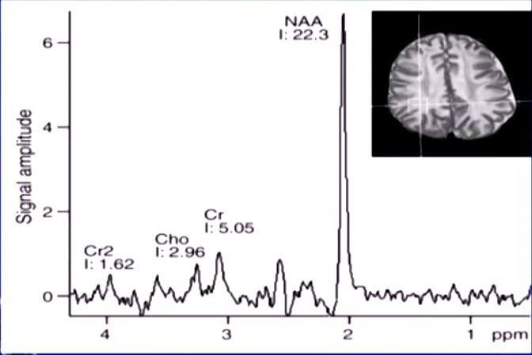
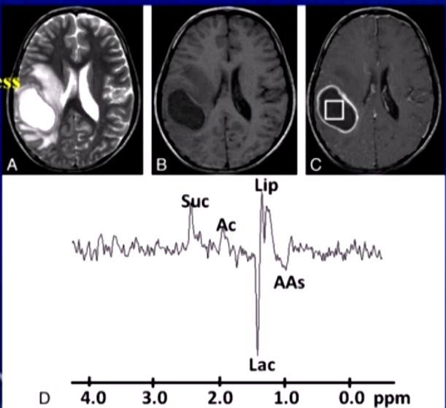
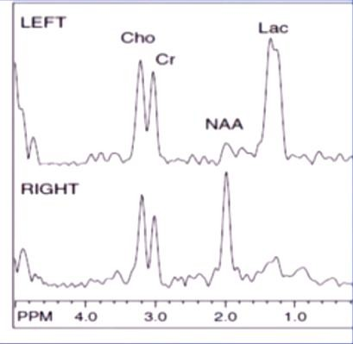
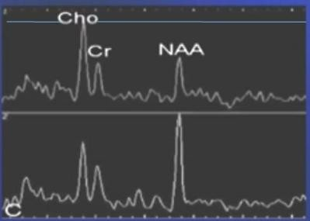
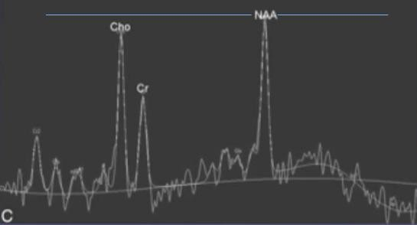
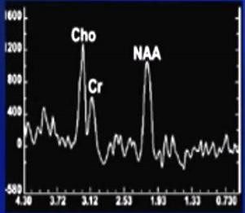
SUMMARY OF MR SPECTROSCOPY
Canavan's Disease | Pyogenic Abscess
Massive Infarction | Ependymoma Recurrence
Radiation Injury | Glioblastoma Multiform Curve Of Peri Lesion Voxel ‘ Raised Cho > NAA i.e. ratio > 1 → Invasive edge = 1 ry Neoplasm

