Slide 1
ENDOSCOPIC ULTRASOUND
DR SHEFALI MESHRAM

Slide 2
Endoscopic ultrasonography (EUS) employs the technology of endoscopy and internally placed high-frequency ultrasound waves to visualize the gastrointestinal wall and adjacent structures.
EUS has emerged as an important modality for the diagnosis and staging of benign and malignant lesions of the gut wall and surrounding structures of the mediastinum, abdomen, and pelvis.

Slide 3
INDICATIONS:
Staging of Ca esophagus, Stomach and Rectum.
Evaluation of abnormalities of GI wall or adjacent structures ( submucosal masses, extrinsic compression)
Evaluation of thickened gastric folds.
Diagnosis (FNAC) and staging of Ca pancreas.
Evaluation of pancreatic abnormalities ( suspected masses, cystic lesions including pseudocysts, suspected chronic pancreatitis).
Staging ampullary neoplasms.
Diagnosis and staging of cholangeocarcinoma.
Evaluation of suspected choledocholithiasis.
Celiac plexus neurolysis for chronic pain due to intraabdominal malignancy or chronic pancreatitis.
Diagnosis of Ca lung and its staging.

Slide 4
Two types of echoendoscopes are generally used in studying the gastrointestinal tract.
One is a 360° radial scanner (eg, Olympus UM20, UM30 Echoendoscopes),
The other, a sector scanner (eg, Olympus UC30P, Pentax FG32UA Echoendoscopes).

Slide 6
The radial scanner produces a 360° view perpendicular to the shaft of the endoscope and has the option of scanning at 12 or 7.5 MHz . The higher frequency scanning (12 MHz) allows for better visualization of details at close range. The lower the frequency, the better the penetration of ultrasound waves; thus, at 7.5 MHz, the scanning range increases over 12 MHz.
The radial echoendoscope is preferred by many endosonographers because it gives a 360°overview, similar to a computer tomogram, allowing complete visualization of the gastrointestinal tract and its adjacent structures.

Slide 8
The sector scanners are preferred for use in EUSFNA because they allow direct visualization of the needle up to 5-6 cm parallel to the shaft of the endoscope.
The radial scanner is difficult to use for FNA because the tip of the needle quickly leaves the scanning area, which is perpendicular to the tip of the endoscope

Slide 10
A waterfilled balloon over the transducer allows close contact of the transducer to suspected lesions in the gastrointestinal wall or adjacent structures.
For the evaluation of lesions located in the stomach wall, filling the stomach with 200-500mL of water often allows for detailed images of the gastric wall structures.

Slide 11
In addition, highfrequency ultrasound probes that are passed through the biopsy channel of an endoscope are available.
Catheterbased ultrasound probes that employ highfrequency ultrasound (20 mHz) may be used through traditional videoendoscopes. These highfrequency ultrasound probes (HFUPs) are useful in evaluating small mucosal/submucosal lesions in the luminal gastrointestinal tract.

Slide 12
PREPARATION.
Preparation of the patient is same as that for conventional endoscopy.
NBM for 8 hrs.
Medications such as Aspirin or any other blood thinners are usually stopped 5-7 days prior to the procedure.
For lower GI scopy, the colon should be free of any faecal matters. For that laxatives are given 1 day prior to the procedure. Patient is kept on liquid diet and enema may be required prior to the procedure.
All the risks of the procedure are explained to the patient and written informed consent is taken.
It is usually done under conscious sedation and the
procedure takes almost 1 hr. Patient is usually kept under
observation for 1 hr.

Slide 13
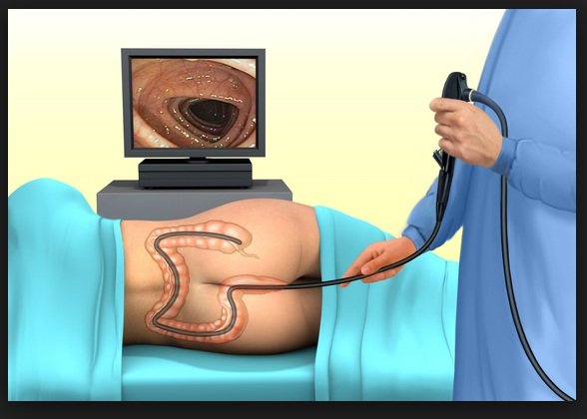
POSITION

Slide 14
RISKS
Upper GI endoscopy (EGD): Although rare, bleeding and puncture of your esophagus or stomach walls are possible during EGD. Other complications include the following:
Severe irregular heartbeat
Pulmonary aspiration - When material, either particulate (food, foreign body) or fluid (gastric contents, blood, or saliva), enters from your throat into your windpipe
Infections and fever that wax and wane.
Respiratory depression, a decrease in the rate or depth of breathing, in people with severe lung diseases or liver cirrhosis
Reaction of the vagus nerve system to the sedatives

Slide 15
RISKS
Lower GI endoscopy (colonoscopy, sigmoidoscopy, enteroscopy): Although uncommon, possible complications of colonoscopy and sigmoidoscopy include the following:
Local pain
Dehydration (due to excess of laxatives and enemas for bowel preparation)
Cardiac arrhythmias
Bleeding and infection
Respiratory depression usually due to oversedation in people with chronic lung disease

Slide 16
EUS is more difficult than conventional endoscopy, because the EUS endoscope has a forward oblique or sideviewing and also because the rigid portion of the endoscope tip is longer than it is on conventional upper endoscopes. This design increases the risk of perforation, especially if the instrument is advanced from the stomach into the descending duodenum. Experience in transabdominal ultrasound is helpful in this setting because it introduces the examiner to the echostructures located in the abdomen, such as the liver, spleen, pancreas, kidneys, and intraabdominal vessels.
In many institution, transabdominal ultrasound is routinely performed prior to EUS to obtain an overview.

Slide 17
EUS can detect lesions as small as 2-3 mm in size and is the best method for determining the 5 echogenic layers of the stomach. The 5 layers are histologically correlated with the mucosa (layer 1), deep mucosa (layer 2), submucosa (layer 3), muscularis propria (layer 4), and serosa or adventitia (layer 5)

Slide 25
Notes:
Criteria for assessing malignant lymph node invasion on EUS include: size greater than 1 cm, hypoechoic appearance, distinct borders, and round shape.

Slide 36
THANK YOU.

