Slide 1
HIFU
Dr Prashant Bansal

Slide 2
Two basic forms of thermal therapy for treatment of prostate cancer have been developed: cryotherapy, which freezes tissue to destroy it, and HIFU (High-Intensity Focused Ultrasound), which uses focused sound energy to heat tissue to destroy it.
HIFU is different from cryotherapy in that the focal zone is extremely discrete with little or no tissue effects in areas immediately adjacent to the treatment zone.

Slide 3
HIFU Technology
HIFU uses high-energy ultrasound waves to destroy tissue at focal point of a transducer without injuring the intervening tissue.
Strong ultrasound waves in the inaudible sound range and approximately 10,000 times stronger than diagnostic ultrasound are generated by a transducer with a parabolic configuration.
This parabolic configuration focuses these sound waves into a discrete focal point measuring approximately 3 mm × 3 mm × 11 mm.
This focal point is located 3 to 4 cm distant from the transducer, and its size and shape is dependent on the energy emitted by the transducer, the geometric configuration of the transducer, and the characteristics of the tissue.
At the focal point of the transducer, ultrasound energy is concentrated, is absorbed by the tissue, and generates temperatures that can exceed 80° C, resulting in coagulative necrosis and the destruction of tissue.

Slide 4
HIFU is generally performed under general or regional anaesthesia.
A transducer probe placed in a balloon filled with liquid (cooled or room temperature) is inserted into rectum (serves as an acoustical interface and to cool the rectal wall)
There are two transducers on these devices
Low-energy transducers (3 to 4 Mhz) for imaging
High-energy transducers for treatment.
The prostate is imaged in both the sagittal and coronal planes, and the target treatment zone is outlined.
There is a treatment cycle in which the treatment zone is heated and then a cooling period during which the computer-controlled device moves to the next treatment zone distant from the first.

Slide 5
The procedure is performed by imaging the prostate in the coronal and sagittal planes with a transrectally placed stationary probe.
This probe allows both imaging and treatment of the prostate. The treating physician outlines the areas to be treated in both planes
This focal point is then sequentially moved through the tissue to be destroyed by a computer-driven system that moves the parabolic transducer sagittally and coronally until the entire selected area has been coagulated.
The primary advantage of HIFU technology is precision.
In order to prevent the conductive spread of thermal energy through the prostate, the computer-controlled transducer is moved throughout the treatment to allow treated areas to cool down.
Because of the lack of adjacent tissue damage, HIFU is a repeatable precise technology.

Slide 6
HIFU results in coagulative necrosis of the treated tissue.
In the case of complete prostate ablation with HIFU, the prostate gland retains its general anatomic configuration but shrinks to a small size (≈15 mL) over 3 to 6 months post therapy.
Post-HIFU biopsies show fibrosis only.
GENERAL CLINICAL USE of HIFU
Spleen, liver, kidney, breast, uterus, and bone
HIFU has been most well studied in treatment of prostatic conditions
HIFU has not been widely used for the treatment of symptomatic BPH because of its relatively invasive nature in comparison to other thermal-based modalities such as microwave and radiofrequency ablation.
Currently, HIFU does not have USFDA approval.
HIFU currently has FDA approval for the treatment of uterine fibroids
2 HIFU devices are available for the treatment of prostate:- Ablatherm and Sonoblate -500

Slide 7
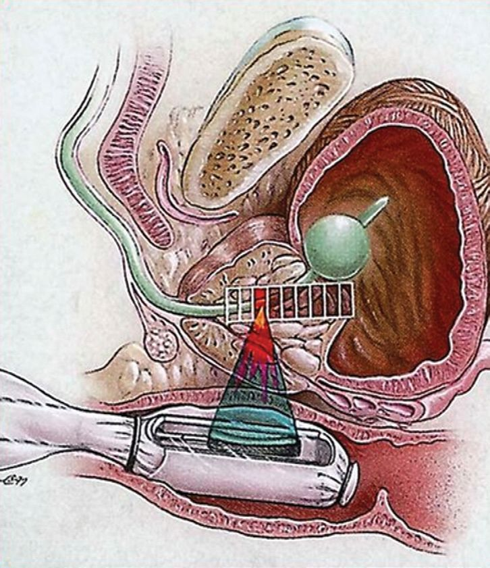

Slide 8
Indications:
Ideal indications for HIFU as primary therapy are:
Older patients (≥70 years) with clinical stage T₁-T₂ N₀ M₀ prostate cancer
Gleason score < 7
PSA < 15 ng /ml
Prostate vol < 40 ml
Particularly if patient refuses/is unsuitable for radical therapy
In this situation a lymph node evaluation is unnecessary and best chance for local control of cancer seems to be present.

Slide 9
Safety
MC complications after primary therapy with HIFU are
UTI
SUI
ED
Rectal burn and rectourethral fistula/Retention
Stenosis or strictures (Urethral/bladder neck)
With the technical improvements of the Ablatherm device c/c have decreased considerably
The use of TURP before HIFU also significantly decreases incidence of SUI, UTI, stenosis / strictures and BOO requiring TURP.
TURP is therefore indicated before HIFU. But this does not have any affect on disease control

Slide 10
HIFU in Localized Prostate Cancer
Madersbacher and colleagues (1995) were the first to examine the feasibility of HIFU for treatment of localized prostate cancer.
They demonstrated that HIFU resulted in a sharply demarcated lesion with no treatment effects in areas immediately adjacent to the treatment zone no heat damage was noted to rectum/neurovascular bundle even though HIFU was extended to prostatic capsule

Slide 11
HIFU after Radiation Failure
HIFU devices have also been tested for use as salvage therapy after radiation failure
The original ASTRO consensus panel recommendations were that treatment failure after external beam radiotherapy should be defined as two consecutive rises in the PSA after the occurrence of the PSA nadir. It specifically stated that this criterion for failure was not appropriate for other forms of radiation, for radiation combined with hormonal therapy, or for cryotherapy (and therefore other thermal-based approaches).
biochemical failure after radiation be defined as a rise of 2 ng/mL after nadir occurred, the so-called Phoenix criteria

Slide 12
Treatment of HIFU Failures
HIFU remains unique compared with other modalities for localized prostate cancer in that it results in much less adjacent tissue damage.
This makes it a repeatable technology and thus potentially more salvageable by other techniques when it fails.

Slide 13
Endorectal HIFU devices
There are currently two commercially available clinical HIFU instruments: Ablatherm, by EDAP TMS, and Sonablate manufactured by Focus Surgery Inc.

Slide 14
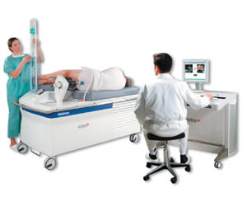
Ablatherm
Has a 4 cm focal length driven at 2.25-3 MHz and has an intensity of 1000 W/ sq. cm.

Slide 15
Sonablate system
Consists of chiller, probe, and console. The chiller circulates and cools water flowing around the HIFU transducer in order to cool the probe. The probe itself is also motorized, allowing for computer-driven movement and also includes both ultrasound imaging capability and HIFU treatment.

Slide 16
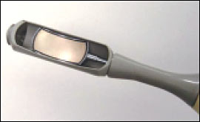
The Sonablate system probe uses a 4 MHz PZT transducer that produces a beam of 3, 3.5, or 4 cm focal length with an intensity at the focus of 1680-2000 W/ sq. cm.

Slide 17
Treatment Monitoring
In current practice, this is achieved in one of two ways–either by using real-time ultrasound, or MRI.
A t contrast enhanced MRI is the gold standard method.

Slide 18
Why HIFU?
Achieves the necessary temperature rise in the timescale required to ablate tumours.
Margin of ablation is accurate.
Ablated tissue is re-absorbed by the body
Non-invasive (extracorporeal transducers)
No blood loss
No therapeutic interference with other modalities
Repeatability.

Slide 19
Therapeutic Applications
Liver tumours.
Prostatic lesions.
Bladder.
Kidney.
Pancreatic malignancy.
Breast lesions.

Slide 20
Therapeutic applications.
Neuro surgical.
Obstetrics and Gynecology.
Role in Thrombolysis.
Role in Gene therapy.
Body sculpting.
Haemostasis.

Slide 21
Role of HIFU in liver.
Mainly are two indication HCC and Metastatic lesions.
Even though the surgery is mainstay of treatment, even after surgical resection survival rate of after 5 yrs only 25-30% so this makes HIFU as attractive non invasive treatment option.

Slide 22
Prostatic Lesions
BHP
Role of HIFU in treatment of BHP is not rewarding. Even though the symptoms are reduced in immediate post procedure period, but these results were temporary.
Symptoms reccured by 1 yr. HIFU is not recommended as alternative to Minimally invasive TURP

Slide 23
Prostatic Carcinoma
The treatment of carcinoma of the prostate (CaP) is more complex than that of BPH. Different treatment modalities have a place in the different disease stages.
The therapeutic choice for organ confined CaP lies essentially between radical prostatectomy and external beam radiotherapy, but the ability of HIFU to destroy the to destroy entire tumours successfully, makes HIFU as additive tool in the treatment of CaP

Slide 24
Pre-HIFU TURP is indeed now standard for treatment in Europe. Complications
Stress incontinence
Significant hematuria.
Immediate post procedure retention.
Erectile dysfunction
UTI.

Slide 25
Bladder
Superficial bladder cancer has also been identified as a potential target for treatment with extracorporeal HIFU.
Diagnostic ultrasound has been proposed as an alternative to cystoscopy.
If this is combined with HIFU this will obviate the need of invasive cystoscopy.

Slide 26
Kidney.
Although studies are not numerous, accuracy and reliability of HIFU techniques seems provide a useful non-invasive alternative to surgery for the treatment of advanced renal tumours.

Slide 27
Pancreatic Malignancy
HIFU is mainly used as palliative procedure in patient with advanced pancreatic malignancy.
The mean survival of the patients treated with HIFU increased from 6 to 12 months.
High-intensity focused ultrasound might be an effective treatment option for pain control, particularly in patients with tumors infiltrating the celiac plexus and in whom conventional pain treatments are not considered an effective option.

Slide 28
Breast
Main indications are fibroadenoma and localised malignancy.
Promising results are seen in treatment of localised malignancy.
Main advantage is repeatability after tumour reccurence.

Slide 29
Neurosurgical
Earliest clinical research HIFU was in the field of neurosurgery, Parkinson’s disease were treated at this time these early studies were all limited in part by the lack of accurate imaging facilities, and in part by the need for
craniotomy to provide an acoustic window in the skull.

Slide 30
Obstetrics and Gynecology
Uterine fibroids
Infertility treatment.
Umbilical vessel ablation

Slide 31
Role in Thrombolysis
Pulsed HIFU enhanced the tPA mediated thrombolysis of clot by 50%.
But does not show any significant increase in thrombolysis with the clot treated with only Pulsed HIFU.
There was corresponding increase in thrombolysis with increasing number of pulses and total acoustic power.

Slide 32
Gene therapy
“small, reparable tears or holes, which permeate a cell membrane and allow the insertion” of a substance into a cell without compromising its viability.
So HIFU has got tremendous role and great hope in transforming knowledge of Genetics into Medical treatments.

Slide 33
Body Sculpting
Recently, the medical use of HIFU has been extended to include the ablation of unwanted subcutaneous adipose tissue as a non-invasive method of body sculpting.

Slide 34
Haemostasis
Effective in arresting haemorrhage from either organs or vessels.

Slide 35
Limitations
As ultrasound waves cannot pass through the air filled structures, so HIFU cannot be used in tumours of lung.
Ablation of tumours lying in close proximity to bowel or indeed of the bowel wall itself, would run the risk of visceral perforation.
Treatment times- longer usually it will take few hours to complete the procedure

Slide 36
Requires anaesthesia.
Movement of organs at the time of exposure of HIFU limit the efficacy of treatment.

