Slide 1
ISCHEMIC HEART DISEASE
DR. SACHIN RATHI
06/07/2015

Slide 2
ISCHEMIC HEART DISEASE
INTRODUCTION
PATHOPHYSIOLOGY
IMAGING IN ISCHAEMIC HEART DISEASE (IHD)
COMPLICATION OF IHD

Slide 3
ISCHEMIC HEART DISEASE
INTRODUCTION
Ischaemic heart disease (IHD), the leading cause of morbidity and mortality.
Survivors of a first myocardial infarction are at increased risk of death from IHD at later ages.
Various contributing factors increasing risk
Need rational, evidence-based use of diagnostic and therapeutic means
Cardiac computed tomography (CCT) and cardiovascular magnetic resonance (CMR) important in IHD
Imaging techniques to study the highly complex and heterogeneous disease entity of IHD.
Notes:
Other conditions: Type II diabetes, physical inactivity and obesity

Slide 4
ISCHEMIC HEART DISEASE
PATHOPHYSIOLOGY
Coronary artery disease (CAD) usual cause of IHD.
Significantly impaired coronary blood flow leads to myocardial ischaemia .
Chronic stable plaque
Ruptured plaque (Acute Coronary Syndrome)
An ischaemic cascade: metabolic disturbances regional dysfunction ECG changes anginal symptoms.
20–30 min of sustained ischaemia leads to irreversible myocardial damage.
Myocardial infarctions are usually classified by (a) location (b) size and (c) duration
Notes:
Coronary artery disease (CAD), i.e. the process of atherosclerotic plaque formation, is the usual cause of IHD.
Myocardial infarctions are usually classified by (a) location (anterior, inferior, lateral), (b) size (focal necrosis, small (<10%), moderate (10–30%) and large (>30% of LV myocardium) and (c) temporally as evolving (<6 h), acute (6 h–7 days), healing (7–28 days) and healed (>28 days).

Slide 5
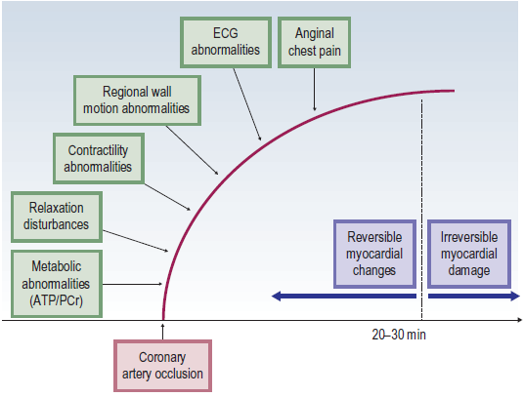

Slide 6
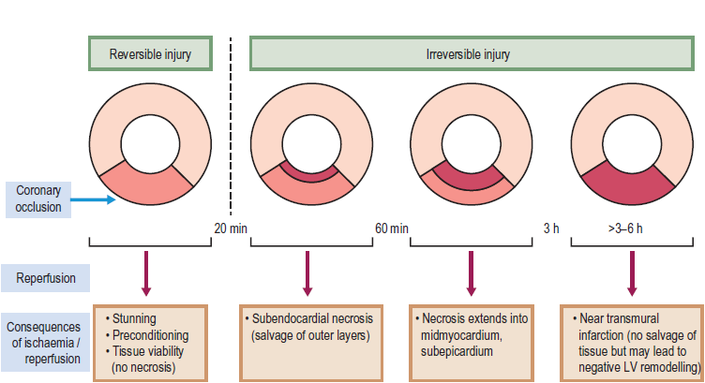

Slide 7
ISCHEMIC HEART DISEASE
IMAGING
Conventional Film (X-ray)
Conventional Coronary Angiography
Echocardiography
Cardiac CT and Coronary CT angiography
Cardiac MRI and MR Coronary Angiography
Single-photon Emission Computed Tomography (SPECT)
Positron Emission Tomography (PET)
Nuclear Cardiac Imaging (perfusion studies)
Stress Imaging

Slide 8
ISCHEMIC HEART DISEASE
Conventional Film (X-ray)
Provide valuable information about
cardiac size,
enlargement of a specific cardiac chamber
pulmonary filling status,
The chest X-ray help to exclude
pulmonary,
pleural or
aortic disease
Help to monitor therapy, demonstrate concomitant pulmonary disease , correct positioning of devices

Slide 9
ISCHEMIC HEART DISEASE
Conventional Coronary Angiography
Selective injection of contrast medium into the right and left coronary arteries and the left ventricle.
A percutaneous femoral arterial catheterization
catheters are passed into each coronary artery and one for the left ventricle
low osmolality contrast media with rapid filming at 25 frames/s
Images are acquired in multiple orientations
Notes:
is the usual approach (an alternative percutaneous route is the radial artery)
at least 3 shaped catheters are required – one for each coronary artery and one for the left ventricle)

Slide 10
ISCHEMIC HEART DISEASE
Coronary angiography provides information regarding
Severity and length of stenosis,
CA occlusions,
Number of vessels affected,
Stenosis configuration (smooth, ulcerated),
Presence of thrombus,
Collateral vessels,
CA anatomy and variants
Limitations :
Mild or nonstenotic CAD not visualised
No information about the plaque composition
Degree of vascular remodelling.
Notes:
Significant CAD is considered in the presence of a diameter stenosis of ≥ 70% in a major vessel or ≥ 50% in the left main,

Slide 11
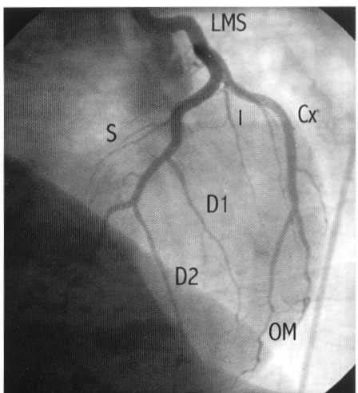
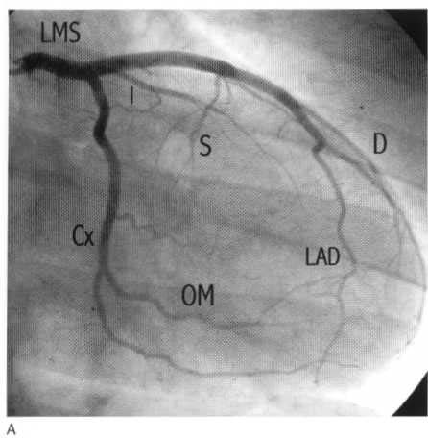
ISCHEMIC HEART DISEASE
Notes:
Sutton 274

Slide 12
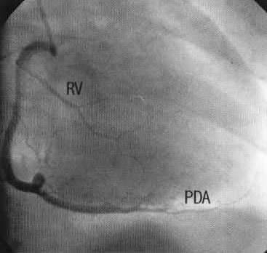
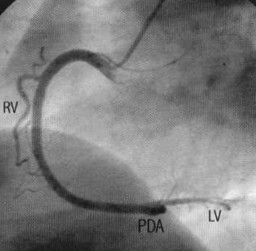
ISCHEMIC HEART DISEASE
Notes:
Sutton 274

Slide 13
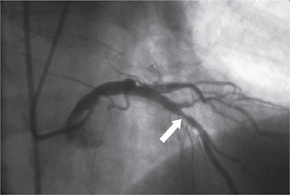
Selective coronary arteriogram (right anterior oblique with cranial angulation) shows a significant left anterior descending coronary artery stenosis

Slide 14
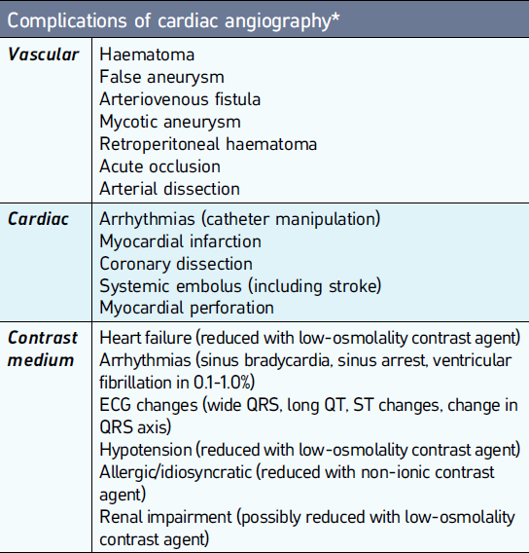
Notes:
Complication of conventional coronary angiography
Femoral
Dissection of femoral/iliac artery or aorta
Haematoma
Aorta
Damage to aortic intima
Embolus to head and neck vessels
Aortic root dissection
Coronary
Ostial dissection
Coronary embolus
Arrhythmia due to catheter wedging or contrast medium
Spasm due to catheter or contrast medium
General
Hypotension
Left heart failure-contrast overload

Slide 15
ISCHEMIC HEART DISEASE
Echocardiography
2D echocardiography : Imaging of the heart and great vessels through chest wall acoustic window.
Doppler echocardiography : estimate blood flow and pressure gradients
Contrast medium echocardiography :
Margins of the ventricular cavity.
Increase accuracy of assessing ventricular function
Assess myocardial perfusion
Stress echocardiography :

Slide 16
ISCHEMIC HEART DISEASE
Echocardiography
Demonstrate effects of IHD on ventricular function.
Detect structural complications
Demonstrate origins of the main coronary arteries and their anomalies

Slide 17
ISCHEMIC HEART DISEASE
Cardiac CT and Coronary CT angiography
Electron beam CT (EBCT)
less commonly used and uses an electronically steered beam of electrons allowing very rapid pulsing and rotation of the X-ray beam
Multidetector CT (MDCT)
Typically uses 16 rows of static detectors with fast tube rotations (with ECG triggering and control of the tube current modulation)
Images obtained at end diastole (at the point of least movement artefact)
Reliable imaging requires a regular, relatively slow heart rate (< 75 beats/min) may require beta blockade
Dual source cardiac CT :
Contain 2 X-ray tubes and 2 sets of detectors, require a reduced rotation speed
CTA Dual head injection pumps allow contrast injection to be followed by saline injection (or a mixture of contrast and saline) using biphasic or triphasic injection protocols (cf. single head pumps) ▶ the typical volume of contrast ranges from 50 to 120ml with an injection rate of 4–7ml/s

Slide 18
ISCHEMIC HEART DISEASE
Cardiac CT and Coronary CT angiography
Post Processing :
Multiplanar reconstruction (MPR)
Maximum intensity projection (MIP)
Surface shaded display (SSD)
Volume-rendered techniques
Notes:
Multiplanar reconstruction (MPR) This enables the viewing of any 2D section from a 3D dataset (the spatial resolution is the same for any orientation with near isometric voxels) ▶ a curved MPR can follow any tortuous anatomy
Maximum intensity projection (MIP) The highest attenuation voxels (CTA) or highest signal voxel (MRA) along any ray (line) are identified and projected onto a 3D image
Surface shaded display (SSD) All voxels with an attenuation or signal above a certain threshold are represented as a 3D image (which can be rotated in any direction)▶an imaginary source of illumination is used to provide 3D perspective
Volume-rendered techniques Volumes with a certain range of attenuations or SI are assigned a colour or grey scale density ▶ 3D reconstructions can benefit from the removal of areas of a certain.

Slide 19
ISCHEMIC HEART DISEASE
Has two major components:
Unenhanced coronary artery calcium scoring
Contrast enhanced coronary artery angiography.
Coronary Calcification : Agatston calcium score
Quantifies high attenuation material within the coronary arteries.
High calcium score predicts an increased risk of an adverse coronary event
Detect significant stenoses high sensitivity and specificity
Demonstrate normal coronary arteries and detect stenoses with a high positive and negative predictive value
MDCT can detect significant non-cardiac diagnoses

Slide 20
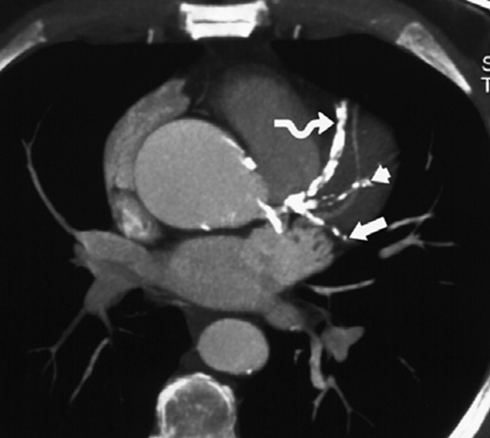
Axial thin MIP reconstruction from a coronary CTA shows multiple areas of dense calcification in the left anterior descending (LAD) (curved arrow), ramus intermedius (arrowhead), and circumflex (arrow) coronary arteries.

Slide 21
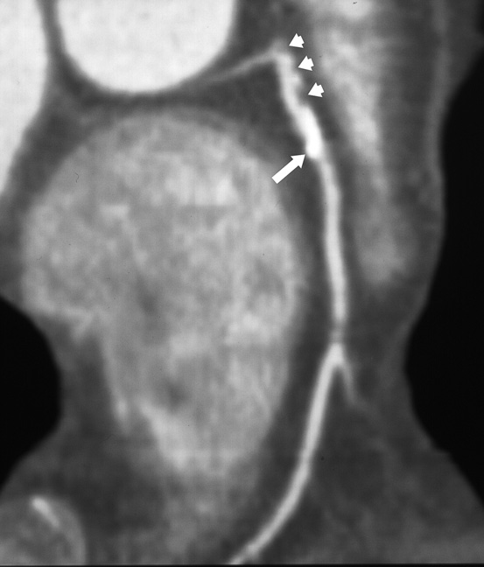
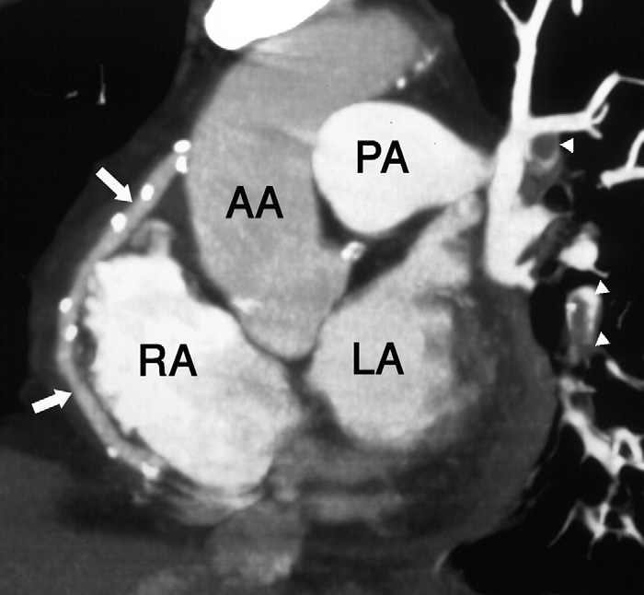

Slide 22
ISCHEMIC HEART DISEASE
Cardiac MRI and MR Coronary Angiography
Spin-echo imaging (‘Black blood’ imaging)
Gradient-echo imaging (White blood’ imaging)
Phase shift velocity mapping (quantification of flow velocities)
Myocardial perfusion imaging
Contrast-enhanced MRA
Myocardial tagging
Cardiac gating

Slide 23
ISCHEMIC HEART DISEASE
CMR indications and applications
Myocardial function at rest
Myocardial function during stress:
Myocardial perfusion and viability:
Coronary arteries and bypass grafts:
Valvular heart disease
Acutemyocarditis
Cardiac infiltration
Sarcoidosis
Amyloidosis
Myocardial iron overload

Slide 24
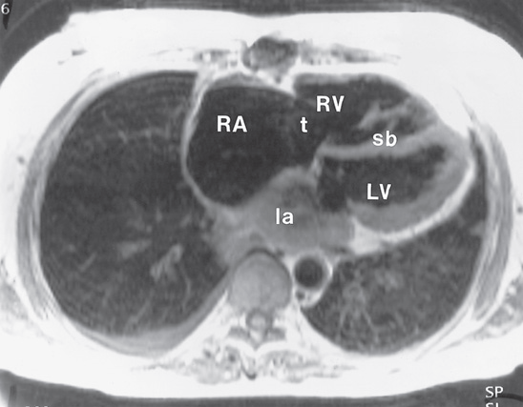
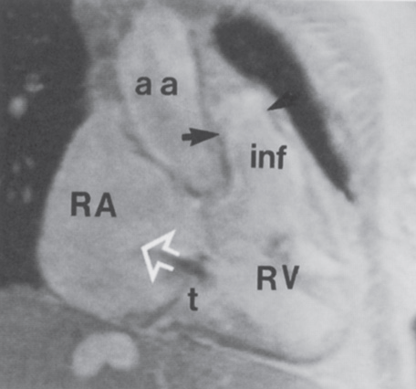
Axial MRI in mitral stenosis. (A) Axial ECG-gated spin-echo image of patient with mitral stenosis leading to right heart failure. Slow flow in the left atrium has produced high signal in that chamber.
(A)
(B) Oblique coronal breath-hold cine-MRA image of the heart. There is dilatation of the right atrium (RA) and right ventricle
(RV). There is mild tricuspid
regurgitation (jet of flow dephasing ¼ open arrow).
(B)

Slide 25
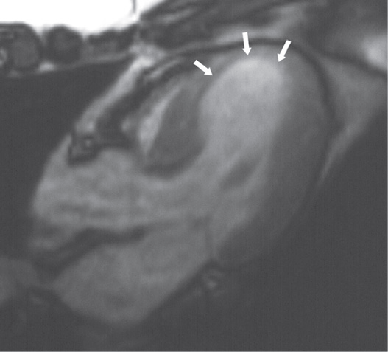
Evaluation of cardiac perfusion and viability by CMR. (A) Four-chamber long-axis view from cine-FISP MRA at end systole shows persisting apical myocardial thinning (arrows) while the basal myocardium thickens normally.
(A)
(B) Short-axis view obtained during a first pass of contrast (gadopentetate) through the myocardium shows delayed enhancement of non-viable myocardium best shown at an inversion time of 182 ms (arrows). * ¼ normal myocardium.*
(B)

Slide 26
ISCHEMIC HEART DISEASE
Single-photon Emission Computed Tomography (SPECT)
Nuclear medicine tomographic imaging technique using gamma rays.
A gamma-emitting radioisotope (radionuclide) injected intravenously followed by multiple planar projections are acquired using gamma camera rotates and reconstructed into tomograms.
Can combined with CT, which allow for attenuation correction and the provision of anatomical information

Slide 27
ISCHEMIC HEART DISEASE
POSITRON EMISSION TOMOGRAPHY (PET)
Positrons travel a very short distance in matter followed by an annihilation reaction with emission of two gamma photons in opposite directions are sensed simultaneously by opposing detectors.
This inherent spatial information allows construction of a tomographic image without the need for collimators.
Advantages over SPECT :
better spatial resolution and higher sensitivity
most physiological molecules can be use as tracers
measure tracer distribution in absolute terms as a function of time

Slide 28
ISCHEMIC HEART DISEASE
Nuclear Cardiac Imaging
Assessment of myocardial perfusion in CAD patients and risk stratification for major adverse cardiac events.
Commonly used radionuclides are
Thallium
99m Technetium MIBI (SESTAMIBI)
Myocardial perfusion imaging depends on differential flow delivering different amounts of activity to normal and ischaemic myocardium

Slide 29
ISCHEMIC HEART DISEASE
Thallium :
Myocardial perfusion agent.
Cyclotron produced and decays by electron capture.
Higher myocardial accumulation than 99m technetium
Poor resolution , long t1/2 (3 days), high cost and limited availability
Intracellular uptake and myocardial clearance proportional to the regional myocardial blood flow.
Stress images (5-30 min post injection)
Redistribution image (2-4 h post injection)

Slide 30
ISCHEMIC HEART DISEASE
99mTECHNETIUM MIBI (SESTAMIBI)
High myocardial accumulation (proportional to the regional perfusion) with a slow washout and a long myocardial retention time. Therefore imaging requires separate injections for stress and rest studies
Protocols:
1-day protocol: rest images stress images 4 h later
2-day protocol: stress images (1st day) rest images (2nd day, if the original stress images are abnormal)
A combined 99m technetium and thallium approach: an initial thallium injection immediate 99mtechnetium injection (as its higher energy photons are unaffected by any residual thallium)
Shorter t1/2 (6 h) allows larger doses, improved resolution, low cost and easy availability
no redistribution phase for viability assessment

Slide 31
ISCHEMIC HEART DISEASE
Stress Imaging
Anatomical imaging (conventional coronary angiography, CCT) provide limited information regarding the impact of a stenosis on the coronary flow.
Stress testing help to assess the extent of myocardial ischaemia.
Functional severity of a stenosis can be determined by the FFR During cardiac catheterisation.
In stress test , reversible ischaemia is achieved by stressing the heart and evaluating whether during stress, symptoms of angina, ECG signs of myocardial ischaemia, ischaemia-induced myocardial wall motion abnormalities or myocardial perfusion disturbances occur.

Slide 32
ISCHEMIC HEART DISEASE
Stress Imaging
In stress imaging, perfusion of heart is evaluated in resting and under stressful condition.
To induce stress in cardiac muscle, dobutamine is infused.
Dobutamine , β agonist which increases cardiac muscle contractility and heart rate leading to increase oxygen consumption. So blood supply to heart increases.

Slide 33
ISCHEMIC HEART DISEASE
Stress Imaging
Normally supplied myocardium shows a progressive increase in myocardial contractility.
Myocardium supplied by a flow-limiting coronary stenosis becomes ischaemic when the compensatory increase in coronary blood supply is insufficient to match the increased demand in oxygen.
This leads to various changes like wall motion abnormality, chest pain, changes ECG, delayed perfusion on CMR, nuclear perfusion imaging.

Slide 34
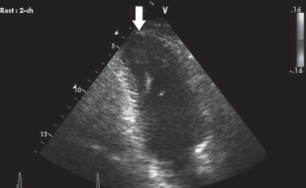
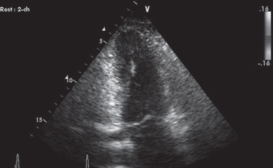
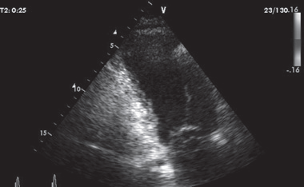
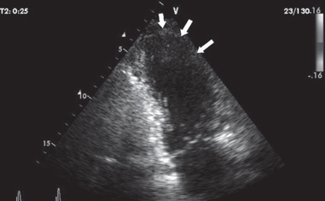
Stress echocardiography. (A) End-diastolic apical two-chamber view at rest shows thinning of the apical myocardium (arrow). (B) End-systolic apical two-chamber view at rest shows concentric contraction of left ventricle, except for the cardiac apex. (C) Enddiastolic apical two-chamber view during stress (dobutamine infusion) shows dilatation of the left ventricle when compared with (A). (D) End-systolic apical two-chamber view during stress (dobutamine infusion) shows dilatation of the left ventricle due to akinesia of the anterior wall to contract (arrows).

Slide 35
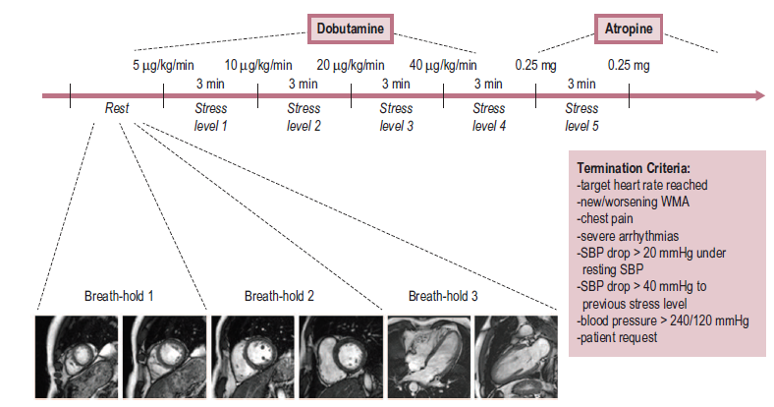
ISCHEMIC HEART DISEASE
Practical scheme for dobutamine stress CMR. Per stress level, four short-axis and two long-axis cine studies are obtained in three consecutive breath-holds, making it possible to evaluate the left ventricle for new wall motion abnormalities (WMAs). If termination criteria are not met at the highest dobutamine dose, atropine can be additionally administered.
Notes:
Practical scheme for dobutamine stress CMR. Per stress level, four short-axis and two long-axis cine studies are
obtained in three consecutive breath-holds, making it possible to evaluate the left ventricle for new wall motion abnormalities
(WMAs). If termination criteria are not met at the highest dobutamine dose, atropine can be additionally administered.

Slide 36
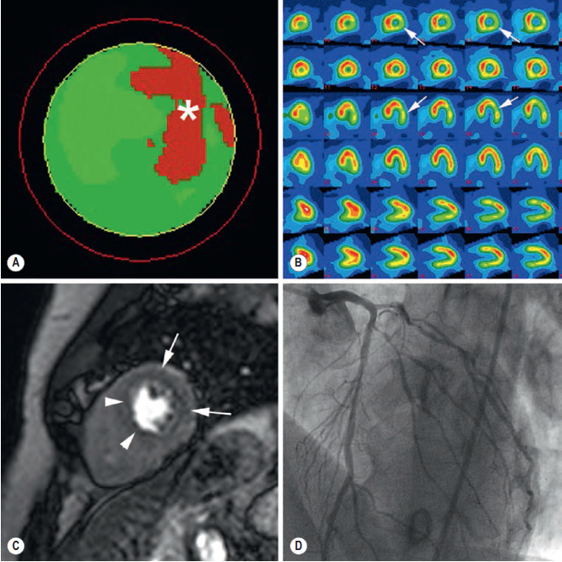
MIBI SPECT shows reversible perfusion defect in lateral LV wall with an estimated ischaemia of 19% of LV myocardium
(*, A) (arrows, B). Stress perfusion CMR shows extensive stress-induced perfusion defect in lateral LV wall (arrows, C) and subendocardial
perfusion in anterior LV wall and septum (arrowheads, C). At coronary angiography (D) severe two-vessel CAD is shown with distal LCx 80% stenosis, 1st lateral 80% stenosis, and mid anterior LAD 70% stenosis and distal LAD 80% stenosis.
Notes:
MIBI SPECT shows reversible perfusion defect in lateral LV wall with an estimated ischaemia of 19% of LV myocardium
(*, A) (arrows, B). Stress perfusion CMR shows extensive stress-induced perfusion defect in lateral LV wall (arrows, C) and subendocardial
perfusion in anterior LV wall and septum (arrowheads, C). At coronary angiography (D) severe two-vessel CAD is shown with distal LCx 80% stenosis, 1st lateral 80% stenosis, and mid anterior LAD 70% stenosis and distal LAD 80% stenosis.

Slide 37
ISCHEMIC HEART DISEASE
IMAGING IN ISCHAEMIC HEART DISEASE (IHD)
Myocardial Infarct Imaging
Most patients usually have obstructive coronary artery disease
Plaque rupture is important cause in <50% stenosis
Assessment of the electrical cardiac activity using 12-lead electrocardiography and analysis of cardiac biomarkers are central diagnostic techniques
Plaque fissuring thrombosis develop on the exposed intima artery occlusion infarction or unstable angina

Slide 38
ISCHEMIC HEART DISEASE
Increase cardiac marker recent myocardial injury and EEG infarct related artery
However no one give inside in evolving process.
Cardiac USG and Cardiac catheterisation visualised acute MI indirectly by abnormal wall motion but no idea about necrotic myocardium
Gated SPECT show MI as fixed defect with loss of function. Small subendothelial infarct can be missed.

Slide 39
ISCHEMIC HEART DISEASE
Cardiac Magnetic Resonance Imaging :
Give idea about inside process. Better resolution so subendocardial infarct can be easily pick up
Increase water on ischemic myocardium prolongs T2 relaxation and is related duration of ischemia
Late gadolinium enhanced CMR : in this delayed imaging is done and delay is of 10-25 min.
High spatial and contrast resolution allows depiction of subtle myocardial damage.
T2WI and LGE CMR images are used to determine area at risk and extent of infarction.
Difference between these two images show salvageable myocardium

Slide 40
ISCHEMIC HEART DISEASE
Various parameter to be look on CMR :
Infarct size
Infarct transmurality
Microvascular obstruction (CE CMR)
Postreperfusion hemorrhage (T2WI)

Slide 41
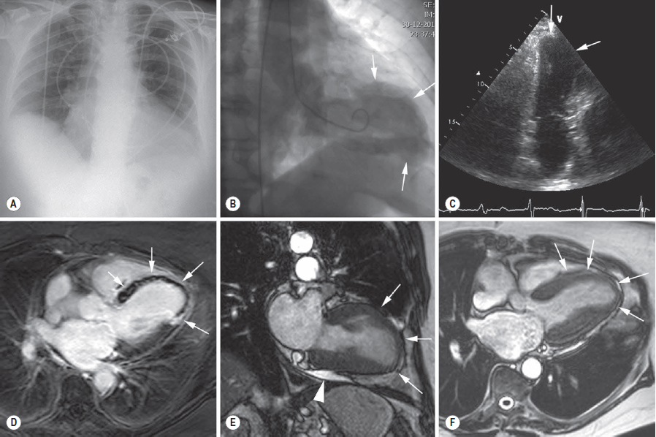
ISCHEMIC HEART DISEASE
Conventional CXR shows moderate cardiomegaly. LV contrast ventriculography (RAO position, end-systolic time frame) shows extensive area of decreased contractility involving the anterior wall, apex and the apicoinferior LV wall (arrows, B). Cardiac ultrasound (longitudinal parasternal view) reveals similar information (arrows, C). LGE CMR shows extensive myocardial infarction involving the majority of the ventricular septum, apical two-thirds of the anterior wall, apex, and apical inferolateral wall (arrows, D). While the periphery of the infarct is strongly enhanced, centrally an extensive zone of microvascular obstruction remains on LGE CMR, reflecting severe microvascular damage. The functional consequences of the infarction can be well appreciated on cine CMR

Slide 42
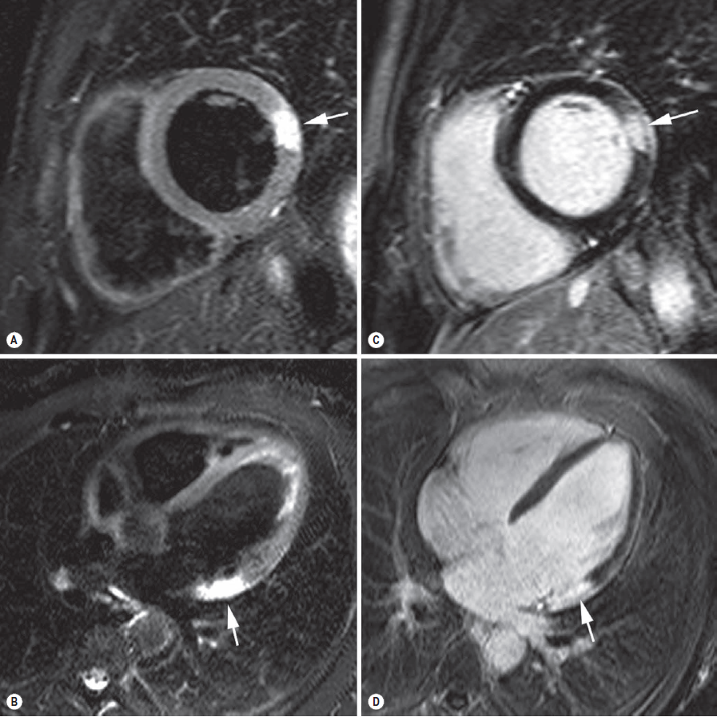
Acute laterobasal myocardial infarction. T2-weighted imaging in short axis (A) and horizontal long axis (B). LGE CMR in short axis (C), and horizontal long axis (D). Sharply defined zone of myocardial oedema in laterobasal (arrows, A, B). LGE CMR shows strong enhancement in anterior and lateral wall (arrows, C, D).
The extent of enhancement coincides very well with the extent of myocardial oedema, which means that the major
part of the jeopardised myocardium has been irreversibly damaged. In other words, myocardial salvage is very low.

Slide 43
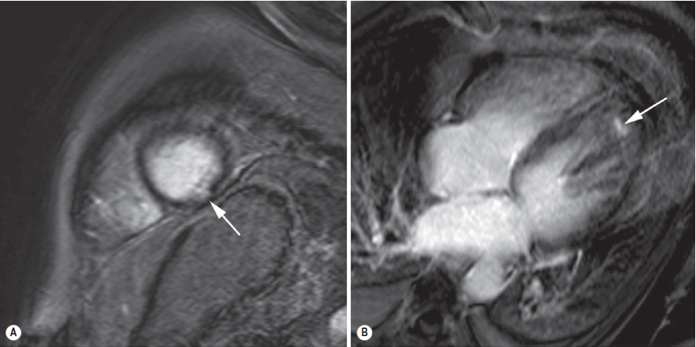
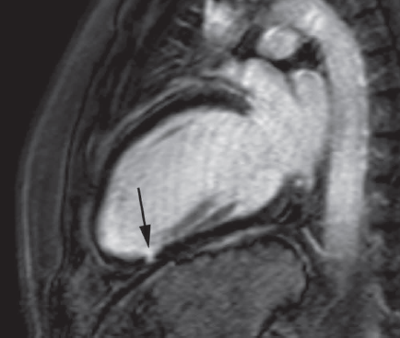
A 47-year-old patient admitted with retrosternal chest pain and left hemiparesis. Slightly increased cardiac enzymes (troponin I: 0.5 μg/L) and no evidence of obstructive CAD on coronary angiography. LGE CMR in cardiac short axis (A), horizontal long axis (B) and vertical long axis (C) show subtle myocardial damage

Slide 44
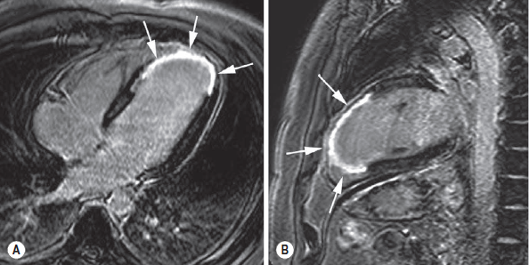
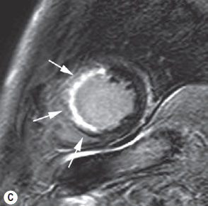
Typical presentation of acute transmural anterior myocardial infarction. LGE CMR in horizontal long axis (A), vertical long axis (B) and short axis (C). Transmural myocardial enhancement is shown in anterior myocardial

Slide 45
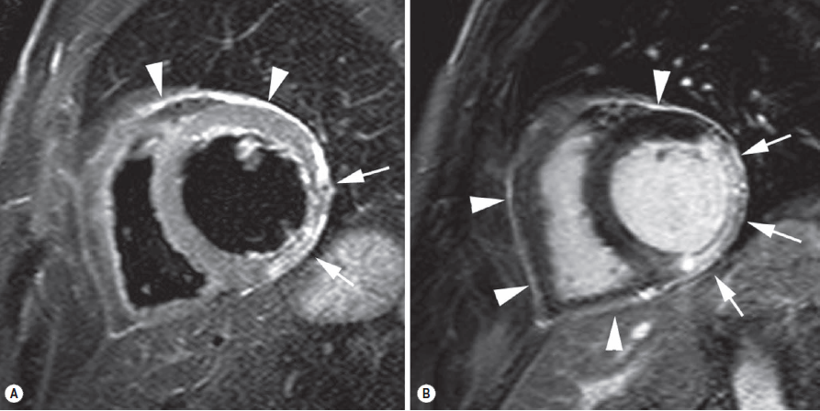
Acute transmural inferolateral myocardial infarction with secondary pericardial inflammation. T2-weighted CMR (A) and LGE CMR (B) in cardiac short axis. Presence of myocardial oedema (bright signal) in inferolateral LV wall (arrows, A), and presence of increased signal intensity of the pericardium mainly along the anterolateral part of the left ventricle (arrowheads, A). LGE CMR shows transmural enhancement of the inferolateral LV wall (arrows, B) and diffuse enhancement of a minimally thickened pericardium (arrowheads, B) reflecting infarct-related pericardial inflammation.

Slide 46
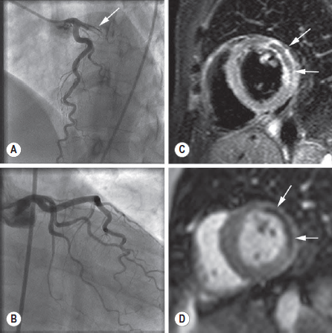
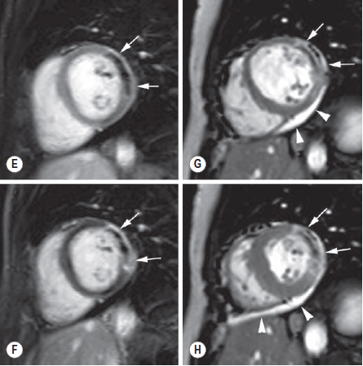

Slide 47
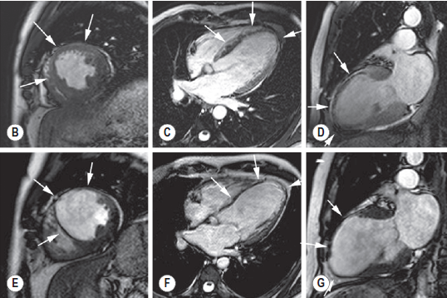
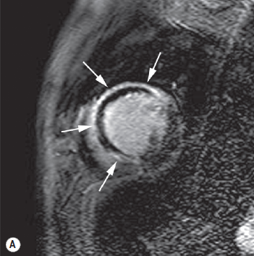
Short-axis LGE CMR (A) early post-infarction shows extensive transmural enhancement (arrows; segments with large zone of microvascular obstruction.
Cine CMR early (B–D) and 6 months (E–G) post-infarction. Note the important wall thinning of the involved segments with aneurysm formation at 6-month follow-up (arrows, E–G).

Slide 48
ISCHEMIC HEART DISEASE
COMPLICATION OF IHD
Cardiac Rupture
Left Ventricular Aneurysm
False or pseudoaneurysm
Post-infarction VSD
Post-infarction MR
Ventricular Thrombosis
Dressler’s syndrome

Slide 49
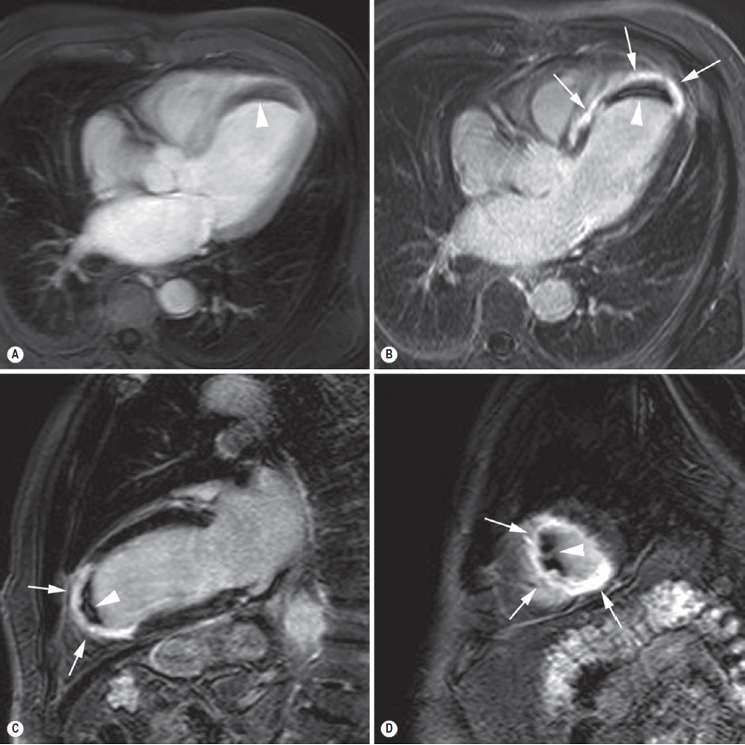
Thrombus formation post-infarction. Contrast-enhanced inversion-recovery CMR early following contrast administration (A) showing myocardium is brightly hyperintense, and the blood pool is strongly enhanced. An intracavitary is visible as a hypointense structure (arrowhead, A). LGE CMR in horizontal long axis (B), vertical long axis (C) and apical short axis (D). On LGE CMR the irreversibly damaged myocardium in the LAD perfusion territory is strongly enhanced (arrows, B–D) and the adjacent mural thrombus is well visible
(arrowhead, B–D).

Slide 50
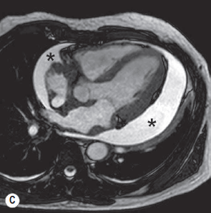
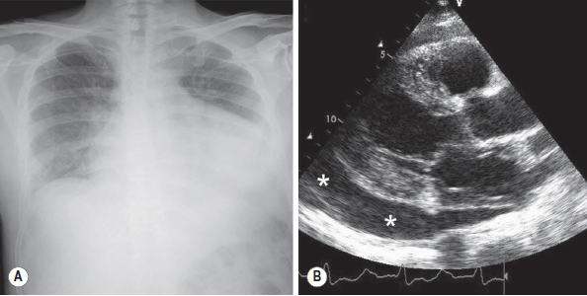
Chest radiograph (A) showing presence of severe cardiomegaly caused by lateral displacement of the left heart border. The abnormalities are caused by a moderate to severe pericardial effusion as clearly visible on cardiac ultrasound (*, B).
CMR confirms the cardiac ultrasound findings

Slide 51
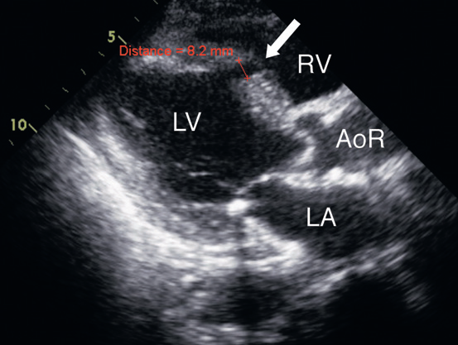
(A) Long-axis view from transthoracic echocardiography shows an 8mm echo-free area (arrow) in the interventricular septum representing an infarct VSD.
Infarct VSD
(A)
(B) Equivalent view with colour Doppler shows variable colour (high-velocity flow, arrow) in the infarct VSD.*
(B)

Slide 52
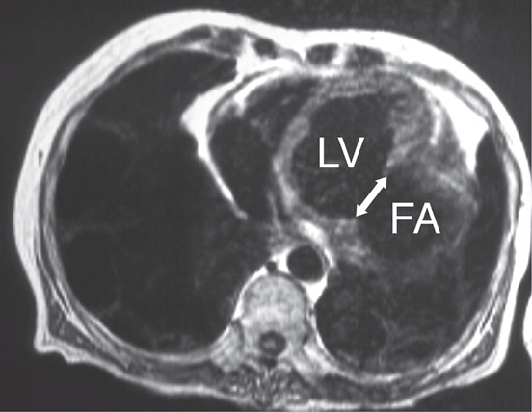
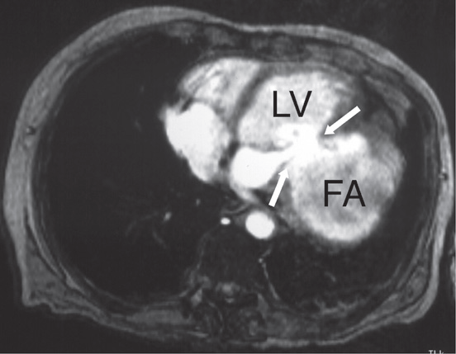
False aneurysm
(A)
(A) Axial spin-echo MRI image
shows a large false aneurysm (FA) arising from the posterior wall of the left ventricle (LV). Note the abrupt change in contour at the mouth of the FA (arrow).
(B)
(B) Axial cine-MRA image at
the same level as (A) shows
flow into the FA (arrows)

Slide 53
THANK YOU

