Slide 1
PINEAL REGION MASS
Dr Mohit Goel
JR 1
15 Dec. 2012

Slide 2
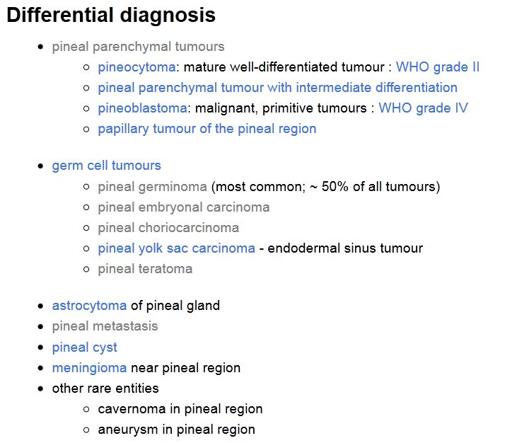
Pineal Region Mass

Slide 3
Signs and symptoms of pineal region masses are most often related to mass effect on the adjacent structures, but higher-grade structures, such as a pineoblastoma, may also invade the surrounding tissue.
These signs and symptoms include Parinaud syndrome (it consists of a failure of conjugate vertical eye movement, failed ocular convergence, and blepharospasm),
precocious puberty,
and, rarely, pineal apoplexy.
Hydrocephalus results from obstruction of the aqueduct of Sylvius; patients may also develop headache, nausea, and vomiting as a result of increased intracranial pressure.
Precocious puberty is more commonly associated with germ cell tumors (GCTs) and may be related to increased human chorionic gonadotropin (hCG) secreted by the tumor.
Hemorrhage into a pineal tumor or cyst is referred to as pineal apoplexy; the most common presenting symptom is a sudden decrease in consciousness associated with headache.

Slide 4
Tumors of Pineal Parenchymal Origin
Pineal parenchymal tumors are rare lesions, accounting for less than 0.2% of intracranial neoplasms.
These lesions include
the low-grade pineocytoma,
the intermediate-grade pineal parenchymal tumor of intermediate differentiation (PPTID), and
the highly malignant pineoblastoma.
Pineocytoma
Pineocytoma is a slow-growing lesion that accounts for 14%–60% of pineal parenchymal neoplasms it is most common pinel prenchyml tumour. Well demrcted round nd lobulted ..mc ge is 40yrs dult. Grows slowly stble for yers
Imaging Findings.—
At computed tomography (CT), pineocytomas are well demarcated, usually less than 3 cm, and iso- to hyperattenuating. Pinel clcifiction is exploded

Slide 5
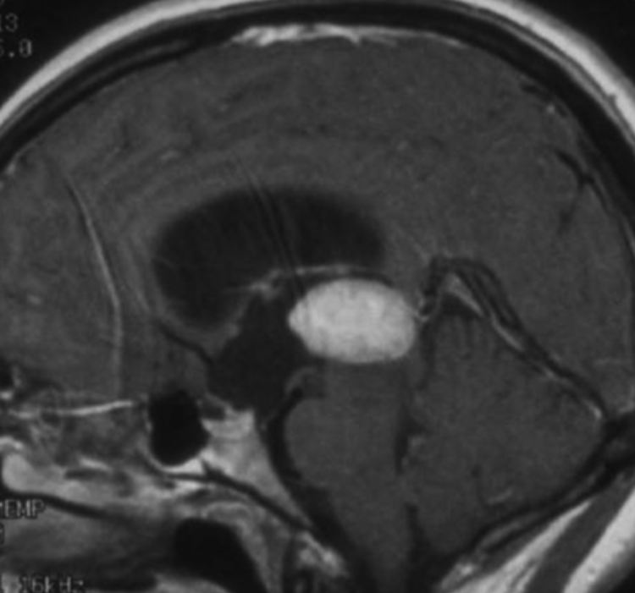
Pineal parenchymal tumors expand and obliterate pineal architecture, “exploding” the normal pineal calcification toward the periphery.
At MR imaging, pineocytomas are well-circumscribed lesions that are hypo- to isointense on T1-weighted images and hyperintense on T2-weighted images.
On postcontrast images, they typically demonstrate avid, homogeneous enhancement.
Cystic or partially cystic changes may occur which may show hemorrhage, occasionally making differentiation from a pineal cyst difficult
Variable enhancement- solid, rim, nodular
d/d – pineal cyst. Germinoma ( engulfing type
Ca++), PPTID
Pineocytoma in a 35-year-old man with a history of headaches. Sagittal postcontrast T1-weighted MR image shows an avidly enhancing mass in the pineal region with resultant hydrocephalus.

Slide 6
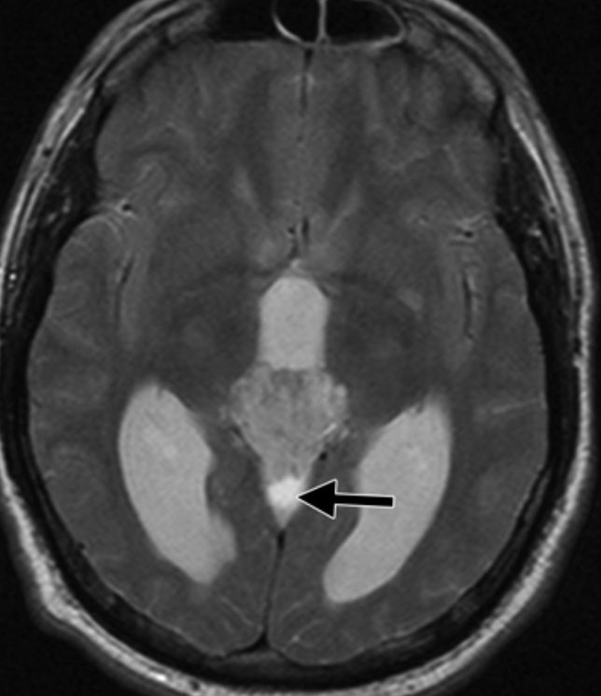
Pineal Parenchymal Tumor of Intermediate Differentiation
They make up at least 20% of all pineal parenchymal tumors and affect patients of any age, but the peak prevalence is in early adulthood. WHO grade 2 or 3
Imaging Findings.—No specific imaging findings separate PPTID from pineoblastoma or pineocytoma. PPTIDs demonstrate high signal intensity on T2-weighted images and enhance on postcontrast images. Cystic areas may also be seen.
Axial T2-weighted MR image shows a hyperintense mass involving the pineal region with resultant hydrocephalus. A cystic region is present posteriorly (arrow).

Slide 7
Pineoblastoma
Pineoblastomas are highly malignant lesions that represent the most primitive form of pineal parenchymal tumors and account for 40% of pineal parenchymal tumors.
They are embryonal tumors described as a primitive neuroectodermal tumor of the pineal gland. WHO grade 4.
They most commonly occur in the first 2 decades but can occur at any age, and there is no gender predilection.
CSF dissemination is a common finding and necessitates imaging of the entire craniospinal axis and it is the most common cause of death.
Imaging Findings.—
CT reveals a large (typically ≥3 cm), lobulated, typically hyperattenuating mass, an appearance that reflects its highly cellular histologic features.
The pineal calcifications, if seen, may appear exploded at the periphery of the lesion. Nearly 100% of patients have obstructive hydrocephalus.

Slide 8
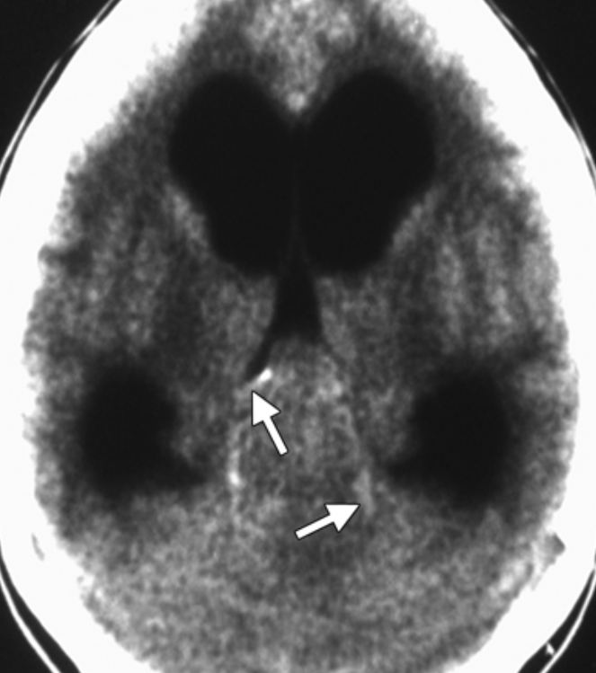
At MR imaging, pineoblastomas are heterogeneous in appearance, with the solid portion appearing hypo- to isointense on T1-weighted images and iso- to mildly hyperintense to the cortex on T2-weighted images. Pineoblastomas demonstrate strong but heterogeneous enhancement on postcontrast images.
Necrosis and hemorrhage is common
Dwi- restriction+
Look for CSF spread
Pineoblastoma in a 10-year-old girl with lethargy, emesis, and downward gaze. Axial nonenhanced CT image shows a large pineal region mass with resultant hydrocephalus. The pineal calcifications are exploded toward the periphery (arrows).

Slide 9
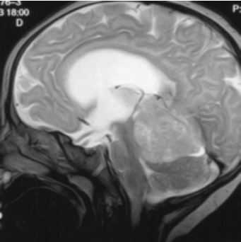
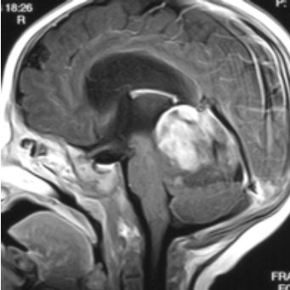
Pineoblastoma in a 4-year-old boy with nausea and vomiting.
Sagittal T2-weighted MR image shows a large mass in the pineal region with resultant hydrocephalus. The mass is hyperintense relative to gray matter.
(b) Postcontrast T1-weighted MR image shows heterogeneous enhancement within the mass.

Slide 10
Papillary tumour of pineal region
Newly recognized tumour probabaly arise from wall of 3rd ventricle with ependymal diffrentiation
WHO grade 3 or 4 shows local recurrence and CSF dissimination
Imaging ; nonspecific large lobulated enhancing mass
Dd: PPTID

Slide 11
Germ Cell Tumors
Central nervous system GCTs are most commonly located in the pineal and suprasellar regions.
The WHO classifies them into
germinomas and
nongerminomatous GCTs.
The nongerminomatous GCTs include
teratomas,
embryonal carcinoma,
yolk sac tumor,
choriocarcinoma, and
the mixed GCTs.
Genrally affect childrens and young adults < 20 yrs
Many secrete oncoproteins like b- hcg and a- fetoproteins.

Slide 12
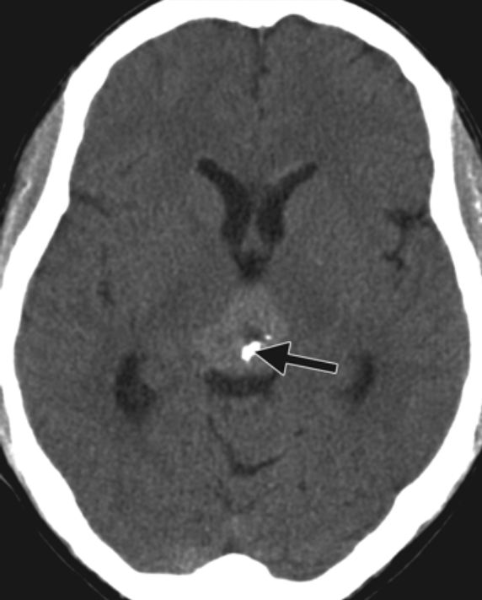
Germinoma
Commonly affect midline structures. Pineal > suprasellar > basal ganglia.
Multiple involving pineal and suprasellar cells.
Fifty percent to 65% of intracranial germinomas occur in the pineal region, and 25%–35% are located in the suprasellar region.
Dissemination by CSF and invasion of the adjacent brain commonly occur.
Imaging Findings.—
CT demonstrates a sharply circumscribed,
hyperattenuating mass that engulfs the
pineal calcifications. The increased attenuation
is related to the highly cellular lymphocyte
component within the tumor.
Enhnaces strongly and uniformly
Hydrocephalus may be present.

Slide 13
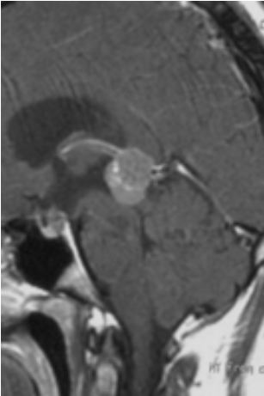
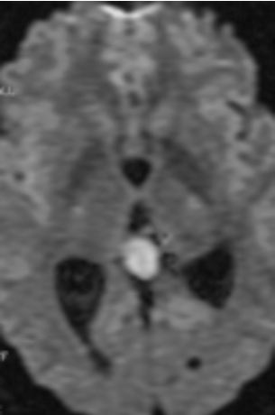
MR imaging typically reveals a solid mass that may have cystic components.
Germinomas are iso- to hyperintense to gray matter on T1- and T2-weighted images and demonstrate avid, homogeneous enhancement on postcontrast images.
Restriction of diffusion may be seen. GRE image show central calcification.
Sagittal postcontrast T1-weighted MR image shows a lesion in the pineal region that homogeneously enhances. Note the associated mild hydrocephalus.

Slide 14
Teratoma
There are three types of teratoma: mature teratoma (fully differentiated tissue), immature teratoma (complex mixture of fetal-type tissues from all three germ layers and mature tissue elements), and teratoma with malignant transformation.
Imaging Findings.—
CT reveals a multiloculated, lobulated lesion with foci of fat attenuation, calcification, and cystic regions.
Large holocranial or extracranial lesion in newborn – most likely teratoma
Distorts skull brain and splits sutures. Intracranial structures may be unrecognisable.
May extend through skull base into oral cavity.
T1-weighted MR images may show foci of T1 shortening due to fat and variable signal intensity related to calcification.
On T2-weighted images, the soft-tissue component is iso- to hypointense. The soft-tissue component demonstrates enhancement on postcontrast images. The malignant form may have a more homogeneous imaging appearance (fewer cysts and calcifications).
Causes obstructive hydrocephalus.

Slide 15
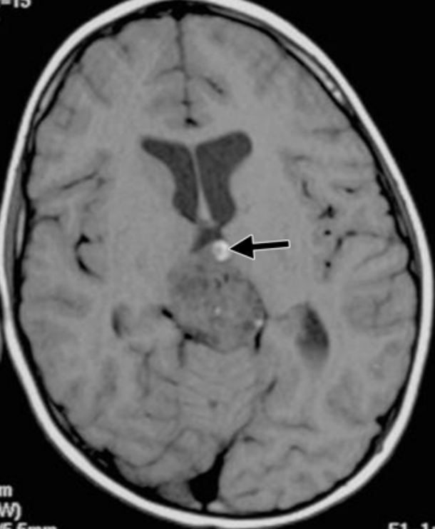
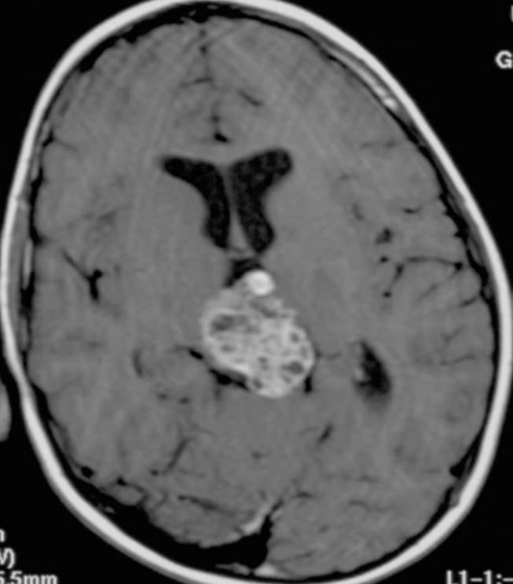
Axial T1-weighted MR image shows a lobulated, heterogeneous lesion that contains an area of hyperintensity (arrow), a finding consistent with fat.
Postcontrast MR image shows enhancement of the soft-tissue portions of the lesion.

Slide 16
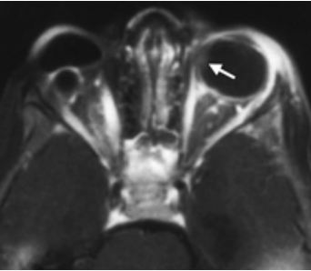
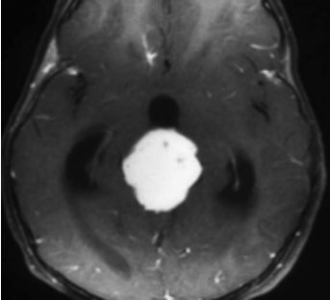
Trilateral Retinoblastoma
Trilateral retinoblastoma refers to the presence of bilateral ocular retinoblastoma and an intracranial, typically midline, small cell tumor. Intracranial tumors associated with retinoblastoma occur most frequently in the region of the pineal gland (pineoblastoma).
The second most common location is the suprasellar region.
Trilateral retinoblastoma in a 2-year-old girl with a history of enucleation for retinoblastoma. (a) Axial postcontrast fat-saturated T1-weighted MR image shows a focus of enhancement along the medial wall of the left globe (arrow), a finding consistent with retinoblastoma. The right globe was removed due to retinoblastoma, and a prosthesis is in place. (b) Axial postcontrast T1-weighted MR image shows an associated enhancing pineoblastoma with resultant hydrocephalus.

Slide 17
Pineal Cyst
Pineal cysts occur in all age ranges but are most predominant in adults 40–49 years of age.
Their origin is debated, with some suggesting they result from degenerative changes in the gland.
These lesions are typically asymptomatic and are usually 2–15 mm in size.
Follow-up studies have indicated that these lesions remain stable in size over time. When they exceed 15 mm, patients may become symptomatic, typically with headache or visual changes.
Intracystic hemorrhage (“pineal apoplexy”) and acute hydrocephalus rarely occur; resultant death has been reported.

Slide 18
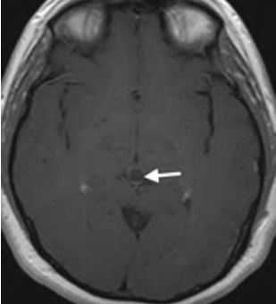
Axial postcontrast T1-weighted MR image
shows a round, low-signal-intensity, 8-mm
lesion in the pineal region, a finding
consistent with a cyst. The lesion has a
thin incomplete enhancing rim (arrow).
No nodularity of the wall and no associated
hydrocephalus are seen.
At delayed imaging, uniform enhancement of the cyst has been reported, resulting in the appearance of a solid mass. The mechanism behind this finding is not understood, but it may be related to passive diffusion of the contrast agent through the cyst wall or to active secretion of contrast agent by the cyst wall.
Fine internal septa and internal cysts may be seen at high-resolution imaging. The differential diagnosis includes cystic tumors such as astrocytoma, pineocytoma, and pineoblastoma.

Slide 19
Astrocytoma
Astrocytomas arising in the pineal region are uncommon. They derive from stromal astrocytes, and in the pineal region they arise from the splenium of the corpus callosum, the thalamus, or the tectum of the midbrain. Rarely, they may arise from the neuronal elements within the pineal gland.
Those that occur in the region of the tectum are usually low grade (WHO grade I or II) and result in enlargement of the tectum with secondary obstruction of the aqueduct.
At MR imaging, bulbous enlargement of the tectal plate is noted. The lesion is typically isointense on T1-weighted images and hyperintense on T2-weighted images with no to minimal enhancement on postcontrast images.

Slide 20
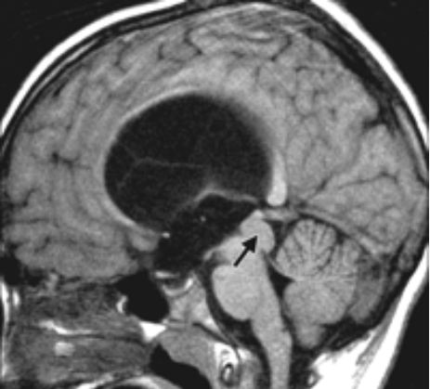
Tectal glioma in a 5-year-old girl with headaches and drowsiness.
Sagittal nonenhanced T1-weighted MR image shows enlargement of the tectal plate (arrow) with resultant compression of the aqueduct. There is marked hydrocephalus involving the lateral and third ventricles.

Slide 21
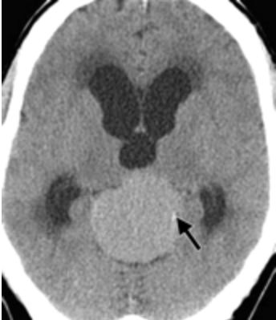
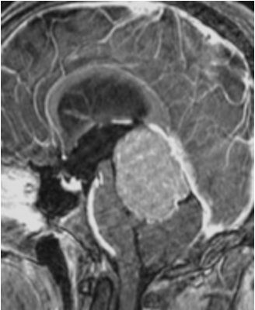
Meningioma
At CT, meningiomas are typically hyperattenuating, reflecting the highly cellular nature of these lesions.
Calcifications are seen in 15%–20%. They are vascular, so avid enhancement is seen on postcontrast images. At MR imaging, they are hypo- to isointense on T1-weighted images and iso- to hyperintense on T2-weighted images
Nonenhanced CT image shows a large hyperattenuating lesion with an associated calcification (arrow) in the pineal region.
(b) Sagittal postcontrast T1-weighted MR image shows a homogeneously enhancing broad-based lesion attached to the tentorium.

Slide 22
Metastasis
Metastases to the pineal gland are rare.
The most common tumors to spread to the pineal region are those of the lung (most frequent), breast, kidney, esophagus, stomach, and colon.
Pineal metastases may be present without metastases to the brain parenchyma.

Slide 23
Thank you

