Slide 1
PERFUSION CT
DR. DEEPIKA SOLANKI

Slide 2
Perfusion
Perfusion is defined as the passage of fluid through the blood vessels to an organ or a tissue. The practice of perfusion scanning, is the process by which this perfusion can be observed, recorded and quantified

Slide 3
Technique
Before the patient arrives:
Injector filled with contrast medium warmed up to body temperature.
Injector settings:
Recommended: 4 ml/s, 50 ml
Conc. Of the contrast (non ionic iodinated contrast) recommended: 300mg/ml
Scan Protocols loaded:
Standard pre-contrast Head
Perfusion (DynMulti/ Volume)
.
Notes:
If 370 mg of iodine per milliliter is used, a volume of 40 mL is given at a rate of 4 mL/sec with a scan duration of 45 seconds

Slide 5
Notes:
. After unenhanced CT of the whole brain, four adjacent 5-mm-thick sections are selected starting at the level of the basal ganglia. At this level, all three supratentorial vascular territories are visualized

Slide 6
At 5 seconds after initiation of the injection, a cine (continuous) scan is initiated with the following technique: 80 kVp, 190–200 mA, 4 × 5-mm sections, 1-second per rotation for a duration of 50 seconds
Patient on a table with a cannula of 16, 18 gauge
Patient’s head pulled towards the chest, well fixed, patient calmed down
Topogram + pre-contrast scan (In case of hemorrhage don’t continue).
Cut-line positioning: through the basal ganglia, perpendicular to the occipital bone,
Start the scanner and the injector simultaneously
Watch the patient during scanning (50s)

Slide 7
Perfusion CT is performed by monitoring only the first pass of an iodinated contrast agent bolus through the cerebral circulation . It involves continuous cine imaging for 50 seconds over the same slab of tissue during the dynamic administration of a small (50-mL), high-flow contrast material bolus (injection rate, 4–5 mL/sec).

Slide 8
1. The contrast agent passes through the brain tissue, causing a transient hyperattenuation that is directly proportional to the amount of contrast material in the vessels and blood in that region. This principle is used to generate time-attenuation curves for an arterial ROI, a venous ROI, and each pixel. 2. The arterial ROI is optimally selected in one unaffected vessel that is perpendicular to the acquisition plane, either one of the anterior cerebral arteries (ACAs) or the contralateral MCA. The venous ROI is placed over the superior sagittal sinus or torcular Herophili. 3. The curve must have included an initial plane before rising and a decline before the end of the acquisition and to distinguish good arterial input function or venous outflow function (the venous curve must be higher than and represent a 1–2-second delay after the arterial curve).
Notes:
Despite there being new, accurate automatic options in the available software to generate all the maps, it is still frequently better to use a semiautomatic option, which consists of first manually tracing a large ROI around the vessel and then letting the software automatically select an accurate ROI. In emergency settings, we prefer to select an ACA as the default arterial input function for simplicity because it has been shown to be adequate .

Slide 9
Perfusion - basic parameters
Blood Flow – basic parameter . It indicates the amount of Blood flow through the brain in a specific period.
Unit: ml/min/100g
Blood Volume – It is the percentage of blood in a specific volume of the tissue.
Unit: ml/100g
Mean Transit Time – difference between the arterial inflow and Venous outflow in the region of interest.
Unit: sec
Time To Peak – time from arterial start to the tissue enhancement peak,
Unit: sec or 0.1sec
Permeability - the rate of passage of blood across a wall of tissue capillaries, Unit: ml/min/100g

Slide 10
Perfusion - Calulations
What we see is the contrast medium:
Appearing, disappearing, recirculating
What we are interested in is the blood flow, volume…
Out of dynamically changing enhancement of the contrast media
we have to calculate temoporarily constant values of blood flow.

Slide 11
Hemodynamics:
In normal human brain:
1. CBF (mL/100g/min): ~ 50 mL/100g/min
2. CBV (mL/100ml tissue): ~ 4 mL/100ml tissue
3. MTT = CBF / CBV (sec): ~ 5 seconds

Slide 12
The theory behind this technique is the central volume principle, which relates cerebral blood flow (CBF), cerebral blood volume (CBV), and mean transit time (MTT) in the following equation:
CBF = CBV/MTT
Notes:
Contrast agent time-concentration curves are generated in an arterial region of interest (ROI), a venous ROI, and in each pixel. Deconvolution of arterial and tissue enhancement curves, a complex mathematic process, gives the MTT. CBV is calculated as the area under the curve in a parenchymal pixel divided by the area under the curve in an arterial pixel. The central volume equation can then be solved for CBF

Slide 13
Ishemia hemodynamics
Collateral flow – increased MTT
Vasodilatation – increased CBV (until CPP decreased)
End result – decreased CBF

Slide 14
Notes:
There is a linear relationship between contrast agent concentration and attenuation, with the contrast agent causing a transient increase in attenuation proportional to the amount of contrast agent in a given region. Contrast agent time-concentration curves are generated in an arterial region of interest (ROI), a venous ROI, and in each pixel. Deconvolution of arterial and tissue enhancement curves, a complex mathematic process, gives the MTT. CBV is calculated as the area under the curve in a parenchymal pixel divided by the area under the curve in an arterial pixel. The central volume equation can then be solved for CBF

Slide 15
Ischemic thresholds
< 20 cc/100 gm/min-electrical electrical dysfunction
< 12 cc/100 gm/min-loss of viability
? 30 minutes duration

Slide 16
The overall effective dose required for dynamic CT (2.0–3.4 mSv) is only slightly higher than that required for routine head CT (1.5–2.5 mSv)

Slide 17
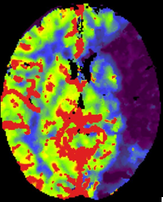
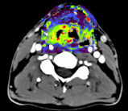
Perfusion - Aim
Why we want to measure perfusion
Brain Stroke
Tumors (Head & Body)
Body perfusion
Detection and assessment of ischemic stroke
(Lower perfusion )
Diagnosis, staging, assessment of tumour grade and prognosis
Treatment response
Post treatment evaluation
Prognosis of therapy effectiveness
(Higher perfusion indicates active part of a tumor - angiogenesis)

Slide 18
CT Perfusion in Ischaemic Stroke
Its advantage is that it is able to delineate areas of the brain which may be salvaged by intervention (e.g. thrombolysis or clot retrieval), known as the penumbra , from the parts which are irrevocably destined to go onto infarct regardless of therapy, known as the infarct core

Slide 19
The infarct core is the part of the ischaemic brain which has already or is destined to infarct regardless of therapy. It is defined as an area with prolonged MTT or Tmax, markedly decreased CBF and markedly reduced CBV .
The ischaemic penumbra, which in most cases surrounds the infarct core, also has prolonged MTT or Tmax but in contrast has only moderately reduced CBF and importantly near normal or even increased CBV (due to autoregulatory vasodilatation) ¹⁻³.

Slide 20
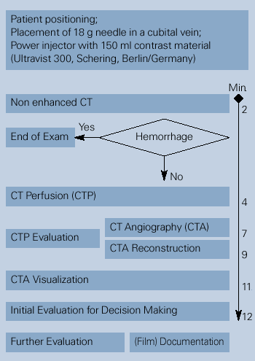
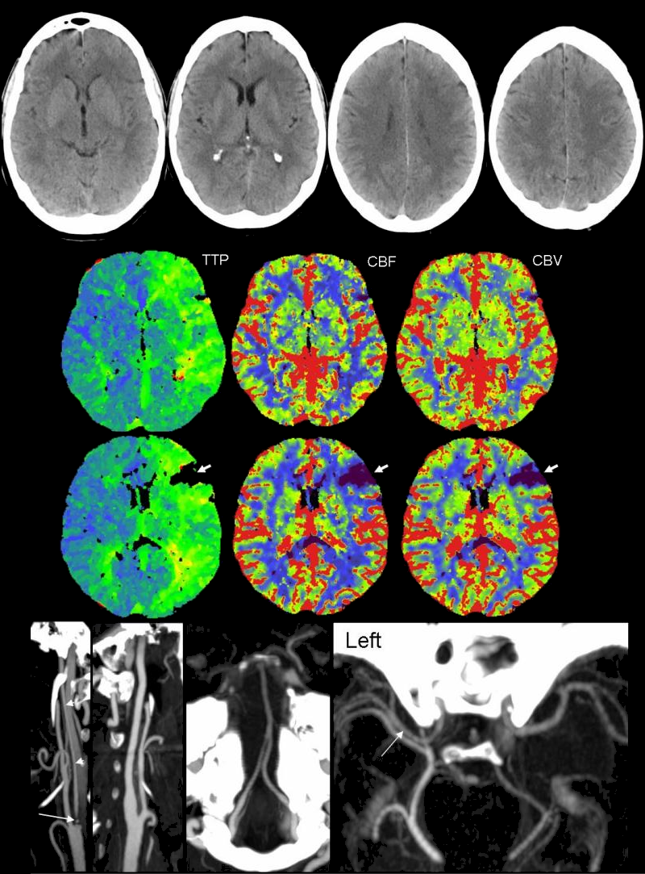
Plain CT, Perfusion CT and CTA: Comprehensive stroke assessement in less than 15 minutes
Examination
Notes:
Bern D Tomandl From the University of Bremen former University of Erlangen has described in his radiographics paper a complete stroke assessment for CT in less than 15 min..
Plain CT is the typical primary imaging modality with proven excellence to demonstrate or rule out hemorrhagic stroke and a high (24/7 availability)
After intracranial hemorrhage is excluded with nonenhanced CT
perfusion CT is immediately started, Perfusion CT shows hemodynamic status type and extent of ischemic process aswel as quality of collateral flow CTA provides information about vascular pathology shows (confirms) occlusion type and location as well improves planning of potential interventionsPlain CT
The evaluation of the perfusion CT data occurs simultaneously with the acquisition and reformatting of the CT angiography source images. Data acquisition with the three studies is generally completed within 7–8 minutes.
Multiplanar reformatting and postprocessing of the CT angiograms with maximum intensity projection (MIP
Within less than 15 min which are required for the evaluation of all data, a safe therapeutic decisions concerning thrombolysis can be made in less than 15 minutes .
While the patient is still on the table:

Slide 21
Interpretation
General facts:
Ischemic but surviving areas have a mean CBF value of around 60% of the non-ischemic side.
This roughly corresponds to 35 ml/100ml/min in normalized CBF images.
The absolute lowest CBV value in surviving areas is around 40% of the non-ischemic side.
This roughly corresponds to 1.2 ml/100 ml in normalized CBV images.

Slide 22
Interpretation
CBF < 60% - ischemia
And additionally CBV < 40% - irreversible changes (dead tissue)
CBF < 35ml/min/100ml - ischemia
And additionally CBV < 1.2 ml/100ml - irreversible changes (dead tissue)

Slide 23
Thus, MTT maps may be the most sensitive indicators of stroke, with changes in CBF and CBV being more specific for distinguishing ischemia from infarction

Slide 24
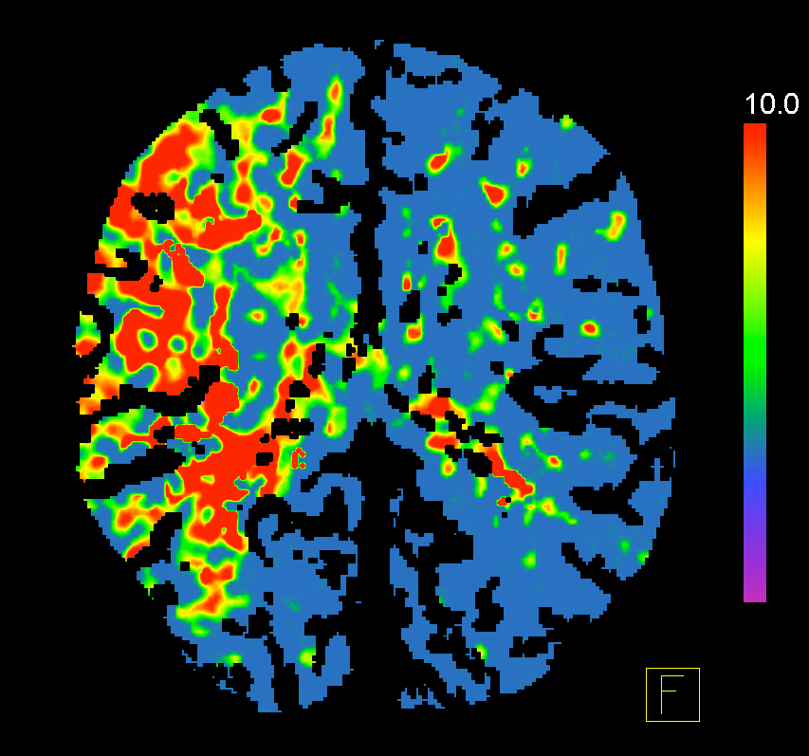

Slide 25
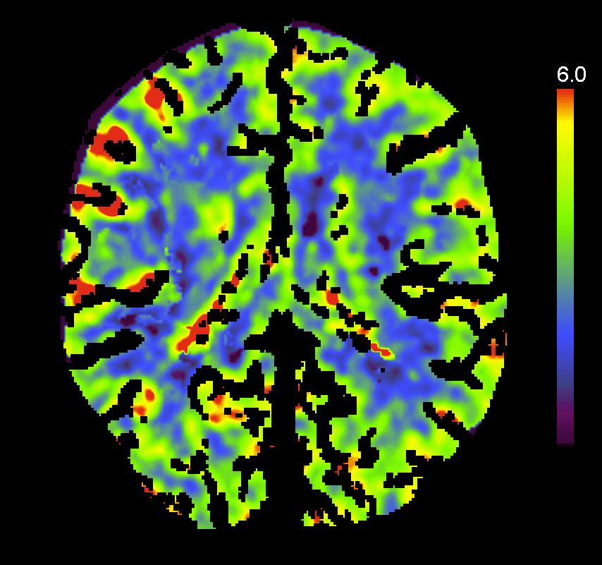

Slide 26
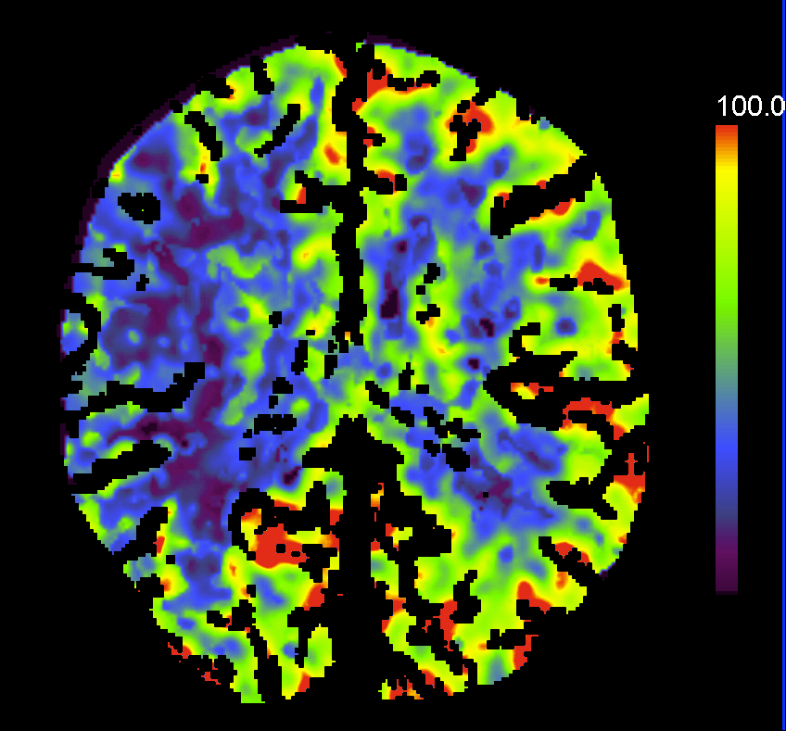

Slide 27
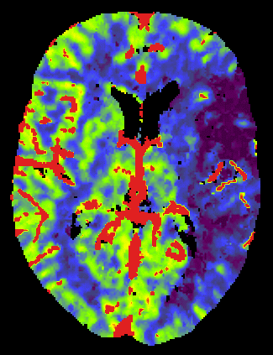
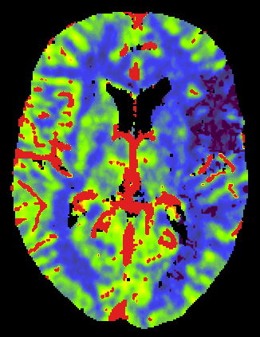
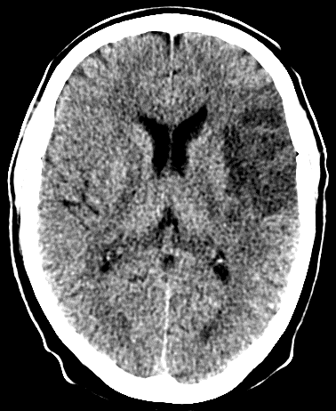
Interpretation
We can compare hemispheres (important thresholds CBF = 60%, CBV = 40%)
CBF CBV 2d
18% 28% -
40% 68% +
Irreversible changes
Ischemia

Slide 28
Other applications:
For evaluation of cerebrovascular reserve with acetazolamide challenge in patients with stenotic lesions who are potential candidates for bypass surgery or neuroendovascular treatment
For evaluation of collateral flow and cerebrovascular reserve in patients undergoing temporary balloon occlusion
For evaluation of patients with possible vasospasm after subarachnoid hemorrhage (SAH).

Slide 29
Limitations : 1. Reproducibility 2. Limited anatomic coverage

Slide 30
THANK YOU!

