Slide 1
Basic Biostatistics Measures of central tendency and dispersion
Dr. Carol

Slide 2
Overview of the presentation
Types of data
Continuous
Discrete
Univariate analysis
Measures of central tendency
Measures of dispersion

Slide 3
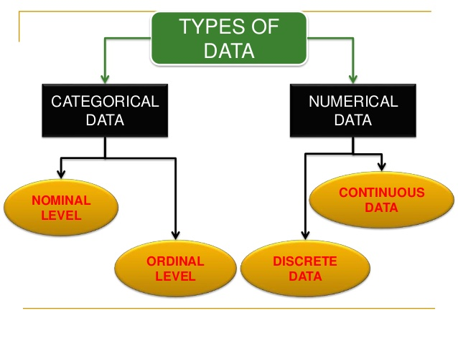
Number
Character,
Any Number
Eg:weight of the babies
Describing type
Eg: gender
Counts
No. of babies died
Order
Pain scale

Slide 4
Each level of measurement determines the statistics that can be used or cannot be used

Slide 5
Exercise

Slide 6
You have collected age, gender, delirium and co morbidities. What type of data is:
Age
Gender
Delirium
Co- morbidities

Slide 7
You have collected age and gender of 10 patients.
Now that you have collected some data, how do you summarize it

Slide 8
Univariate analysis

Slide 9
What and why?
Descriptive analysis of a single variable
Purpose:
To describe a sample into a few understandable numbers

Slide 10
Thumb rule
For categorical variable- Frequency distribution
Numerical variable: Measures of central tendency and dispersion

Slide 11
You have collected age and gender of 10 patients.
Now that you have collected some data, how do you summarize it

Slide 12
Frequency distribution
Frequency distribution: no of times characteristic of a variable is observed in the sample
10 patients, 2 are males, 8 females

Slide 13
Scenario
You measured Hb of 5people. 3 were women and 2 men.
The values are 11,9,12,3,4.
How do you summarise your finding?

Slide 14
Measures of central tendency
Estimate of a centre of values
There are three ways
Mean: average
Median: middle value of a rank ordered group
Mode: most frequent

Slide 15
Meaures of Dispersion
It shows the extent of variation
The measures are
Range (Commonly used)
Interquartile range
Mean deviation
Standard deviation (most commonly used)

Slide 16
Dispersion
The spread of values around the central tendency
Range: Highest value – Lowest value

Slide 17
Inter quartile range
What is a quartile?
IQR=Q3-Q1

Slide 18
There are 5 values below the median (lower half), the middle value is 64 which is the first quartile. There are 5 values above the median (upper half), the middle value is 77 which is the third quartile. The interquartile range is 77 – 64 = 13; the interquartile range is the range of the middle 50% of the data.

Slide 19
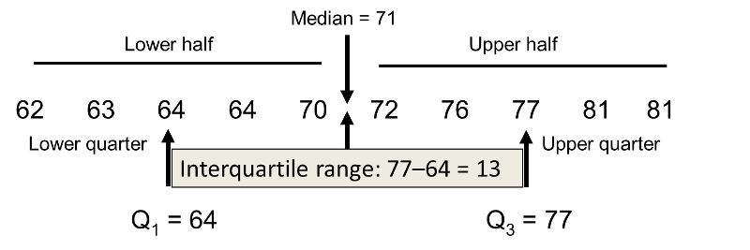
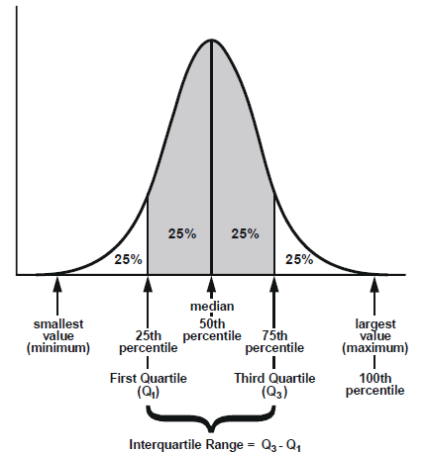

Slide 20
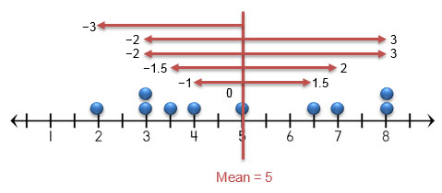
Mean deviation
How far, on average, all values are from the middle
Calculate mean
Value – mean without sign
Add
Divide by n

Slide 22
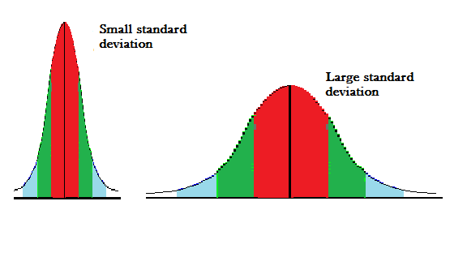
Standard deviation
Standard deviation is a number used to tell how measurements for a group are spread out from the average (mean). A low standard deviation means that most of the numbers are very close to the average. A high standard deviation means that the numbers are spread out

Slide 23
Standard variation

Slide 24
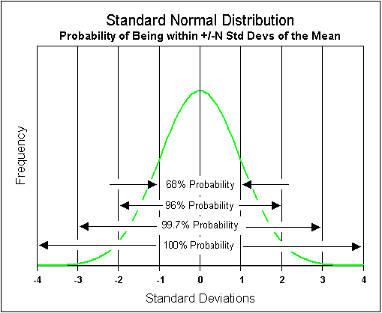

Slide 25
How to calculate
Data set
2, 4,4,4,5,5,7,9
Mean = 5
Deviation from mean and square it: 2-5= (-3)${}^{2}$= 9
Mean of all the values
Square root of it

Slide 26
Comment on this?
The weight of DNB students is
50±20
50±10
50±100

Slide 27
Gist
Frequency distribution
Measures of central tendency
Measures of dispersion

Slide 28
Thank you

