Slide 1
Radioloksabha spotters series- I
Radioloksabha is a free educational website for medical students, residents and doctors to
share knowledge contributing to the world of Radiology
Dr Pavankumar(DMRD, DNB) . Dr Saarah khan ( MD) . Dr Anju (MD) . Dr Ashok sharma(MD)
we support FOAMrad - free open access radiology education

Slide 2
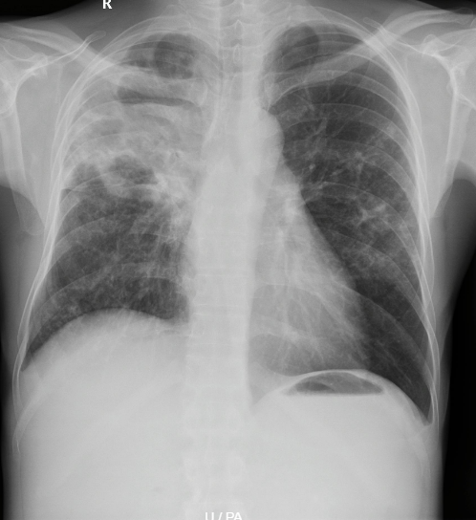

Slide 3
Fungal ball in the right mid zone
Other findings Cavitory lesion in the right upper zone. Consolidatory changes in the right upper and mid zones with loss of silhoette with the right heart border.

Slide 4
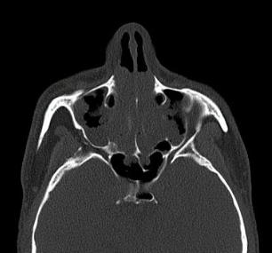
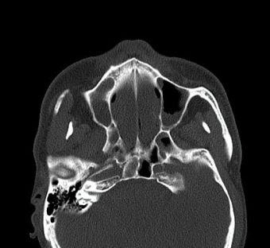
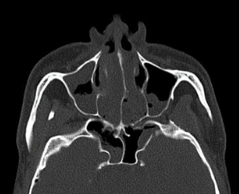

Slide 5
Nasal polyps
Extensive nasal polyps occupying and obliterating the nasal cavity and paranasal sinuses.
Obliteration and widening of bilateral osteomeatal complex noted.

Slide 6
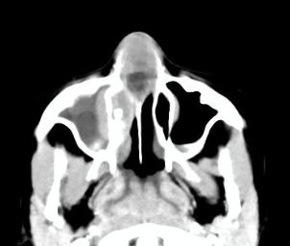
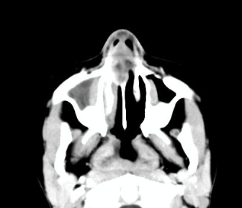

Slide 7
An expansile area with peripheral enhancement with central necrotic area arising from the cartilaginous part of the nasal septum as - s/o nasal septal abcess
Mucosal thickening of variable density in the right maxillary, ethmoid and frontal sinuses -s/o sinusitis - most likely fungal etiology
Adenoid hypertrophy.

Slide 9
Proptosis with enlarged lacrimal glands
The distance between the interzygomatic line and the anterior surface of the globe on both sides is approximately 25 mm on the right and 27mm on the left - suggestive of proptosis.

Slide 10
Measuring proptosis

Slide 11
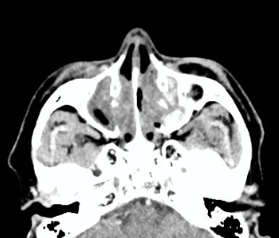

Slide 12
Fungal sinusitis
Evidence of mucosal thickening with hyperdensities within noted in the bilateral amxillary antra, ethmoidal, frontal and sphenoidal sinuses with associated widening of the infunbula and bony erosions.

Slide 13
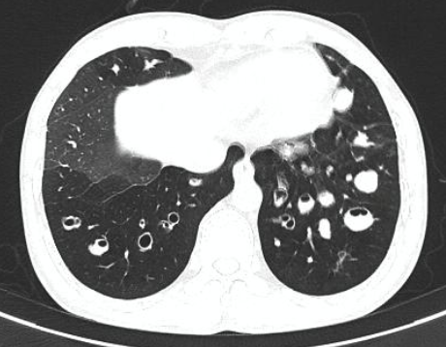

Slide 15
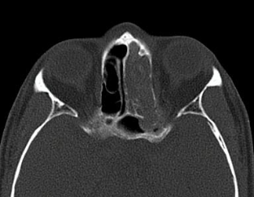
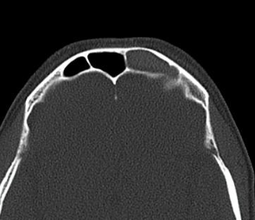

Slide 16
Fungal sinusitis
Involving the left maxillary, frntal, ethmoidal and sphenoidal sinuses with erosions and thinning of left lamina papyracea with focal breech of the supero-medial wall of the orbit.

Slide 17
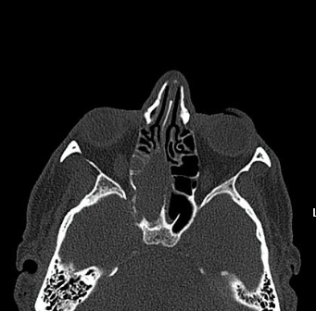
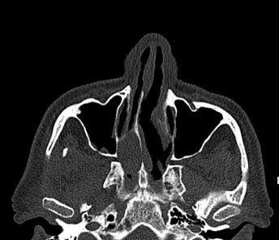
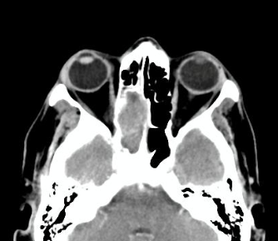

Slide 18
Fungal sinusitis

Slide 19
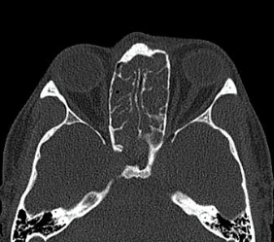
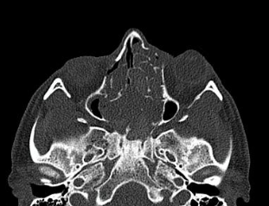
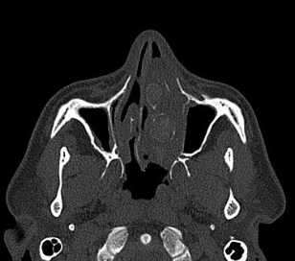

Slide 20
Fungal sinusitis
Soft tissue lesion with intermittent hyperattenuating areas noted involving both frontal, ethmoid and sphenoid sinus and entire nasal cavity. Errosion of the bilateral nasal turbinates noted.

Slide 21
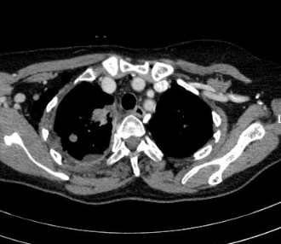
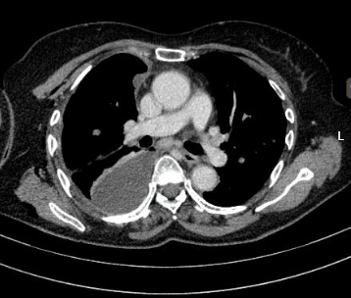
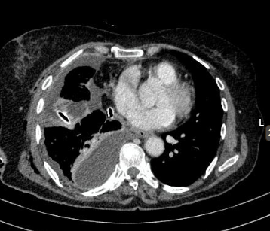

Slide 22
Right apical bronchogenic carcinoma with satellite nodules in both the lung.
Multiple loculated effusions.

Slide 23
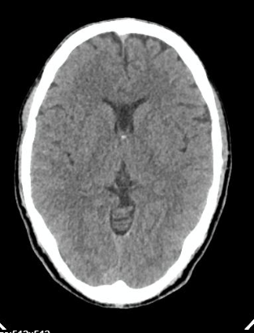

Slide 24
Persistent cavum septum pellucidum and cavum vergae

Slide 25
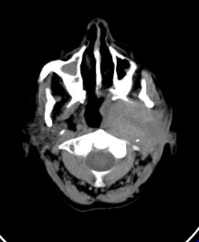

Slide 26
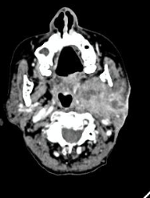

Slide 27
Carcinoma left parotid
In a known case of carcinoma ex pleomorphic adenoma of left parotid,post operative status,present scan reveals *Lobulated Heterogenously enhancing lesion involving the left parotid,masticator,carotid and parapharyngeal spaces with extensions and relations and ipsilateral lymphadenopathy.

Slide 28
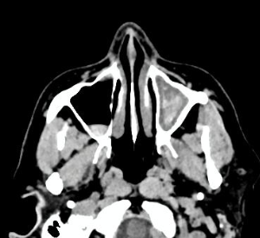

Slide 29
Fungal sinusitis

Slide 30
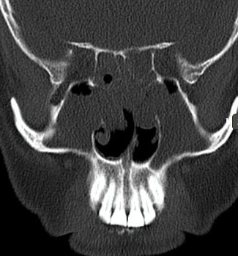
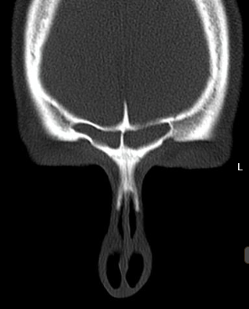

Slide 31
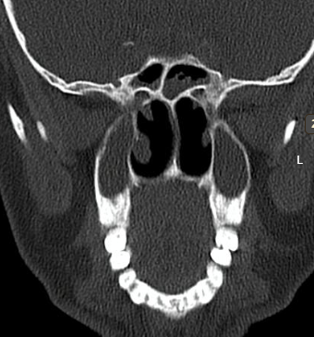

Slide 32
Pansinusitis

Slide 33
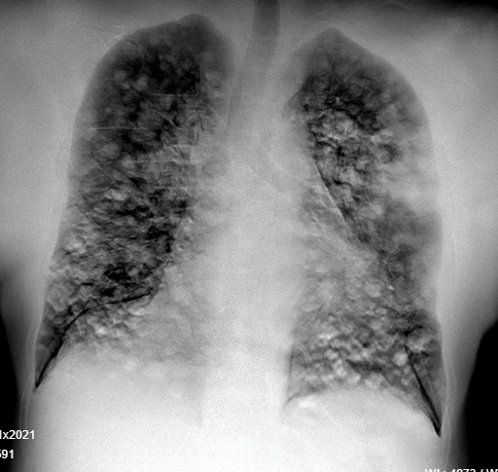

Slide 34
Canon ball metastasis
Multiple ill defined non homogenous opacities, few appearing confluent noted in the both the lungs involving all zones-likly metastatic changes

Slide 35
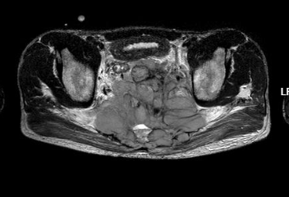
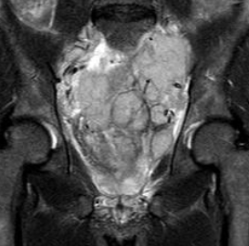
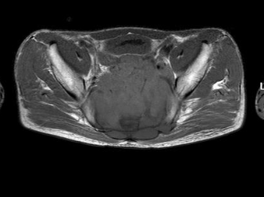
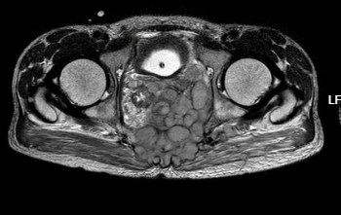
T2
T1

Slide 36
Sacral chordoma
Ill-defined lobulated, multi-septated enhancing lesion in the midline, involving the sacrum and ocupying the spinal canal upto the L5 vertebral body as described- likely sacral chordoma.

Slide 37
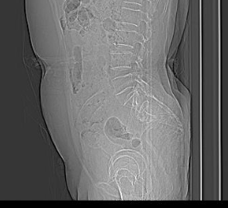
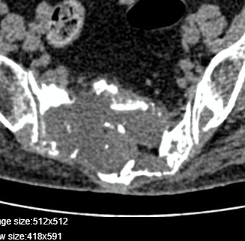

Slide 38
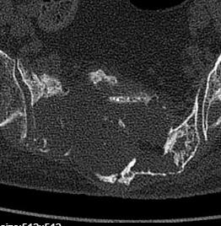

Slide 39
Sacral GCT vs chordoma
Evidence of an ill defined lytic lesion in the sacrum involving the all sacral vertebrae on the right extending into the midline and partly to the contralateral side. Cortical destruction with extraosseous soft tissue component noted with an approximate AP measurement of 52mm amd transverse measurement of 90mm. Multiple bony fragments are seen in the soft tissue component. Left sacral ale and part of promontory are spared.

Slide 40
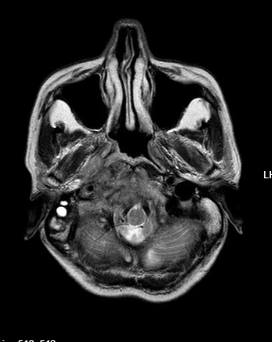
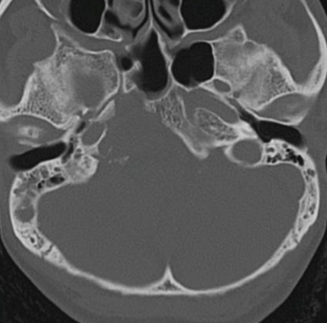
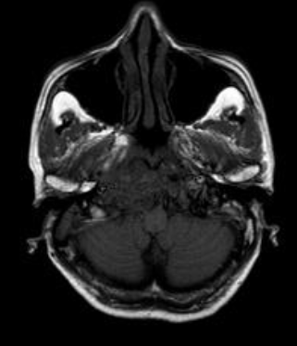
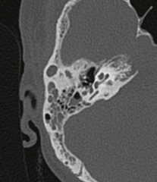
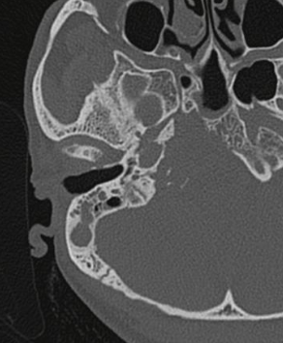

Slide 41
Chondrosarcoma

Slide 42
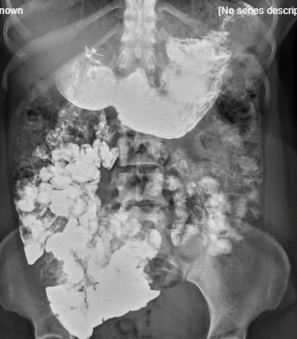

Slide 43
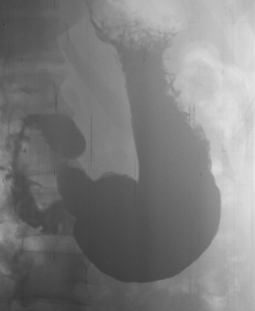
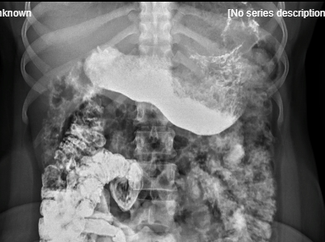

Slide 44
GASTRIC MUCOSAL THICKENING –
GASTRITIS WITH DUODENITS AND INCREASED INTESTINAL MOTILITY WITH DILUTION OF CONTRAST MEDIA - MAL ABSORPTION SYNDROME
The stomach is normal in contour, coarse mucosal folds are noted along the greater curvature. The Duodenal cap is regular in shape and disposition. No irregularities noted. The Duodenal “C” curve is within normal limits, the mucosa is slightly coarse. Delayed films of the small bowel show a significant hurry with areas shows contrast dilution. The barium as it is seen to have reached the ileum in 40 minutes and the ascending colon in 1 hour. Signficant Barium is seen in the stomach in the one hour film .

Slide 45
THANK YOU
You can share pictures, videos, events, articles, presentations and cases
On Radioloksabha.com
Register at https://www.radioloksabha.com/home.php

