Slide 1
Radioloksabha spotters series- V
Radioloksabha is a free educational website for medical students, residents and doctors to
share knowledge contributing to the world of Radiology
Dr Pavankumar(DMRD, DNB) . Dr Anju (MD). Dr Saarah khan ( MD) . Dr Ashok sharma(MD)
we support FOAMrad - Free open access radiology education

Slide 2
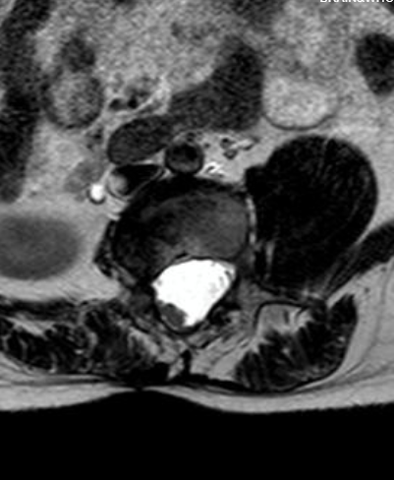

Slide 3
Syringohydromyelia and occipital meningocele.

Slide 4
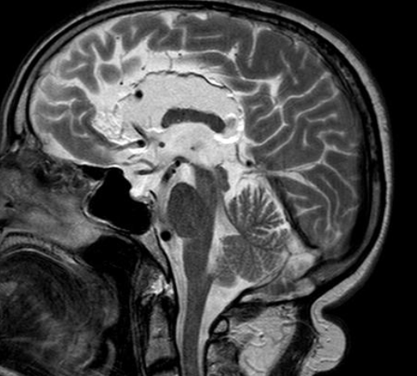

Slide 5
Evidence of a well-defined lobulated lesion epicentered in the peri-callosal region, more towards the right of midline, measuring approximately 7x2.5cm [ApxTr] It is seen causing a mass effect in the form of compression on both the right lateral ventricles and compression on the right frontal and parietal, lobes, however the interhemispheric fissure is centered. It appears hyperintense on T1 and iso-intense on T2/FLAIR and hypointense on T2 FFE and T1 FS sequences with no restriction on DWI -- s/o pericallosal lipoma

Slide 6
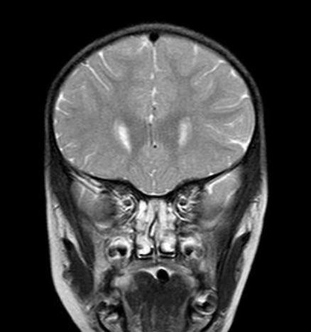

Slide 8
T1W/T2W hyperintensity noted in the superior margin of the posterior corpus callosum- Pericallosal lipoma. Patent cavum sptum pellucidum and cavum vergae.

Slide 9
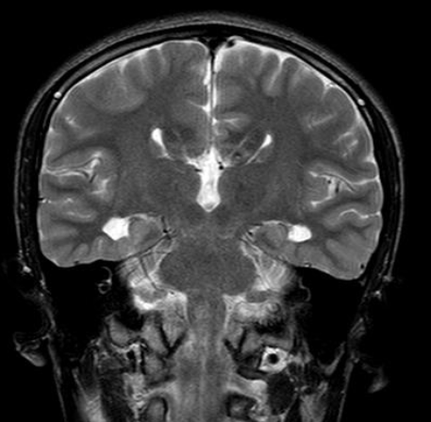

Slide 11
Pericallosal lipoma with absent corpus callosum
There is evidence of a well defined rounded lesion paralleling fat on all sequences measuring 14.5x17.5x10 mm[ApxTrxCc] noted in the midline along the interhemispheric fissure in the pericallosal region-S/o pericallosal lipoma. Absent corpus callosum with widely spaces lateral ventricles and disproportionate prominence of the occipital horns of bilateral lateral ventricles[S/o colpocephaly]- racing car sign.

Slide 12
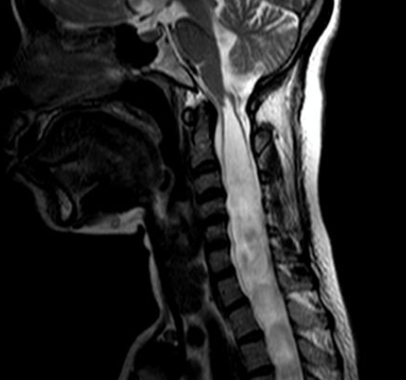

Slide 13
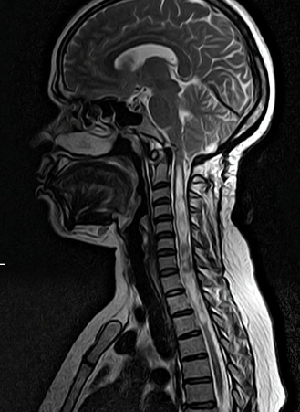

Slide 14
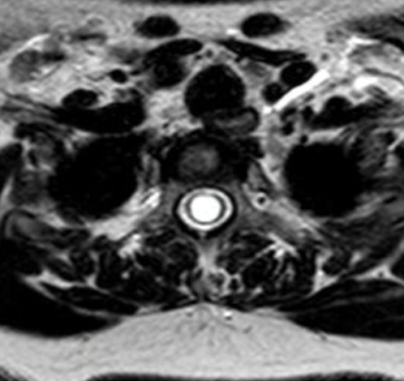

Slide 15
Evidence of cerebellar tonsilar descent through the foramen magnum for a distance of 9mm causing compression of the medulla at the cervicomedullary junction with resultant spinal cord syrinx[ dilatation of central canal] from C1 to T3 vertebrae, with widening of the spinal canal. ---Features consistent with Chiari malformation type I

Slide 16
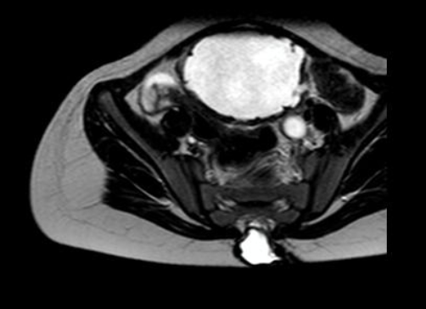

Slide 17
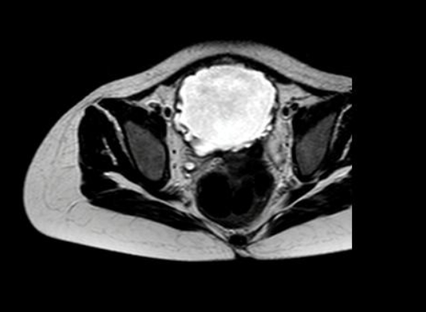

Slide 18
Chiari malformation - II
Tonsillar descent below the Chamberlains line for a distance of 4mm noted The posterior cranial fossa appears mildly small in size. There is gross dilatation of the bilateral lateral ventricle and third ventricles with transependymal seepage of fluid noted. However fourth ventricles appear normal - s/o obstructive hydrocephalus CSF flow study shows a defect at the region of cervicomedullary junction- possible due to compression by the tonsillar descent.

Slide 19
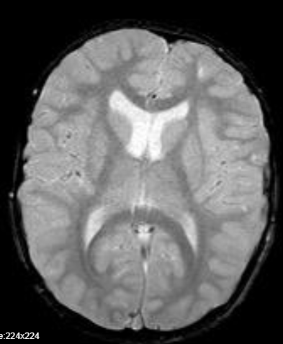

Slide 20
Crouzon syndrome, with Arnold Chiari Malformation type I Abnormal shape of the skull (brachycephalic )

Slide 22
Chiari I

Slide 23
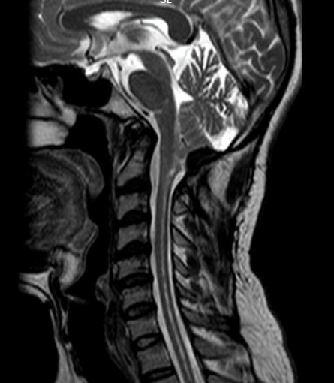

Slide 24
In a follow up case of Type I arnold chiari malformation , post operative status, present study reveals residual cerebellar tonsil herniation with syrinx.

Slide 25
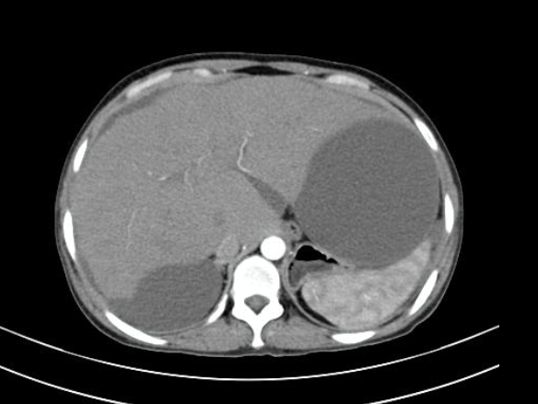

Slide 26
Heterogeneous mottled pattern of contrast enhancement of the hepatic parenchyma in the arterial , portal and venous phases with decreased enhancement of the liver periphery,multiple regenerative nodules ,caudate lobe hypertrophy with non-opacification of hepatic veins,few intrahepatic veno-venous collaterals.-
- Features suggestive of budd chiari syndrome.

Slide 27
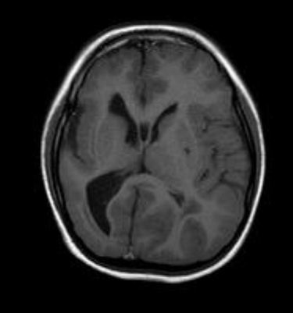

Slide 28
Cortical maldevelopment (lissencephaly - pachygyria spectrum).

Slide 29
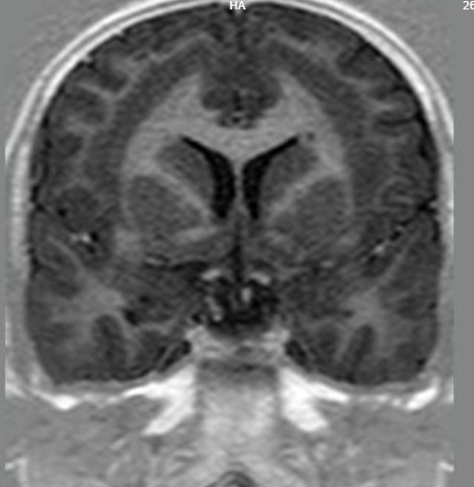

Slide 31
Band heterotopia with patchygyria
There is evidence of a continuous ribbon of grey matter[T1W isointense, T2W hyperintense] seen deep to the cortex, seperated from it with a thin layer of white matter-s/o band heterotopia. The overlying brain parenchyma shows shallow sulci-s/o pachygyria.

Slide 32
THANK YOU
You can share presentation, cases, events and articles On Radioloksabha.com
Register at https://www.radioloksabha.com/home.php
Download DNB/MD question papers, presentation and formats.

