Slide 1
Radioloksabha spotters series- VII
Radioloksabha is a free educational website for medical students, residents and doctors to
share knowledge contributing to world of Radiology
Dr Pavankumar(DMRD, DNB) . Dr Anju (MD). Dr Saarah khan ( MD) . Dr Ashok sharma(MD)
we support FOAMrad - Free open access radiology education

Slide 2
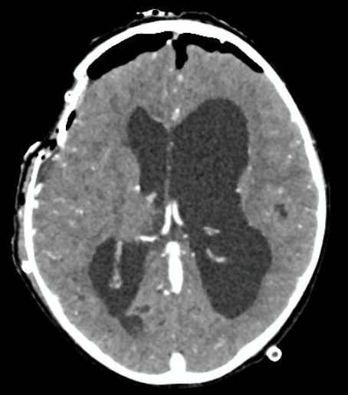

Slide 4
Pneumocephalus
Sub-arachnoid hemorrhage in the right frontal region. Obstructive hydrocephalus. Sub-dural hygroma in the right temporal and frontal region.

Slide 5
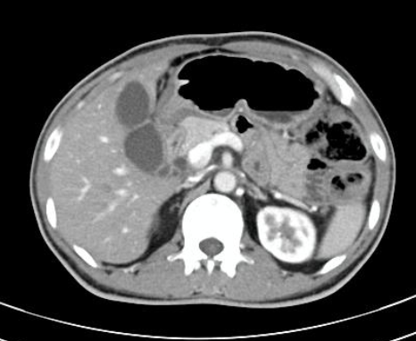

Slide 7
Pancreatic body and tail are not visualized with dependant small bowel loops in the pancreatic bed-features suggestive of Dorsal pancreatic agenesis.

Slide 8
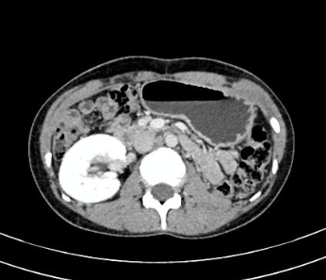

Slide 10
Left renal agenesis.

Slide 11
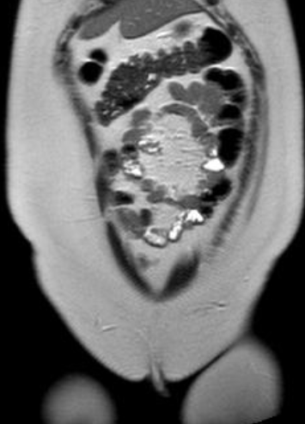

Slide 12
Male patient

Slide 14
In a case of Prader willi syndrome, present study reveals : *Non visualization of testis in inguinal canal/abdomino-pelvi cavity - congenital absence/testicular agenesis.

Slide 15
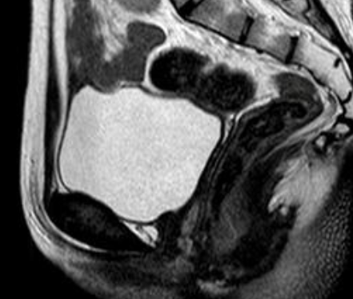
Female patient

Slide 16
Kidney

Slide 17
MRKH
Complete agenesis of uterus. Ectopic left kidney in the pelvic cavity.

Slide 18
22 year old female

Slide 19
Bilateral frontal agenesis

Slide 20
22 year old male

Slide 21
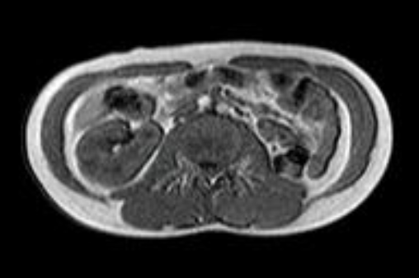

Slide 23
Features are suggestive of left renal agenesis with left atrophic testis and non-visualization of the right testis.

Slide 24
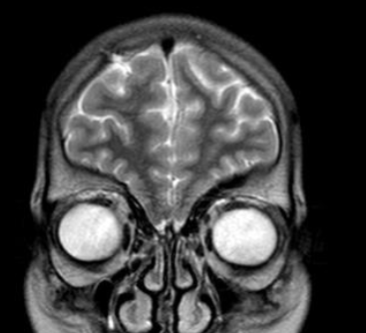
22 year old male

Slide 25
Rudimentary olfactory bulbs ,gyrus rectus and medial orbital gyrus with non-visualization of the olfactory sulcus.-Findings are likely to suggest Kallmann syndrome.

Slide 26
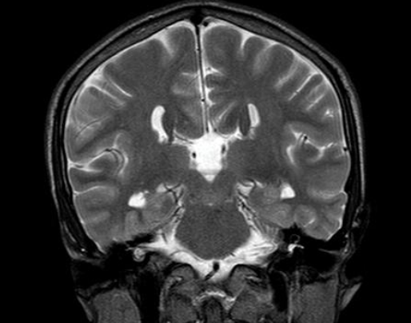

Slide 27
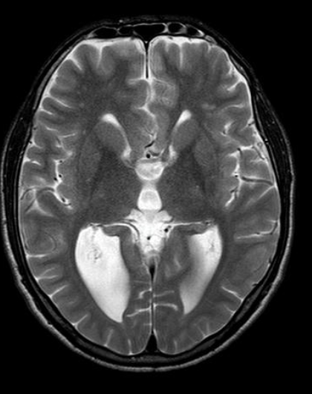

Slide 28
Corpus callosal agenesis
There is partial agenesis of the corpus callosum involving body and splenium.
Symmetrical dilatation of the occipital horns of lateral ventricles [Colpocephaly]. No signs of raised intacranial tension noted.

Slide 29
22 year female with primary infertility

Slide 30
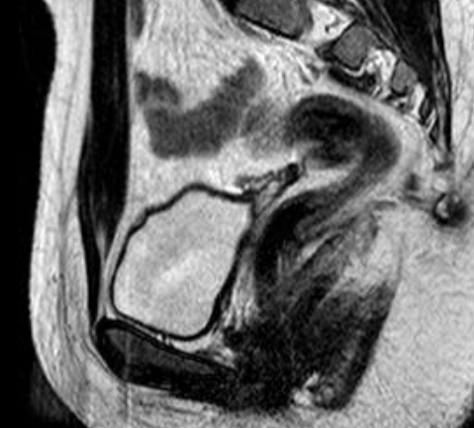

Slide 32
MDA with renal agenesis: Class 1 Mayer-Rokitansky-Küster-Hauser syndrome (MRKH).
Rudimentary Lt uterine horn (2 cm ) noted in the Lt illiac fossa with Rt horn,cervical and upper 2/3 of vaginal agenesis. ​Both ovaries are visualized and are in normal site with mulitple small follicles..Right ovary measuring 15x15 mm and left ovary measuring 18x10 mm. No evidence of additional gonadal tissues.

Slide 33
THANK YOU
You can share presentation, cases, events and articles On Radioloksabha.com
Register at https://www.radioloksabha.com/home.php
Download DNB/MD question papers, presentation and formats.

