Slide 1
Radioloksabha spotters series- XII GENITOURINARY
Radioloksabha is a free educational website for medical students, residents and doctors to
share knowledge contributing to world of Radiology
Contributing radiologists - Dr Ashok sharma(MD)
Dr Pavankumar(DMRD, DNB) . Dr Anju Chaudhary (MD). Dr Saarah khan ( MD) .
we support FOAMrad - Free open access radiology education

Slide 2
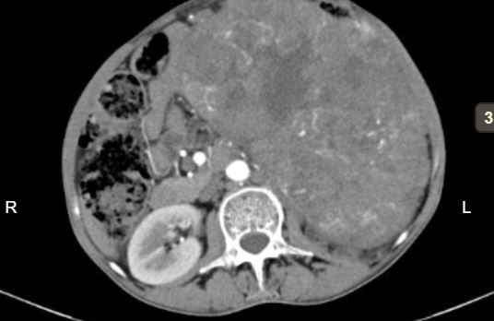
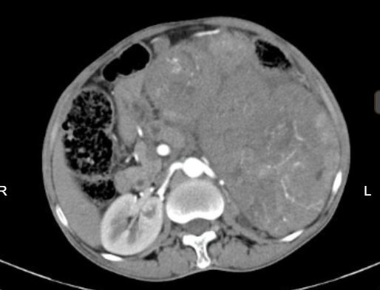

Slide 3
Description
A large well-defined heterogenously enhancing mass lesion with central necrosis is noted arising from the mid and lower poles of the left kidney. The lesion is seen extending upto the anterior abdominal wall. It is also compressing the transverse colon. Laterally and posteriorly, the lesion is extending upto the abdominal wall. Posteromedially, the lesion is seen abutting the psoas muscle and vertebral bodies, and displacing the aorta and bowel loops to the right.
Diagnosis- Renal Cell Carcinoma

Slide 4
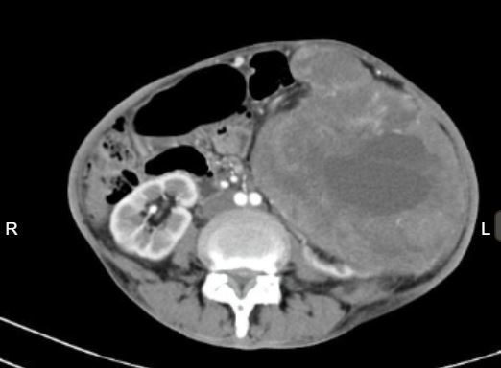
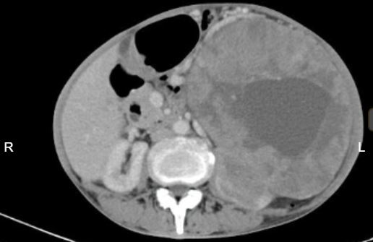
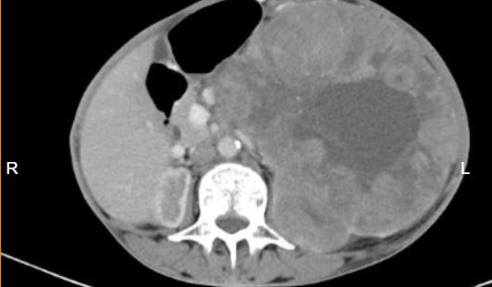

Slide 5
Description
Large well defined, exophytic soft tissue attenuating, lobulated, heterogeneously Enhancing lesion is noted arising from the left renal cortex /capsule showing necrotic and few calcific areas within. The left kidney is compressed and displaced inferiorly by the lesion. Anterosuperiorly lesion is seen abutting the grater curvature of stomach with indistinct fat planes displacing the stomach and pancreas, to the right side, the small and large bowel loops and the spleen posteriorly and raising the left hemidiaphram.
Diagnosis- Renal Cell Carcinoma
Differential Diagnosis- Oncocytoma

Slide 6
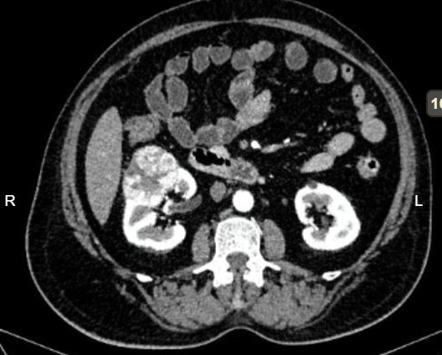
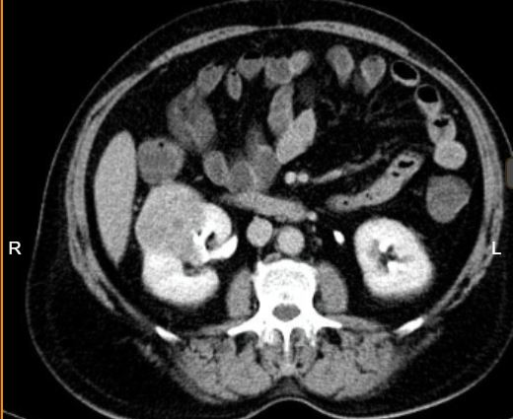

Slide 7
Description
A well-defined, capsulated, heterogeneous lesion with central stellate scar giving spoke wheel appearance is noted at the jucntion of mid region and lower pole of right kidney. The lesion is showing heterogeneous enhancement in coticomedullary phase, showing washout in the nephrogenic and delayed phase with no enhancement of the central scar, The lesion is seen to the infiltrate the calicys without invovlvement of renal pelvis. No evidence of calcifications/fat component noted within the lesion. Anteriorly, it is abutting the bowel loops with maintained fat plane. Perinephric fat stranding noted.
Diagnosis- Oncocytoma
Differential Diagnosis-Renal Cell Carcinoma

Slide 8
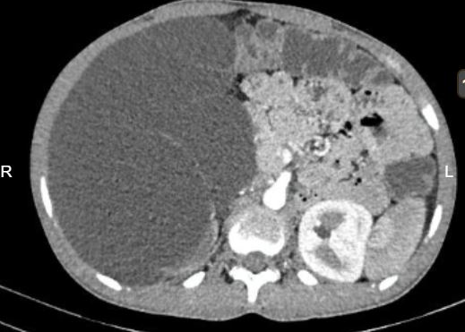
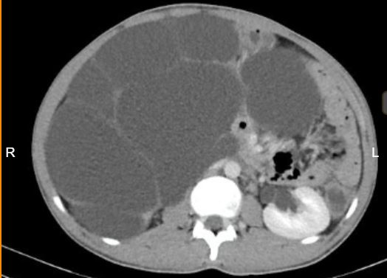
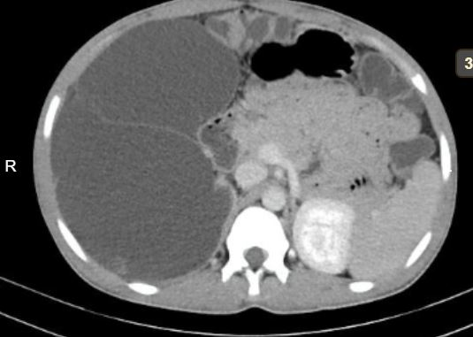

Slide 9
Description
A large muliseptated fluid attenuating cystic lesions is noted involving the right renal fossa arising from right kidney with no evidence of calcification/abnormally enhancing solid areas within. Anteriorly the lesion is seen abutting the anterior abdominal wall with displacement of the hepatic flexure. It is displacing the small and large bowel loops to the left side. Thin rim of renal cortical tissue with positive beak sign noted postero-medially with renal artery seen supplying the lesion confirming the renal origin.
Diagnosis- Multicystic nephroma

Slide 10
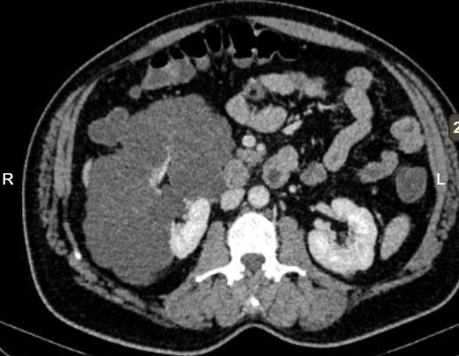
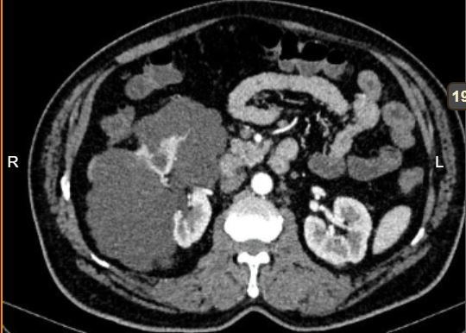
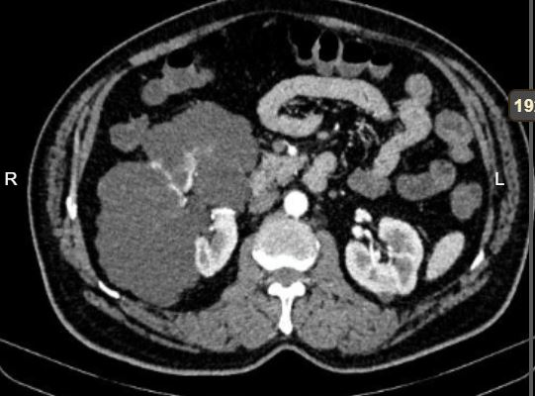
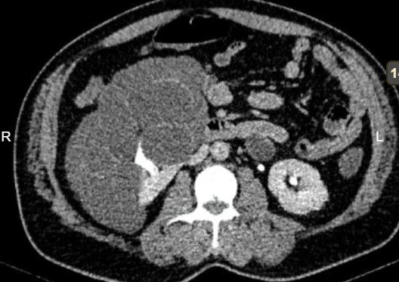

Slide 11
Discription
A Well defined multiloculated multi cystic lesion is noted arising from the mid and lower pole of right kidney . No evidence of soft tissue component/ hemorrhage noted. On contrast admintration wall enhancement is noted with few areas of calcification. Medially lesion is seen protruding into renal pelvis with displacemnent of ureter superiorly and medially. Rest of the kidney shows normal corticomedullary differenation and normnal excretion. Fat planes with liver, psoas, bowel loops and posterolateral abdominal wall are maintained.
Diagnosis- Multi Cystic nephroma
Differential Diagnosis- Cystic RCC

Slide 12
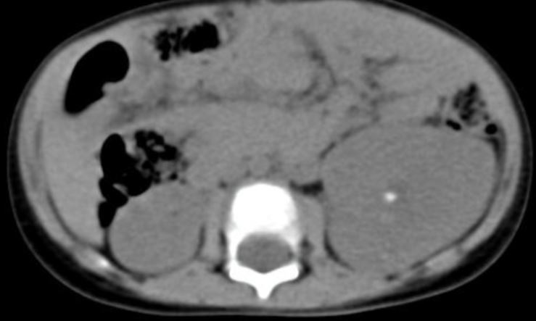
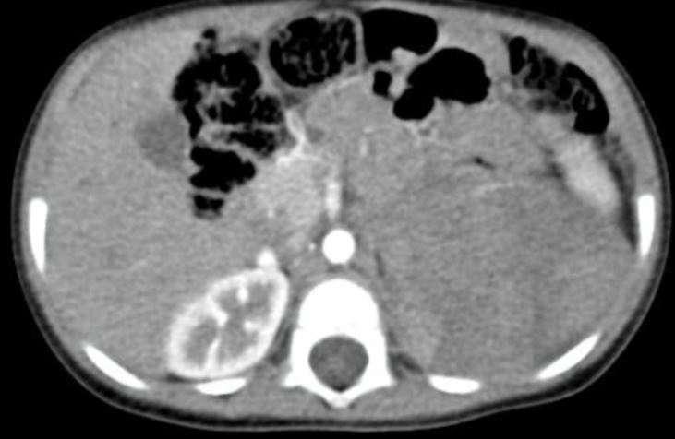
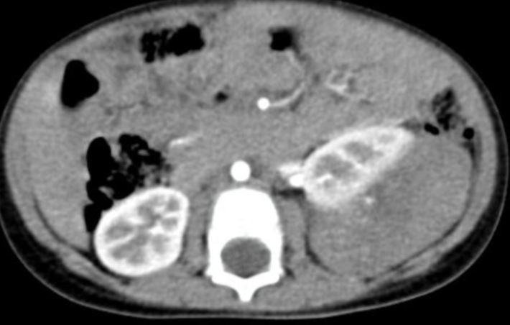

Slide 13
Description
There is large heterogeneously, predominantly enhancing lobulated mass lesion noted in the left supra renal region. Left adrenal gland is not separately visualized from the mass. Few non-enhancing areas of hypodensity are seen within the lesion representing necrosis. Few tiny specs of calcification is seen. No evidence of haemorrhage. It is displacing kidney inferiorly. It is displacing pancreas and bowel loops right side. Medially it is abutting the left psoas and aorta with maintained aft plane.
Diagnosis- Neuroblastoma

Slide 14
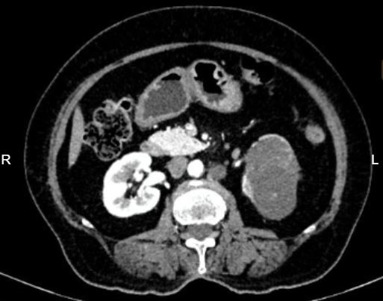

Slide 15
Description
A well-defined heterogeneously enhancing mass lesion containing areas of necrosis and calcification within is noted arising from the mid poles of the left kidney. The lesion is seen splaying the calyces of the mid pole, with extension into the pelvicalyceal system.
Diagnosis- Renal Cell Carcinoma

Slide 16
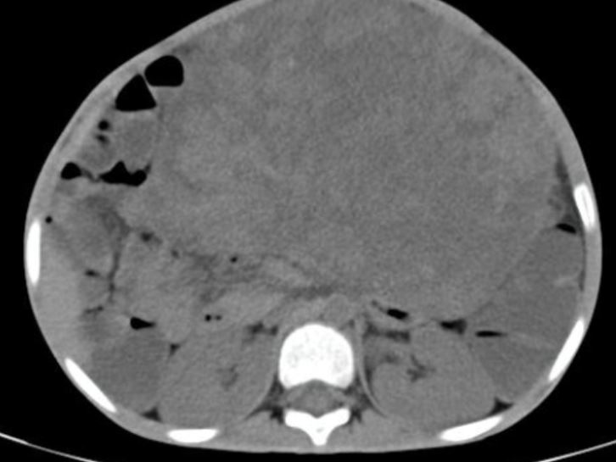
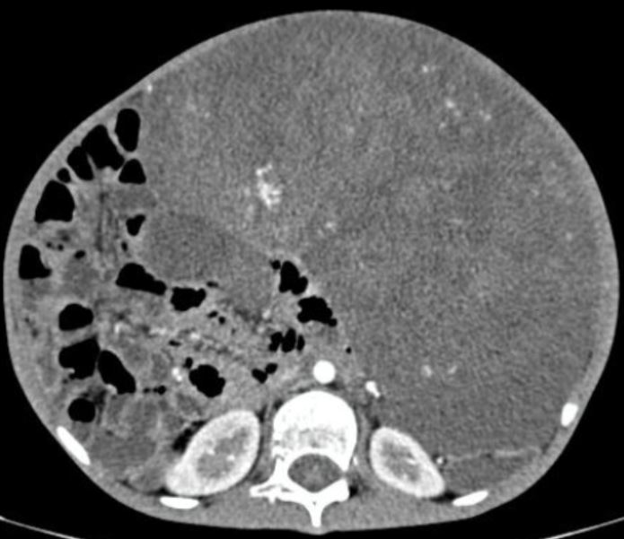
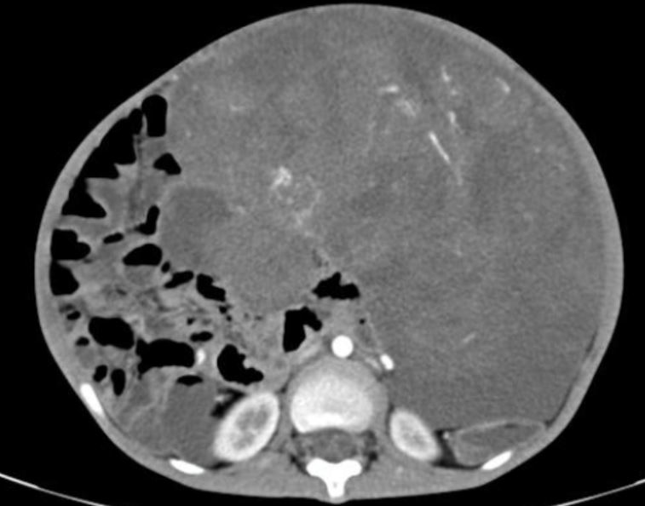
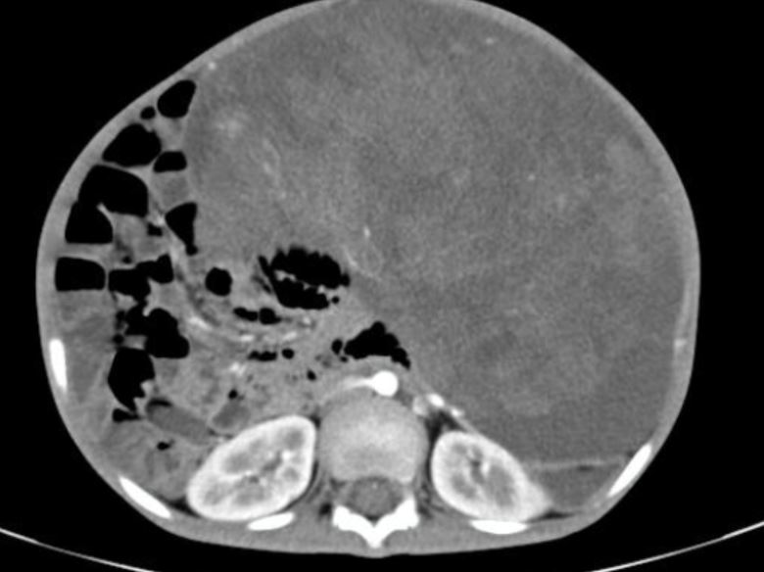

Slide 17
Description
A large well defined solid mass lesion with internal cystic areas /necrosis showing heterogenous Enhancement noted in the abdomen, epigastric, umbilical, bilateral lumbar & left t iliac quadrants. Multiple calcifications noted within the lesion. It is displacing pancreas and bowel loops anteriorly with maintained aft plane.
Diagnosis- Neuroblastoma

Slide 18
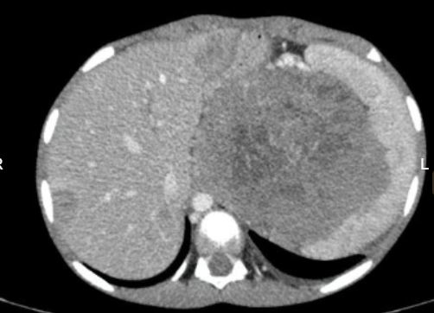
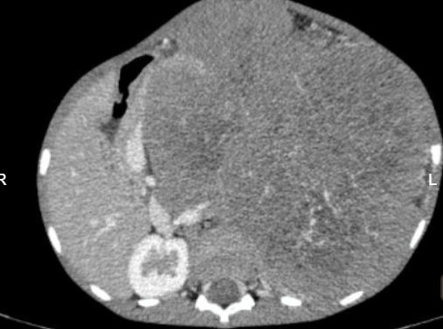
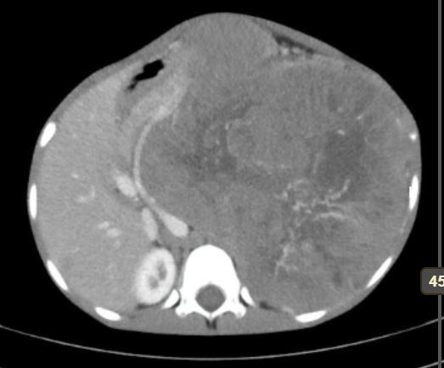
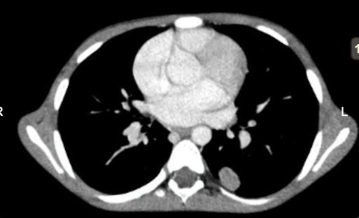

Slide 19
Discription
Large well defined heterogenously enhancing lesion with internal cystic areas /necrosis seen in the abdominal cavity in left lumbar region arising from left kideny, seen abutting the spleen on the left and the liver on the right measuring with displacement of bowel loops inferiorly and laterally. No evidence of tumor thrombus in the inferior vena cava. Left kidney,adrenal gland and left renal vein cannot be seen separately. No evidence of calcification/hemorrhage noted within the lesion.
Few ill defined enhancing hypodense lesions are noted in liver and lungs s/o metastasis.
Diagnosis- Wilms Tumor

Slide 20
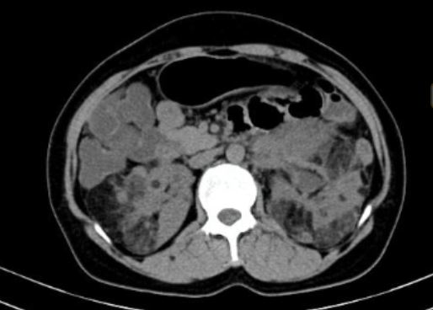
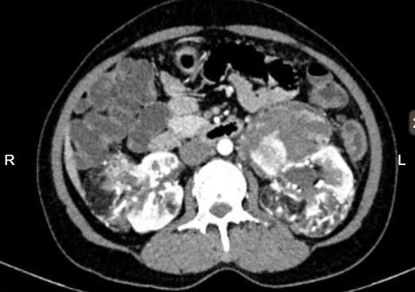
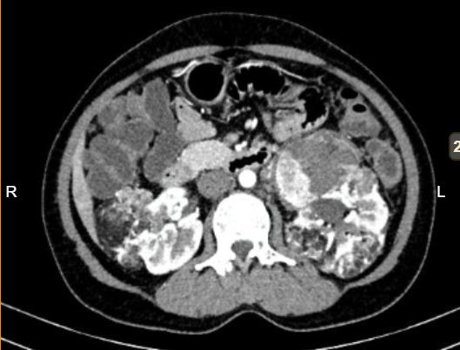
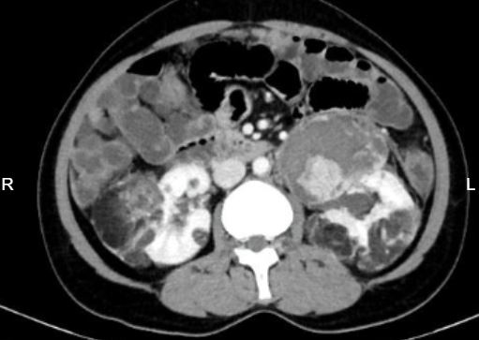

Slide 21
Description
Ill defined heterodense cortical based lesions containing macroscopic fat & soft tissue, predominantly containing fat attenuating areas is noted involving mid pole of the bilateral kidneys. These soft tissue components showing hyper enhancement. Intervening normal renal parenchyma noted with normal contrast uptake and excretion.
Diagnosis- Bilateral Angiomyolipoma

Slide 22
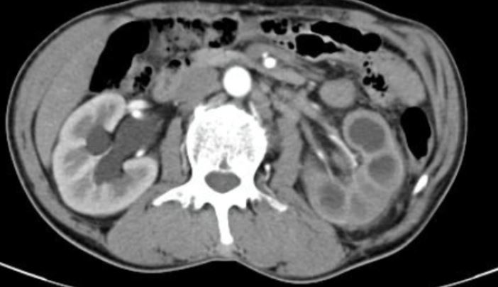
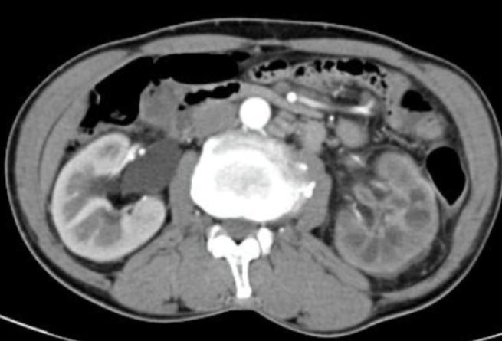
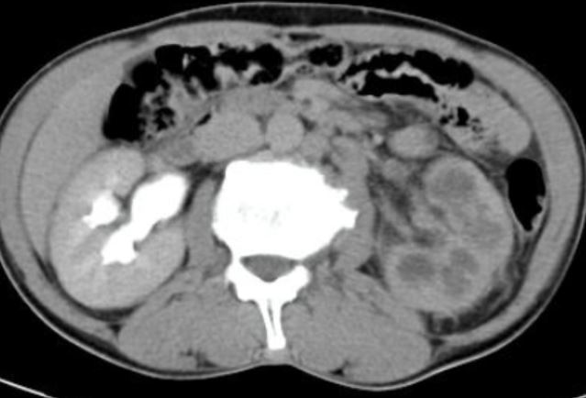

Slide 23
Description
Left kidney appers mildly bulkuy. Pelvicalyceal system appears dilated. Diffrential enhancement noted with poor functioning and absent excretion ,With prominent edematous renal pyramids . Perinephric fat stranding is seen.
Diagnosis- Xanthogranulomatous pyelonephritis.
DD- Tubercular Xanthogranulomatous pyelonephritis

Slide 24
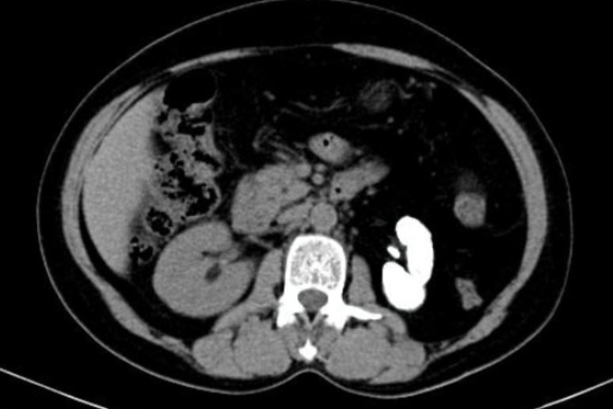
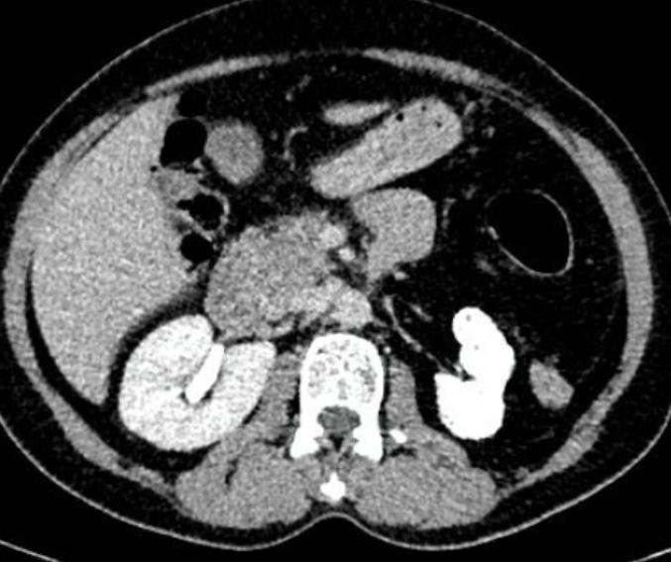

Slide 25
Description
The left kidney is shrunken and completely replaced by homogenoous ground-glass calcifications.
Diagnosis- Putty Kideny

Slide 26
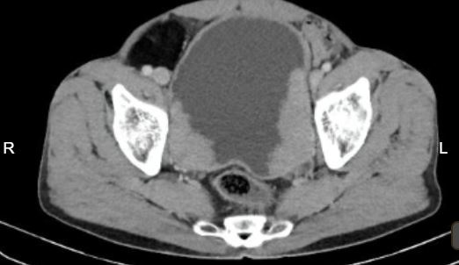
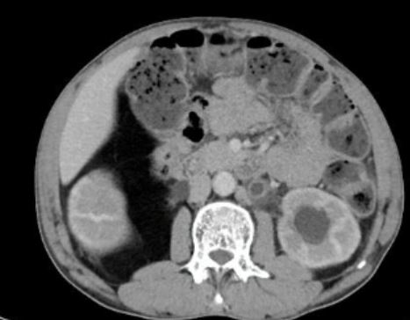
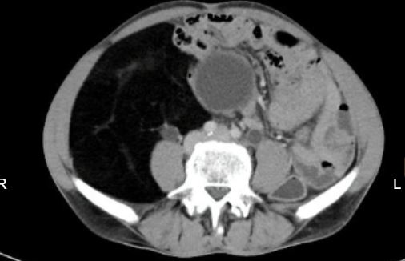
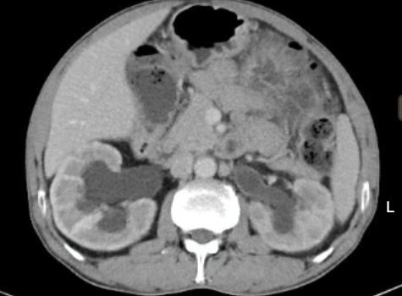

Slide 27
Discription
Multiple fairly well defined enhancing broad based polypoidal lesions noted in the mucosa layer in the right lateral, left lateral walls of the urinary bladder, projecting into the lumen of the bladder, largest in the left lateral wall extending posteriorly. These lesion is seen involving the bilateral vesicoureteric junctions, causing obstructive uropathy in the form of upstream dilatation of bilateral ureters and the pelvicalyceal system of both kidneys. Fat planes with the rectum are well maintained.
A large well-defined fat-attenuating lesion noted in the right lumbar and iliac regions, causing an upward displacement of the right kidney and medial displacement of the adjacent bowel loops likely s/o lipoma or retroperitoneal lipomatous lesion
Diagnosis- Urothelial Cracinoma of urinary bladder.

Slide 28
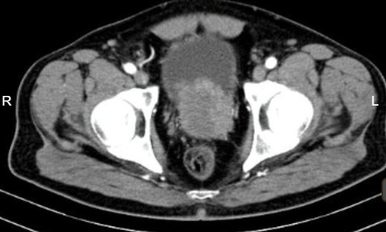
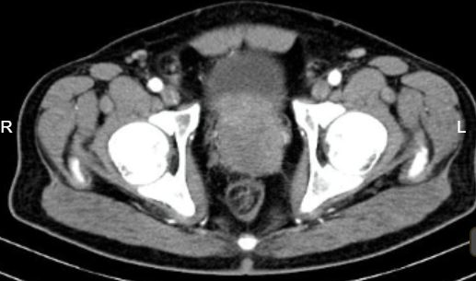
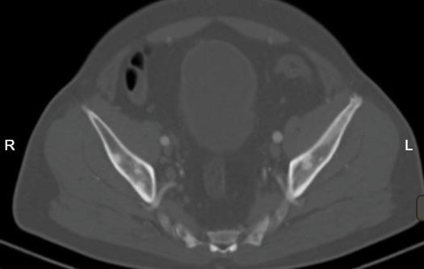
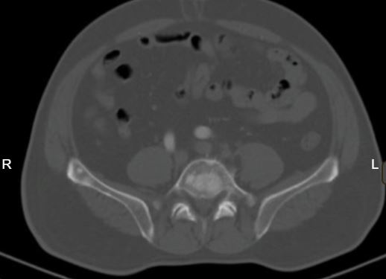

Slide 29
Description
Appears bulky with ill-defined enhancing hypointense lesions noted in the central and peripheral zone of the prostate. Anterirorly the lesion is seen infiltrating the base of the bladder and trigone. Posteriorly abutting the mesorectal fascia. Superiorly the lesion is seen infiltrating into the seminal vesicles. Few subcentimeteric inguinal lymph nodes noted.
Well defined multiple lytic sclerotic lesion are noted invoving vertibra and pelvic bones.
Diagnosis- Carcinoma prostate.

Slide 30
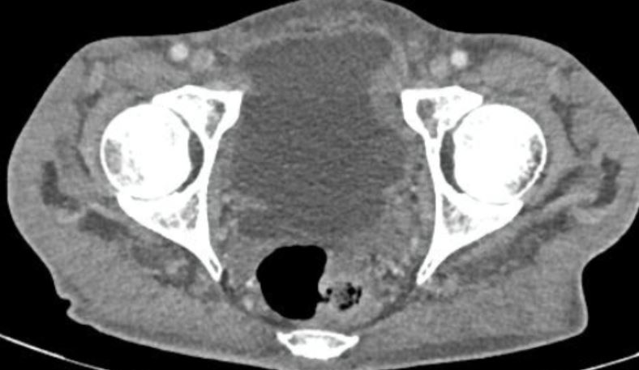
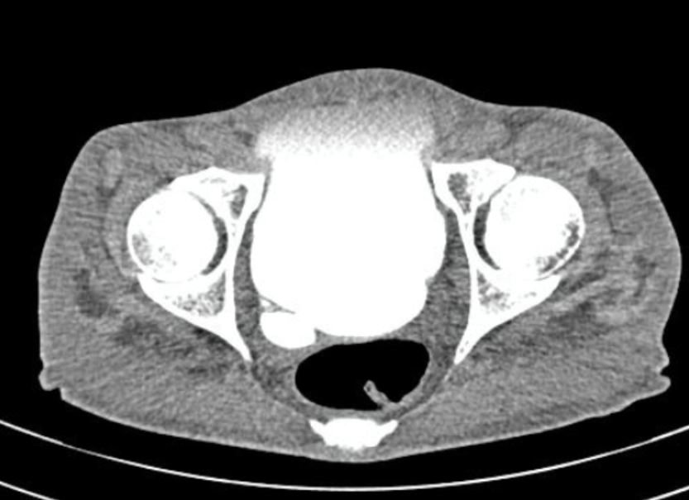

Slide 31
BLADDER DIVERTICULAM

Slide 32
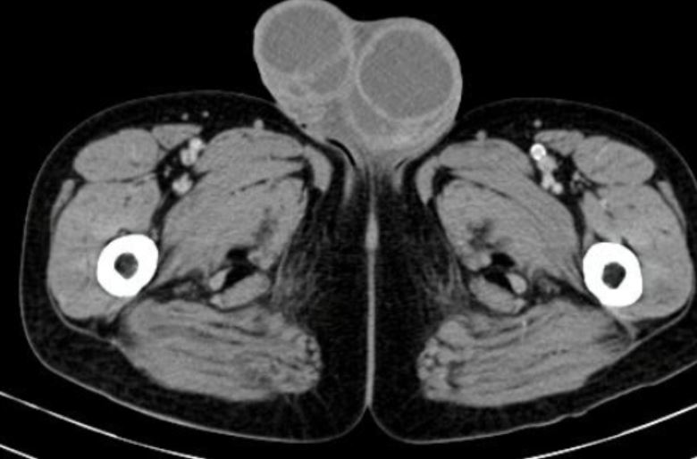
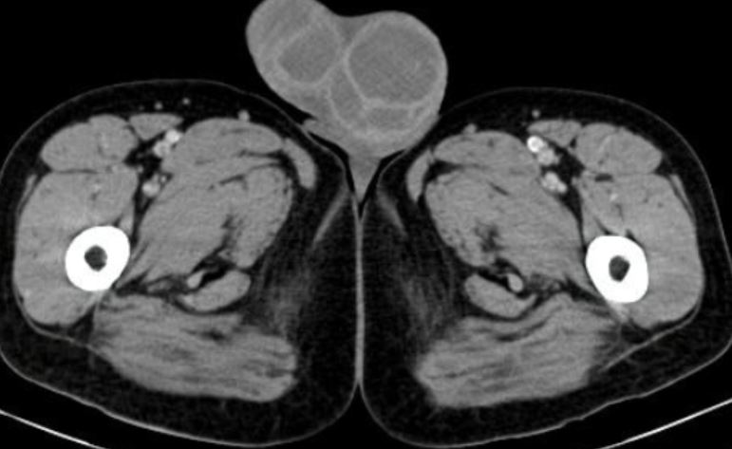

Slide 33
Discription
Both testes are enlarged and oedematous. Left testis is hypoattenuating with streaks of enhancing septate within. Bilateral epididymis bulky and heterogenous.
Diagnosis- Epididymoorchitis secondary to tubercular etiology

Slide 34
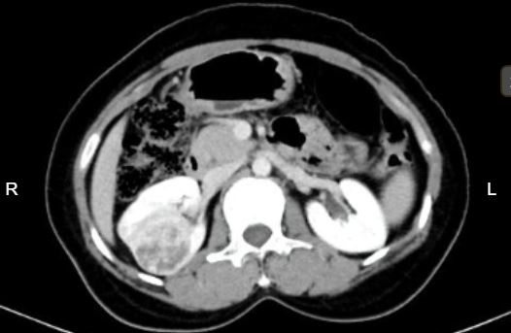
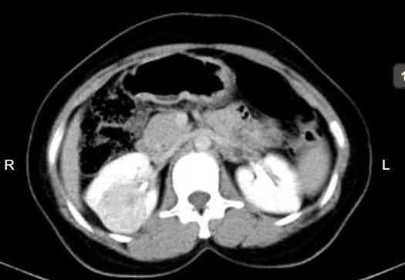

Slide 35
Description
A well-defined ball type heterogeneously enhancing mass lesion containing areas of necrosis within is noted arising from the mid poles of the right kidney. It shows intense arterial enhancement. The lesion is seen splaying the calyces of the mid pole, however no extension into the pelvicalyceal system. No evidence of involvement of the renal vein/inferior vena cava. posteriorly, the lesion is extending upto the abdominal wall.
Diagnosis- Renal Cell Carcinoma

Slide 36
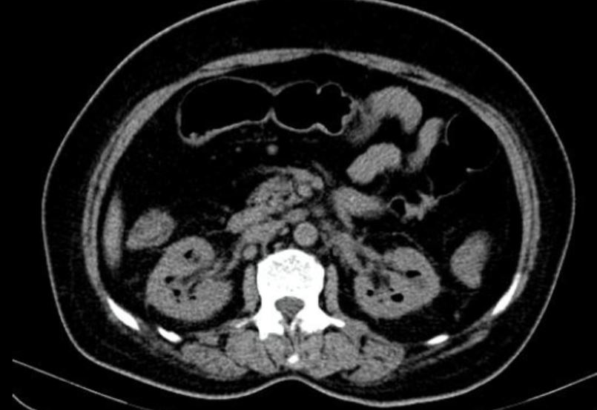

Slide 37
Description
Fat stranding noted in the bilateral peri-nephric regions. No obvious collection/abscess of the psoas noted.
There are few ill-defined hypoattenuating air foci are noted in all the polar regions of the bilateral kidney.
Diagnosis- Bilateral emphysematous pyelonephritis

Slide 39
Description
Both the right and left kidneys are fused in the right para-saggital region, with the lower pole of the upper moiety fusing with the upper pole of lower moeity. The upper moiety is malrotated with the hilum facing antero-laterally. The hilum of the lower moiety is facing anteriorly.
Diagnosis- Crossed fused ectopic kidneys in the right para-saggital region

Slide 40
THANK YOU
You can share presentation, cases, events and articles on Radioloksabha.com
Register at https://www.radioloksabha.com/home.php
Download DNB/MD question papers, presentation and formats.
You can also message me your cases/ presentation/practical exam experience on telegram https://t.me/Radioloksabha

